Slide 1



PPA 500 Culminating Project Orientation
Virtual Welcome
Notes:
Rob

Slide 2



Agenda
Fall 2025 Advisor Assignments
PPA Culminating Options
Example Syllabus
Attend Project Showcase
Q&A
Notes:
Rob

Slide 3
Fall 2025 Advisor Assignments
Cuellar | Malluli | Ahrum
Durgin | Rita | Ahrum
Zarate Sepulveda | Monica | Ahrum
Torres | Luiz | Ahrum
Matlock | Jessica | Shane
Melville | Matthew | Shane
Xiong | Zour | Shane
Gladstein | Luke | Shane (599)
Mecca | Tahmirah | Amal
Sosa | Jordan | Amal (599)
Notes:
Rob

Slide 4
Culminating Options
Option # | Principal Product | Based on Course “Artifacts” | Oral PP Presentation | Executive Summary Submitted to OGS
1 | Draft Article in the Style of an Academic Journal | An assignment [artifact] from one PPA course that the instructor agrees is relevant for expansion to an article | Yes | Yes
2 | Applied professional public policy or public administration report | Assignment(s) [artifacts] from PPA course(s) | Yes | Yes
3 | A professional portfolio that includes a 3-4 page reflective essay and professional development plan (resume, cover letter to “ideal” job, and professional development goals | Three or more revised assignments [artifacts] from PPA courses that demonstrate your ability to perform the job you are seeking | Yes | Yes, of your revised assignments
Examples from 2021- 2024 @ https://www.csus.edu/college/social-sciences-interdisciplinary-studies/public-policy-administration/thesis-project-bank.html
Notes:
Sara & Suzi

Slide 5
For option 2
A first draft of the policy or public administration report should be completed prior to enrollment in PPA 500 and it can be built off of a prior classroom assignment.
During PPA 500, the instructor will support students in
finalizing the draft, and
writing a short synthesis (fewer than 5 pages double spaced) that views the topic through the lenses stressed in the PPA program as applicable, such as economics, finance, and budgeting; politics; and organizational theory and administration.

Slide 6
OGS Requirements
https://www.csus.edu/graduate-studies/spotlights/ogs_annoucements.html

Slide 7
Answers to FAQs
PPA faculty have assigned potential artifacts in classes and explicitly called them out to students for potential PPA 500 use.
Scaffolding in bi-weekly PPA 500 Zoom sessions helps students maintain momentum.
Advisors will lead Zoom check-in sessions
Notes:
Rob

Slide 8
Example syllabus and schedule
https://www.csus.edu/college/social-sciences-interdisciplinary-studies/public-policy-administration/internal/_internal/_documents/syllabi/ppa500_fall2023.pdf
Notes:
Rob

Slide 9
Tips and Tricks
Find a Writing Buddy
Develop a timeline/GANTT chart
Carve out time in your schedule each day/week to work on this
Consistent small windows are better than occasional large windows
Start talking to your advisor now

Slide 10
Joel Chacon | Bridging the Gap: What drives Legislator Engagement with Constituents
Cynella Aghasi Lolham | Strengthening Partnerships: The Role of Community-Based Organizations in Public Benefits Outreach and Emergency Response
Ruth Sosa-Martinez | The Hidden Wounds of Over Policing: Unveiling the Mental Health Impacts of Police Victimization on Communities of Color
Marisol Ferreyra Orozco | 'Forever Chemicals' in Pesticides: Understanding PFAS Contamination and Policy Implications for Water Quality
Dexter Davis | Debunking Internal Service Funds: Improving Billing Methodology and Transparency to their Customers
Lorena Paredes | Policing Poverty: An Analysis of the Criminal Penalties of California's Safety Net Programs
Jennifer Tovar | From Care to Confinement: Assessing AB12 and Chafee ETV’s Impact on California’s Foster Care-to-Prison Pipeline
Beatriz Smith | The Tijuana River: An Environmental Justice Crisis - a literature review
Douglas Drozd | Social Housing as a Solution to California’s Housing Crisis: Policy Analysis and Recommendations
Jason Hansen | Mitigating the Pandemic Learning Loss: Differential Effects of California’s K-12 Weighted Formula Aid on Student Performance
Shoshana Levy | An Empirical Investigation into the Role of NIMBYism in the Lack of Affordable Housing in California Cities
Elise Madison | Examining Biased Conduct in California Law Enforcement Agencies
Travis Esser | No Place to Call Home: Homelessness Policy in San Joaquin County
Joey Sais | From Stigma to Support: The Impact of California Policies on LGBTQ+ Mental Health

Slide 11

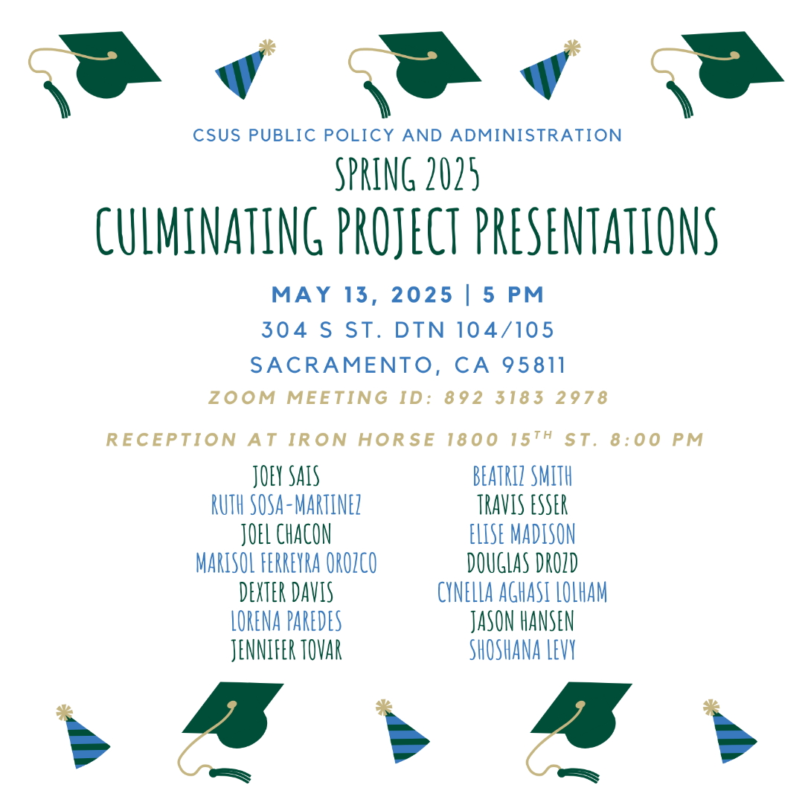

Slide 12

Questions??
Notes:
Rob

