Slide 1

Master of Public Policy and Administration
Fall 2027 Cohort Start
Information Session

Slide 2
Housekeeping
You are muted upon entry
Please remain muted for now
Simply raise your hand or use the chat feature for immediate questions, comments, or technical issues
We have allotted time throughout and at the end of the meeting for live (unmuted) questions
Notes:
Record video?

Slide 3
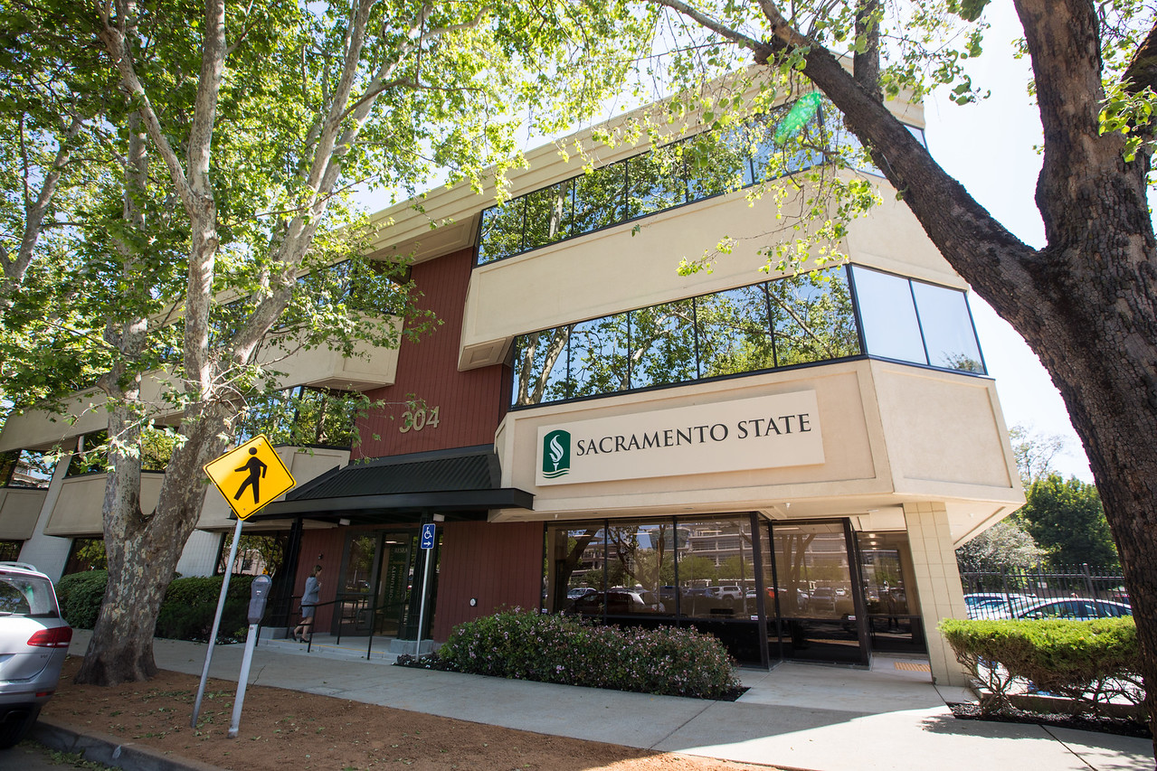
Welcome!
Assistant Professor & Vice Chair, Ahrum Chang
Academic Department Coordinator, Sovannra Yos
Notes:
yos@csus.edu or Ppa-01@csus.edu

Slide 4
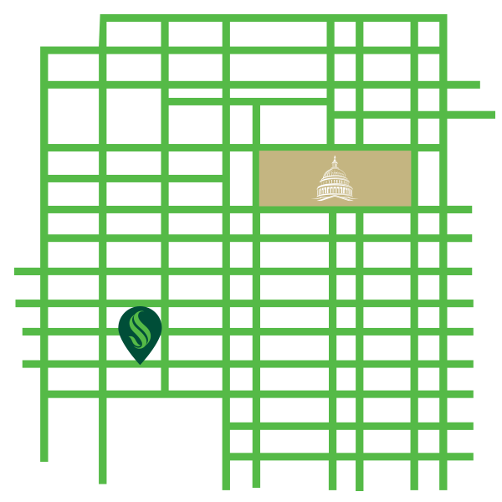
Agenda
Mission
Why MPPA?
Overview of the Program
Application Requirements & Process
Q & A

Slide 5
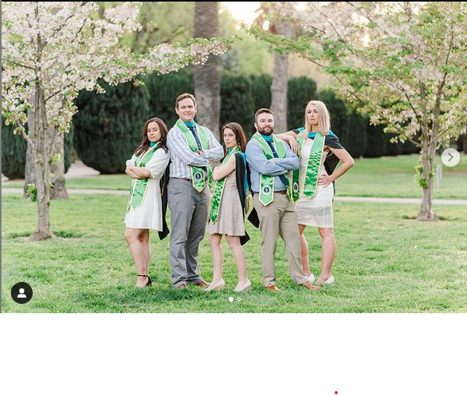
Our Mission
The Capital Campus's graduate programs in Public Policy and Administration prepare future leaders to address the complex issues that face California. We serve the State and the region by developing leaders with strong analytical tools and a deep commitment to public service.
Notes:
Founded in 1947, Sacramento State’s 300 acre campus is home to 3500 trees and serves more than 30,000 students. Professor Emerita Cristy Jensen founded the MPPA program in 1989, with the MSULD program joining the Department in the mid 2000’s. We have turned out almost 450 alumni between our two graduate programs in our more than 25 year history.

Slide 6
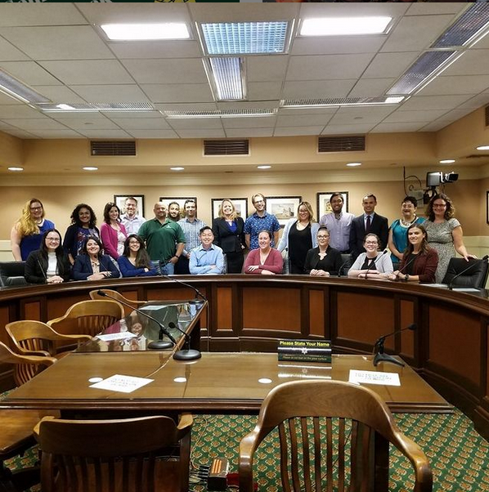
Why MPPA?
Capital Campus: located on the downtown campus
Community & Network: Cohort model, fall start only (regular F/S semester teaching), small seminar classes, strong alum network, professional development and social events through Graduate Association of Students in Public Policy and Administration (GASPPA)
  Job Fair
  Resume Workshop
  Salary Negotiation Workshop
  Professional Headshot
  Social Gatherings & Network

Slide 7
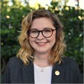
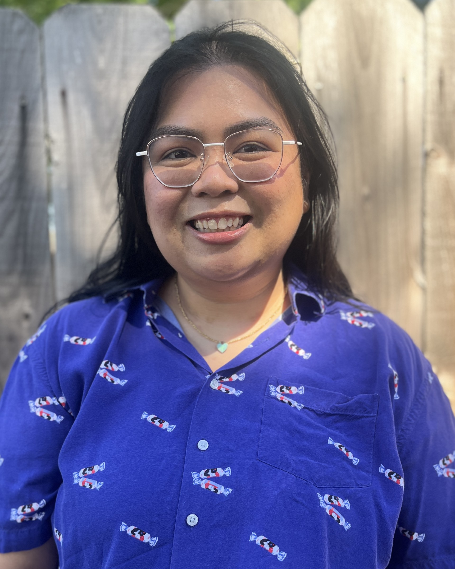
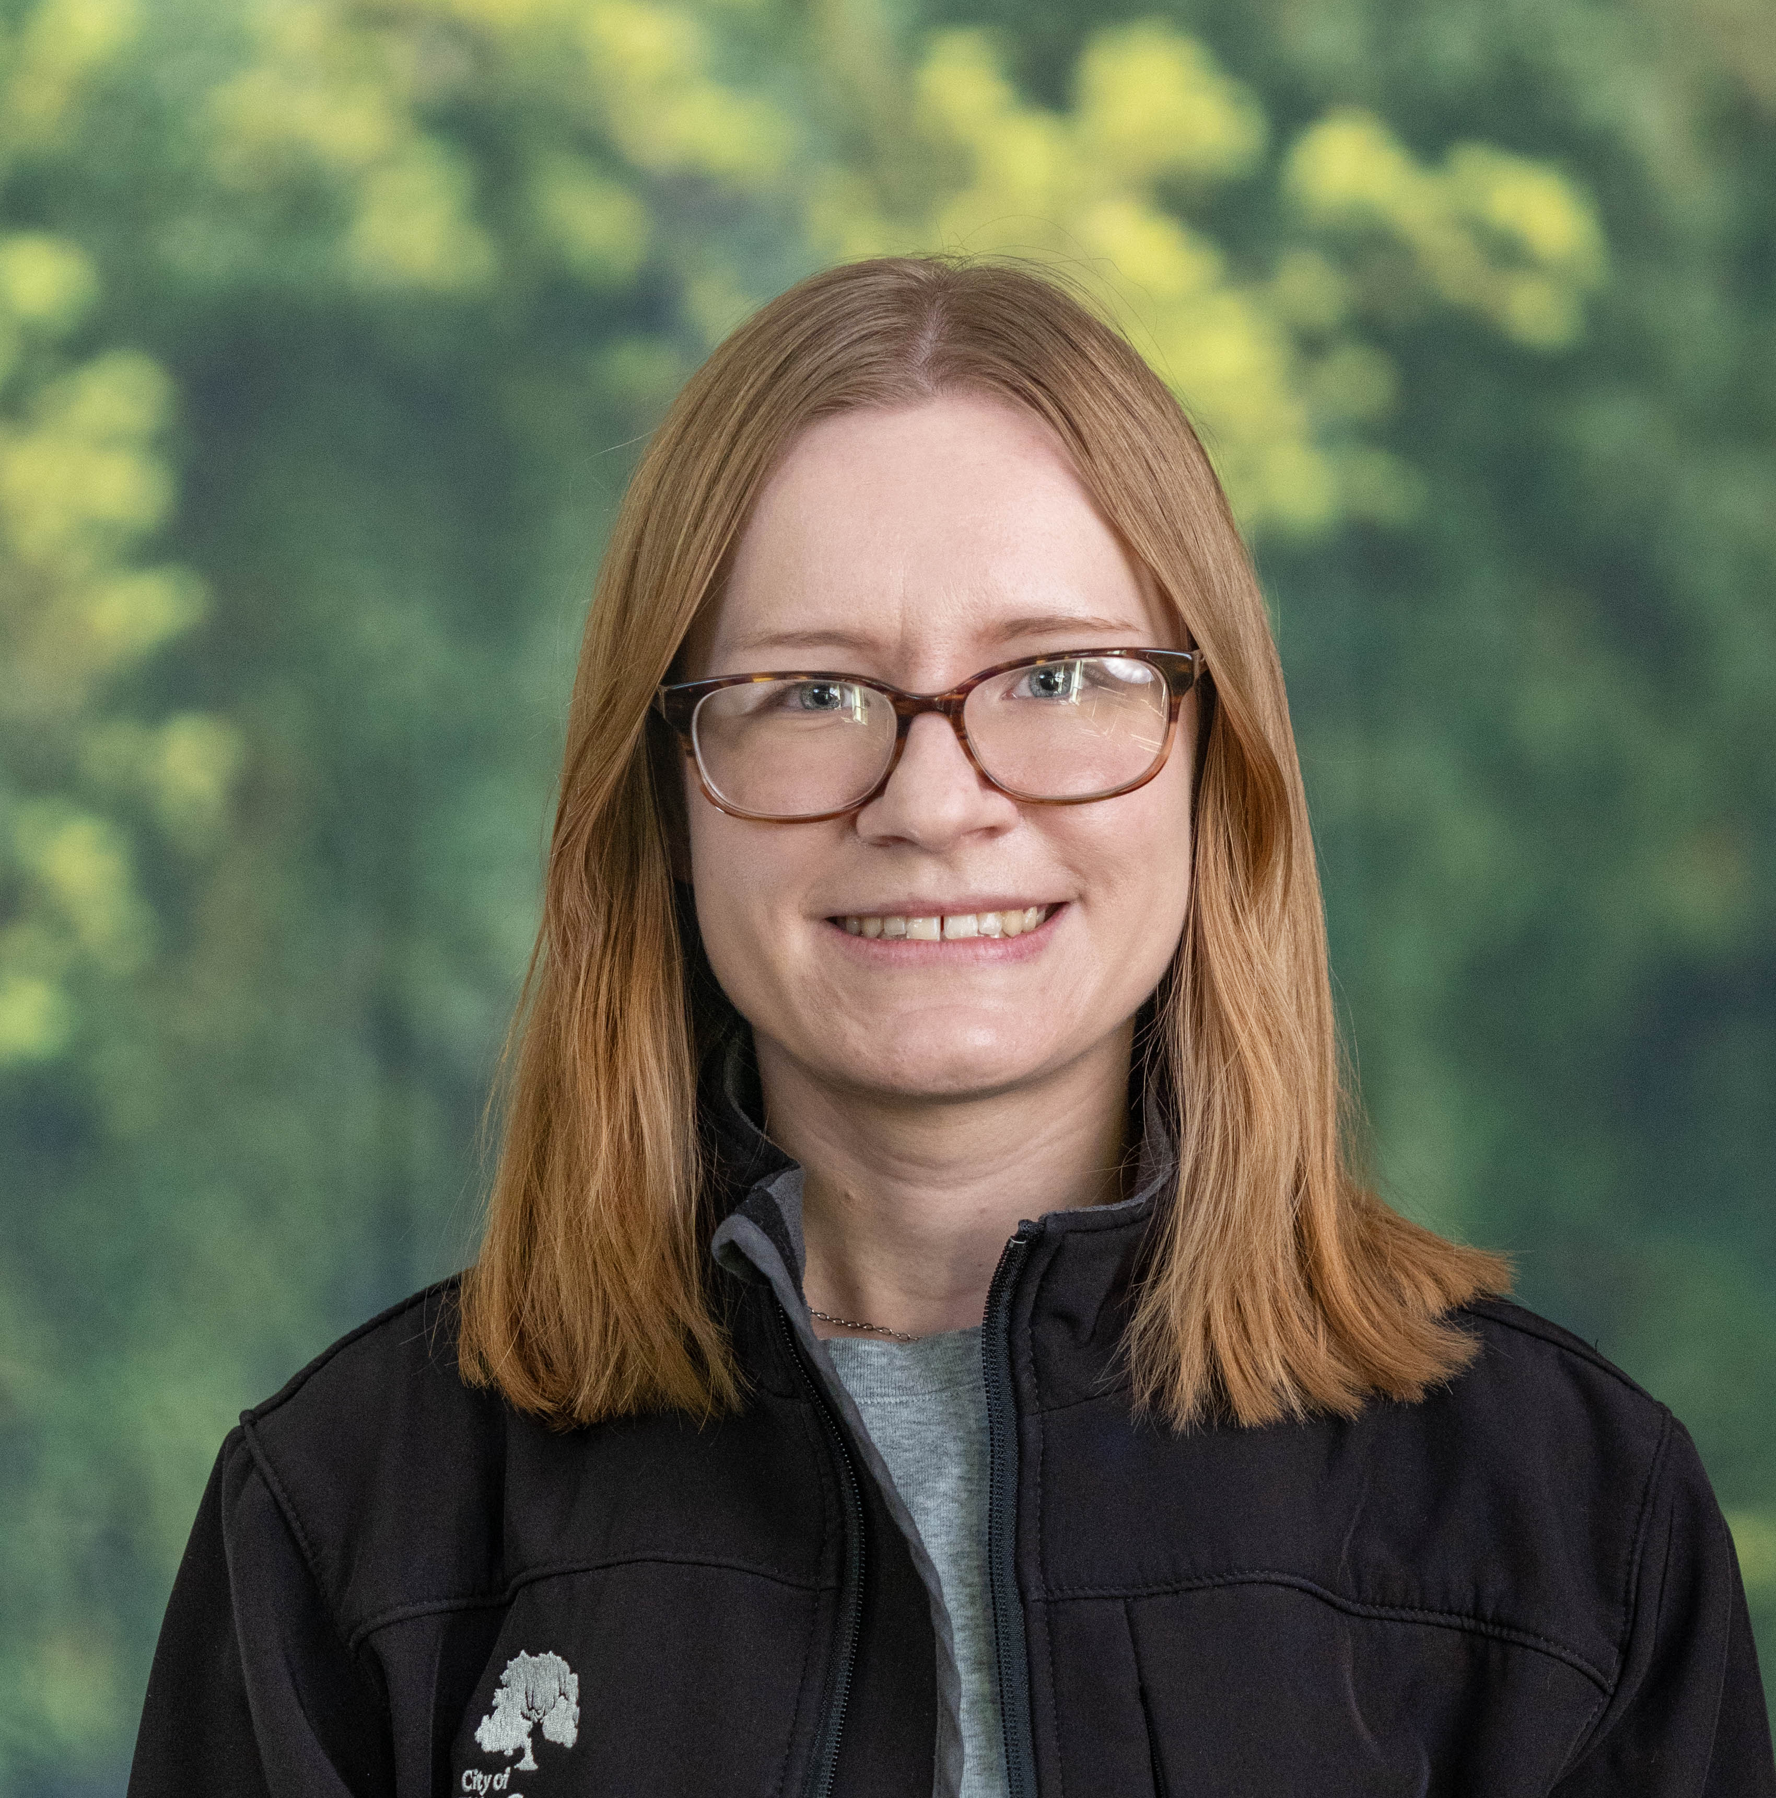
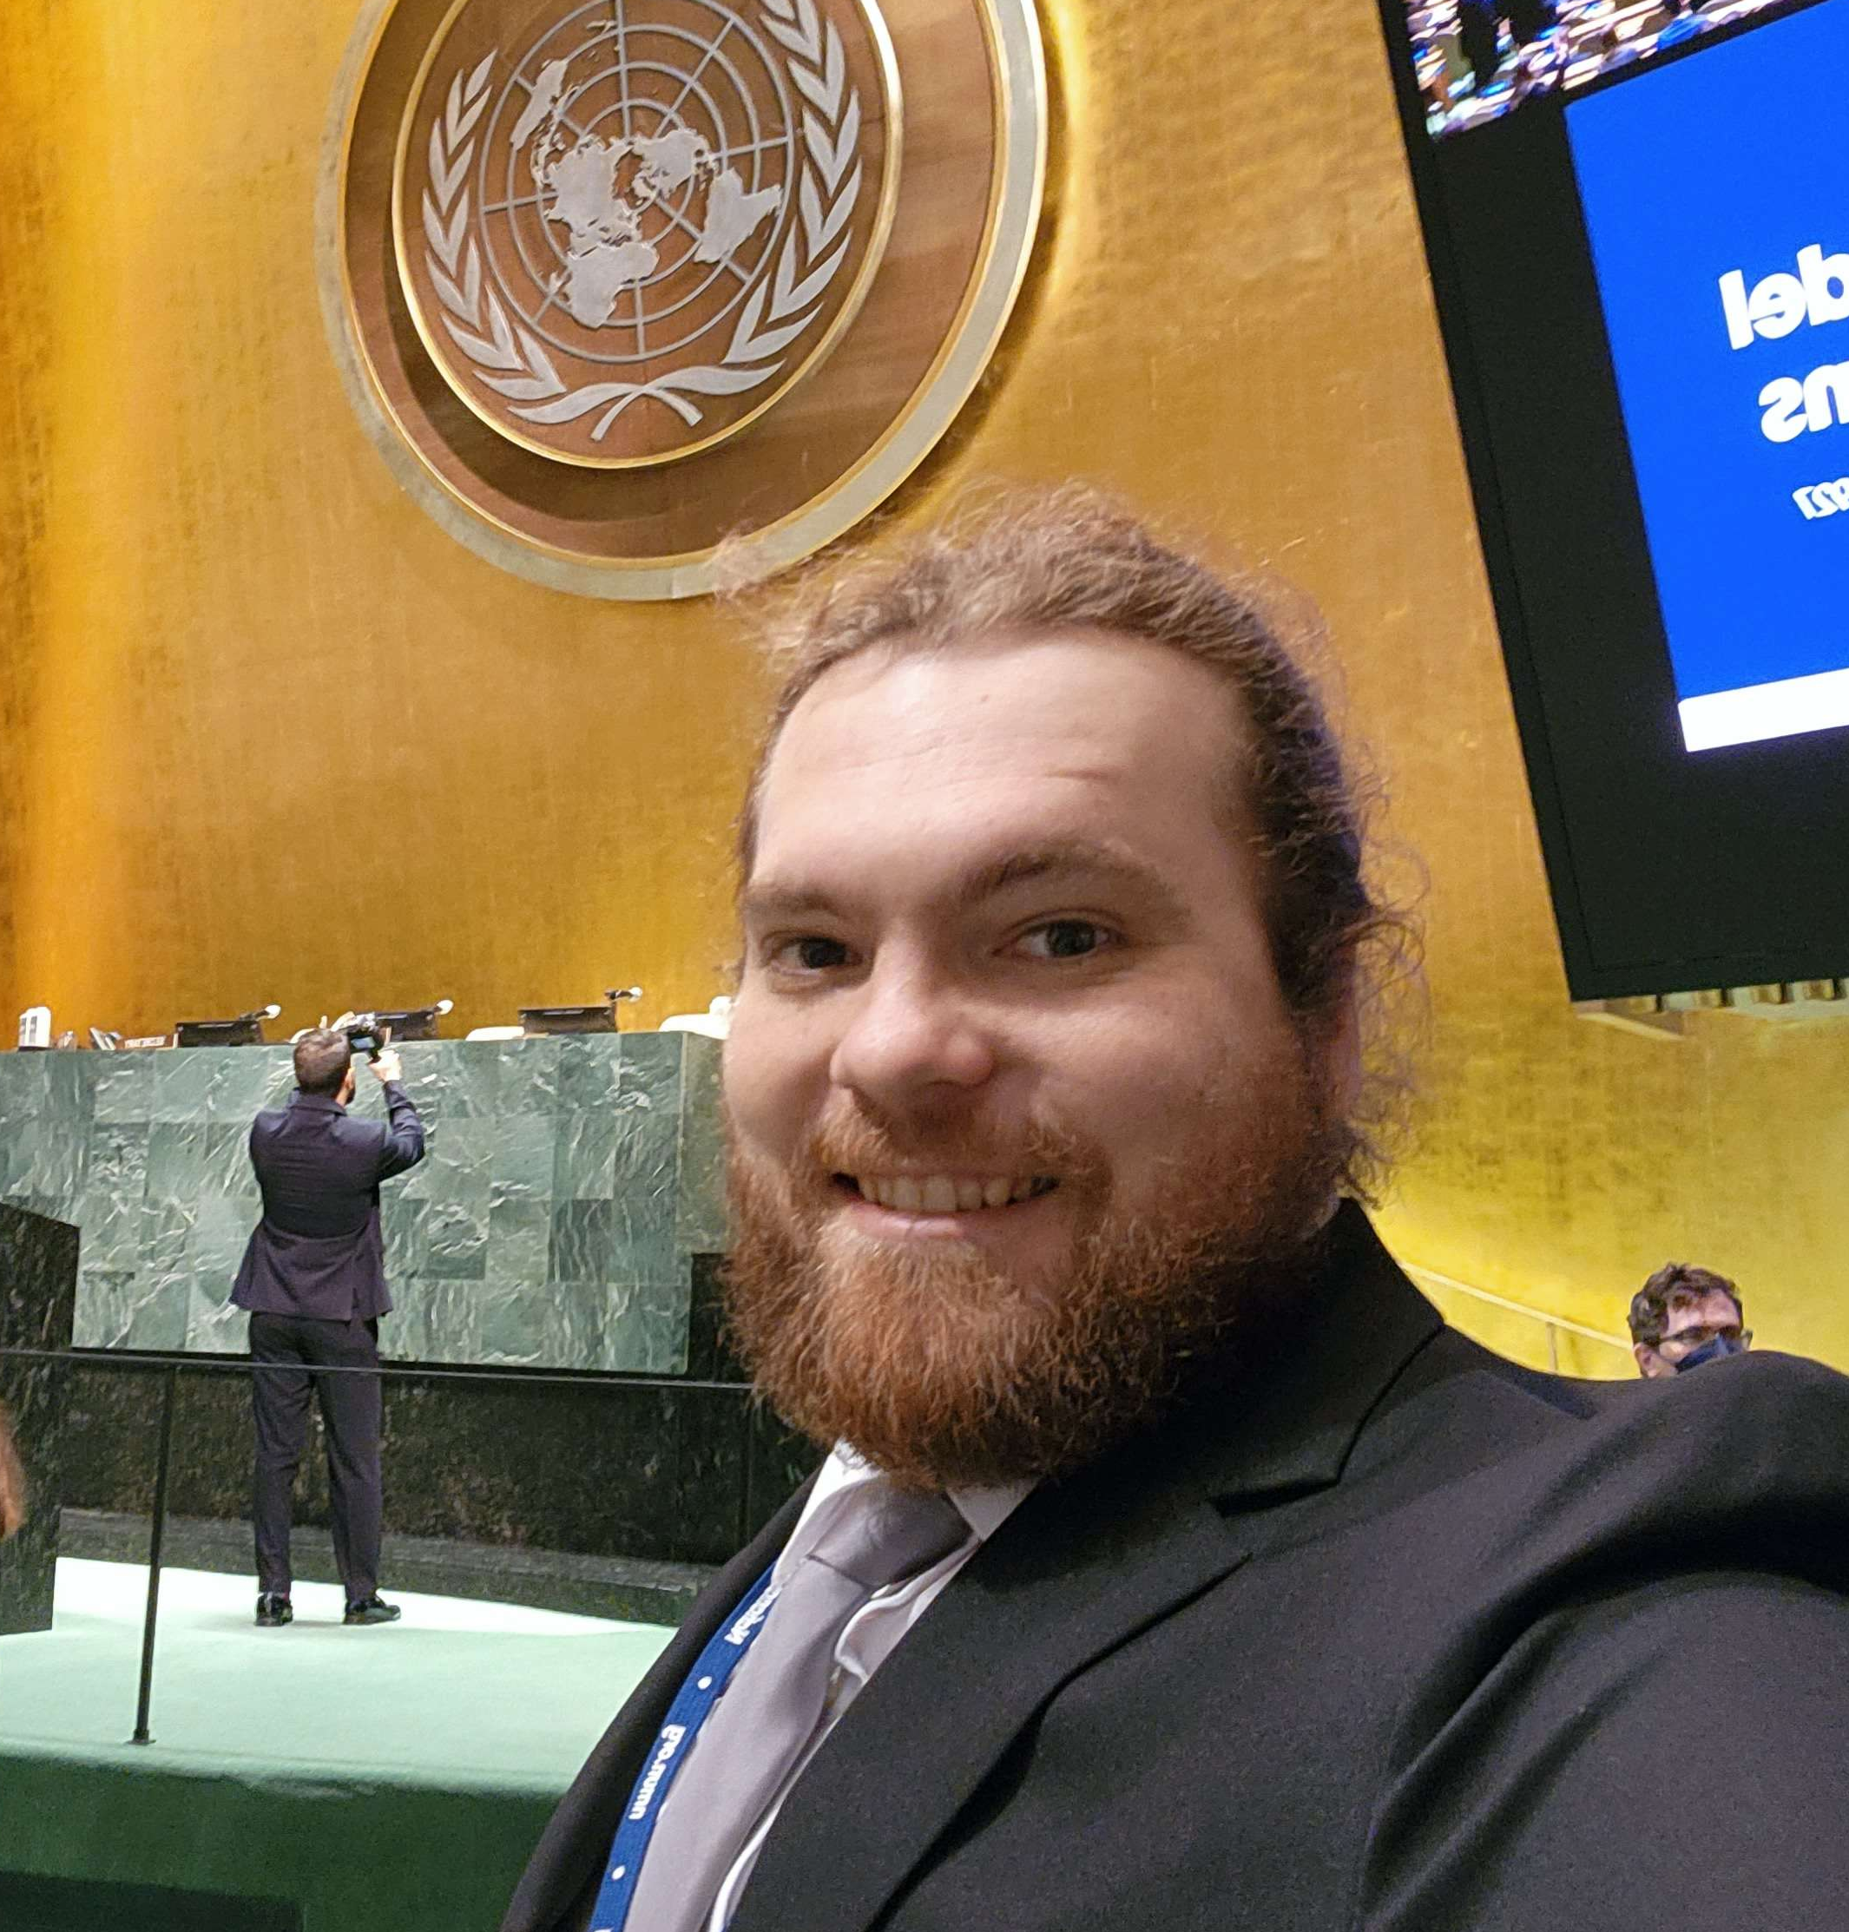
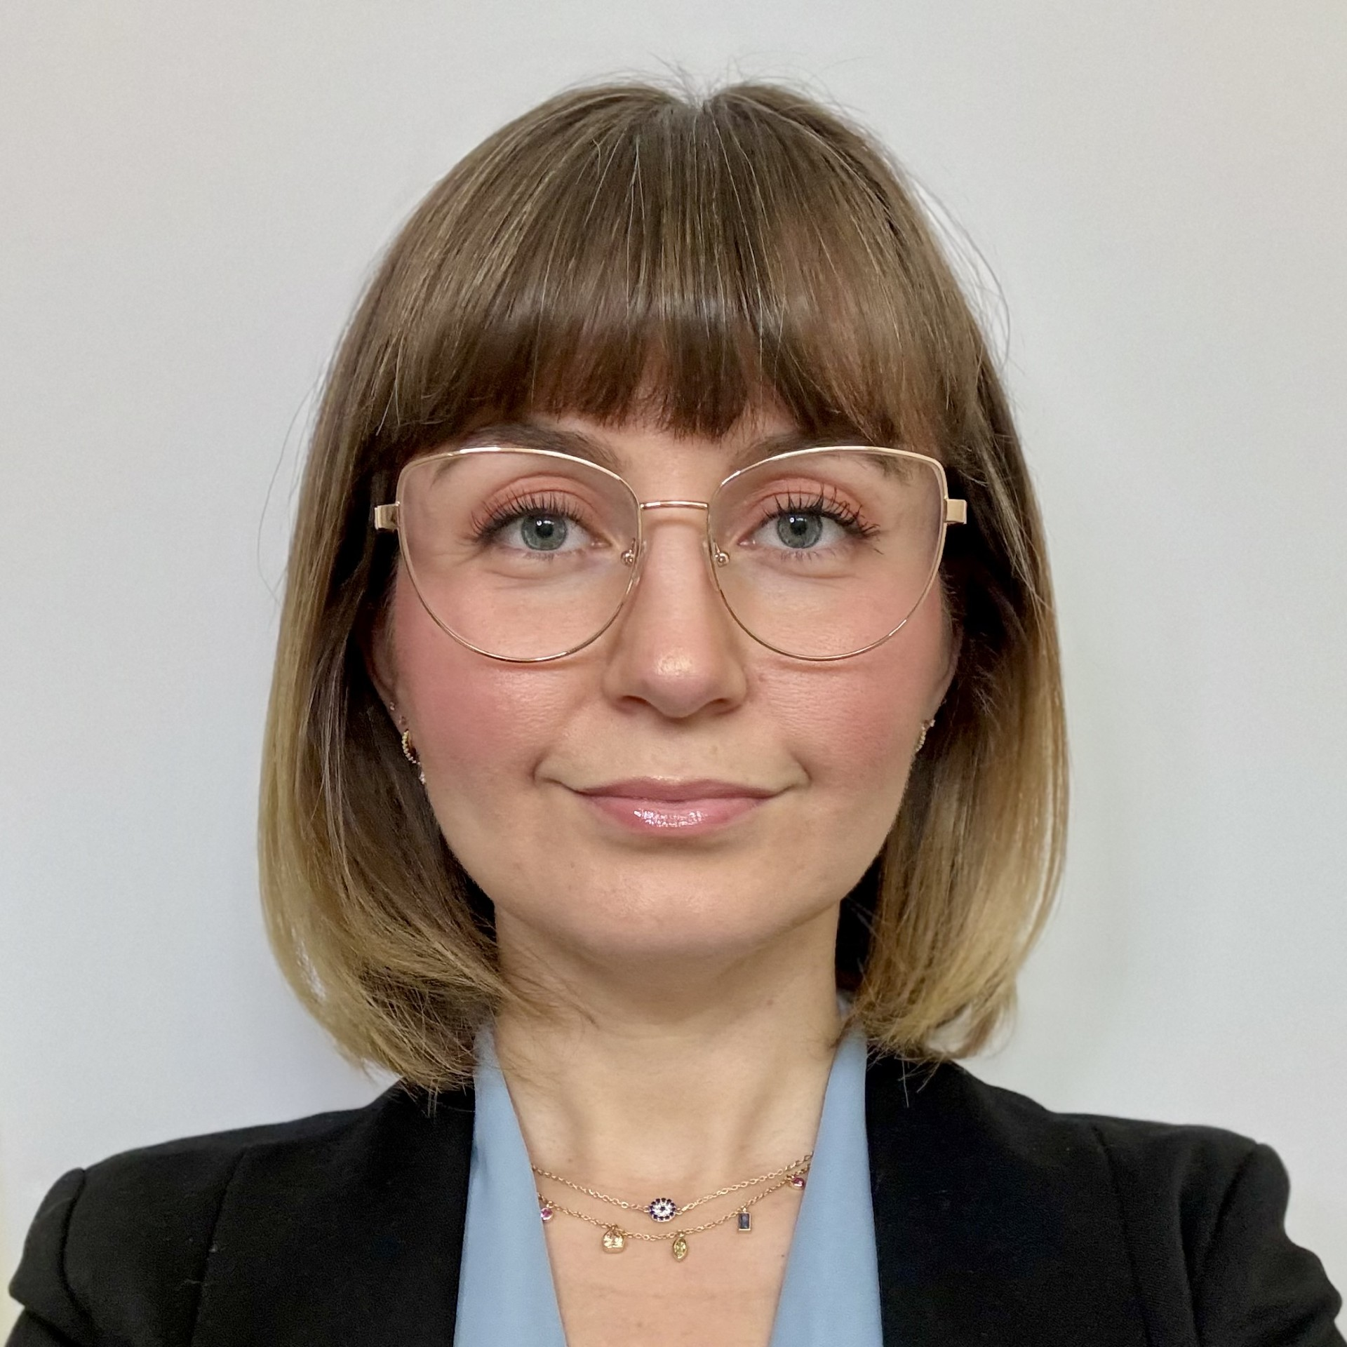
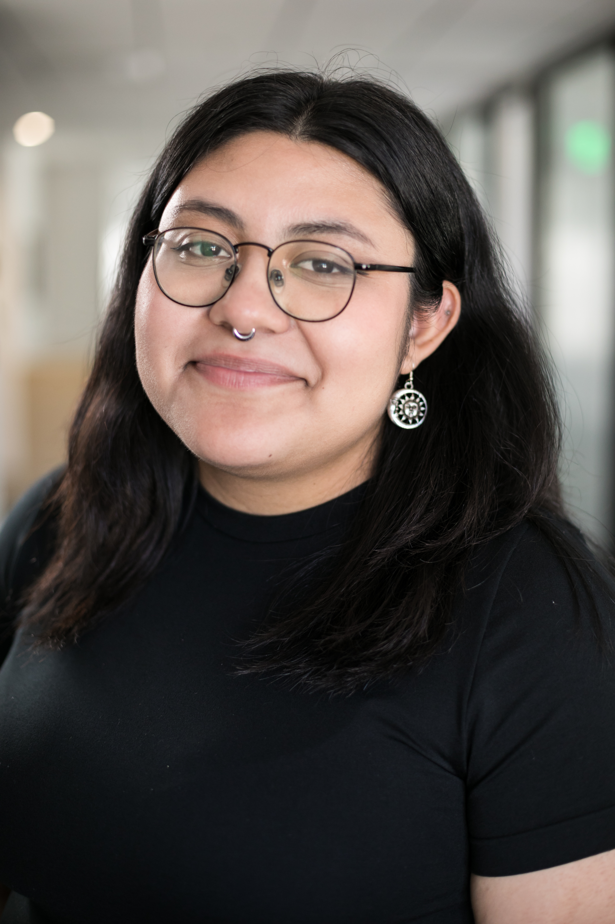
26-27 Graduate Association of Students in Public Policy and Administration (GASPPA)
GASPPA provides social and professional support to students. If you have any questions about the student-side experience:
Emails: sacstategasppa@csus.edu & sacstategasppa@gmail.com
Instagram: @sacstate_gasppa
LinkedIn: Graduate Association of Students in Public Policy and Administration
Newsletter Subscription: https://orgsync.us14.list-manage.com/subscribe?u=5c04b8dacc6c136bcb08a2b3a&id=e2de54ad3c
  Rhiannon Morales, President
  Christine Gutierrez, Vice President
  Kaylah Ball, Finance Director
  Chandler Witthaus, Communications Director
  Dea Ali, Academic Director
  Kimberly Cazares, Alumni Coordinator

Slide 8

You are Invited!
Grow your mind, grow your network, grow your opportunity!
Emails: sacstategasppa@csus.edu
& sacstategasppa@gmail.com
Instagram:@sacstate_gasppa
LinkedIn: Graduate Association of Students in Public Policy and Administration

Slide 9
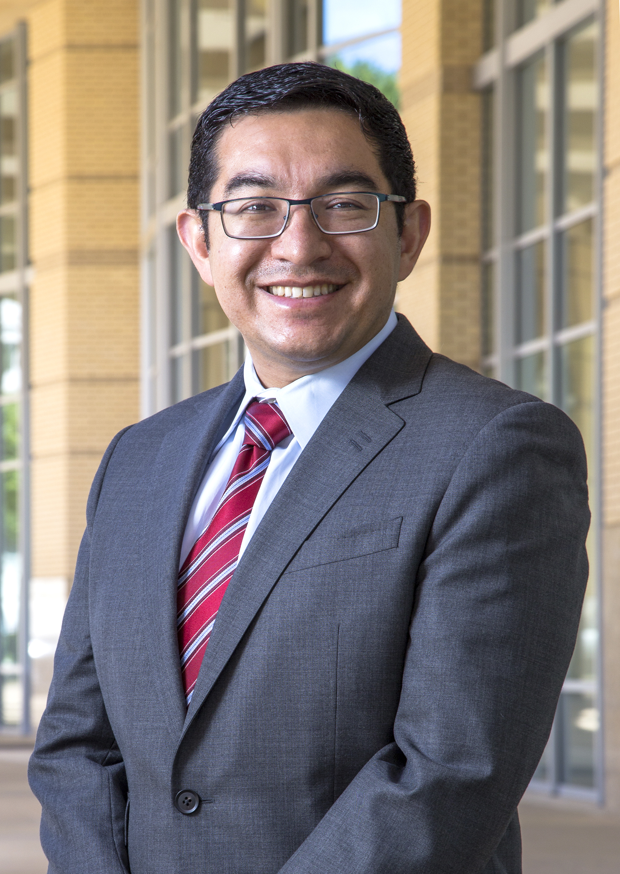
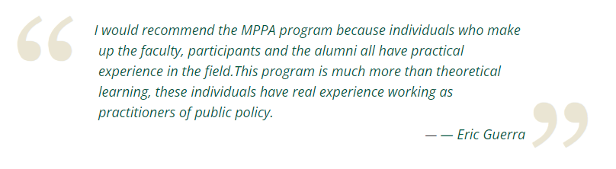
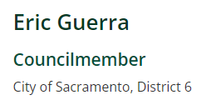
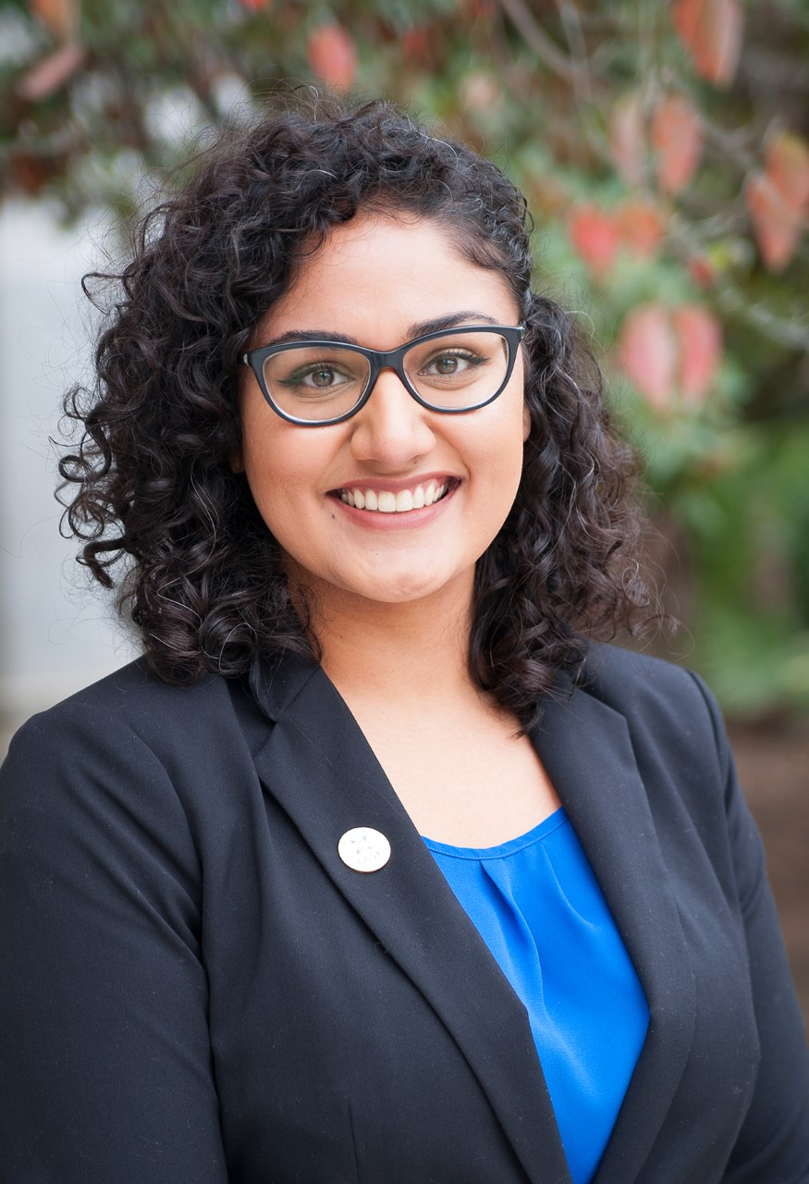
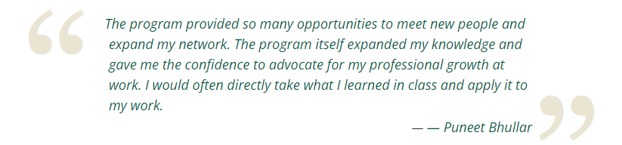
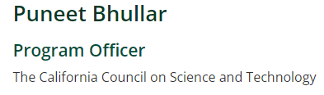
Alumna

Slide 10
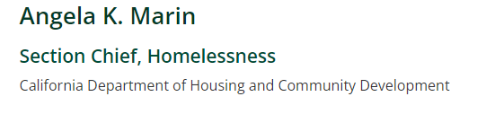
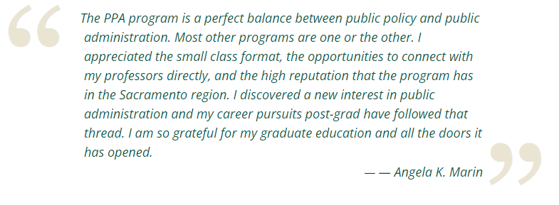
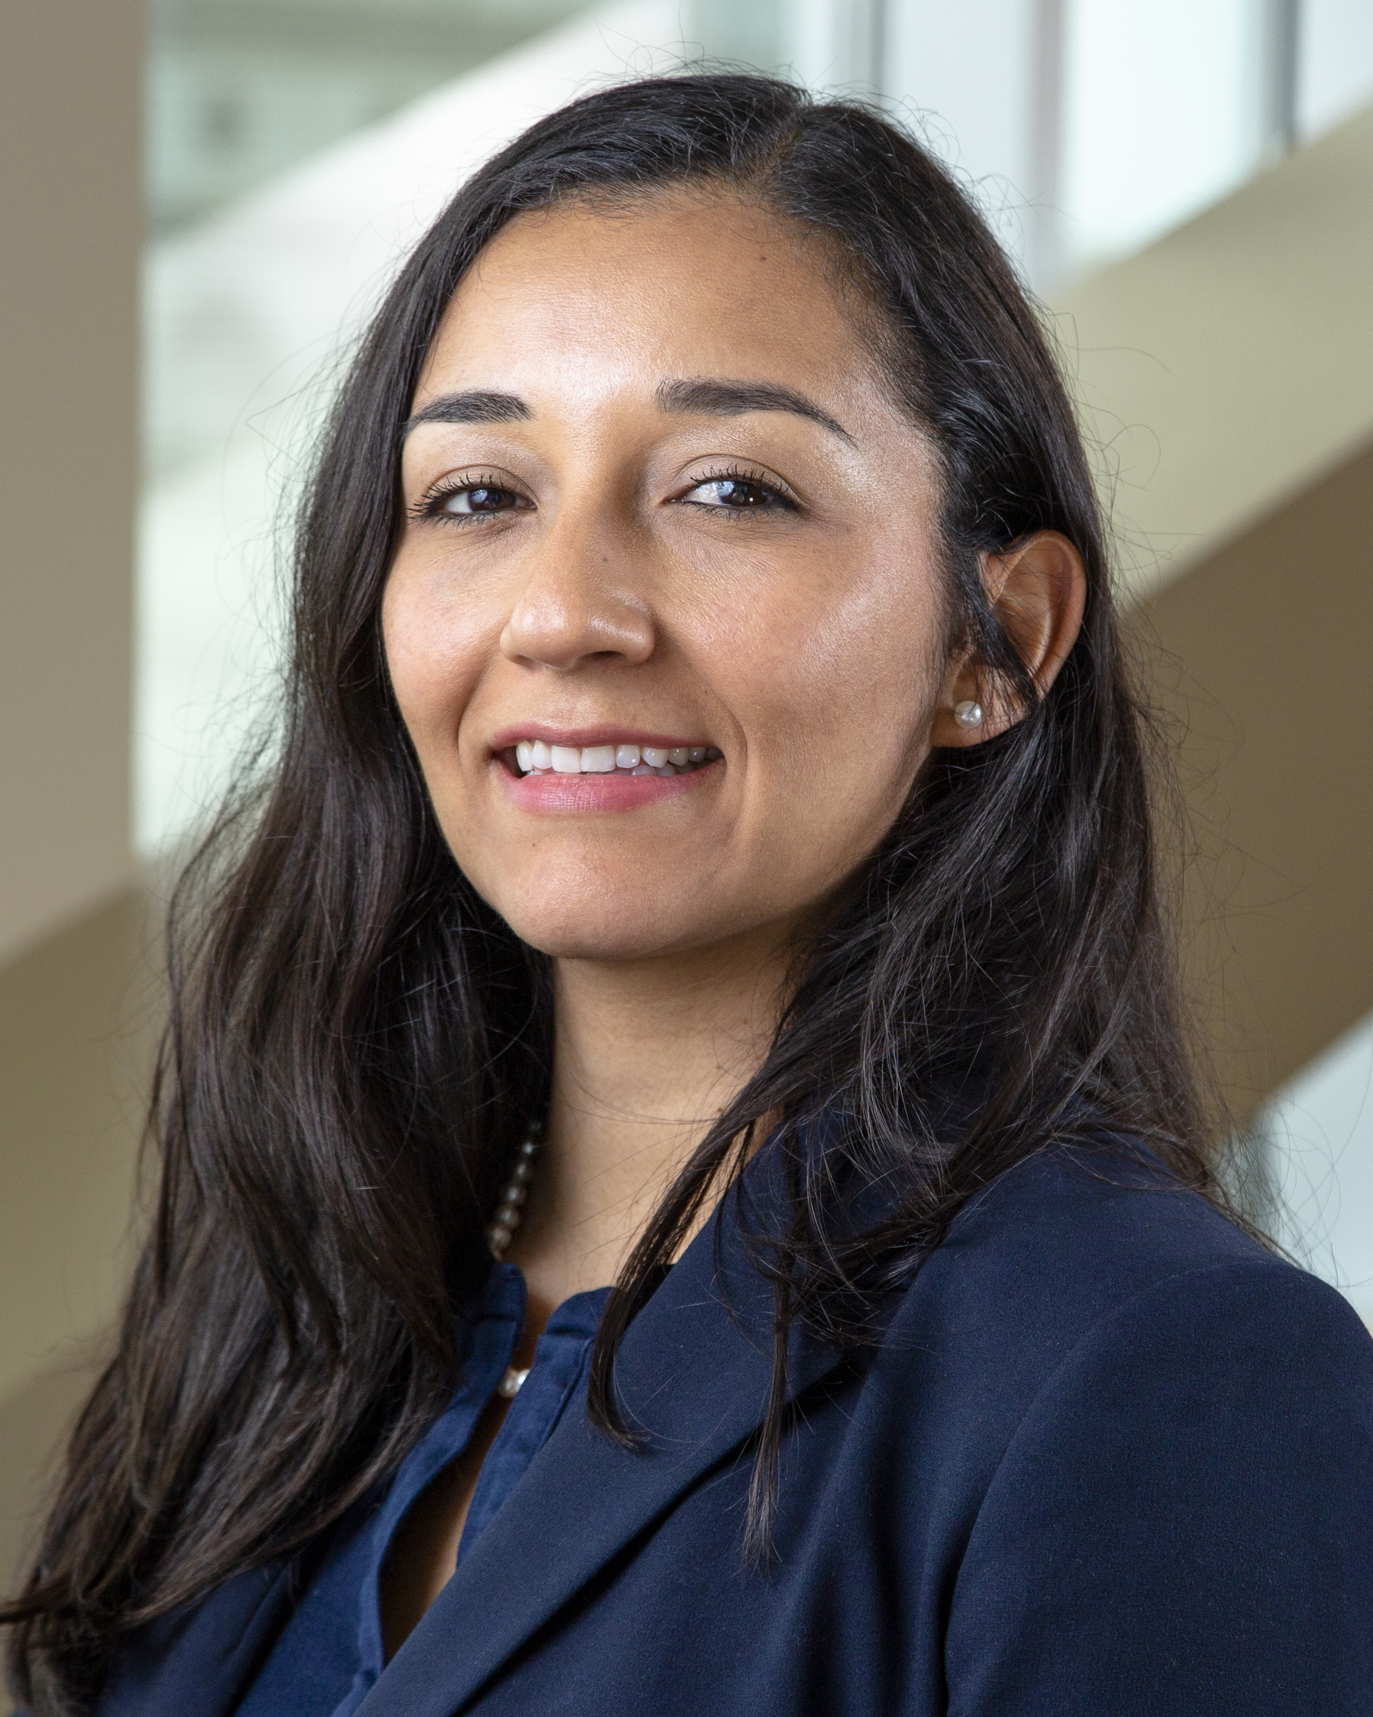
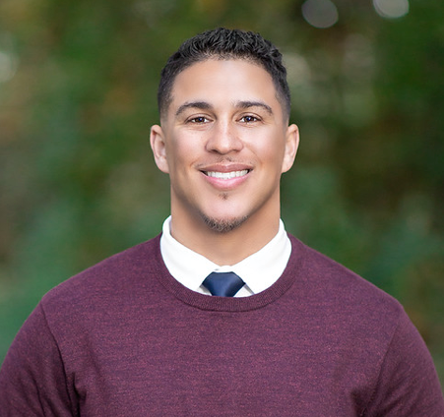
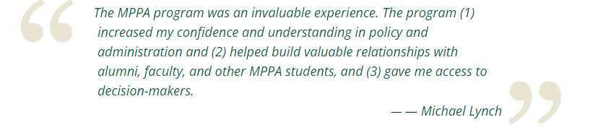
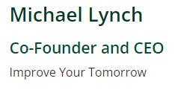
Alumna

Slide 11
Where are they now?
Governor’s Office of Service and Community Engagement
Power California
Rural County Assistance Corporation
California State Senate
California Community Colleges
League of California Cities
California State Auditor
California State Treasurer’s Office
California Department of Human Resources
California Department of Social Services
California Budget and Policy Center
City of Elk Grove, Davis, Sacramento, West Sacramento, Dickson, etc.
California Department of Fish and Wildlife
Institute for Local Government
California Association of Councils of Governments
California State Library

Slide 12
Why MPPA?
3. Teaching and (Peer) Mentorship: Focus on excellence in teaching and mentorship, face-to-face format, faculty’s regular office hours, and communication, etc.
4. Public Policy AND Public Administration: Curriculum covers both policy and administration

Slide 13
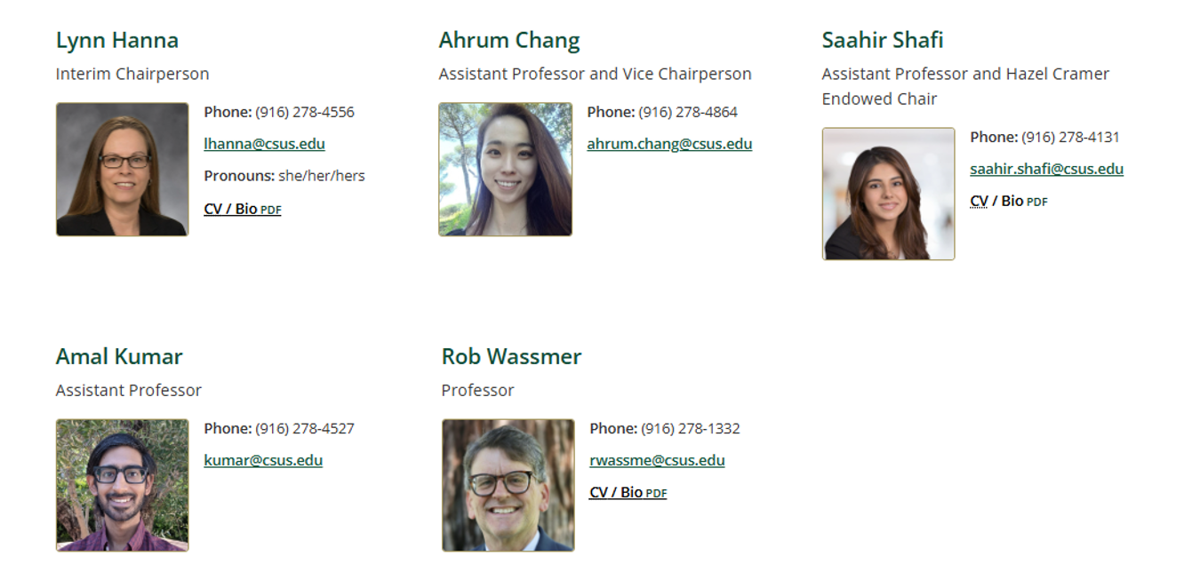
Faculty

Slide 14
Overview of Curriculum (total 36 units)
Core Courses (27 units = 9 classes X 3 units)
PPA 200, Introduction to Public Policy and Administration
PPA 205, Research Methods and PPA 207, Quantitative Methods (sequence)
PPA 220A and PPA 220B, Applied Economic Analysis (sequence)
PPA 240A and PPA 240B, Public Management and Administration (sequence)
PPA 230, Public Budgeting and Finance
PPA 210, Political Environment of Policy Making
Electives (6 units chosen from among PPA courses and classes in other departments)
PPA 270, Collaborative Policy
PPA 272, Collaborative Governance Advanced Practice
- Certificate for Collaborative Governance
Culminating Experience (3 units)
PPA 500, Culminating Experience

Slide 15

PPA500: Culminating Experience
All MPPA Students Required to Complete a Master’s Project
See https://www.csus.edu/college/social-sciences-interdisciplinary-studies/public-policy-administration/thesis-project-overview.html
Option # | Principal Product | Based on Course “Artifacts” | Oral PP Presentation | Executive Summary Submitted to OGS
1 | Applied professional public policy or public administration report | Assignment(s) from and PPA course(s) | Yes | Yes
2 | Draft Article in the Style of an Academic Journal | An assignment from one PPA course that the instructor agrees is relevant for expansion to an article | Yes | Yes
3 | A professional portfolio that includes a 3-4 page reflective essay and professional development plan (resume, cover letter to “ideal” job, and professional development goals | Three or more revised assignments from PPA courses that demonstrate your ability to perform the job you are seeking | Yes | Yes, of your revised assignments

Slide 16
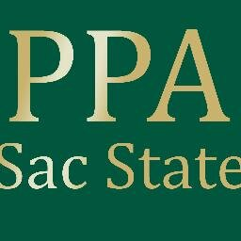
Timelines and Pacing
General expectations
  Two years if full-time, three if part-time (Cohort Model)
  7-year deadline to complete the degree by university policy
Full-time vs. part-time enrollment
  If students are working full-time, the department highly encourages them to start the program on a part-time basis (two classes per semester) instead of a full-time basis (three classes per semester).
All classes are in-person in the evenings (no summer/winter classes) at DTN.

Slide 17
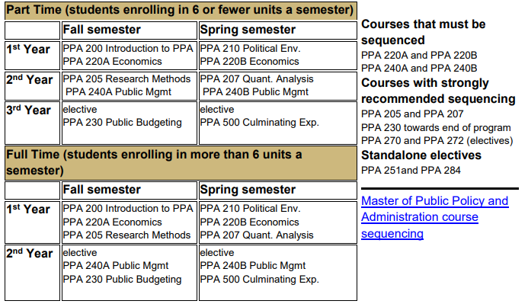

Slide 18

Cost Overview
Expect to spend about $25,000 to $27,000 for your entire degree.
If you take 6 or fewer units, you pay about $3,800 for that semester (as of fall 2026).
If you take more than 6 units, you pay about $5,600 for that semester (as of fall 2026).
Books, parking, and graduation fees are extra.
Our department does not offer any financial aid or tuition waiver. For direct inquiries regarding institutional scholarships & financial aid, reach out directly to the Scholarships Office: scholarshipfaqs@csus.edu & navigate the Office of Graduate Studies (OGS) website here: Grad School Financial Aid Opportunities

Slide 19
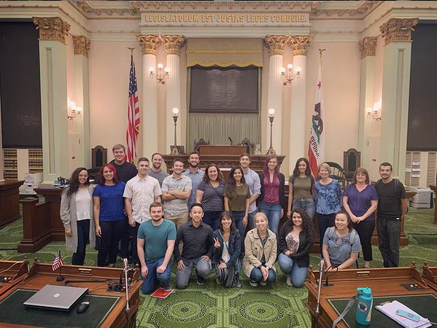
Application Deadlines
Fall 2027 admission cycle: Oct 1, 2026 – Feb 10, 2027
Fall 2026 priority admission closes: Dec 1, 2026
We do not have spring admissions.

Slide 20
Eligibility Requirements
Applicants must possess a baccalaureate degree with a minimum overall GPA of 2.75. We welcome applicants from all majors.
GRE requirement is permanently suspended.
Applicants need a grade of B or better (Not B minus) in two prerequisite courses before starting the program.
MPPA Two Prerequisites
  1. Introduction to U.S. Government or Political Science
  2. Introduction to Microeconomics
  Introduction to Statistics (Recommended)
  Click here to find some prerequisite options online at any California Community College (see the table).

Slide 21
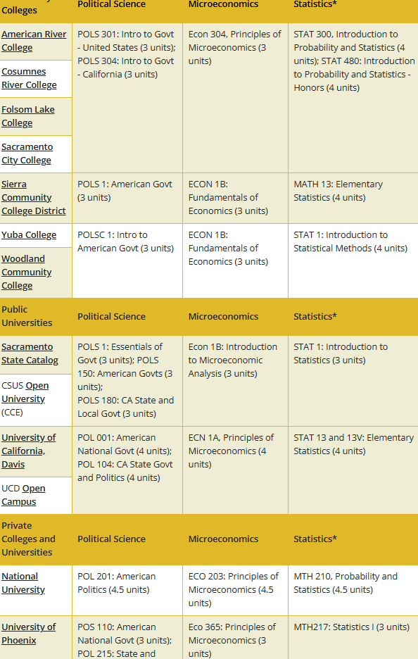

Slide 22
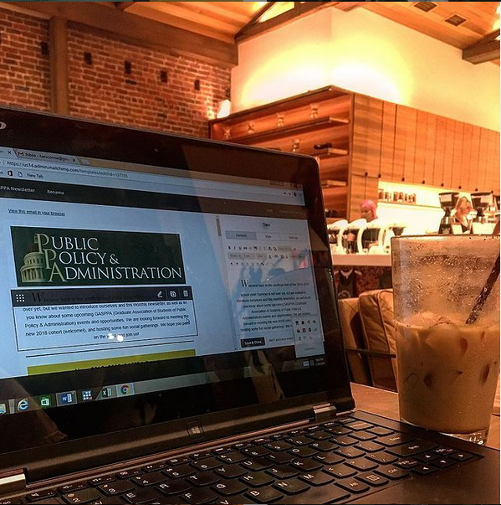
Application Process
NOW
  Review Instructions: MPPA program website
  Visit Cal State Apply
  Upload supplemental application form (prerequisites) and materials (statement of purpose and resume/CV)
  Prepare ALL required unofficial transcripts
  Reach out to request references (two letters are fine; at least one academic is encouraged)
  *All recommendations are submitted electronically using Letters by Liaison through the Cal State Apply Recommender Portal. Let them know the request is from calstateapply@liaisoncas.com. The deadline to submit recommendations is the same as the application deadline.)
  Submit applications
  *Contact the Office of Graduate Studies (OGS) if there are any technical issues during the application process: grad_admissions@csus.edu
LATER
  Request official transcripts (institution to institution) only if accepted, and complete any missing prerequisites

Slide 23

Questions or Comments?

