Slide 1

Criminal Punishment
Part 2

Slide 2
Just Punishment
Just as a person can be unjust in violating a social rule or law, society in turn can be unjust in exacting punishment for violations of law.
What we need:
Identify and explain the reasons/justifications for punishment
Determine the just or appropriate limitations on punishment

Slide 3
California’s Three Strikes Law
Is recidivism a relevant factor?

Slide 4
Example: (Former) Three Strikes Law
In 2011, Jesse, a 28-year-old man, went into a Wal-Mart store and stole three DVDs. The DVDs were worth a total of $45. He was caught by a security officer. He was later arrested and charged with felony petty theft with a prior. In 2001, Jesse committed prior theft offenses. He went to a convenience store and robbed two store clerks with a knife in his hand. He was convicted of two counts of armed robbery. He is sentenced for the current theft offense to 25 years-to-life under the Three Strikes Law.
Three Strikes Law (pre-2012; former PC § 667) provided that a defendant convicted of any felony with two prior serious or violent felonies would be sentenced to a mandated term of 25 years to life.
Does the sentence satisfy minimal retributivism (specifically, the requirement of relevance and proportionality)?

Slide 5
Just Punishment and Proportionality
Just punishment, in part, is a punishment that is not in excess of what a person deserves; or a punishment that is proportionate given the offense and offender.
Premeditated Murder Other Murder Rape Battery Petty Theft
Death LWOP 25YTL 25Y 20Y 15Y 10Y 5Y 1Y
Indeterminate Determinate

Slide 6
Recidivism, A Relevant Consideration?
Recidivism: a tendency to reoffend
“Further, appellant was punished not just for his current offense but for his recidivism. Recidivism justifies the imposition of longer sentences for subsequent offenses. (Rummel v. Estelle, supra, 445 U.S. at p. 284 [].)” (People v. Cooper (1996) 43 Cal.App.4th 815, 824-825.)
“[The recidivist statute’s] primary goals are to deter repeat offenders and, at some point in the life of one who repeatedly commits criminal offenses serious enough to be punished as felonies, to segregate that person from the rest of society for an extended period of time. This segregation and its duration are based not merely on that person's most recent offense but also on the propensities he has demonstrated over a period of time during which he has been convicted of and sentenced for other crimes. Like the line dividing felony theft from petty larceny, the point at which a recidivist will be deemed to have demonstrated the necessary propensities and the amount of time that the recidivist will be isolated from society are matters largely within the discretion of the punishing jurisdiction.” (Rummel, supra, 445 U.S. at pp. 284-285.)

Slide 7
Cruel and Unusual Punishment
Are indeterminate life sentences Proportionate to the crimes?

Slide 8
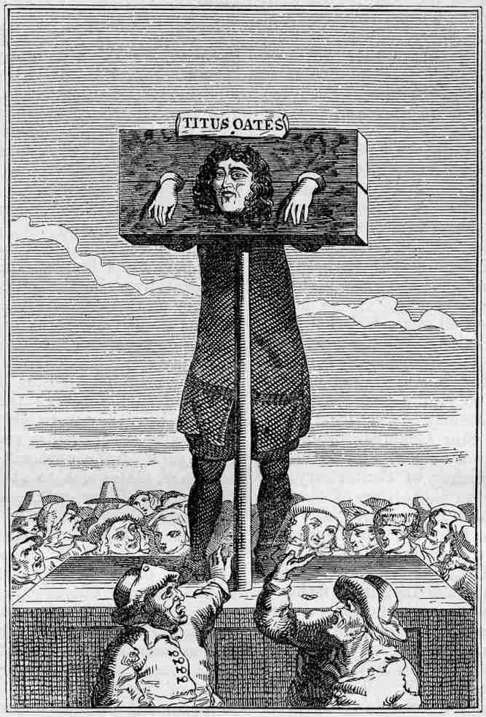
Eighth Amendment
“Excessive bail shall not be required, nor excessive fines imposed, nor cruel and unusual punishments inflicted.”
Eighth Amendment prohibits cruel and unusual punishment.

Slide 9
Ewing v. California (2003) 538 U.S. 11
Facts | Ewing stole three golf clubs worth $399 each and was convicted of felony grand theft. He had four prior serious or violent felonies. He was sentenced under CA’s Three Strikes Law (PC § 667) to 25 years to life. He appealed.
Issue | Is Ewing’s sentence grossly disproportionate in violation of the Eighth Amendment?
Rule | 8th Amend. prohibits cruel and unusual punishment, which involves a narrow proportionality test in noncapital cases, i.e., only prohibiting grossly disproportionate sentences. In applying the test, deference is given to states in making policy judgments re: public safety and the need for longer sentences for repeat offenders. (Deference to state’s determination of recidivism as a relevant consideration.)
Application Analysis | A punishment violates the 8th Amend. if it is grossly disproportionate based on the offense and the offender. The indeterminate life sentence is not grossly disproportionate here based on the offense, past offenses, and recidivism.
Conclusions | Ewing’s sentence does not violate the 8th Amend, affirming Appellate Court’s decision.

Slide 10
Gross Disproportionality
Eighth Amendment requires only narrow proportionality in noncapital cases (Conc. Opn. by Kennedy, Harmelin v. Michigan):
Narrow proportionality: the punishment must not be grossly disproportionate with the crime
Broad proportionality: the punishment must be strictly proportionate to the crime
“[T]he primacy of the legislature, the variety of legitimate penological schemes, the nature of our federal system, and the requirement that proportionality review be guided by objective factors” inform the final principle that the “Eighth Amendment does not require strict proportionality between crime and sentence [but] forbids only extreme sentences that are ‘grossly disproportionate’ to the crime.” (Ewing v. California (2003) 538 U.S. 1, 11-12, citing conc. opn. of J. Kennedy, Harmelin v. Michigan (1991) 501 U.S. 957, 996-997).

Slide 11
Not Grossly Disproportionate
In noncapital cases, can any sentence be grossly disproportionate to the crime, given the offense and the offender, as evaluated under the state’s theory of punishment?
“Successful challenges to the proportionality of particular sentences have been exceedingly rare.” [] Although we stated that the proportionality principle “would ... come into play in the extreme example ... if a legislature made overtime parking a felony punishable by life imprisonment” [], we held that “the mandatory life sentence imposed upon this petitioner does not constitute cruel and unusual punishment under the Eighth and Fourteenth Amendments.”
“In weighing the gravity of Ewing's offense, we must place on the scales not only his current felony, but also his long history of felony recidivism.” Here, not grossly disproportionate.

Slide 12
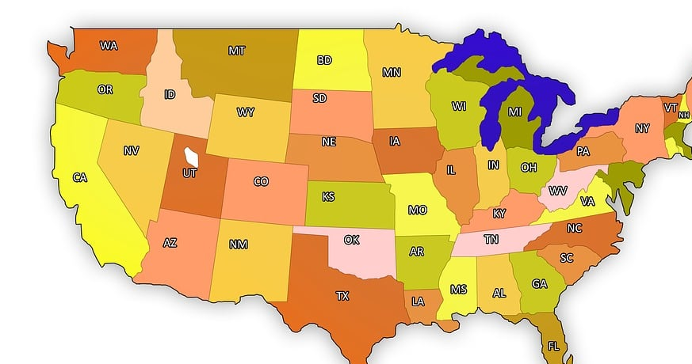
Deference to States
For felonies in noncapital cases, … “the length of the sentence actually imposed is purely a matter of legislative prerogative.” (Harmelin v. Michigan (1991) 501 U.S. 957, 959.)
“Our traditional deference to legislative policy choices finds a corollary in the principle that the Constitution “does not mandate adoption of any one penological theory.” [] A sentence can have a variety of justifications, such as incapacitation, deterrence, retribution, or rehabilitation. [] Some or all of these justifications may play a role in a State's sentencing scheme. Selecting the sentencing rationales is generally a policy choice to be made by state legislatures, not federal courts.” (Ewing, supra, at p. 25, citations omitted.)

Slide 13
Deference to the States (cont.)
Which theory of (just) punishment applies?
Incapacitation (Utilitarianism)
Deterrence (Utilitarianism)
Retributivism
Hybrid Utilitarianism
Hybrid Retributivism
The states decide based on public will, public morality, or their own theory of justice (liberal, moralist, contractualist, etc.), so long as their penological scheme is consistent with the Constitution (thin common theory of democratic justice).

Slide 14
Constitution Setting Minimal Limits; States Deciding the Rest
State A
State C
Constitution (Thin theory of justice)
Thick theory of justice
Penological theory (deterrence, retributivism, rehabilitation, etc.)
Other principles or values
State B

Slide 15

California: Incapacitating and Deterring Repeat Felons
California specifically had an interest in incapacitating and deterring repeat criminals.
Sacramento Bee study (1996)
233 three strike offenders had 1,165 prior felonies (5 each on average)
Prior offenses included 322 robberies and 262 burglaries.
84% committed prior violent felonies (17 homicides, 7 attempted slayings, and 91 sexual assaults and child molestations)
After passing the Three Strikes Law, the recidivism rate dropped by 25%.
(Ewing, supra, at pp. 26-27)

Slide 16
Conclusion: Not Grossly Disproportionate
In noncapital cases, can any sentence be grossly disproportionate to the crime, given the offense and the offender, as evaluated under the state’s theory of punishment?
What the state considers as relevant factors: defendant’s recidivism
State’s interest in incapacitating and deterring repeat offenders
Comparing other noncapital cases
“In weighing the gravity of Ewing's offense, we must place on the scales not only his current felony, but also his long history of felony recidivism.” Here, not grossly disproportionate.

Slide 17
Rummel v. Estelle (1988) 445 U.S. 263
Facts
Issue
Rule
Application Analysis
Conclusions

Slide 18
Rummel v. Estelle (1988) 445 U.S. 263
Facts | Rummel was charged and convicted of obtaining $120 by false pretenses. He had prior felonies for fraudulent use of a credit card and a forged check. He was sentenced to life under TX’s recidivist statute (PC Art. 63)
Issue | Is the application of TX’s recidivist statute on Rummel to impose a life sentence grossly disproportionate in violation of the Eighth Amendment?
Rule | 8th Amend.’s cruel and unusual punishment clause prohibits sentences grossly disproportionate to the severity of the crime.
Application Analysis | Court distinguished between capital punishment (unique in its irrevocability) and noncapital sentences. In noncap cases, reversals under the 8th amend are rare. Compared examples of cases that also do not qualify as cruel and unusual punishment. Compared different state sentencing schemes. Rummel’s offense/sentence is no different from other cases. Sentence under TX sentencing scheme is not grossly disproportionate to sentences in other states.
Conclusions | Rummel’s mandatory life sentence was not grossly disproportionate and did not constitute cruel and unusual punishment.

Slide 19

Eighth Amendment Analysis
Court distinguished between capital punishment (unique in its irrevocability) and noncapital sentences.
Applies to Death Penalty cases
Limited application in non-capital cases (reversals are “exceedingly rare”)
Court’s approach in non-capital cases
Compare examples of cases that also do not qualify as cruel and unusual punishment.
Compare different state sentencing schemes

Slide 20
Comparing Cases
Examples from precedent
15 years imprisonment in hard labor and chains for falsifying a public document (Weems v. United States, 217 U.S. 249 (1910) (Philippine Islands).
Five years' imprisonment for mail fraud (Badders v. United States, 240 U.S. 391 (1916)).
Life sentence for stealing one bay mare valued at $50 and past similar crimes (Graham v. West Virginia, 224 U.S. 616 (1912)).

Slide 21
Comparing and Deferring to States: Comparing Apples and Avocadoes
Defendant/petitioner: “[n]o jurisdiction in the United States or the Free World punishes habitual offenders as harshly as Texas.” Id., at 39.
Rummel Court (p. 282):
As Mr. Justice Holmes noted in his dissenting opinion in Lochner v. New York [], our Constitution “is made for people of fundamentally differing views . . ..” Until quite recently, Arizona punished as a felony the theft of any “neat or horned animal,” regardless of its value; California considers the theft of “avocados, olives, citrus or deciduous fruits, nuts and artichokes” particularly reprehensible. In one State theft of $100 will earn the offender a fine or a short term in jail; in another State it could earn him a sentence of 10 years' imprisonment. Absent a constitutionally imposed uniformity inimical to traditional notions of federalism, some State will always bear the distinction of treating particular offenders more severely than any other State. (Footnotes and citations omitted.)

Slide 22
Accommodating Different Views
State system of crimes and punishments
Liberalism v. Moralism
Deterrence, Incapacitation, Retributivism, Rehabilitation
Other values, principles, or policies
Different states with different systems of criminal justice, each with their own theoretical commitments or values.
Is a lack of uniformity and consistency good or bad?

Slide 23
Critiques of Ewing and Rummel?

