Slide 1
History of Wireless Communications
1897:
Marconi invented wireless concept
1960’s & 1970’s:
Bell laboratories developed the
cellular concept
1970’s:
Development of highly reliable, miniature solid state radio frequency hardware
Wireless communication era was born

Slide 2
Evolution of wireless users
1984 - 25,000
1994 - 16 million
1997 - 50 million
2000 - Number of wireless users =
Number of wired users
2010 – 5 billion users worldwide

Slide 3
Commonly used wireless systems
Garage door openers
Remote controllers for home entertainment
Cordless telephones
Hand-held walkie-talkies
Pagers
Cellular telephones

Slide 4
Components of wireless system
Mobile – Describes a radio terminal attached to a high speed mobile (e.g., A cellular phone in a fast moving vehicle)
Portable – Describes a radio terminal that can be hand-held and used by someone at walking speed (e.g., cordless telephone)
Subscriber – Mobile user
Base stations – Link mobiles through a backbone network

Slide 5
Types of wireless transmission systems
Simplex – Communication possible only in one direction, (e.g., paging systems)
Half Duplex – Two way communication, but uses the same radio channel for both transmission and reception. User can only transmit or receive information
Full Duplex – Simultaneous two-way radio transmission and reception between subscriber and base station

Slide 6
Types of duplex systems
Frequency Division Duplex (FDD) -Two simultaneous but separate channels
Time Division Duplex (TDD)-Adjacent timeslots on a single radio channel
TDD can multiplicate number of channels in FDD

Slide 7
Cordless Telephone Systems
Full duplex communication
Usable range ~ hundred meters
wireless
link
Public Switched Telephone Network
(PSTN)
Fixed
Port
(Base
Station)
cordless
handset

Slide 8
Wide Area Paging System
Landline link
City 1:
Paging
terminal
PSTN
Landline link
City 2:
Paging
terminal
Paging
control
center
City N:
Paging
terminal
Satellite link

Slide 9
Message format in Paging systems
Numeric messages
Alpha-numeric message
Voice message
News headlines
Stock quotes
Faxes

Slide 10
Cellular System
Mobiles(Users)
Base stations (towers)
Mobile Switching Center (MSC)
Public Switched Telephone Network (PSTN)
MSC
PSTN

Slide 11
Base Station-Mobile Network
RVC
FVC
RCC
FCC
FVC - Forward Voice Channel
RVC - Reverse Voice Channel
FCC - Forward Control Channel
RCC - Reverse Control Channel

Slide 12
Functions of Cellular System
Provides wireless connection between users and Public Switched Telephone Network (PSTN)
PSTN is the wired network that includes coaxial, microwave, fiber optic, under-sea cables, satellite.
PSTN is the telephone network that provided sole service before we had cell phones
Cellular service merely extends the PSTN service to the mobile location

Slide 13
How does cellular system work?
Base stations provide wireless connectivity to mobile users
Each base station limits control to its small geographical area (2-3 sq. km) or cell.
High capacity of cellular network is achieved:
  by limiting the coverage to the cell
  By using concept of Frequency reuse
  However, frequencies are reused in cells quite far away to minimize interference

Slide 14
Cellular system handoff and capacity
Switching system, called handoff, enables call to proceed uninterrupted when
user moves from one cell to another
Typical MSC handles 100,000 cellular users and 5,000 simultaneous conversations
at a time

Slide 15
Steps in telephone call made to Mobile User
Incoming
Telephone
Call to
Mobile X
Base Stations
Step 1
2, 6
Mobile Switching Center
5
4
3, 7
Mobile X
PSTN

Slide 16
Cellular Process in call to Mobile User
Step 1 Incoming telephone call is received by MSC
Step 2 MSC dispatches request to all BSs
Step 3 BSs broadcast MIN over FCC
Step 4 Mobile acknowledges over RCC to local BS
Step 5 BS relays mobile reply to MSC
Step 6 MSC instructs local BS to initiate call
Step 7-1 BS signals mobile to use unused channel*
Step 7-2 Alert is transmitted over FVC to ring mobile*
* Simultaneous process

Slide 17
Steps in telephone call made from mobile user
Mobile Switching Center
3
2
PSTN
Telephone
Call Placed
by Mobile X
1

Slide 18
Cellular Process in call from mobile user
Step 1-1 Mobile dials MIN of called party to BS
Step 1-2 Mobile transmits SCM* to show signal power
Step 2 BS receives data and sends it to MSC
Step 3-1 MSC validates request
Step 3-2 MSC connects to called party via PSTN
Step 4 MSC validates unused channel to mobile
* Station class mark

Slide 19
Cellular Roaming
Roaming allows subscribers to operate in service areas other than the home area.
When a mobile enters a geographic area that is different from its home service area, it is registered as a roamer in the new service area.
Roaming is essential to maintain service for users in areas other than their home network.

Slide 20
Roaming Protocol
Periodically, the MSC issues a global command over each FCC in the system, requesting mobiles to report their MIN and
ESN over the RCC.
MSC registers users in two categories:
  Home users
  Visitor users or roamers
Roaming will be discussed further in the Cellular Networks chapter.

Slide 21
Initial Frequency Spectrum for US Cellular
Channel Number | Center Frequency (MHz)
1 ≤ N ≤ 799 | .03 N + 825
990 ≤ N ≤ 1023 | .03 (N – 1023) + 825
1 ≤ N ≤ 799 | .03 N + 870
990 ≤ N ≤ 1023 | .03 (N – 1023) + 870
Channels 800-989 are unused.

Slide 22
Comparison of Mobile Stations
Service
Coverage range
Required infra-structure
Com-
plexity
Hardware cost
Carrier frequency
Function-ality
TV remote control
trans-mitter
low
low
low
low
infra-red
Garage door opener
<100 MHz
trans-mitter
low
low
low
low
Paging system
high
high
low
low
<1 GHz
receiver
Cordless phone
<100 MHz
trans-ceiver
low
low
moderate
low
Cellular phone
trans-ceiver
high
high
high
moderate
<1 GHz

Slide 23
Comparison of Base Stations
Coverage range
Com-
plexity
Hardware cost
Carrier frequency
Function-ality
Service
Required infra-structure
TV remote control
low
low
low
low
infra-red
receiver
Garage door opener
<100 MHz
low
low
low
low
receiver
Paging system
trans-mitter
high
high
high
high
<1 GHz
Cordless phone
<100 MHz
trans-ceiver
low
low
low
moderate
Cellular phone
trans-ceiver
high
high
high
high
<1 GHz

Slide 24
The Cellular Concept
The cellular concept was a major breakthrough in solving the problem of spectral congestion and user capacity.
Replaces single high power transmitter (large cell) with many low power transmitters (small cells), each providing coverage to only a small area.

Slide 25
Frequency Reuse Concept
B
Cells with the same letter, use
the same set of frequencies.
A cell cluster is outlined
in bold, and replicated over
the coverage area.
In this figure, the
cluster size, N, is equal to 7;
since there are 7 cells in the cluster.
G
C
A
F
D
E
B
B
G
C
G
C
A
A
F
D
F
D
E
E

Slide 26
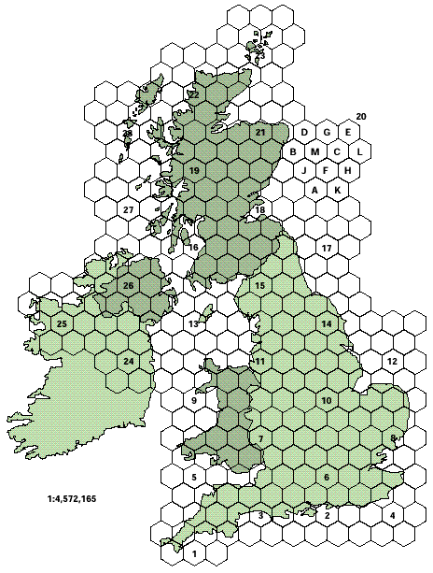
Example of cellular structure
Courtesy: UK cellular plan for scanning telemetry

Slide 27
Why the Hexagonal Cell?
Factors required for cell
Equal area
No overlap between cells

Slide 28
Possible choices for cell shape
S
S
S
A1
A 2
A 3
For a given radius S, A3 provides maximum
coverage area.
By using hexagon geometry, the fewest number of cells covers a given geographic region.
Actual cellular footprint is determined by the contour of a given transmitting antenna.

Slide 29
Comparison of possible cell shapes
For a given radius S, A3 provides maximum
coverage area.
Actual cellular footprint is determined by the contour of a given transmitting antenna.
By using hexagon geometry, the fewest number of cells covers a given geographic region.

Slide 30
Calculation of channel capacity
Channel capacity (C) of a particular area is the defined as the number of users that can be served by the cellular system.
C = M*K*N
Where:
M = Number of clusters in the area
K = Number of duplex channels/cell
N = Number of cells/cluster

Slide 31
Design of cluster size N
Tessellation condition (no gaps between cells)
N = i² ⁺ ij + j²
where i and j are non-negative integers
Example; i = 2, j = 1
N = 2² + 2(1) + 1² = 4 + 2 + 1 = 7
Cluster sizes are 1, 4, 7, 12, 19…

Slide 32
Co-channel cells
Co-channel cells are cells using the same frequency channels
For each cell, there are six co-channel cells in the first layer
Co-channel cells are designed to be as far away as possible from each other to minimize interference

Slide 33
Location of co-channel cells
N = 19; i = 3, j = 2
Move i cells
Rotate 120 degrees counterclockwise
Move j cells
Reach co-channel cell
A
A
A
A
A
A
A

Slide 34
Example problem
If a particular FDD cellular telephone system has a total bandwidth of 33 MHz, and if the phone system uses two 25 KHz simplex channels to provide full duplex voice and control channels,
compute the number of channels per cell if
N = 4, 7, 12.

Slide 35
Solution
Total bandwidth = 33 MHz
Channel bandwidth = 25 KHz x 2 = 50 KHz
Total available channels = 33 MHz / 50 KHz = 660
N = 4 Channel per cell = 660 / 4 =
165 channels
N = 7 Channel per cell = 660 / 7 =
95 channels
N = 12 Channel per cell = 660 / 12 =
55 channels

Slide 36
Fixed Channel Assignments
Each cell is allocated a pre-determined
set of voice channels.
If all the channels in that cell are occupied, the call is blocked, and the subscriber does not receive service.
Variation includes a borrowing strategy:
a cell is allowed to borrow channels from a neighboring cell if all its own channels are occupied. This is supervised by the MSC.

Slide 37
Dynamic Channel Assignments
Voice channels are not allocated to different cells permanently.
Each time a call request is made, the base station requests a channel from the MSC.
The MSC then allocates a channel to the requested call, based on frequency re-use of candidate channel, cost factors.
Dynamic channel assignment is more complex, but reduces likelihood of blocking.

Slide 38
Handoff Strategies
Handoff is a key process in any cellular system
Handoff occurs when a mobile moves into a different cell, and the MSC automatically transfers the call to a new channel belonging to the new base station
Handoffs must be performed successfully, as infrequently as possible and not visible to users.

Slide 39
Handoff scenario: Improper handoff
Level at point A
Handoff threshold
P_{n}
Received signal level
Minimum acceptable signal to maintain the call
P_{m}
Level at point B
(call is terminated)
Time
A
B
P_{n}– P_{m} = ∆
∆ too large- too many handoffs
∆ too small- call may be lost
BS1
BS2

Slide 40
Handoff scenario: Proper handoff
Level at point B
Received signal level
Level at which handoff is made
Time
A
B
BS1
BS2

Slide 41
Handoff parameters and variations
Each base station constantly monitors the signal strength of all its reverse voice channels to determine the relative location of each mobile user with respect to the base station tower.
Mobile assisted hand-off (MAHO) -
Every mobile station measures the received power from surrounding base stations and reports these measurements to the serving base station - Faster hand-off rate.
Inter-system handoff - One cellular system to a different cellular system.

Slide 42
Interference and System Capacity
Signal interference is a major limiting factor in performance of cellular systems
Two main types of of interference:
  Co-channel interference
  Adjacent channel interference

Slide 43
Co-Channel Interference
Cells that use the same set of frequencies are called co-channel cells.
Interference between these cells is called co-channel interference.
Standard form of interference measurement is SNR (Signal to noise ratio) of SIR (Signal to interference ratio)

Slide 44
Co-Channel Interference
Signal to interference ratio (SIR) or S/ I for a mobile receiver is given by:
=
S = signal power from base station
I_{i} = Interference power from ith co-channel cell
i₀ = Number of interfering stations

Slide 45
Schematic of co-channel interference
A
A
D+R
A
D
R
D+R
D-R
A
D
A
A
D-R
A

Slide 46
Calculation of Antenna power
Base station antenna power at distance d
P_{o}
P_{r}
d
where n is path loss exponent

Slide 47
Calculation of SIR
i_{o} = total number of first layer interfering cells

Slide 48
Mobile at center of cell (D_{i} = D)

Slide 49
Mobile at cell boundary (maximum interference)

Slide 50
Adjacent Channel Interference
Interference resulting from signals with neighboring frequency to the desired signal.
Interference occurs due to imperfect receiver filters that allow spectrum leakage.
Can be minimized by:
  careful filtering and assignments
  keeping frequency separation between cell channels as large as possible.

Slide 51
Trunking and Grade of Service
Cellular radio system relies on trunking to accommodate a large number of users with limited spectrum.
Trunking - each user is allocated a channel on a per-call basis; and upon termination of the call, the channel is immediately returned to the pool of available channels.
Initiated by Danish mathematician, Erlang.

Slide 52
Grade of Service (GOS)
GOS is the ability of the user to access a trunked system during the busiest hour of a week, month or year (for example, 4 - 6 pm Friday is a very busy air time)
Traffic intensity is defined as the measure of channel usage for each user.
Cellular traffic is similar to traffic on the freeway, with each lane corresponding to a group of channels.

Slide 53
Measure of Traffic Intensity
Traffic usage of of each user is:
A_{μ} = λ H
λ - Average number of calls per sec.
H - duration of a call (sec.)
Total traffic usage with U users:
A = U A_{μ} Erlangs
Traffic load/channel:
A_{c} = U A_{μ} / C

Slide 54
Blocked Calls Cleared System
No queuing mechanism available for call requests.
If no channels are available, the requesting user is blocked without access and is free to try again later.

Slide 55
Calculation of GOS for Blocked system
Assuming a finite number of available channels C, and using queuing theory:
GOS = Probability (call is blocked)
=

Slide 56
Practical estimation of GOS
AMPS cellular is designed for GOS = 0.02
This is called Erlang B formula (Appendix A) - Figure 3.6 in book.

Slide 57
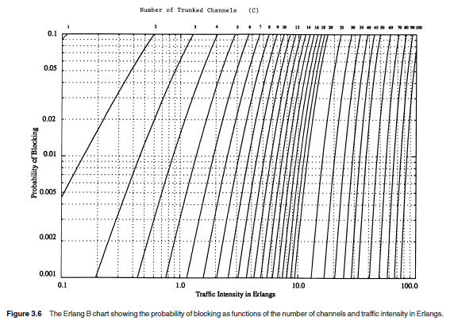

Slide 58
Blocked calls delayed system
Queue is provided to hold calls until a channel becomes available
Prob [Delay > 0 ] =
Prob [Delay > t sec] = Prob [Delay > 0] x e ^{– (C-A) t / H}

Slide 59
Blocked calls delayed system
Average Delay D for all calls in a queued system is given by:
This is called Erlang C formula (Appendix A) -Figure 3.7 of book

Slide 60
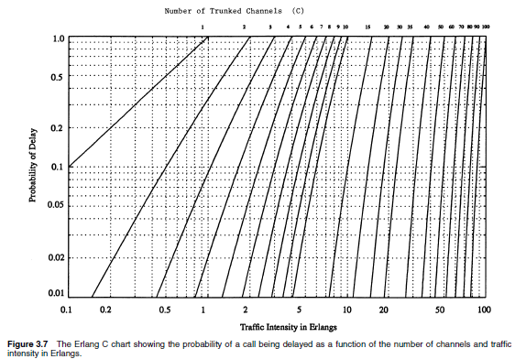

Slide 61
Example problem
A hexagonal cell in a 4-cell system has
a radius of 1.387km, and a total of 60 channels for the system.
If the load / user is 0.029 Erlangs, λ = 1 call per hour, compute the following for an Erlang C system that has a 5% probability of a delayed call.
  a. How many users per square km
  will the system support?
  b. What is the Prob [ Delay > 10s ]?

Slide 62
Solution
Cell radius = R = 1.387 km
Area covered per cell = 2.6 R²
= 2.6 (1.387)² = 5 sq km
Number of cells per cluster = 4
Total number of channels per cell =
60 / 4 = 15 channels

Slide 63
... Solution
a. From Erlang C chart, GOS = 0.05, C = 15,
  Traffic intensity A = 9.0 E
  Number of users
  = total traffic intensity / Traffic per user
  = 9.0 / 0.029 = 310 users
  Number of users per sq. km =
  310 / 5 = 62 users per sq. km.

Slide 64
... Solution
b. Prob [Delay > 10s] = Pr [Delay > 0 ] e ^{–(C-A) t} ^{/ H}
= 0.05 x e ^{–(15-9) 10 / H}
  H = Aμ / λ = 0.029 hr
  = .029 x 60 x 60 seconds
  = 104.4 seconds
  Prob [Delay > 10s] = 0.05 e ^{–(15-9) 10 / 104.4}
  = 0.0281
  = 2.81%

Slide 65
Improving Capacity in Cellular Systems
As demand for wireless services increases, the number of channels assigned to a cell is not enough to support the required number of users.
Solution is to increase channels per unit coverage area.

Slide 66
Increasing capacity by Cell Splitting
Subdivides a congested cell into smaller cells, each with its own base station.
Increases the capacity of a cellular system.

Slide 67
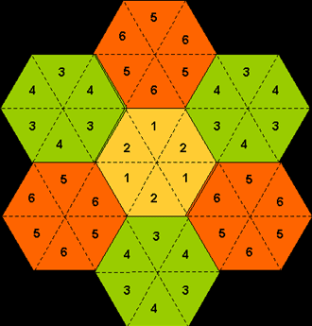
Increasing capacity by Sectoring
Sectoring divides the cell into independent segments.
Each sector is controlled by its own individual sectoral antenna.

Slide 68
Increasing capacity by Sectoring
Achieves capacity improvement by essentially rescaling the system.
Cell radius R is unchanged but the
co-channel ratio D / R is decreased.
Capacity improvement is achieved by reducing the number of cells in a cluster, and this increases frequency reuse.
Replacing a single omni-directional antenna at base station with several directional antennas, each radiating within a specified sector.

Slide 69
The Micro Cell Concept
(Adapted from
[Lee91b] © IEEE)
Increasing capacity by Micro Cell Concept
Microwave or
fiber optic link
Zone Selector
Base
station
Tx/Rx
Tx/Rx
Tx/Rx

Slide 70
Micro Cell Concept
Large control base station is replaced by several lower powered transmitters on the edge of the cell.
The mobile retains the same channel and the base station simply switches the channel to a different zone site and the mobile moves from zone to zone.
Since a given channel is active only in a particular zone in which mobile is traveling, base station radiation is localized and interference is reduced.

Slide 71
Advantages of Micro Cell Zone
The channels are distributed in time and space by all three zones are reused in co-channel cells.
Advantage is that while the cell maintains a particular coverage radius, co-channel interference is reduced due to zone transmitters on edge of the cell.

Slide 72
Practice Problem
The US AMPS system has 50 MHz of spectrum in the 800 MHz range and provides 832 channels. 42 of those channels are control channels.
The forward channel frequency is exactly 45 MHz greater than the reverse channel frequency.

Slide 73
… Practice Problem
a. Is the AMPS system simplex, half-duplex or duplex? What is the bandwidth for each channel, and how is it distributed between the base station and the subscriber?
b. Assume a base station transmits control information on channel 352 operating at 880.56 MHZ. What is the transmission frequency of a subscriber unit transmitting on
channel 352?

Slide 74
... Practice Problem
c. The A side and B side cellular carriers evenly split the AMPS channels. Find the number of voice channels and number of control channels for each carrier?
d. For an ideal hexagonal cellular layout which has identical cell sites, what is the distance between the centers of the two nearest co-channel cells:
  For 7 cell reuse?
  For 4 cell re-use?

Slide 75
Solution
(a.)AMPS system is duplex.
Total bandwidth = 50 MHz
Total number of channels = 832
Bandwidth/channel = 50 MHz / 832 = 60 KHz
60 KHz is split into two 30 KHz channels (forward and reverse channels).
Forward channel is 45 MHz > reverse channel.

Slide 76
Solution
(b.) For F_{fw} = 880.560 MHz
F_{rev} = F_{fw} – 45 MHz = 835.560 MHz

Slide 77
Solution
(c.) Total number of channels = 832 = N
Total number of control channels N_{con} = 42
Total number of voice channels N_{vo} =
832 – 42 = 790
Number of voice channels for each carrier = 790 / 2 = 395 channels
Number of control channels for each carrier = 42 / 2 = 21 channels

Slide 78
Solution
(d.) N = 7
Q = D / R = 3N = 21 = 4.58
    ⇨D = 4.58 R
N = 4
Q = = 3.46
⇨ D = 3.46 R
12

