Slide 1
Mobile Radio Propagation
Mobile radio channel is an important factor in wireless systems.
Wired channels are stationary and predictable, while radio channels are random and have complex models.
Modeling of radio channels is done in statistical fashion based on receiver measurements.

Slide 2
Types of propagation models
Large scale propagation models
  To predict the average signal strength at a given distance from the transmitter
  Controlled by signal decay with distance
Small scale or fading models.
  To predict the signal strength at close distance to a particular location
  Controlled by multipath and Doppler effects.

Slide 3
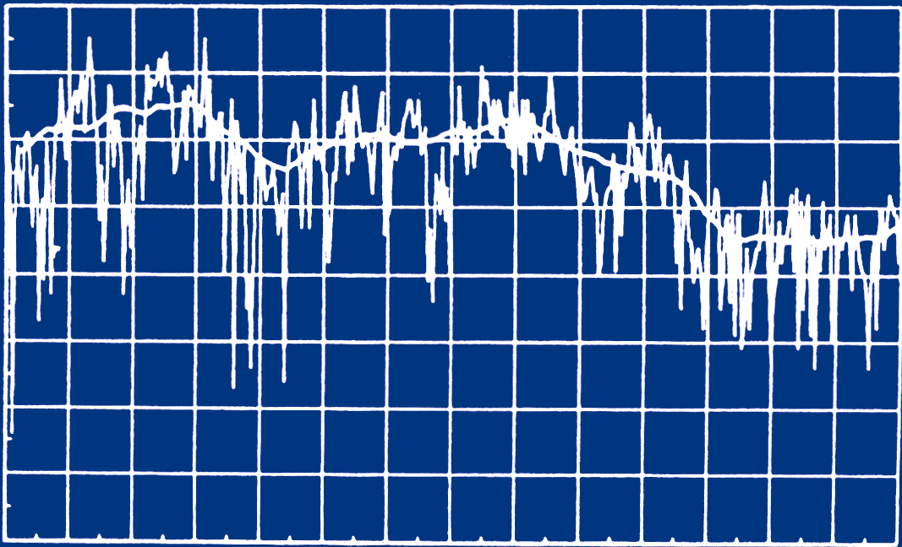
Radio signal pattern
-30
-40
Received Power (dBm)
-50
-60
-70
14
16
18
20
22
24
26
28
T-R Separation (meters)

Slide 4
Measured signal parameters
Electrical Field (Volts/m)
Magnitude E = IEI
Vector
Direction E = xE_{x} + yE_{y} + zE_{z}
Power (Watts or dBm)
  Power is scalar quantity and easier to measure.

Slide 5
Relation between Watts and dBm
P (dBm) = 10 log₁₀ [ P (mW)]
P(mW) | P(dBm)
10 | 10
1 | 0
10⁻¹ | -10
10⁻² | -20
10⁻⁶ | -60

Slide 6
Physical propagation models
Free Space Propagation
  Transmitter/receiver have clear LOS (Line Of Sight) path
Reflection
  Wave reaches receiver after reflection off surfaces larger than wavelength
Diffraction
  Wave reaches receiver by bending at sharp edges (peaks) or curved surfaces (earth).
Scattering
  Wave reaches receiver after bouncing off objects smaller than wavelength (snow, rain)

Slide 7

Free Space Propagation
Transmitter and receiver have clear, unobstructed LOS path between them.
(Courtesy: webbroadband.blogspot.com)

Slide 8
LOS (Friis) transmission equation
P_{r} = P_{t} G_{t} G_{r} λ²
(4π)² d² L
P_{t} = Transmitted Power (W)
P_{r} = Received Power (W)
G_{t} = Transmitter antenna gain
G_{r} = Receiver antenna gain
L = System loss factor
  Due to line losses, but not due to propagation
  L ≥ 1

Slide 9
Antenna Gain
Power Gain of antenna
G = 4πA_{e} / λ²,
A_{e} is effective aperture area of antenna
Wavelength λ = c / f (Hz)
= 3 • 10⁸ / f , meters

Slide 10
Example
A transmitter produces 50W of power.
If this power is applied to a unity gain antenna with 900 MHz carrier frequency, find the received power at a LOS distance of 100 m from the antenna. What is the received power at 10 km?
Assume unity gain for the receiver antenna.

Slide 11
Solution
P_{r} = P_{t} G_{t} G_{r} λ²
(4π)² d² L
P_{t} = 50 W, G_{t} = 1, G_{r} = 1, L = 1, d = 100 m
λ = (3 • 10⁸) / (900 • 10⁶) = 0.33 m
Solving, P_{r} = 3.5 • 10⁻⁶ W
P_{r} (10 km) = P_{r} (100 m) • (100/10000)²
= 3.5 • 10⁻⁶ • (1/100)²
= 3.5 • 10⁻¹⁰ W

Slide 12
Electric Properties of Material Bodies
Fundamental constants
Permittivity ε = ε₀ ε_{r} , Farads/m
Permeability μ = μ₀ μ_{r} ,Henries/m
Conductivity σ, Siemens/m
Types of materials
  Dielectrics – allow EM waves to pass
  Conductors – block EM waves
  Metamaterials – bend EM waves

Slide 13
Ground Reflection (2-Ray Model)
T (transmitter)
P_{r} = P_{LOS} +P_{ref}
P_{LOS}
P_{i}
R (receiver)
h_{t}
P_{ref}
h_{r}
d

Slide 14
Ground Reflection Equations
For d > 20h_{t}h_{r} / λ,
Received power P_{r}=

Slide 15
Example
A mobile is located 5 km away from a base station, and uses a vertical λ/4 monopole antenna with a gain of 2.55dB.
Assuming carrier frequency of 900 MHz and transmitted power of 100 W with 10 dB antenna gain, find the received power at the mobile using the 2-ray model if the height of the transmitting antenna is 50 m and receiving antenna is 1.5 m above the ground.

Slide 16
Solution
T (transmitter)
P_{r} = P_{LOS} +P_{ref}
P_{LOS}
P_{i}
R (receiver)
50
P_{ref}
1.5
d

Slide 17
Gain of receiving antenna = 2.55 dB => 1.8
Gain of transmitting antenna = 10 dB => 10
Received power P_{r}=
= 100 • 10 • 1.8 • 50² • 1.5²
(5 • 10³)⁴
= 0.0162 μW

Slide 18
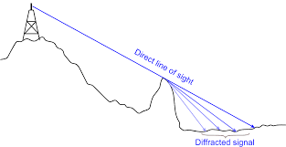
Diffraction
Diffraction allows radio signals to propagate around the curved surface or propagate behind obstructions.
(Courtesy: electronics-notes.com)

Slide 19
Knife-edge Diffraction Geometry
T
α
h
β
h’
γ
R
d₁
d₂
h_{t}
h_{r}

Slide 20
Diffraction Parameter and Gain
Diffraction parameter
v =
Diffracted power = LOS power+ Diffraction Gain
P_{d} = P_{LOS} + G_{d} (dB)

Slide 21
Empirical formula for Gain
v G_{d} (dB)
v ≤ -1 0
-1 ≤ v ≤ 0 20 log (0.5 – 0.62 v)
0 ≤ v ≤1 20 log (0.5 e^{-0.95v} )
1 ≤ v ≤ 2.4 20 log (0.4 – √ [0.1184 – (0.38 – 0.1 v)²]
v > 2.4 20 log (0.225 / v)

Slide 22
Example
Compute the diffraction power at the receiver assuming:
Transmitter frequency = 900 MHz
LOS received power = 50 mW
d₁ = 1 km
d₂ = 1 km
h = 25 m

Slide 23
Solution
Diffraction parameter v =
λ = (3 • 10⁸) / (900 • 10⁶) = 0.33 m
=> v = = 2.74
Using the table,
G_{d} (dB) = 20 log (0.225/2.74) = -22 dB
Hence diffracted power P_{d} = P_{LOS} + G_{d} (dB)
= 10 log(50) -22
= -5.01 dBm => 0.316 mW

Slide 24
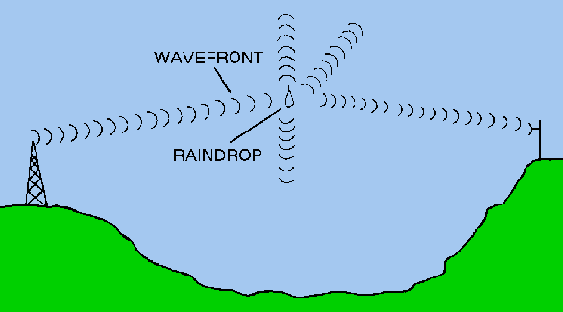
Scattering
When a radio wave impinges on a rough surface, the reflected energy is spread out in all directions
Examples of scattering surfaces: lamp posts,
trees, cars, rain, snow.
(Courtesy:http://www.tpub.com/)

Slide 25
Radar Cross Section (RCS) Model
RCS (Radar Cross Section) =
Power density of scattered wave
in direction of receiver
Power density of radio wave incident
on the scattering object

Slide 26
Scattering Power Equation
P_{R} = P_{T} • G_{T} • λ² • RCS
(4π)³ • d_{T} ² • d_{R} ²
P_{T} = Transmitted Power
G_{T} = Gain of Transmitting antenna
d_{T} = Distance of scattering object from Transmitter
d_{R} = Distance of scattering object from Receiver

Slide 27
Practical Propagation models
Most radio propagation models are derived using a combination of analytical and empirical models.
Empirical approach is based on fitting curves or analytical expressions that recreate a set of measured data.

Slide 28
Pros and cons of empirical models
Takes into account all propagation factors, both known and unknown.
Disadvantages:
New models need to be measured for different environment or frequency.

Slide 29
Path Loss (PL) Model
Transmitter – receiver model
T d₀ R
P_{T} P_{R}(d₀) P_{R}(d)
Logarithmic model ( dB)
PL(d) = PL(d₀) + 10n log₁₀ (d/d₀)
Received power( dBm)
P_{R}(d) = P_{t} – PL(d)

Slide 30
Emprical values of path loss factor n
Environment n
Free space 2
Urban area cellular radio 2.7 – 3.5
LOS in building 1.6 – 1.8

Slide 31
More accurate propagation models
Logarithmic path loss normal gives only the average value of path loss.
Surrounding environment may be vastly different at two locations having the same T – R separation d.
More accurate model includes a random variable with standard deviation σ to account for change in environment.

Slide 32
Practical propagation model development
Values of n and σ are computed from measured data.
Linear regression method which minimizes the difference between measured and estimated path
Estimated over a wide range of measurement locations and T – R separations.

Slide 33
Random Propagation Model equation
Probability [ P_{R} (d) > γ ] =
Probability [ P_{R} (d) < γ ] =
Average received power is calculated
using logarithmic model

Slide 34
Calculation of Q Function
x
−
x
2
/
2
e
z
Q(z) = Q function =
Q(z) table from Appendix F of book (Rappaport), for z values 0 < z < 3.9
For z > 3.9, use the approximation:

Slide 35
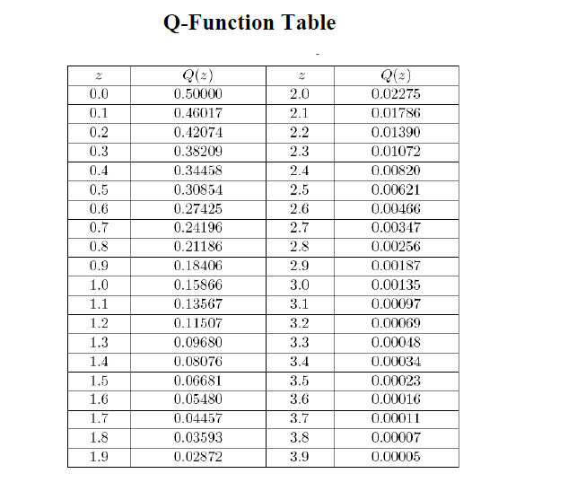
Q Function Table

Slide 36
Example
Four received power measurements were taken at the distances of
100m, 200m, 1 km and 3 km from a transmitter.
T-R distance Measured Power
100 m 0 dBm
200 m - 20 dBm
1 km - 35 dBm
3 km - 70 dBm

Slide 37
Example
a. Find the minimum mean square error (MMSE) estimate for the path loss exponent n, assuming d₀ = 100m.
b. Calculate the standard deviation
about the mean value.
c. Estimate the received power at
d = 2 km using the resulting model.
d. Predict the likelihood that the received signal at 2 km will be greater than
–60 dBm.

Slide 38
Solution
Let P_{i} be the average received power
at distance d_{i} :
P_{i} (d) = P (d₀) – 10n log (d /100)
d = d₀ = 100m
= P_{i} (d₀) = P₀= 0 dBm

Slide 39
a.
d₁= 200 m, P₁= -3n,
d₂= 1 km, P₃= -10n,
d₃= 3 km, P₄= -14.77n
Mean square error J = Σ (P – P_{i})²
= (0 – 0)² + [-20 – (-3n)] ²
+ [-35 – (-10n)] ² + [-70 – (-14.77n)] ²
= 6525 – 2887.8n + 327.153n²
Minimum value = > dJ(n) / dn
= 654.306n – 2887.8 = 0 ⇒ n = 4.4

Slide 40
b.
Variance σ² = J / 4 = ( P – P_{i})² / 4
= (0 + 0) + (-20 +13.2)² + (-35 + 44)² + (-70 + 64.988)²
4
= 152.36 / 4 = 38.09
⇒ σ = 6.17 dB

Slide 41
c.
P_{i} (d = 2 km)
= 0 – 10(4.4) log (2000/100)
= -57.24 dBm

Slide 42
d.
Probability that the received signal
will be greater than –60 dBm is:
_____
P_{R} = [P_{R}(d) > -60 dBm] = Q [(γ- P_{R} (d)) / σ ]
= Q [(-60 + 57.24) / 6.17 ]
= Q [- 0.4473]
= 1 – Q [0.4473]
= 1 – 0.326
= 0.674 = > 67.4%

Slide 43
Percentage of Coverage Area
Given a circular coverage area of radius R
In the area A, the received power
P_{R} ≥ γ
The area A is defined as U(γ)
R
r
Area A

Slide 44
Calculation of Coverage Area U(γ)
Use Figure 4.18 from book (Rappaport)

Slide 45
Example
For the previous problem, predict the percentage of area with a 2 km radius cell that receives signals greater than –60 dBm.

Slide 46
Solution
From solution to previous example,
Prob [P_{R} (R) > γ] = 0.674
=>(σ / n) = 6.17 / 4.4
= 1.402
From table 4.18,
Fraction of total area = 0.92 => 92%

Slide 47
Outdoor Propagation Models
  Longley Rice model
  point-to-point communication systems (40MHz–100MHz)
  Okumara’s model
  widely used in urban areas
  (150 MHz – 300 MHz)
  Hata model
  graphical path loss
  (150 MHz – 1500 MHz)

Slide 48
Indoor Propagation Models
  Log-distance path loss model
  Ericsson multiple breakdown model

