Slide 1
Techniques to control noise and fading
Noise and fading are the primary sources of distortion in communication channels
Techniques to reduce noise and fading are usually implemented at the receiver
The most common mechanism is to have a receiver filter that can reduce the effects of noise and fading
Primary techniques are equalization and diversity

Slide 2
Principle of Equalization
Equalization is the process of compensation at the receiver, to reduce noise effects
The channel is treated as a filter with transfer function H_{c}(f)
Equalization is the process of creating a filter with an inverse transfer function of the channel: H(f) = 1/ H_{c}(f)
Since a wireless channel is changing (e.g. medium, vehicles) equalizer filter also has to change accordingly, hence the term adaptive.

Slide 3
Equalization Model-Signal detection
Carrier
Transmitter
Channel
Receiver
Front End
IF Stage
Message signal x(t)
Detector
Detected signal y(t)

Slide 4
Equalization model-Correction
Reconstructed
Signal
Decision
Maker
Equalizer
+

Slide 5
System Equations
Error
MSE Error =
Aim of equalizer: To minimize MSE error

Slide 6
Equalizer Operating Modes
Training
Tracking

Slide 7
Training and Tracking functions
Training sequence is a known fixed bit pattern sent by the transmitter
The user data is sent immediately after the training sequence
The equalizer uses training sequence to adjust its frequency response H_{eq} (f) and is optimally ready for data sequence
Adjustment goes on dynamically, hence it is adaptive equalizer

Slide 8
Diversity techniques
Diversity is a powerful communications technique for minimizing fading effects
It provides wireless link improvement at relatively low cost
Unlike equalization, diversity requires no training overhead
Practical version is the popular Rake receiver

Slide 9
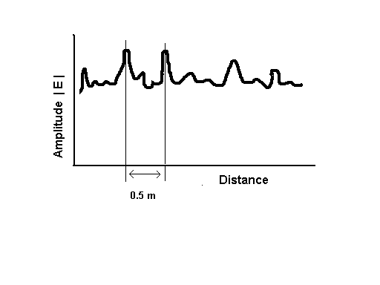
Fading effects
Small Scale fading causes rapid amplitude fluctuations in received wireless signal
Fading results in signal loss and distortion

Slide 10
Principle of diversity
If we space 2 antennas at 0.5 m, one may receive a null while the other receives a strong signal
By selecting the best signal at all times, a receiver can mitigate or reduce small-scale fading. This concept is Space diversity or Antenna Diversity

Slide 11
Antenna Diversity
Concept of using more than one antenna (or branch )for reception
Two types of antenna diversity techniques
  Space Diversity (SD)
  Maximum ratio combining (MRC)

Slide 12
Space Diversity (SD)
Receiver uses M antennas and picks the strongest signal
Average SNR improvement using M branches:

Slide 13
Maximal Ratio Combining (MRC)
MRC also uses M antennas at receiver; however uses signals from all antennas
Average SNR improvement using M branches
    _
    γ / Γ = M

Slide 14
Example :
Assume that 5 antennas are used to provide space diversity. Determine the average SNR improvement using (a) SD (b) MRC

Slide 15
Solution :
(a) SD : M =5
SNR improvement:
= 1 + 1/2 + 1/3 + 1/4 + 1/5
= 2.28

Slide 16
Solution :
(b) MRC : M =5
SNR improvement:
= 5
    _
    γ / Γ = M

Slide 17
Types of diversity
Space Diversity
  Either at the mobile or base station
Polarization Diversity
  Orthogonal Polarization to exploit diversity
Frequency Diversity
  More than one carrier frequency is used
Time Diversity :
  Information is sent at time spacings

Slide 18
Practical diversity – Rake receiver
CDMA system uses RAKE Receiver to improve the signal to noise ratio at the receiver
Generally CDMA systems do not require equalization due to multi-path resolution.

Slide 19
Block Diagram Of Rake Receiver
α₁
M1 M2 M3 α₂
r(t) α_{M} Z’ Z
Correlator 1
∫ (•)dt
Correlator 2
Σ
Correlator M
>
<
m’(t)

