Slide 1
Chapter 1: Types of Electronic Communication Systems

Slide 2
Technology that links the world
Types of communication systems
Coaxial (Wired)
Microwave (Wireless)
Satellite (Wireless)
Cable (Wired)
Cellular (Wireless)

Slide 3
Coaxial
Courtesy: customer.xfinity.com

Slide 4
Microwave
Courtesy: https://www.smithandfisher.com

Slide 5
Satellite
Courtesy: www.airforce-technology.com

Slide 6
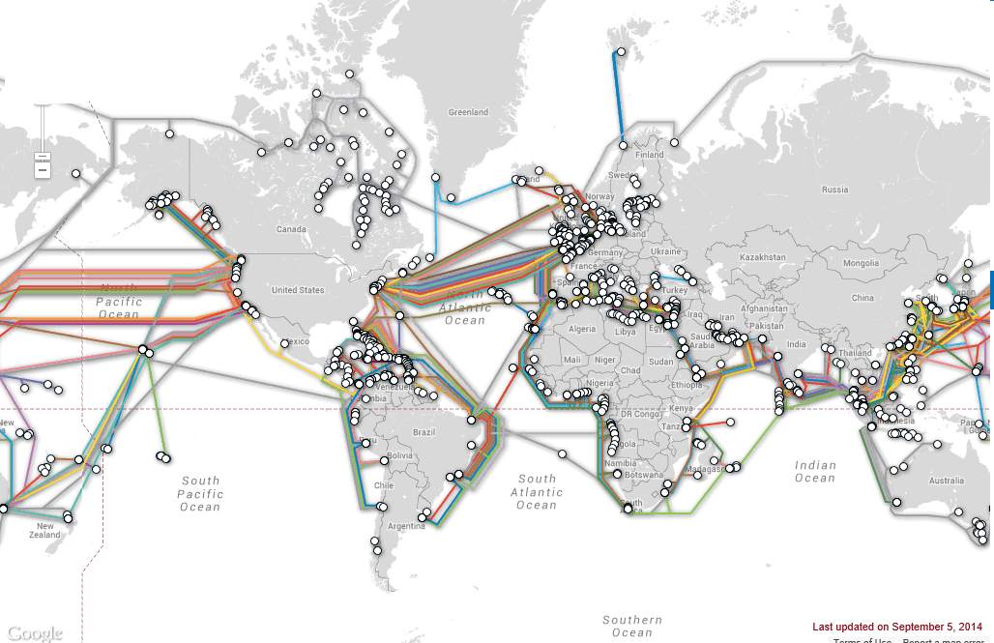
Cable (undersea network)
Courtesy: TeleGeography:
https://www.submarinecablemap.com/

Slide 7
Cellular
Courtesy: https://dgtlinfra.com/cell-tower-locations-4g-lte-5g-towers/

Slide 8
Path loss in communication links
Transmitter P_{t}, W
Receiver P_{r}, W

Slide 9
Path loss factors
Path loss is the loss of power in the transmitted signal
Causes of path loss
Dispersion which causes power to spread out in all directions from transmitter
Objects such as buildings, trees, street lights, snow, rain
Amplifiers can be used in path to boost the signal => repeaters

Slide 10
Path loss calculation
Path loss (PL, magnitude) is defined as:
PL, magnitude = Transmitted power,W
Received power, W
Path loss (PL, dB) is defined as:
PL, dB = Transmitted power, dBm – Received power, dBm

Slide 11
Power calculation
Power (dBm) = 10 log [Power (mW)]
dB is unit of path loss
For example, if Pt = 10 dBm; path loss = 30 dB
=> Pr = 10 dBm – 30 dB = -20 dBm
Power (mW) | Power (dBm)
0.01 | -20
0.1 | -10
1 | 0
10 | 10
100 | 20

Slide 12
Introduction to Matlab/Simulink
Matlab and Simulink are widely used to design and simulate Communication Systems
Matlab is program based solution
Ideal for programming complex system formulae
Equation solving and optimization
Simulink is graphic based solution
Ideal for simulation of system models
System block based approach gives visual perspective
New blocks can be created from Matlab programs

Slide 13
Basic Matlab command symbols
Mathematical symbols
+ Addition
- Subtraction
* Multiplication
/ Division
^ Exponent
’ Transpose of vector or matrix
Logical symbols
& And
| Or
> (>=) Greater than (or equal)
< (<=) Less than (or equal)

Slide 14
Basic Matlab commands
Vector command
>>t=0:0.1:0.8
generates the vector t from 0 to 0.8 in steps of 0.1:
t = [0 0.1 0.2 0.3 0.4 0.5 0.6 0.7 0.8]
To generate a function y(t) = cos(2t) t²,
t = 0,2 sec., use the following commands:
>> t = 0:0.1:2
>> y = cos(2*t).*t.^2
Note the “.” symbol after vector commands

Slide 15
Simulink Basics
Simulink is based on assembling blocks to create a model
Simulink blocks are selected from the Library Browser and copied into the Model window
Different blocks are connected together by joining the input/output block connectors
The full model is ready and ready for simulation

Slide 16
Simulink Library
Simulink library is composed of many sub-libraries and toolboxes
Sub-libraries are general blocks
Sinks and sources
Continuous and discrete
Math operations
Toolboxes are specialized blocks
DSP
Communications
Control systems
Simscape (Power systems)

Slide 17
Simulink Example Model

Slide 18
Simulink output generation
Set Simulink parameters
Start time and stop time
Type of solver (fixed time or variable time)
Time step size (default is auto)
Run the simulation
Trouble shoot if error messages appear
Obtain output in different formats
Plots
Output files
Output code (C, Verilog)

Slide 19
Communication system equipment
Sources are used to generate communication signals from the transmitter
Measurement devices are used to monitor and record communication signals at both transmitter and receiver
Radio Frequency Integrated Circuits are complete communication systems built on chips- also called as System on Chips (SOCs)

Slide 20
Sources
Keysight 33600A Waveform Generator
(Courtesy: Keysight Technologies)

Slide 21
Measurement devices - Time
Keysight DS090254A digital storage oscilloscope
(Courtesy: Keysight Technologies)

Slide 22
Measurement devices - Frequency
Keysight N9000A Signal Analyzer
(Courtesy: Keysight Technologies)

Slide 23
Radio Frequency Integrated Circuits (RFICs)
TI CC2540 Bluetooth SOC (System on Chip)
(Courtesy: Texas Instruments)

