Slide 1
Chapter 2: Time/Frequency analysis of communication signals and systems

Slide 2
Concept of carrier signal in communication systems
Carrier is strong and stable sinusoidal signal x(t) = A cos(ω_{c} t + θ)
Carrier transports information (audio, video, text, email) across the world
Why is the carrier required?
Audio and video signals cannot travel over large distances since they are weak
A carrier is like a plane which transports passengers over long distances

Slide 3
Signal power
General equation for signal power P_{x}
For periodic signals, integration is over one period:
For sinusoidal signals: x(t) = A cos(ω_{c} t + θ)
Power P_{x} = A²/2

Slide 4
Signal bandwidth
Signal bandwidth is the difference between its maximum frequency and minimum frequency
Example : x(t) = 5 cos(1500t + 46 ^{ο}) + 10 sin(2400t + 10 ^{ο})
Maximum frequency= 2400 rad./s
Minimum frequency= 1500 rad./s
Hence, bandwidth = 2400-1500 = 900 rad./s
Commonly used signals
Audio (Speech, Music) has 20 KHz bandwidth
Video has 5 MHz bandwidth

Slide 5
Estimation of signal spectrum by Fourier Transform
Frequency content or bandwidth of a signal x(t) is estimated by Fourier Transform (FT)
The signal can be recovered from its spectrum by Inverse Fourier Transform (IFT)

Slide 6
Spectrum of periodic signals
A periodic signal x(t) has discrete spectrum, existing only at frequencies of nω₀, n an integer:
The signal can be recovered from its spectrum by the Fourier series

Slide 7
Power and Energy relations in the Fourier domain
Parseval’s theorem for signal energy E_{x}
Power relation for periodic signals

Slide 8
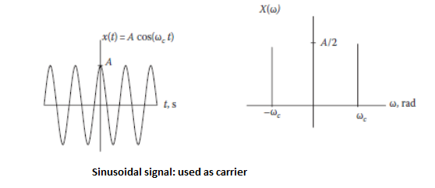
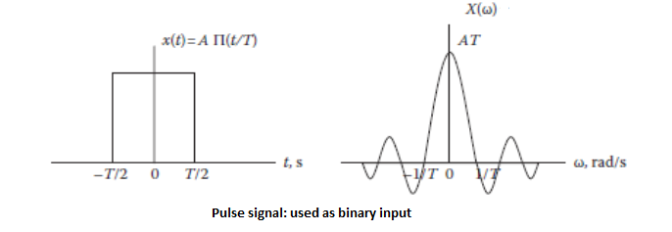
Practical communication signals and their frequency spectra

Slide 9
Frequency analysis of communication systems
Input-output system
Types of systems
Linear systems (ex. resistor)
Non-linear systems (ex. transistor)

Slide 10
Linear Systems
Linear systems obey the law of superposition
Time domain input/output relation
Frequency domain input/output relation

Slide 11
Nonlinear Systems
Nonlinear systems do not obey superposition
Time domain input/output relation (example)
Frequency domain input/output relation (above )example

Slide 12
Practical methods of Spectrum Analysis: DFT and IDFT
Discrete Fourier Transform (DFT)
Inverse Discrete Fourier Transform (IDFT)
Time-frequency relation in DFT
Δw = 2π/(N Δt)

Slide 13
Discrete-time system analysis - Circular Convolution
N point circular convolution
y(n) = x(n) N h(n)
=
Shift is done circularly, not linearly
All sequences (x,h,y) are of length N
Very convenient for computer usage
N is usually a power of 2

Slide 14
Computation of circular convolution using FFT
Step1: Obtain the N-point DFTs of the sequences x(n) and h(n)
Step2: Multiply the two DFTs X(k) and H(k), for k = 0, 1, 2……N-1
Step3: Obtain the N-point IDFT of the sequence Yk), to yield the final output y(n)

Slide 15
The Fast Fourier Transform (FFT)
FFT is a fast way to compute DFT
N-point DFT is slow to compute
Number of computations is N²
Radix-2 (N is power of 2) FFT is most efficient
Number of computations is N log₂N
Example: For N = 64 =>
DFT requires 64 x 64 = 4096 computations
FFT requires 64 x 6 = 384 computations

Slide 16
FFT for convolution
Number of computations using DFT
Step 1: 2N²
Step 2: N
Step 3: N²
Total computations = 3N² + N
^{T}
Number of computations using FFT
Step 1: 2N log₂N
Step 2: N
Step 3: log₂N
Total computations = 3 log₂N + N

