Slide 1
Chapter 3:
First generation systems-Analog Modulation

Slide 2
  What is modulation
Message signals such as audio, video, text, email are weak power signals
Message signals need a carrier signal to travel long distances
The process of combining message and carrier signals is called modulation

Slide 3
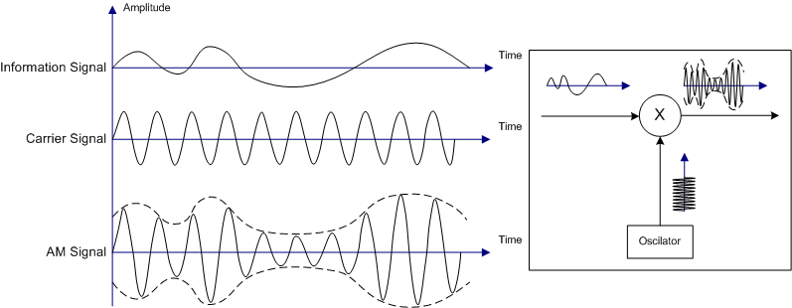
  Amplitude Modulation (AM)

Slide 4

    Double sideband modulation (DSB)
Time domain equation
    y_{AM}(t) = Information or message x carrier
    = m(t) x A cos(w_{c}t)
Frequency domain equation

Slide 5


    DSB power and bandwidth
Power in DSB signal
  DSB-C (with carrier)
  = Carrier Power + Carrier Power x Message power
  DSB-SC (suppressed carrier)
              = Carrier Power x Message power
Bandwidth of DSB signal = 2ω_{m}

Slide 6
Single Sideband Modulation (SSB)
Balanced Modulator SSB generation
y_{SSB}(t)=0.5m(t)cos(w_{c}t)±0.5 sin(w_{c}t)
SSB power and bandwidth
  SSB power = DSB power/2
  SSB bandwidth = DSB bandwidth/2

Slide 7
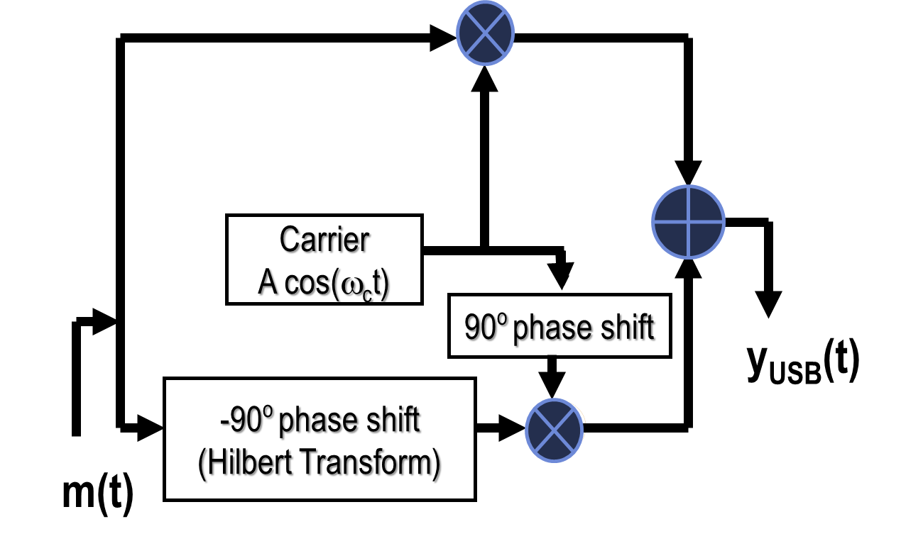
Balanced modulator for SSB generation

Slide 8


AM Parameters
Modulation index μ
Modulation efficiency η
, -1 < μ < 1,

Slide 9
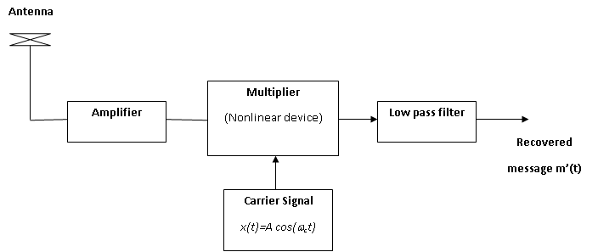
AM Receiver or demodulation
Demodulation is the process of extracting the message from the AM signal

Slide 10
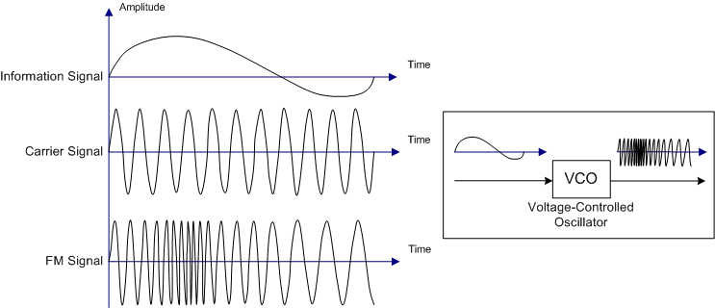
  Angle Modulation

Slide 11


Types of Angle Modulation
Frequency Modulation (FM)
Phase Modulation (PM)

Slide 12

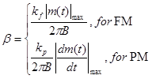
FM/PM power and bandwidth
Power in FM/PM signal
Bandwidth of FM/PM signal
B_{FM/PM} = 2B (1+β)
Modulation index

Slide 13
Comparison of AM and FM modulation systems
FM is less susceptible to noise as compared to AM
FM has better sound quality than AM; however, this also requires higher bandwidth than AM.
Power requirement is less in FM as compared to AM
FM has shorter range of transmission, requiring Line of Sight (LOS) propagation.

Slide 14

Noise performance of AM and FM circuits
Channel interference is estimated by Signal to Noise ratio (SNR)
SNR in AM is constant
SNR_{AM} = SNR_{baseband}
SNR in FM can be improved by increasing the modulation index β
SNR_{FM} = 1.5 β²SNR_{baseband}

Slide 15
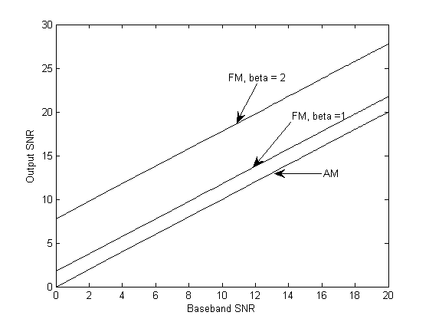
Output SNR of AM/PM systems

Slide 16
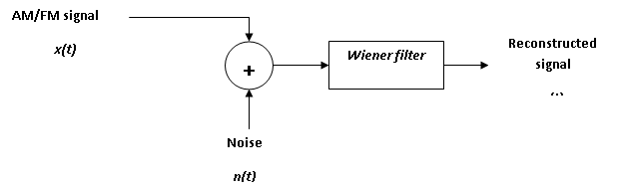

Filtering techniques in AM/FM systems
Filters can minimize noise in AM/FM systems
Weiner Filter can adapt to signal power (S_{x}) and channel noise power (S_{n}) densities

