Slide 1
Chapter 4:
Second generation Systems-Digital Modulation

Slide 2
  Pulse Code Modulation (PCM)
Audio/video signals are analog in nature
  Analog signals can take infinite number of values
  Hence more difficult to detect at receiver after noise corruption
PCM converts analog signals to digital pulses
  3-step process: sampling, quantization, encoding
  Extensions of PCM include DPCM and ADPCM
Pulses can take only finite number of values
  For example, binary pulses can be either 0 or 1
  Easier to detect at receiver (50% chance!)

Slide 3
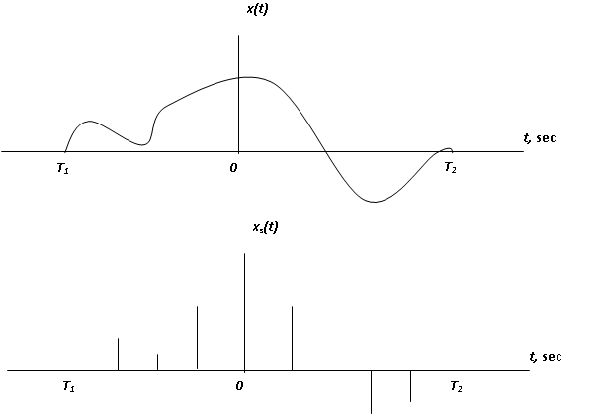
    Time sampling-Ideal

Slide 4
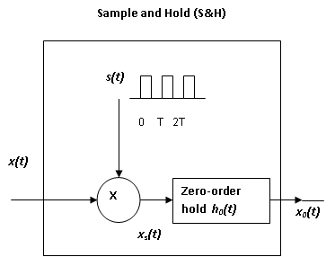
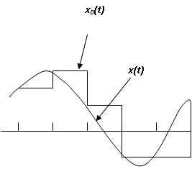
    Time sampling-Practical

Slide 5

    Signal reconstruction
Nyquist law specifies sampling conditions
  Sampling interval T,sec ≤ 1/(2xsignal bandwidth,Hz)
  Sampling frequency f_{s}, Hz ≥ 2xsignal bandwidth,Hz
Signal can be reconstructed from samples (at or higher than Nyquist frequency)

Slide 6
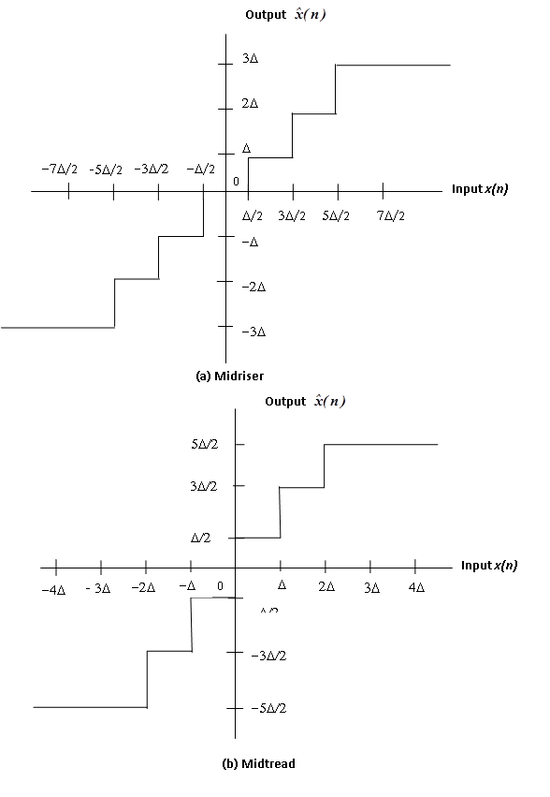
    Amplitude Quantization- Uniform

Slide 7
    Quantizer Design
Design step size Δ, for signal dynamic range
:
Construct quantizer input-output diagram with number of levels L = 2^{p}
Determine quantizer output

Slide 8

    Quantizer SNR
Rounding off signal amplitude creates Quantizer error
SNR varies with signal x(n) and error e(n)
σ_{x}² = Average signal power (W)
σ_{e}² = Average noise power (quantizer error)
~ Δ²/12

Slide 9
    Amplitude Quantization-Nonuniform
Speech is compressed (before quantizing)
and expanded (after quantizing) – compander
Companding improves quantizer SNR

Slide 10
    Digital Encoding
Digital encoding converts L quantizer levels to binary format (p bits)
Normal Binary Code (NBC) goes from 000.. to 111…
2’s complement code can be obtained by complementing left-most bit in NBC
2’s complement can include ± levels
Reconstruction of levels from binary level
  Decimal value =

Slide 11
    Data Transmission
Data rate or bit rate (bps)
R_{b} = Sampling Rate (f_{s}) x Bits/symbol (p)
Channel Capacity C or maximum bit rate
C = B log₂(1 + SNR)
This is Shannon’s theorem

Slide 12
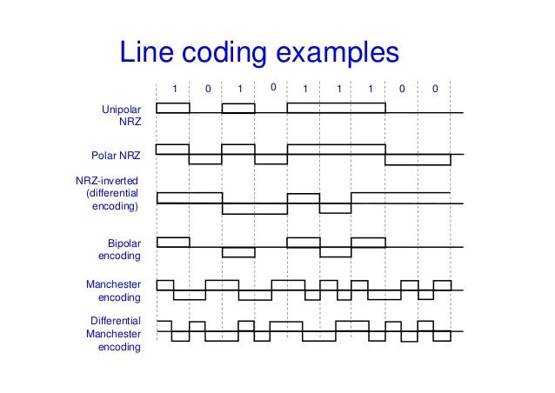
    Line Coding
Line Coding converts 0s and 1s to voltages

Slide 13
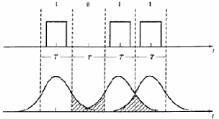
    Pulse Shaping technique
Rectangular pulses are not practical due to sharp edges => leads to Inter Symbol Interference (ISI)
Pulse is shaped using Nyquist criterion for zero ISI – Raised Cosine filter

Slide 14
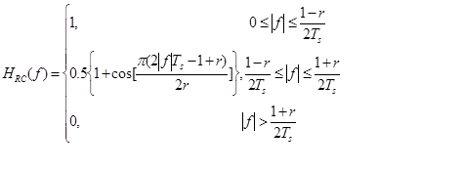
    Raised Cosine Filter- Frequency response
    r = Filter roll off factor
    T_{s} = Symbol period

Slide 15

    Data rate with Raised Cosine Filter
    r = Filter roll off factor
    B = Filter bandwidth

Slide 16
  Digital modulation systems
Digital modulation combines sinusoid carrier (analog) and information (digital)
Digital AM – Examples: BPSK, QPSK, OPSK
Differential AM – Example DPSK
Digital FM – Examples: FSK, GMSK

Slide 17
    Digital AM or Phase Shift Keying (PSK)
PSK generates levels by shifting carrier phase
A cos(w_{c}t + φ_{k}), φ_{k} = 2πk/N
Binary PSK (BPSK): N=2
Quadrature PSK (QPSK): N=4
Octal PSK (OPSK): N=8

Slide 18
    PSK waveforms

Slide 19
    Digital FM or Frequency Shift Keying (FSK)
FSK generates levels by shifting carrier frequency
A cos[(ω_{c} ± Δω)t + φ)
ω_{c} + Δω (1) and ω_{c} – Δω (0)

Slide 20
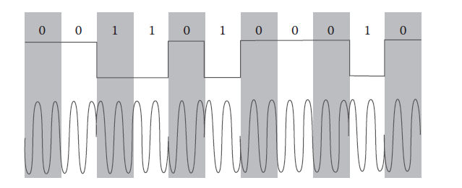
    Differential Phase Shift Keying (DPSK)
PSK technique with data transition (0-1 or 1-0) causing carrier phase shift
DPSK improves noise performance compared to PSK and FSK

Slide 21
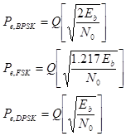
BER of Digital Modulation systems
BER (Bit Error Rate)

Slide 22
Bandwidth of Digital Modulation systems
Bandwidth
B _{BPSK} = R_{b}
B_{FSK} = R_{b}
B_{DPSK} = R_{b} /2
R_{b} = Data rate of system (bps)
DPSK can have twice the data rate of BPSK or FSK, for the same available bandwidth

Slide 23

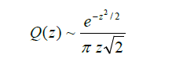
Q Function
Definition of Q function
Approximation of Q function (z > 3.0)

Slide 24
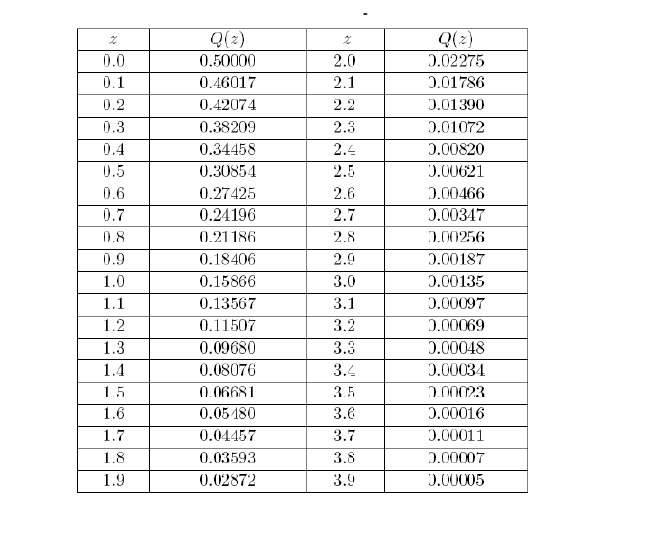
Q Function Table and approximation

Slide 25
Noise Correction and Filtering in Digital Modulation systems
Error detecting codes (EDCs)
  Cyclic Redundancy Checks
  Checksums
  Cryptographic Hash Functions
Error correcting codes (ECCs)
  Convolutional Codes
  Block Codes
  Turbo codes
  Low Density Parity Check codes

Slide 26
Equalization and channel compensation
Equalization is an adaptive filtering process to minimize channel interference
Two-step process
  Training-Fixed sequence pulse is sent from T-R to estimate frequency response of channel
  Tracking – Receiver filter adapts frequency response to compensate channel response
Equalization data sequence
Training pulse - Data - Training pulse - Data-..

Slide 27
Equalization filter

