Slide 1
Chapter 6:
Capacity of communication systems and higher generations

Slide 2
Evolution of capacity and data rate in communication systems
First generation systems utilized frequency axis to separate users into different channels
Second generation systems added time axis to increase number of users in each channel
Third generation systems added code axis to increase bandwidth

Slide 3

Frequency Division Multiple Access (FDMA)
FDMA systems assign a single frequency pair (for duplex transmission) to each user
FDMA systems divide the available bandwidth B_{T} into channels of equal bandwidth B
Number of users including guard band B_{G}

Slide 4

Time Division Multiple Access (TDMA)
TDMA allows two or more users on the same frequency channel
Multiple user data is separated in L time slots/frame
Number of users including guard band B_{G}

Slide 5

TDMA frame efficiency
TDMA frame is complex: includes data bits and overhead bits
Overhead bits are required for slot and frame synchronization
For example, GSM has 1250 bits/frame (b_{T}) of which 322 bits are overhead bits(b_{OH})
Frame efficiency η

Slide 6
Code Division Multiple Access (CDMA)
CDMA uses Spread Spectrum technology to share total bandwidth B_{T}
Hence there is no theoretical limit on number of users
Practical number of users is limited due to system noise
Provides large bandwidth B_{T} to each user

Slide 7
Fourth generation (4G) systems
Long-Term Evolution (LTE ) is 4G wireless communication standard for high-speed data up to 200 Mbps
This standard was initiated by NTT DoCoMo in 2004
4G is organized by Third Generation Partnership Project (3GPP)
The goal of LTE is to increase the capacity and speed of wireless data networks :
  New DSP and modulation techniques
  Simplified wireless network architecture

Slide 8
Multicarrier approach to modulation
Higher data rate implies narrower data pulse width: For example 200 Mbps => 5 ns pulse
Narrow pulses are subject to instability and interference
Solution is to replace single channel carrier with several subcarriers
Subcarriers have lower data rate with more stable pulse widths

Slide 9
Principle of Orthogonal Frequency Division Multiplexing (OFDM)
3-subcarrier system with frequencies f₁, f₂ and f₃
Each subcarrier's frequency spectrum is represented by a sinc function
Each sinc function peaks at its center frequency and go to zero at all integer multiplies of this frequency => orthogonal subcarriers
OFDM receiver can effectively demodulate each subcarrier due to orthogonality
Amplitude
Frequency
f₁
f₂
f₃
2f₁
3f₁

Slide 10
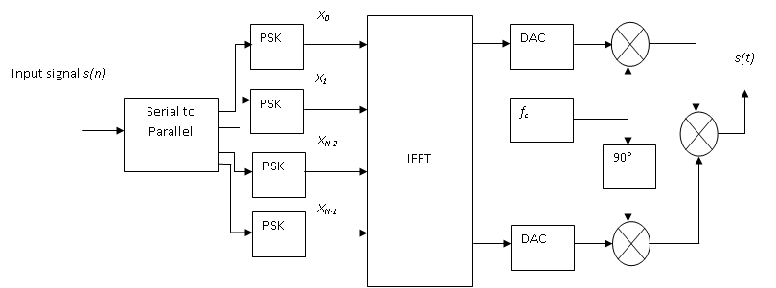
OFDM transmission

Slide 11
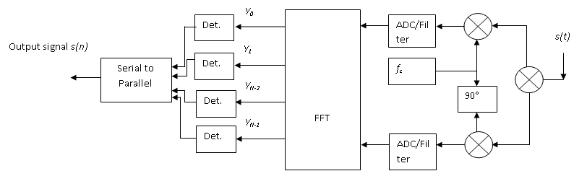
OFDM reception

Slide 12
Advantages and disadvantages of OFDM
High Spectral efficiency as compared to DSB in 2G and Spread Spectrum techniques in 3G
Efficient and fast implementation since it uses the Fast Fourier Transform (FFT)
Resistant to Inter-symbol Interference (ISI) and fading
Shift in orthogonality can cause frequency synchronization problems
Sensitive to Doppler shift
High peak-to-average power ratio (PAPR) which requires poorly efficient linear transmitter circuitry

Slide 13
Multiple-input multiple-output (MIMO) technology
MIMO is a radio communications technology to provide increased capacity i.e. number of users, and also channel reliability
MIMO technology has been adopted in Wi-Fi, WiMAX, LTE
MIMO efficiency is obtained by the use of multiple antennas at the transmitter and receiver
Multiple antennas increase the number of signal paths to carry the data

Slide 14
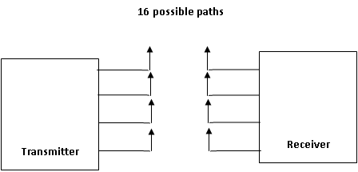
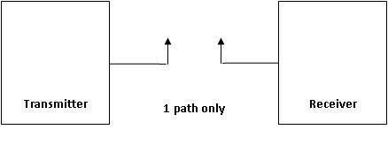
Principle of MIMO systems
Single-input single-output system (SISO) has only one transmission path => with 20 channels, 20 users can transmit simultaneously
In example below, MIMO system has 16 different paths => maximum of 16 x 20 = 320 users can potentially use the system simultaneously
MIMO system would require additional antennae and processors at the receiver to separate out all user data.

Slide 15

Analysis of Input-Output systems
MIMO system: M transmit/N receive antennas
MIMO channel is modeled as matrix H (NxM)
Transmitted vector (x)/received vector (y) relation, with noise vector (n)
y = Hx + n
Channel capacity C

Slide 16
Fifth generation (5G) communication systems
Highly efficient mobile network for lower investment cost
Very fast mobile network to give neighboring coverage over highly dense urban areas.
Use of Dynamic Spectrum Access (DSA) : new spectrum sharing idea that allows secondary users to access abundant spectrum holes in licensed spectrum bands
Coordinated fiber-wireless network that uses the millimeter wave bands (20 – 60 GHz) so as to allow very wide bandwidth radio channels able to support data access speeds of up to 10 Gbps
Short Wireless links like Wi-Fi, with local fiber optic terminals rather than long range cellular service.

