Slide 1
Chapter 7:
Long range and short range communication networks

Slide 2
  Wireless Local Area Networks (WLANs)
WLAN is a wireless network that links many devices within a limited area such as a home, school, university, or office building.
WLANs give users the ability to move around within the local coverage area and still be connected to the network.
Modern WLANs use Spread Spectrum or OFDM technology, under the IEEE 802.11 standard, and are marked as Wi-Fi (Wireless Fidelity) brand name.
First WLAN was ALOHAnet in 1971, using seven computers deployed over four islands to communicate with the central computer on Oahu Island.
Wireless LANs use OFDM technology in the 2.5 GHz and 5 GHz frequency bands to connect to the local access points, which in turn are connected to the large area networks.

Slide 3
  Types of WLANs

Slide 4
Types of WLAN specifications
IEEE 802.11 applies to WLANs and provides up to 2 Mbps transmission in the 2.4 GHz band
IEEE 802.11a is an extension to 802.11 WLANs and provides up to 54-Mbps in the 5GHz band
IEEE 802.11b (802.11 High Rate or Wi-Fi) is an extension to 802.11 WLANS and provides 11 Mbps transmission in the 2.4 GHz band
IEEE 802.11e — a wireless draft standard that defines the Quality of Service (Qos) support for LANs
IEEE 802.11g —WLAN transmission over short distances at up to 54-Mbps in the 2.4 GHz bands
IEEE 802.11n — builds upon 802.11 standards by adding multiple-input multiple-output (MIMO)
IEEE 802.11ac improved 802.11 data rate of 433Mbps/stream, or 1.3Gbps in a 3-antenna (3- stream) design
IEEE 802.11ad WLAN with operating frequency ~ 60 GHz and maximum data rate of 7Gbps
IEEE 802.11r Fast Basic Service Set (BSS) enables Voice over Internet Protocol (VOIP) roaming on Wi-Fi
IEEE 802.1X is port-based Network Access Control that allows secure communication between authenticated and authorized devices.

Slide 5
Wi-Fi networks
Wi-Fi Alliance was founded in 1999
Wi-Fi is defined as Wireless Local Area Network (WLAN) product based on the IEEE 802.11 standard
Many devices can use Wi-Fi, e.g. personal computers, video-game consoles, smartphones and digital cameras.
WI-Fi devices can connect to a network resource such as the Internet via wireless access points (APs) with a range of about 20 meters indoors
Wi-Fi usage has spread in university campuses, shopping malls, airports, and most public places.
City-wide service started in the U.S. in 2005 with Sunnyvale, California being the first to offer free Wi-Fi.
Wi-Fi has competition from local communication industry, which provides superior service at a reasonable cost.

Slide 6
Types of Wi-Fi networks
Infrastructure network is a wireless network configuration commonly used in home networks and hotspots
Data transferred between wireless devices on the network pass through a central access point (AP), such as a wireless network router
Ad Hoc network is a wireless network where data is transmitted directly between wireless devices on the network, without passing through an access point

Slide 7
Personal Area Networks (PANs)
PANs are computer networks that links devices such as computers, telephones and personal digital assistants
PANs can be used for communication among the personal devices within few meters of each other, or to connect to a higher level network and the Internet
Examples of wireless personal area networks (WPANs) include Bluetooth and Zigbee and are defined by the IEEE 802.15 standard

Slide 8
Bluetooth
Bluetooth is a wireless technology standard that was invented by Ericsson in 1994
Bluetooth name originates from the tenth century king, Harald Bluetooth, who united the Scandinavian countries, just as our Bluetooth network connects all our wireless devices
It is based on the IEEE 802.15.1 standard, and is managed by the Bluetooth Special Interest Group (SIG)
Bluetooth uses FHSS technology in the ISM band of 2.4 to 2.485 GHz to connect devices such as keyboards, pointing devices, audio headsets, printers, PDAs, and cell phones.
A Bluetooth PAN is also called a piconet (very small network) that typically has a range of 10 meters.

Slide 9
Bluetooth transmission

Slide 10
Bluetooth reception

Slide 11
Applications of Bluetooth
Wireless communication between a mobile phone and a remote headset
Wireless communication between a mobile phone and a Bluetooth car stereo system.
Wireless communication with PC input and output devices, like mouse, keyboard and printer
GPS receivers, medical equipment, bar code scanners, and traffic control devices
Game consoles: Nintendo's Wii and Sony's PlayStation use Bluetooth for wireless controllers
Short range transmission of health sensor data from medical devices to mobile units
Real-time location systems (RTLS) are used to track and identify the location of objects in real-time using Nodes or tags attached to, or embedded in the objects tracked
Personal security application on mobile phones for prevention of theft or loss of items
Data collected from travelers' Bluetooth devices is used to predict travel times and road congestion for motorists
Wireless transmission of audio, as a more reliable alternative to FM transmitters

Slide 12
Zigbee
ZigBee is an open global PAN wireless system based on the IEEE 802.15.4 standard
Zigbee name originates refers to the waggle dance of honey bees after their return to the beehive
Since it is a low-power network, transmission distances are limited to 10–100 meters
Longer ZigBee range possible through a mesh network of repeater devices
ZigBee operates in the Industrial, Scientific and Medical (ISM) radio bands: 2.4 GHz in most jurisdictions worldwide; 784 MHz in China, 868 MHz in Europe and 915 MHz in the USA and Australia.

Slide 13
Applications of Zigbee
Sensing and location determination at disaster sites
Automotive sensing such as tire pressure monitoring
Agricultural sensing of soil moisture, pesticide, rain content
Home monitoring such as heating, air conditioning (HVAC) and security
Consumer electronics such as remote controls for radio, TVs, DVDs
Wireless health monitoring such as sensors for vital functions
ZigBee Smart Energy to monitor and control the delivery and use of energy and water.

Slide 14
Ultra Wideband (UWB) systems
Ultra-wideband (UWB) systems were pioneered by Robert A. Scholtz and others
A high frequency pulse conveys the information without the need for another sinusoidal carrier
3G or 4G communications is carrier controlled and wideband (~ 100 MHz)
UWB system carrierless and wideband (~ 500 MHz).
UWB systems transmit information, using very narrow pulses enabling short-range gigabit-per-second communications systems.

Slide 15
FCC frequency mask of UWB systems

Slide 16
UWB transmission and reception

Slide 17
UWB modulation

Slide 18
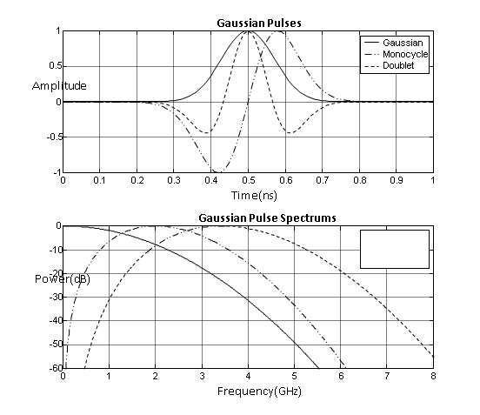


UWB pulse generation

Slide 19
Potential advantages and disadvantages of UWB
Low cost, low power: simple implementation
Low duty cycle operation
Potential for high capacity, high throughput
Large effective processing gain
Multipath resistant
Wireless internet connectivity issues
Pulse Synchronization issues
Susceptibility to interference
Short range (a few meters to a few km)

Slide 20
    Applications of UWB
Imaging systems: medical, surveillance, ground penetrating radar
Operating range below 960 MHz or between 1.99 and 10 GHz
Vehicular radar systems (above 24.075 GHz)
Communications and measurements systems restricted to indoor networks or hand-held devices

