Slide 1
244-1: INTRODUCTION TO PROGRAMMING

Slide 2
Course Goals
Improve programming skills in general
Encourage logical thinking and problem solving skills in individual areas of specialization
Enhance design and synthesis, in addition to just analysis of Electrical Engineering systems

Slide 3
Computer Aided Design (CAD)
CAD is the creation and improvement of software tools
CAD is especially useful to model the complex mathematical equations in Electrical Engineering
Complex analytical solution may be solved in a simple manner through numerical method

Slide 4
Numerical solutions
Numerical solution uses the computer to program the complex model equations
Model should be exact or within close approximation
Numerical solution should be programmed accurately

Slide 5
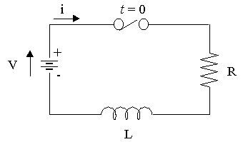
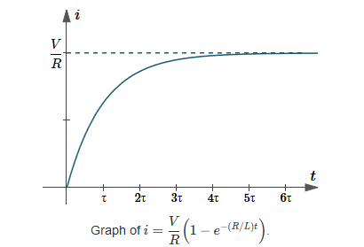
Electrical RL circuit example
Differential equation solution
Differential equation

Slide 6
Numerical solution of RL circuit
If you know the current at time t_{j} , you can calculate current at time t_{j+1}

Slide 7
Advantages of using computers
Computer speeds are very high and measured in teraflops (trillions of floating point operations per second)
The programming of computer solution is called an algorithm
Algorithms can be written or available in packages like MATLAB® or Python ®

Slide 8
Matlab/Python
Courtesy: https://realpython.com/matlab-vs-python/

Slide 9
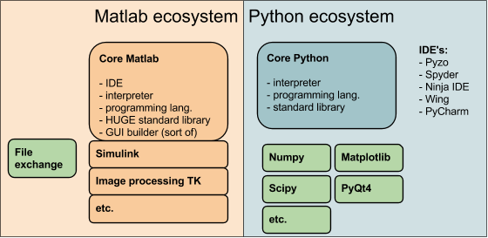
Why Matlab/Python ?
Courtesy: https://pyzo.org/python_vs_matlab.html

Slide 10
Matlab/Python uses
Python is primarily a free programming language – hence, more flexibility but more work
Matlab is primarily a numerical solver – hence, less flexibility, but less work
Matlab has GUI apps, toolboxes and Simulink for immediate use
Python is a general programming language – using it, you can develop apps

Slide 11
Access to MATLAB/Python
From ECS Labs: You can access MATLAB by clicking on the desktop icon, or from START button
From home: You can access MATLAB via VPN https://www.csus.edu/college/engineering-computer-science/computing-services/_internal/_documents/globalprotect-vpn.pdf

Slide 12
Access to Matlab examples
Matlab examples can be obtained at:
http://www.crcpress.com/product/isbn/9781439854297
Select “Support material” and download the file:
978439854297_examples_v2.zip
Students can run examples on their computers and check results

Slide 13
Free Access to Python
You can download Python at:
Download Python | Python.org
Simple Python examples:
Python Syntax (w3schools.com)
Just like learning a new language, more practice makes you better!

Slide 14
Typical applications Matlab/Python
% Matlab program to generate a sphere
sphere(20) % generates a sphere with 20x20x20 points
sphere(200) % generates a sphere with 200x200x200 points
# Python program to move a point
import turtle
turtle.position()
(0.00,0.00)
turtle.backward(30)
turtle.right(45)
Hence, Matlab is more applied and easier to use; however Python gives you more programming power

