Slide 1
244-2: MATLAB/python FUNDAMENTALS

Slide 2
Scalars
To assign a single value to a variable, simply type the variable name, the = sign, and the value:
>> a = 4 a = 4
Note that variable names must start with a letter, though they can contain letters, numbers, and the underscore (_) symbol

Slide 3
Array Creation
% Matlab command to create a vector
>>x = [ 1 2 3 4 5]
ans = 1 2 3 4 5
# Python command to create a vector
Import numpy as np
x = np.array([1,2,3,4,5])
x

Slide 4
Matrix creation
% Matlab command
x=[1 2 3; 4 5 6; 7 8 9];
ans =
1 2 3
4 5 6
7 8 9
# Python command
import numpy as np
x=np.array([[1,2,3], [4,5,6], [7,8,9]])
x

Slide 5
Mathematical Operations
Mathematical operations in MATLAB/Python can be performed on both scalars and arrays
 | Matlab | Python
Exponent | 4^2 = 16 | 4**2 =16
Multiplication and Division | 2*8 = 16 32/4 = 8 | 2*8 = 16 32/4 = 8
Generate π | pi | Import numpy as np 2*np.pi = 6.2832 np.pi/4 = 0.7854
Addition and Subtraction | 3+5 = 8 3-5 = -2 | 3+5 = 8 3-5 = -2

Slide 6
Complex Numbers in Matlab/Python
All operations can be used with complex quantities
x*y
x/y
x+y
x-y
Values containing an imaginary part are entered using:
x = 2+4j

Slide 7
Matrix Calculations in Matlab/Python
MATLAB/Python can also perform operations on vectors and matrices. For example, multiply the two matrices:
A = 3 6 7 B = 1 1
5 -3 0 2 1
3 -3
Matlab | Python
A = [ 3 6 7; 5 -3 0] B = [1 1; 2 1; 3 -3] C = A*B | import numpy as np A = np.array([[3, 6, 7], [5, -3, 0]]) B = np.array([[1, 1], [2, 1], [3, -3]]) C = A.dot(B) print(C)

Slide 8
Element-by-Element Calculations
At times, you will want to carry out calculations item by item in a matrix or vector. They are also often referred to as element-by-element operations.
For array operations, both matrices must be the same size
A = 3 6 7 B = 1 1 1
5 -3 0 2 1 3
Matlab | Python
A = [ 3 6 7; 5 -3 0] B = [1 1 1; 2 1 3] C = A.*B | import numpy as np A = np.array([[3, 6, 7], [5, -3, 0]]) B = np.array([[1, 1, 1], [2, 1, 3 ]]) C = A*B print(C)

Slide 9
Graphics in Matlab/Python
MATLAB/Python have a common plot command to graph vectors
Matlab | Python
x = [ 3 6 7] y = [1 2 3] plot(x,y) | import numpy as np import matplotlib.pyplot as plt x = np.array([3,6,7]) y = np.array([1,2,3]) plt.plot(x,y) plt.xlabel('x') plt.ylabel('some numbers') plt.show()

Slide 10
Other Matlab Plotting Commands
hold on and hold off
hold on will keep the current plot active
Enables the user to superimpose plots on each other
hold off will release the current plot
subplot(m, n, p)
subplot command enables multiple plots on a single page
Divides the page into m x n sections

Slide 11
Loops in Matlab/Python
IF and FOR loops in Matlab are completed with an end command to complete the loop operation
In Python, there is no end command, hence indentation or spacing is used to complete statements
Statements with the same indentation belong to the same group called a suite
The amount of indentation is optional, but it must be consistent throughout that group

Slide 12
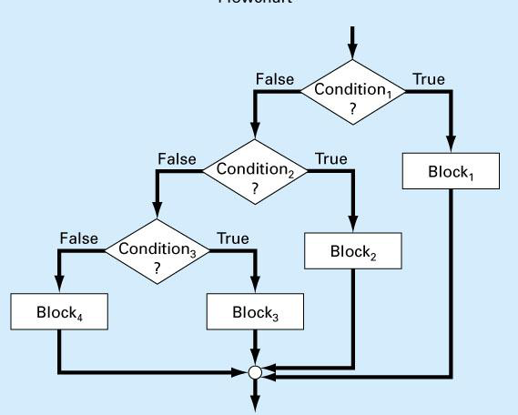
Conditional IF Loops
% IF loop in Matlab
class = 20
x= 5
if class ==1 x=x+8;
elseif class<1 x=x-8;
elseif class<10 x=x-32;
else x=x-64
end
# IF loop in Python
x = 5
if x > 15:
print(“x > 15”)
elif x < 15:
print(“x < 15”)

Slide 13
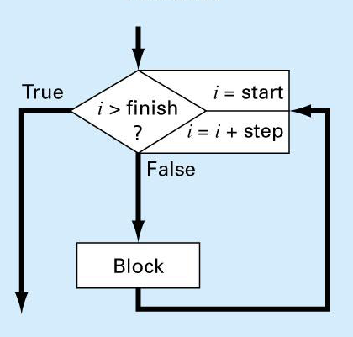
For Loops
% Matlab
x=0
for i = 1:10;
x=x+i
end
# Python
x = 0
for i in range(1,10):
x = x + i
print(x)
Note: Range (1,10) goes from 1-9

Slide 14
Example of Input command
% Matlab program to enter today’s date
clear
month = input(‘enter month,1-12 ’)
day = input(‘enter day, 1-31 ’)
year = input(‘enter year,20xx ’)
today_date=[month day year]

Slide 15
Relational Operators
Summary of relational operators in MATLAB/Python
Example | Operator | Relationship
x == 0 | == | Equal
unit ~= ‘m’ | ~= | Not equal
a < 0 | < | Less than
s > t | > | Greater than
3.9 <= a/3 | <= | Less than or equal to
r >= 0 | >= | Greater than or equal to

