Slide 1
EEE 244-3: MATRICES AND EQUATION SOLVING

Slide 2
Application of Matrices
Matrices occur in solution of linear equations
for Electrical Engineering problems
Example of linear equations:
Voltage-current relation
  V₁ = Z₁₁ I₁ + Z₁₂ I₂
  V₂ = Z₂₁ I₁ + Z₂₂ I₂

Slide 3
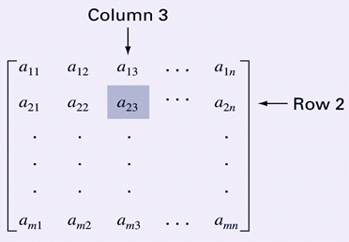
Matrix structure
A matrix consists of a rectangular array of elements represented by a single symbol (example: A).
An individual entry of a matrix is an element (example: a₂₃)
A =

Slide 4
Matrix elements
A horizontal set of elements is called a row and a vertical set of elements is called a column
The first subscript of an element indicates the row while the second indicates the column
The size of a matrix is given as m rows by n columns, or simply m by n (or m x n)

Slide 5
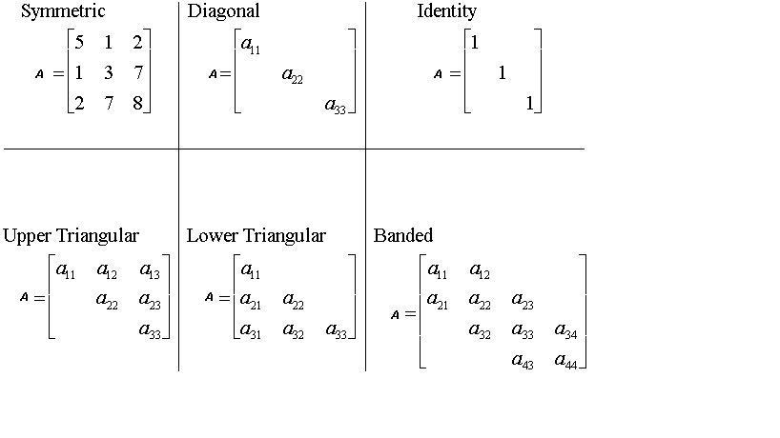
Special Matrices
Matrices where m=n are called square matrices
There are a number of special forms of square matrices:

Slide 6
Matrix Inverse
The inverse of a square, nonsingular matrix A is that matrix which, when multiplied by A, yields the identity matrix.
  A A⁻¹= A A⁻¹ = I
Matlab | Python
A = [ 3 6 7; 5 -3 0;1 1 1] B = inv(A) | import numpy as np A = np.array([[3,6,7],[5 -3, 0],[1, 1, 1]]) B = np.linalg.inv(A) print(B)

Slide 7
Matrix Transpose
The transpose of a matrix involves transforming its rows into columns and its columns into rows.
  (a_{ij})^{T}=a_{ji}
Matlab | Python
A = [ 3 6 7; 5 -3 0] B = A’ | import numpy as np A = np.array([[3, 6, 7], [5, -3, 0]]) B = np.transpose(A) print(B)

Slide 8
System of linear equations
  a₁₁ x₁ + a₁₂ x₂ + a₁₃ x₃ ……… a_{1n} x_{n} = c₁
  a₂₁ x₁ + a₂₂ x₂ + a₂₃ x₃ ……… a_{2n} x_{n} = c₂
  .
  .
  .
  a_{n1} x₁ + a_{n2} x₂ + a_{n3} x₃ ……… a_{nn} x_{n} = c_{n}

Slide 9
Matrix equation
AX = C

Slide 10
Solving With MATLAB/Python
MATLAB/Python can solve system of linear algebraic equations
AX = C
Matlab | Python
% Matrix inversion A = […] C = […] X = inv(A)*C % Gaussian elimination % or Left division X = A\C | import numpy as np A = np.array([[…..]) C = np.array([[…..]) X = np.linalg.inv(A) X = X.dot(C) print(X)

Slide 11
Example electric circuit problem
Find the resistor currents in the circuit below:

Slide 12
KVL equations
I₁
I₂
-10 + (I₁-I₂) x 100 = 0 => 100 I₁ -100 I₂ = 10
(I₂-I₁) x 100 + I₂ x 100 -10 = 0 => -100 I₁ +200 I₂ = 10

Slide 13
Matrix equation

Slide 14
MATLAB/Python solution
MATLAB/Python can solve system of linear algebraic equations
AX = C
Matlab | Python
clear A = [100 -100; -100 200] C = [10; 10] X = inv(A)*C | import numpy as np A = np.array([[100, -100],[-100, 200]]) C = np.array([[10],[10]]) X = np.linalg.inv(A) X = X.dot(C) print(X)

Slide 15
Roots of equations
Engineering problems involve finding roots of complex equations
Equations can be of different types:
  Polynomials with powers of x
  Example: x³ + 2x² – 4x +1 = 0
  Transcendental functions containing sin(x), e^{x}, log(x)
  Example: sin(x) – 4x +1 = 0
Solution of complex equations require
numerical techniques

Slide 16
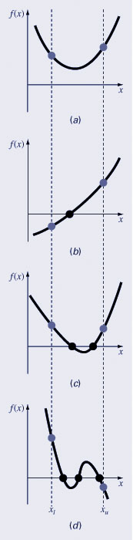
Graphical Methods
Zero crossing is a simple method for obtaining the estimate of the root of the equation f(x)=0
Graphing the function can also indicate types of roots:
  Same sign, no roots
  Different sign, one root
  Same sign, two roots
  Different sign, three roots

Slide 17
Search Method
Make two initial guesses that bracket the root:
f(x)=0
Find two guesses x_{i} and x_{i+1} where the sign of the function changes; that is, where f(x_{i} ) f(x_{I+1} ) < 0
.

Slide 18
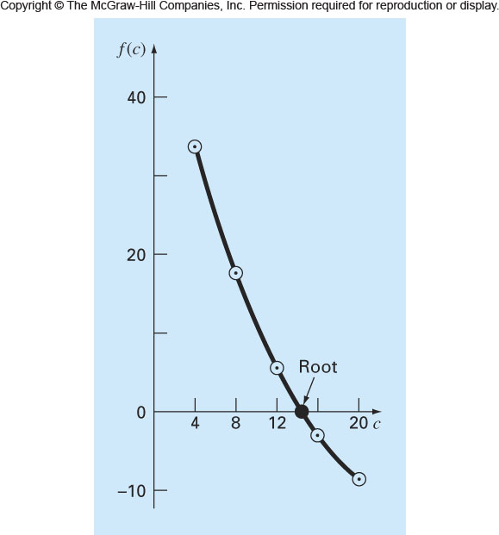
Incremental Search Method
Tests the value of the function at evenly spaced intervals
Finds brackets by identifying function sign changes between neighboring points

Slide 19
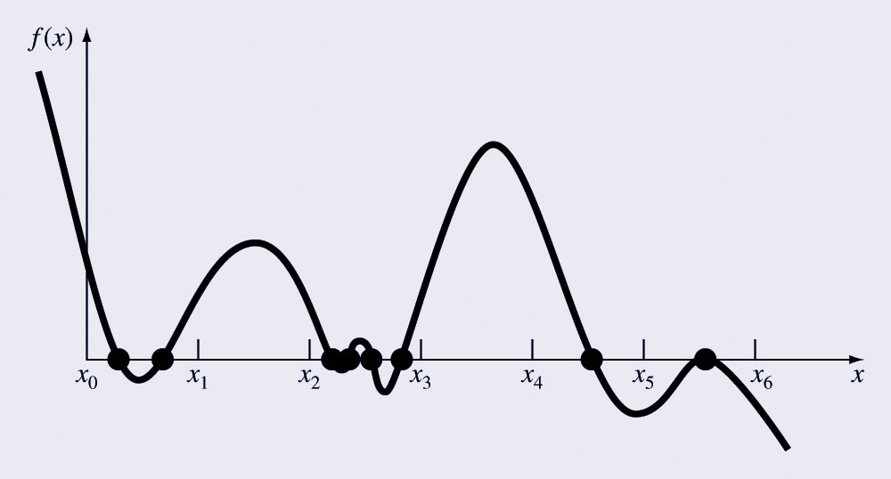
Incremental Search Hazards
If the spacing between the points of an incremental search are too far apart, brackets may be missed
Incremental searches cannot find brackets containing even-multiplicity roots regardless of spacing.

Slide 20
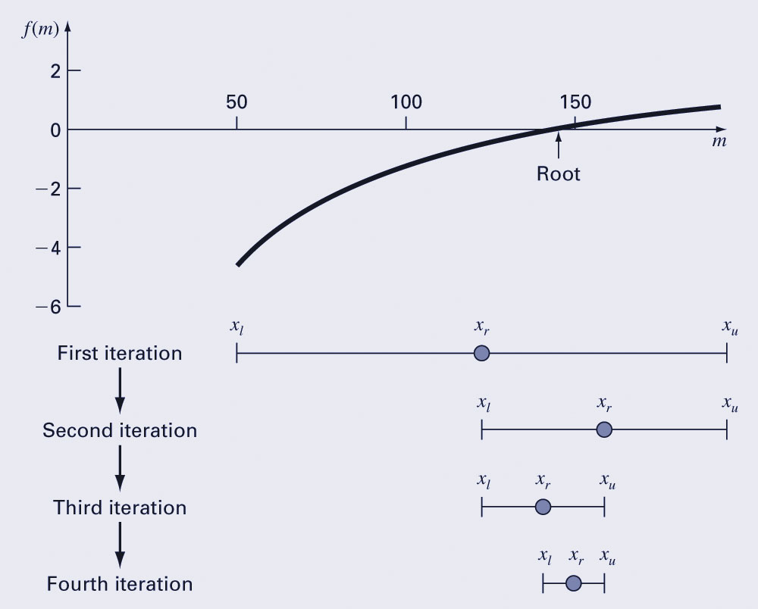
Bisection
The bisection method is the incremental search method in which the interval is always divided in half
If a function changes sign over an interval, the function value at the midpoint is evaluated

Slide 21
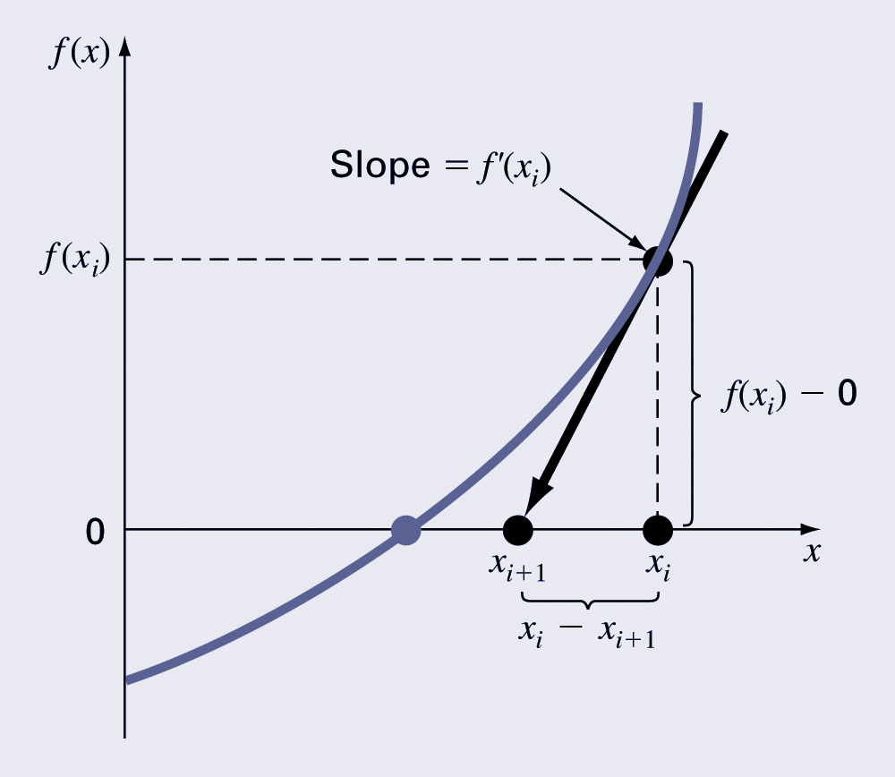
Newton-Raphson Method
Form the tangent line to the f(x) curve at some guess x,
then follow the tangent line to where it crosses the x-axis.

Slide 22
Transcendental Functions
MATLAB/Python use fsolve command to find roots of transcendental function
Step 1: Define the function, for example
f(x) = 2x+cos(x) = 0
Step 2: Use the fsolve command (initial guess x0)
Matlab | Python
clear f=@(x) 2*x+cos(x) x0=0.01 x = fsolve(f,x0) | import numpy as np from scipy.optimize import fsolve def fun(x): return 2*x+np.cos(x) x=fsolve(fun,0.01)

Slide 23
Polynomials
MATLAB/Python have built in program called roots to determine all the roots of a polynomial
Step 1: Define the vector c with polynomial coefficients. Example: For x³+2x²+4x+1=0
c = [1 2 4 1]
Step 2: Use the roots command
Matlab | Python
clear c = [1 2 4 1] x = roots(c) | import numpy as np c = [1,2,4,1] x = np.roots(c) print(x)

Slide 24
Polynomial commands
MATLAB/Python have poly function which can be used to determine polynomial coefficients if roots are given:
  b = poly([v])
    v is the vector containing roots of the polynomial
    b is the vector with polynomial coefficients
MATLAB/Python have polyval function which can evaluate a polynomial at one or more points:
  polyval(b, 1)
    This calculates the value of the polynomial at x=1

