Slide 1
244-4:Numerical Integration

Slide 2
Numerical Integration
Integration:
is the total value, or summation, of f(x) dx over the range from A to B:

Slide 3
Simpson’s Rule -Method
Simpson’s rule consists of dividing the range (A,B) into N subdivisions, where N is an even integer
Connect 3 points using second degree polynomials (parabolas), or even higher order polynomials
Sum all the areas under the parabols to obtain approximation to the total integral:

Slide 4
Simpson’s Rule –Graphical view

Slide 5
Simpson’s Rule -Formulation
Simpson’s 1/3 rule corresponds to using second-order polynomials. Using the Lagrange form for a quadratic fit of three points:
Integration over the three points simplifies to:

Slide 6
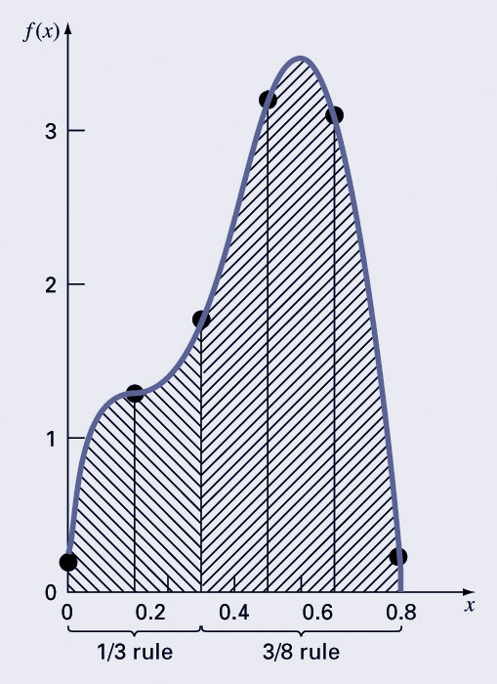
Simpson’s 3/8 Rule
Simpson’s 3/8 rule corresponds to using third-order polynomials to fit four points. Integration over the four points simplifies to:
Simpson’s 3/8 rule is generally used in concert with Simpson’s 1/3 rule when the number of segments is odd.

Slide 7
Higher-Order Formulas
Higher-order Newton-Cotes formulas may also be used
In general, the higher the order of the polynomial used, the higher the derivative of the function in the error estimate and the higher the power of the step size.

Slide 8
MATLAB/Python integration functions
MATLAB/Python have built-in functions to evaluate the integral of the function y between the limits (A,B)
Matlab | Python
clear y = @(x) f(x) I = quad(y,A,B) | from scipy.integrate import quad import numpy as np def y(x): return f(x) I=quad(y,A,B) print I

Slide 9
Integration over vectors
If the curve is given in terms of a vector set (x,y), then quad can also be used to calculate the integral I as follows:
F = griddedInterpolant(x,y)
f=@(x) F(x)
I = quad(f,xl,xu)
where xl and xu are lower and upper limits of x respectively
Hence, quad can be used over a given function (for regular surfaces) or over a vector (for irregular surfaces)

Slide 10
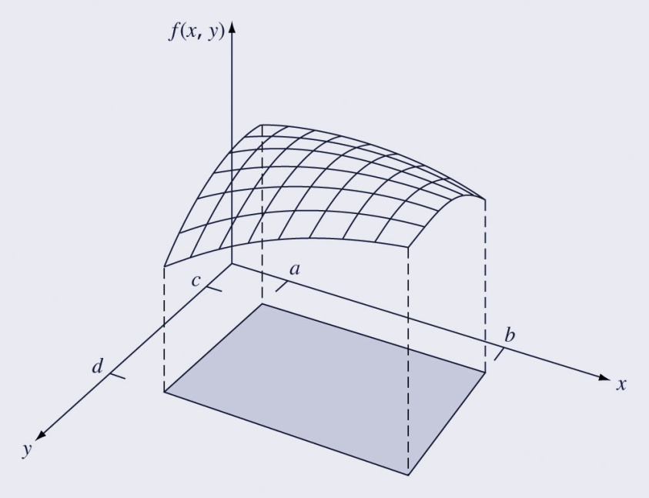
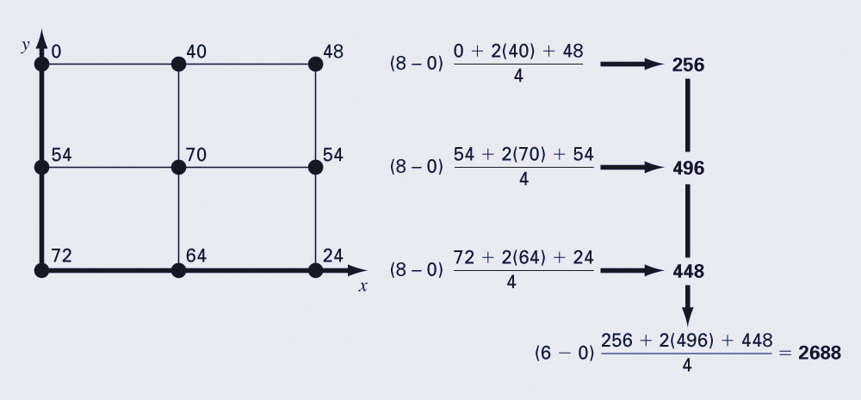
Multiple Integrals
Multiple integrals can be determined numerically by first integrating in one dimension, then a second, and so on for all dimensions of the problem.

Slide 11
MATLAB/Python multiple integral functions
MATLAB/Python also have built-in functions to evaluate the multiple integral of the function z(x,y) between the limits(xmin,xmax,ymin,ymax)
z = f(x,y)
where [x y] is a matrix meshgrid
Matlab | Python
clear z = @(x,y) f(x,y) I = dblquad(z,xmin,xmax,ymin,ymax) | import numpy as np import scipy.integrate def z(y,x): return x**2+y**2+x*y I=scipy.integrate.dblquad(z,-2,2,-5,5) print(I)

