Slide 1
EEE 244-5: Numerical solution of Ordinary Differential Equations (ODEs)

Slide 2
Engineering Problem Solution
Start with physical laws (Faraday’s, Ohm’s, KVL, KCL, Maxwell’s equations)
Generation of differential equation for the specific problem
Numerical or analytical solution of differential equation to obtain the unknown variables, such as current, voltage, power.

Slide 3
ODE – Initial value problem
First order ODE with initial condition
Several techniques are available to solve for the function y(x)

Slide 4
ODE - Example
To solve an RL circuit, we apply KVL around the loop and obtain a differential equation:
The aim is to solve for the unknown current i(t), given the initial condition i(t=0)= i(0)
Numerical solution is practical to solve higher order ODEs

Slide 5
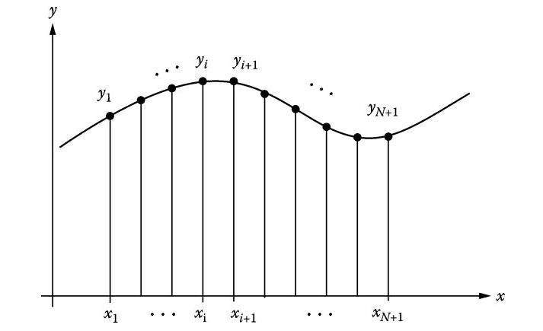
Taylor’s Series

Slide 6
Euler’s method of solving first order ODE
To solve the ODE:
We use the first two terms of the Euler series
h = x_{i+1} – x_{i} ,is the step size
Solve for y using values of i=0,1,2….

Slide 7
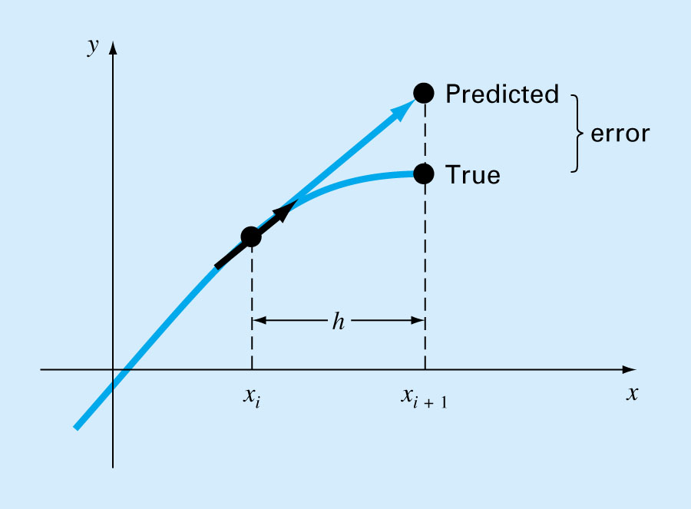
Error in Euler’s method

Slide 8
Modified Euler’s method
Predictor-corrector algorithm
Reduces error in Euler’s method

Slide 9
Matlab/Python commands so solve ODEs
Matlab/Python have the command ode to solve the first order ODE:
$$\frac{dy}{dx}=f(x,y)$$
$$\text{f}\text{or} \text{x}\text{=(}\text{x}\text{1,}\text{x}\text{2) , }\text{initial} \text{condition} y=y_{0}$$
Matlab | Python
clear f=@(x,y) f(x,y) x =[xl xu] [x y] = ode45( f, x,y₀) plot(x,y) | import numpy as np import matplotlib.pyplot as plt from scipy.integrate import odeint xspan=np.linspace(xmin,xmax,points) def f(y,x): return f(x,y) y=odeint(f,y0,xspan) plt.plot(xspan,y) plt.show()

Slide 10
Solution of second order ODE
To solve the second order ODE:
Consider Taylor’s series (first 3 terms) for y_{i+1} and y_{i-1} ; we obtain y as follows:

Slide 11
Matlab/Python commands so solve ODEs
Matlab/Python commands to solve the second order ODE: (for Python define the function f(x,y) as f(x,y[0])
Matlab | Python
syms y(x) dx= y0= y1= eqn = diff(y,x,2) == f(x,y); Dy = diff(y,x) dd=(y1-y0)/dx; cond = [y(0)==y0, Dy(0)==dd]; ysol(x)= dsolve(eqn,cond) x=0:dx:xlimit; y=subs(ysol); plot(x,y) | import matplotlib.pyplot as plt from scipy.integrate import odeint import numpy as np def f(y,x): return(y[1],f(x,y)) y0= y1= dx= dd=(y1-y0)/dx y00=[y0,dd] xs=np.linspace(0,xlimit,no. of points) yss=odeint(f,y00,xs) ys=yss[:,0] plt.plot(xs,ys) plt.show()

