Slide 1
PROFESSIONAL COMMUNICATION

Slide 2
WHAT IS PROFESSIONAL COMMUNICATION
Professional communication is the process of conveying information in the workplace
Examples or professional communication:
Engineer submitting a work update to the manager
Professor teaching a class
Student submitting a project report for a class
Company CEO addressing the employees

Slide 3
BENEFITS OF GOOD PROFESSIONAL COMMUNICATION
Improves chances of success in your profession
Improves your image in the workplace
Improves professional relationships
Decreases chances of conflict or confusion in a group
Any other benefits?

Slide 4
TYPES OF PROFESSIONAL COMMUNICATION
Verbal
Usage of oral or written methods
Examples, speaking, writing
Non-verbal
Usage of silent methods
Examples, body language, tone
Visual
Usage of images and symbols
Examples, signs, pictures, videos

Slide 5
VERBAL AND NON-VERBAL COMMUNICATION
http://bconsi.blogspot.com/2013/04/definition-of-verbal-communication.html

Slide 6
VISUAL COMMUNICATION
https://www.easel.ly/blog/visual-communication-important-skill/

Slide 7
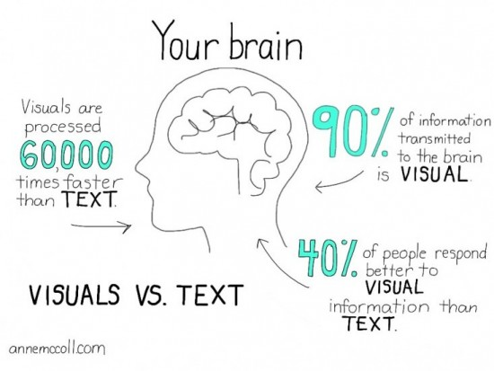
ASPECTS OF VERBAL AND VISUAL COMMUNICATION
https://www.easel.ly/blog/visual-communication-important-skill/

Slide 8
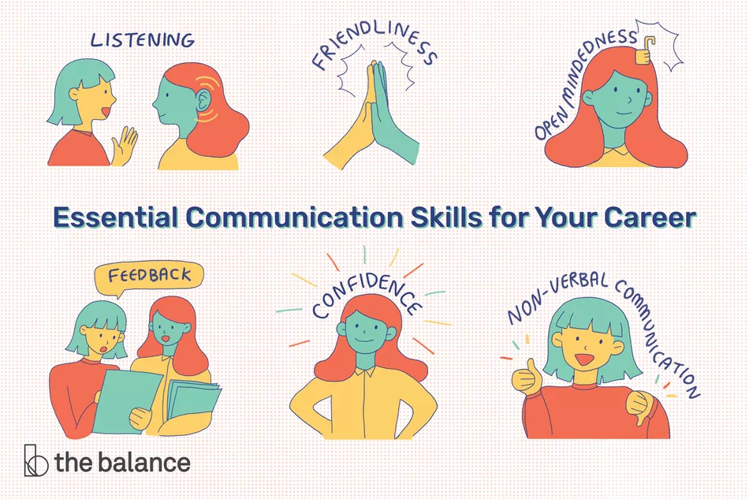
VERBAL/NON-VERBAL COMMUNICATION TIPS
https://www.thebalancecareers.com/communication-skills-list-2063779

Slide 9
VISUAL COMMUNICATION TIPS
https://www.ucreative.com/resources/infographic-10-tips-for-effective-visual-communication/

