Slide 1
Multisensory Intervention for Children with Developmental Language Disorder, Sensory Processing Disorder, and Fine Motor Delays

Slide 2
Celeste Roseberry-McKibbin, Ph.D., CCC-SLP, F-ASHA
Department of Communication Sciences and Disorders
California State University, Sacramento
And San Juan Unified School District

Slide 3

A little about me:
Full time university professor and part-time itinerant SLP in the public schools
Published 17 books and numerous journal articles
Given over 700 workshops at local, state, national, and international conferences

Slide 4
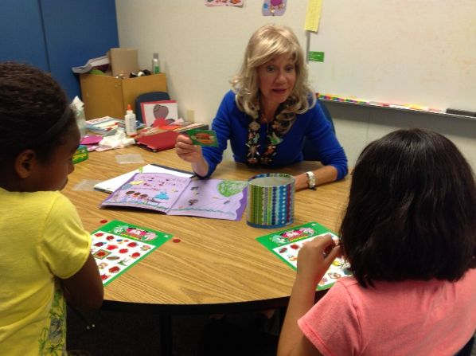
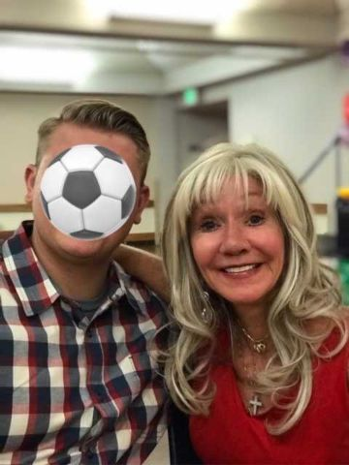
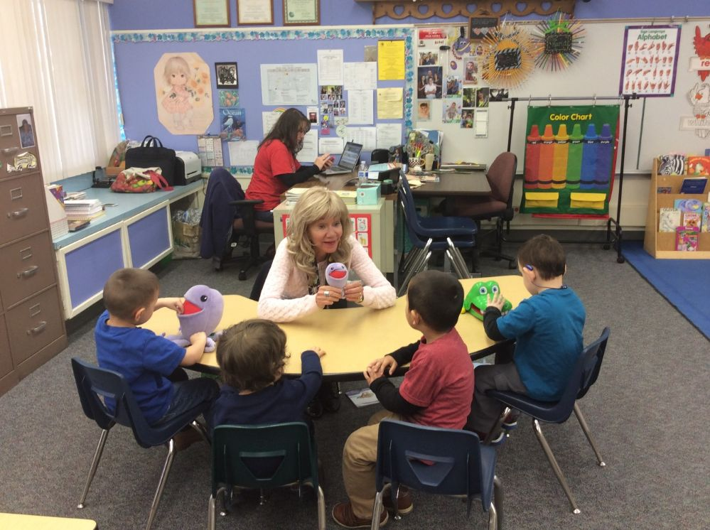
In the schools, I work with students ages 3-22 years old

Slide 5
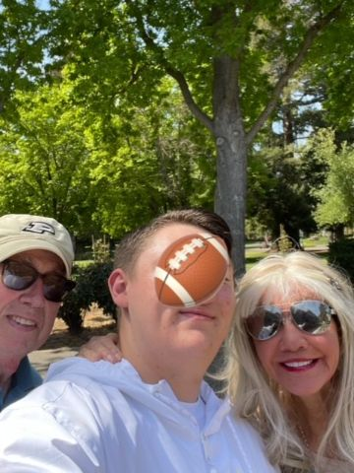

Slide 6

My youtube channel:
Just go to youtube online
www.youtube.com
Type in Celeste Roseberry
Feel free to subscribe

Slide 7
Social Media:
www.lovetalkread.com
Instagram @dr.celesteroseberry
TikTok @celesteroseberry
Youtube: Celeste Roseberry

Slide 8
Email celeste@csus.edu
Please feel free to email me for a comprehensive list of sensory and fine motor activities that are hands-on and fn!
These are also listed on my lovetalkread.com website

Slide 9
To get the full PowerPoint with all the pictures:
Go to my website
https://webpages.csus.edu/celeste/
Click on the Publications link

Slide 10
My goal for you….
Is to leave with an absolute minimum of 3 new ideas that you plan to incorporate into your work setting(s) with your students

Slide 11
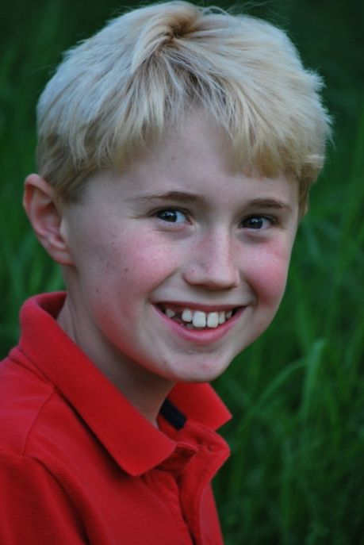
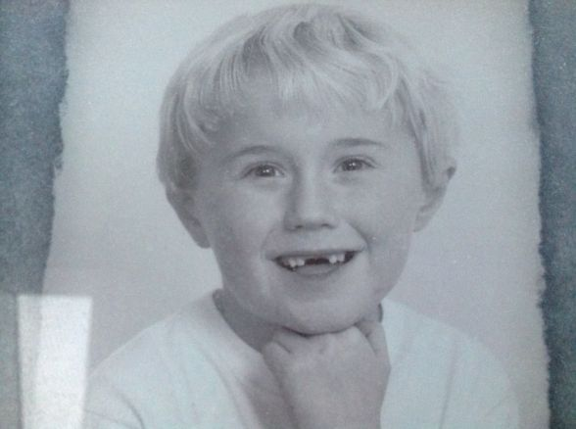
My personal interest in Sensory Processing Disorder:
My son Mark was diagnosed with SPD, dyslexia, and ADHD

Slide 12

We had lots of therapies: Occupational therapy, vision therapy, horseback riding, karate, tutoring…
He graduated from high school with a 4.32 GPA
Out of 3,000 applicants, he was one of 125 accepted into George Washington University’s political journalism program in D.C.

Slide 13


Mark attended Oxford University
He received a Master’s of Philosophy degree in comparative social policy (health care policy)

Slide 14
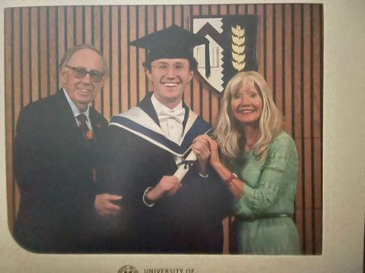


Slide 15


Slide 16
I. BACKGROUND
It is increasingly being found that children with special needs such as specific language impairment (SLI)/Developmental Language Disorder (DLD) and Autism Spectrum Disorder (ASD) have accompanying sensory deficits

Slide 17
Research over the years has clearly shown that sensory processing deficits, often described under the term sensory processing disorder (SPD), are a co-morbid problem that can accompany childhood apraxia of speech, autism spectrum disorder, attention deficit hyperactivity disorder (ADHD), and SLI

Slide 18
Accordingly, in this seminar, I:
I. Define sensory integration and its systems
II. Discuss the term SPD
III. Explain the relationship of SPD to speech and language
IV. Share practical activities and materials to use in speech and language therapy for children with accompanying SPD and fine motor deficits

Slide 19
II. Nature of Sensory Processing Disorder
Sensory integration: the neurological process that organizes sensations from one’s own body and the environment into useable information.
  It is information filtering and processing
Notes:
Developed by Jean Ayres, Psych/OT in 70’s
Looked at sensory systems that must work independently and as a team to accomplish tasks (i.e. tie your shoes, write thoughts on paper)
Any changes in the brain – even subtle changes can have a mjor impact on our feelings
thoughts
actions
Explores environ
Tries new activities
Strives to meet increasingly complex challenges to feel successful
SUCCESS GIVES THE CONFIDENCE TO FORGE AHEAD
Appear normal yet changes result in behaviors that
confuse
anger
frustrate parents/teachers
Many times focus is on emotional, social family problems that are secondary to the underlying neurological problems
Neuron?
We constantly receive a variety of sensory inputs from our environment throughout our day.
“Every child has an appetite for sensory nourishment.” Kranowittz
These inputs include . . . .

Slide 20
O’Gallagher, A. (2023) Understanding Sensory Processing Disorder in Children: A Guide for Parents. https://www.spdfoundation.net/sensory-processing-disorder-in-children/
Children with SPD often have motor coordination challenges and may have trouble catching a ball, tying their shoes, etc.
This makes them less likely to participate in motor-based activities, which slows down their motor development overall

Slide 21

This happened to my son Mark a lot:

Slide 22
STAR Institute, 2025:
Our ability to process sensory data generally does not require conscious thought
Our ability to process sensory data provides emotional stability, our sense of safety, a platform for social interaction, sense of self, well-being, satisfaction and/or accomplishment.

Slide 23
Sensory Integration Dysfunction/Sensory Processing Disorder
An irregularity or disorder in brain function that makes it difficult to integrate sensory input effectively
The brain doesn’t process sensory inputs correctly
This may lead to inappropriate behavioral and motor responses that negatively impact learning, behavior, coordination, and language
This can lead to anxiety, stress, and depression
Notes:
Statistics:
1979 Ayers estimated 5-10% have SI probs significant enough to warrant intervention
Today
According to Dr. Lucy Jane Miller, the statistics report a minimum of 1 in 20 children in the US have SPD. This is the only published statistic and is based on her research thus far.
“It is when the brain is so disorganized that a person has difficulty functioning in daily life that the person has a diagnosis of SID” Kranowitz

Slide 24
Delgado-Lobete et al. tell us that:
Children with ADHD often show more SPD than typically-developing children
Children with Autism Spectrum Disorder frequently have accompanying SPD

Slide 25
Possible Causes of SI Dysfunction
Prematurity
Birth Trauma
Drug/Alcohol Exposure
Infections/Viruses
Genetics
Environment
Neurological
Unknown

Slide 26
Associated Diagnoses
Fragile X
FAS/Drug Exposure
Autism
ADHD
Down Syndrome
Intellectual disability
“Normal” Children
Learning Disabled
Genetic disorders
Neurological disorders
Environmental deprivation
Other sensory impairment
History of trauma/abuse
TBI
Notes:
Can be a stand alone dx
ADHD – 99%
Environmental deprivation – orphanage. Medically compromised
It’s not sensory if therapy doesn’t reduce behavior (give it 4 weeks, take data)
CP - seekers

Slide 27
STAR Institute, 2025:
Pioneering occupational therapist, psychologist, and neuroscientist A. Jean Ayres, Ph.D., likened SPD to a neurological “traffic jam” that prevents certain parts of the brain from receiving the information needed to interpret sensory information correctly.

Slide 28
ASHA Leader May/June 2024:
Meta-analysis carried out at Georgetown University Medical Center (22 studies with 577 DLD participants)
In 100% of studies, they’ve found abnormalities in the anterior neostriatum within the globus pallidus of the basal ganglia, a structure deep in the brain associated with movement

Slide 29
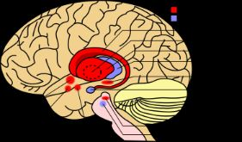

Slide 30
Is it possible that this is why….
So many children with DLD have difficulty with fine motor skills?

Slide 31
2024 Journal of the American Medical Association https://jamanetwork.com/journals/jamapediatrics/article-abstract/2813443**
Analyzed data for 1471 children
They studied screen-viewing data for the group at 12, 18, and 24 months old
At 33 months old, assessed children’s sensory processing

Slide 32
In the JAMA 2024 study, they studied atypical sensory behaviors such as:
Sensation seeking
Sensory sensitivity
Sensation-avoiding
Low registration (slower to respond to stimuli)

Slide 33
The JAMA 2024 study found that:
Toddlers who experienced any screen time before 12 months old had a 105% greater likelihood of exhibiting atypical sensory behaviors related to low registration
Recommended avoiding screen time for children younger than 2 years

Slide 34
III. Eight Sensory Systems
Far (distal) – Tell us what is going on in the world around us
Visual
Auditory
Olfactory (smell)
Gustatory (taste)
Tactile
Near (proximal) – Tell us what is going on in our own bodies
Vestibular (balance)
Proprioceptive
Interoceptive
Notes:
Far – 0versensitive Near - under sensitive
Inetroception
Internal sensations
hunger/thirst
hot/cold
pain/discomfort

Slide 35
Proprioception:
Perception or awareness of the position and movement of the body—our body’s ability to sense movement, action, and location
For example, we can close our eyes and touch our nose with our finger
Without looking, we can tell if we are standing on hard cement or soft grass

Slide 36
If students have poor proprioception, they may
Appear clumsy
Bump into things, including other people
Give a “high 5” too hard or softly
Drop or spill items

Slide 37
Interoception…
Helps you understand and feel what's going on inside your body
Children who struggle with the interoceptive sense may have trouble knowing when they feel hungry, full, hot, cold or thirsty
Often very late to potty train

Slide 38
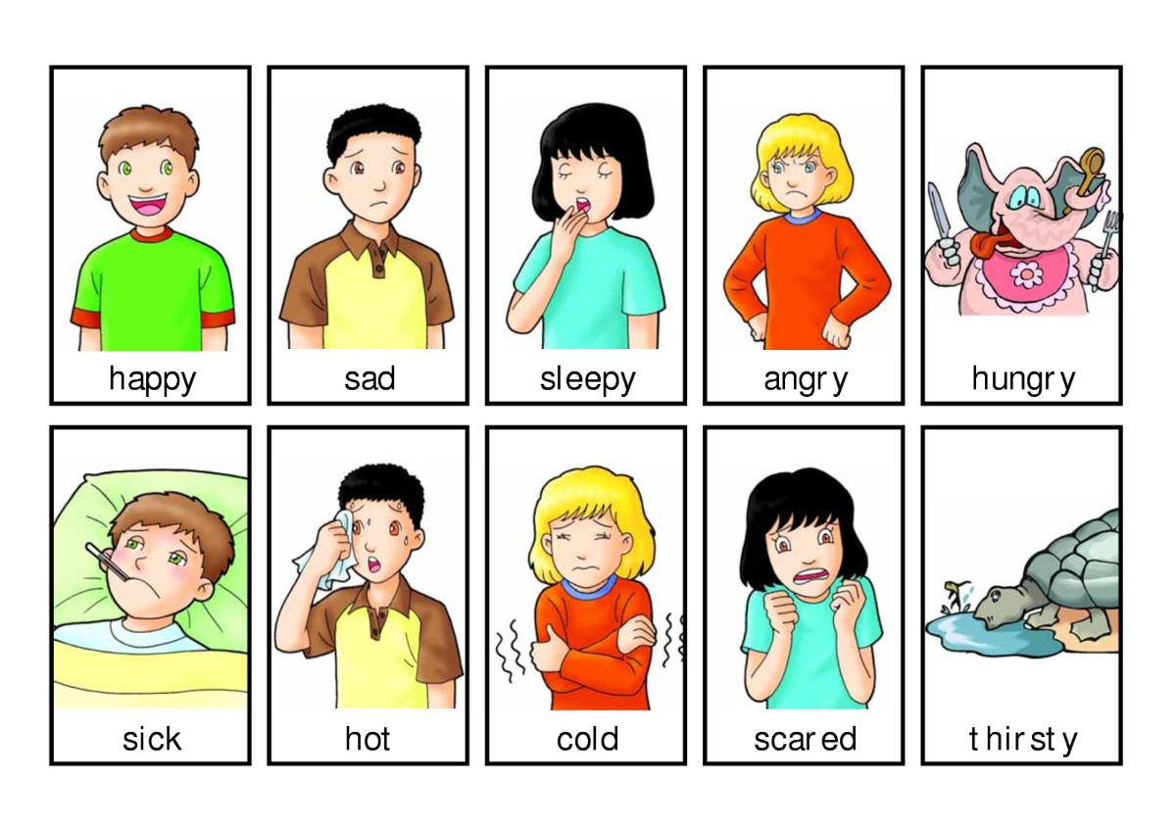
Where to Start?
Start with the near senses
  Child needs to know what is going on with his body before he can interpret information in the environment

Slide 39

Modulation
Allows us to focus on what’s most important
Teaching Self-Modulation
  Recognizing sensory needs
    Teachable moments
  Recognizing how different types of activities can be calming, alerting, or “just right”

Slide 40
Four Levels of Sensory Integration
Level 1: Primary Sensory Systems (by 2 mos.)
  Establishing foundation for all future learning
Level 2: Perceptual Motor Foundations (by 1 year)
  Body Awareness, Visual Feedback, Bilateral Integration, Lateralization, Motor Planning
Notes:
Refer to poster board

Slide 41
4 levels of sensory integration (cont.)
Level 3: Perceptual Motor Skills (by 3 years)
  Auditory Perception, Visual Perception, Visual-Motor Integration, Eye-Hand Coordination, Purposeful Activity
Level 4: Academic Readiness (by 6 years)
  Complex Motor Skills, Regulation of Attention, Organized Behavior, Specialization of Body and Brain, Visualization, Self-Esteem and Self Control

Slide 42
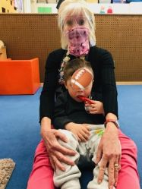

Slide 43
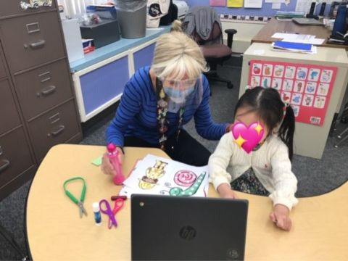

Slide 44
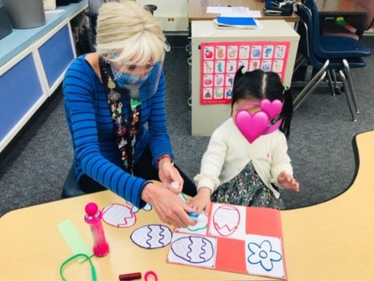

Slide 45
Implications for Speech and Language Learning
Communication is a result of our (sensory) experiences – learning to communicate by hearing, seeing, touching, and moving about the world . . . . . There is a reciprocal relationship among perception, concept and language.
A well integrated sensory system becomes the vehicle for nonverbal expressions (gestures, smiles, frowns) and later for the production of speech and language

Slide 46
Implications . . . (cont.)
The auditory and visual systems, when intact, allow us to be social participants
Motor control and motor planning are necessary for producing intelligible speech
Notes:
Vestibular – motor planning
May lack awareness of how his mouth, lips and tongue feels and work together

Slide 47
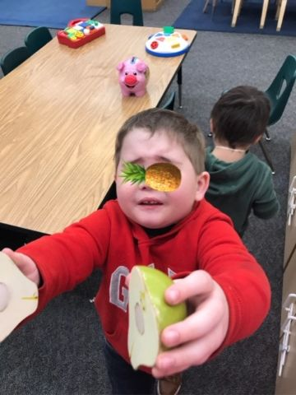

Slide 48
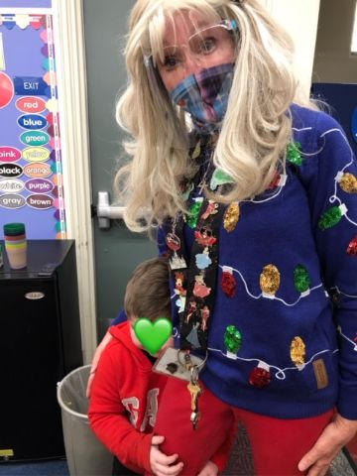

Slide 49
Implications . . . (cont.)
Disordered language:
  Echolalic speech
  stereotypical vocalizations/verbalizations
  Pragmatics
Inappropriate pitch and intonation patterns
Oral Issues

Slide 50
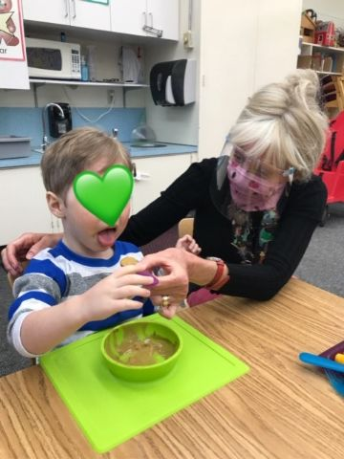
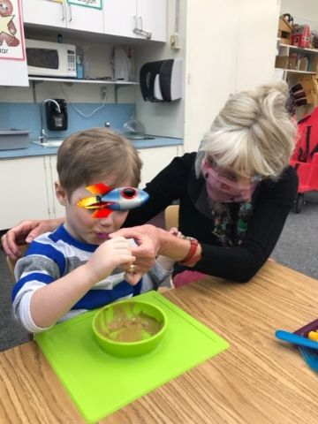

Slide 51
Over-Responsive
AKA “sensory defensive”
Over-responsiveness of the nervous system
May be generalized or specific to a particular sensory system
Avoiders
Primarily need calming activities

Slide 52
Under-Responsive (passive)
Under-active response of the nervous system to incoming stimuli
Bump on a log
May be passive and oblivious to stimuli
Need alerting/stimulating experiences

Slide 53
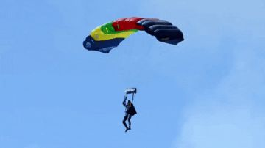
The Sensory Seeking Person
Typically due to under-responsivity
Constant motion – thrill seeker
“Needers” – behaviors are attempts to reach high threshold level for sensory registration
Need alerting/stimulating activities
Notes:
Your instinct is to calm them down
Seekers can become even more disorganized if input is not provided in an =organized and structured manner

Slide 54
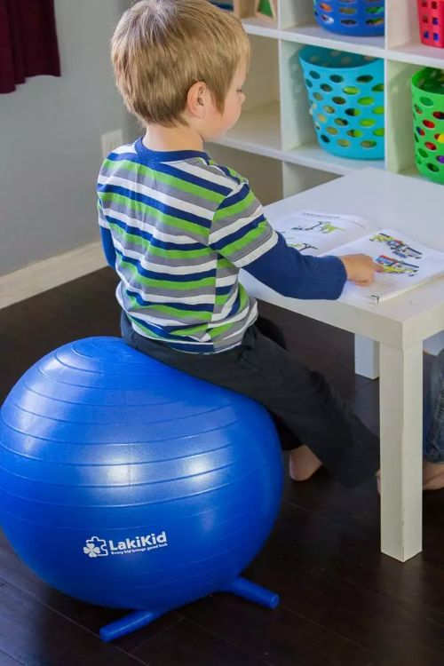
As clinicians:
We can provide more input like movement games, bright colors and lights, and a yoga ball as a chair

Slide 55

Mixed Response
Especially people with ASD have both over-responsivity in some systems and under-responsivity in other systems
  Common ASD pattern: over-responsive to far sensory systems and under-responsive to near sensory systems

Slide 56
IV. Sensory Diet
Term coined by Patricia Wilbarger
“The optimum sensorimotor input a person needs to feel alert, exert effortless control, and perform at peak.” (Biel, Peske)
The strategic use of sensory activities

Slide 57
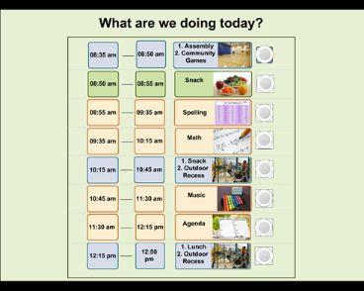
Sensory diet approach should include:
  Sensory breaks
  Sensory routines
  Sensory modifications and adaptations
At school – build sensory breaks into a visual schedule

Slide 58
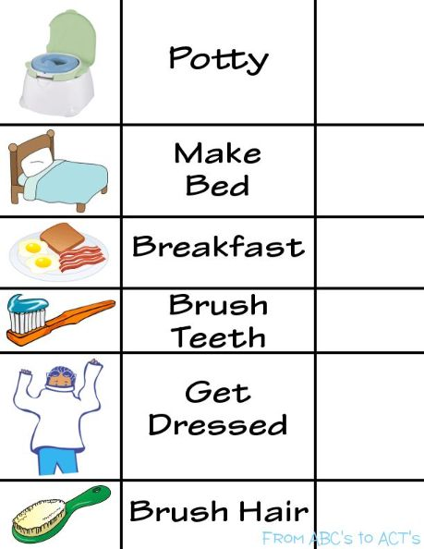
Recommendations for Home
Schedule
  Written or picture schedule
  Avoid getting in a rush
  Minimize screen time
  Allow for movement activities in the schedule
  Calm time for homework
  Sensational Brain

Slide 59
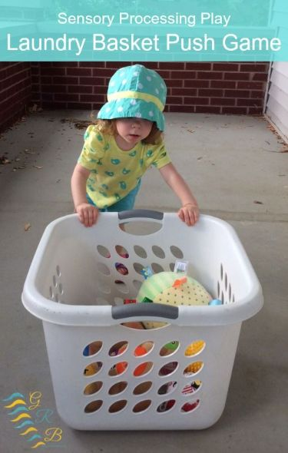
Recommendations for Home
Activities
  Deep pressure activities
  Non-competitive extra-curricular activities
    Gymnastics
    Karate
    Swimming
    Horse-back riding
    Sensational Brain

Slide 60
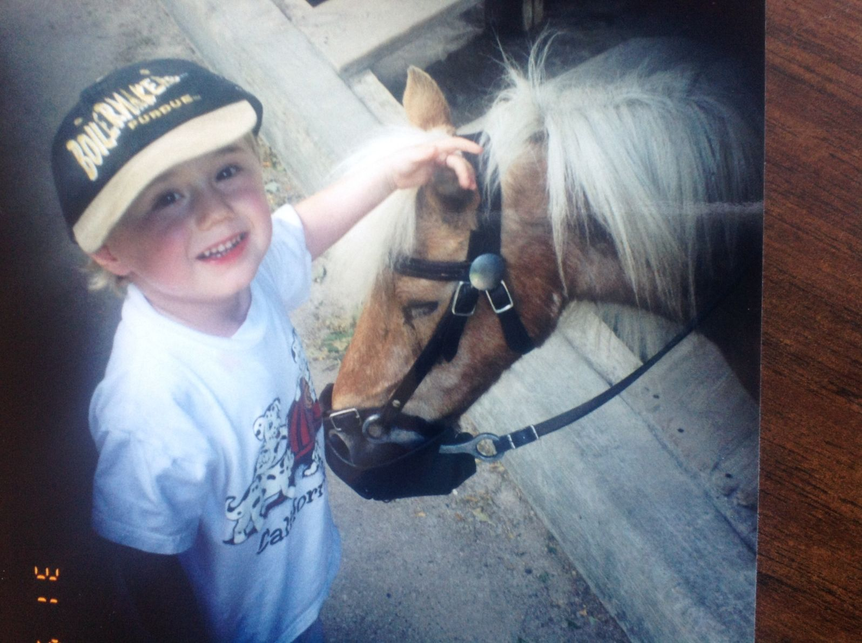

Slide 61
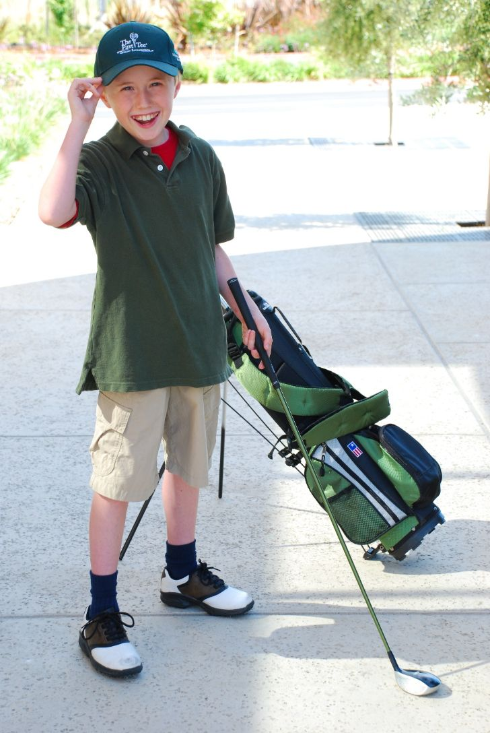
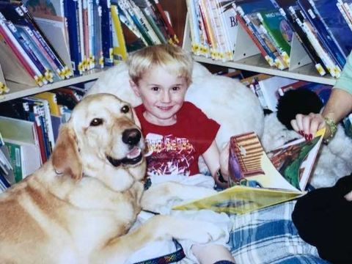

Slide 62
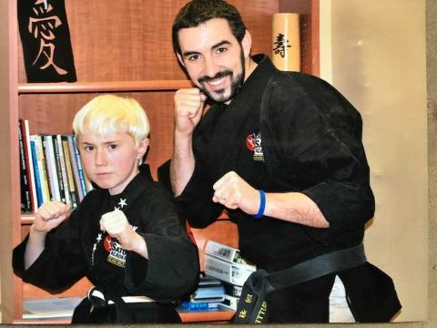
Mark got a junior black belt in karate—
Very helpful for sensory integration, attention, listening, focusing

Slide 63
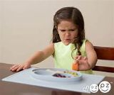
Recommendations for Home
General
  Provide choices whenever possible
  Clothing accommodations
  Food sensitivities –
    meal time should not be a battle
    Sensational Brain

Slide 64
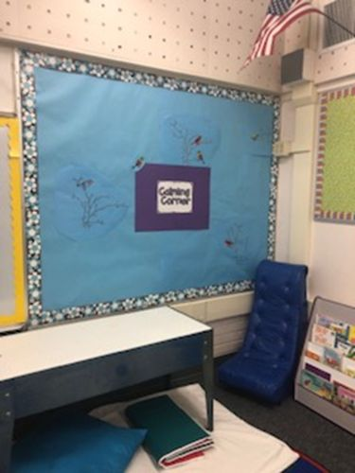
School Modifications
Calming Strategies:
  Lighting
  Stress balls/fidget toys
  Position changes
  “Heavy work” chores
  Music
  Headphones
  Schedule
  Calming corner
              Sensational Brain

Slide 65
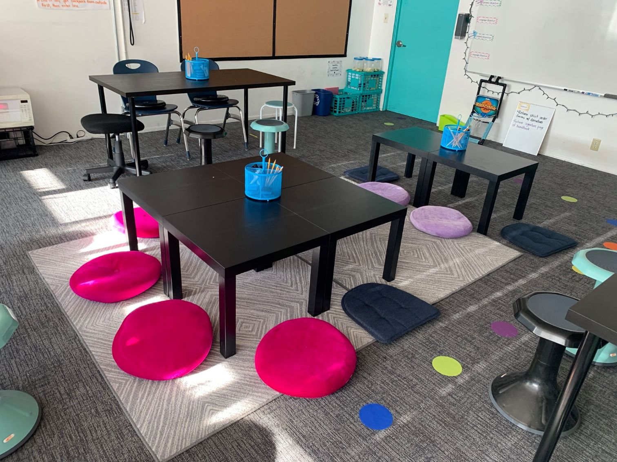

Slide 66
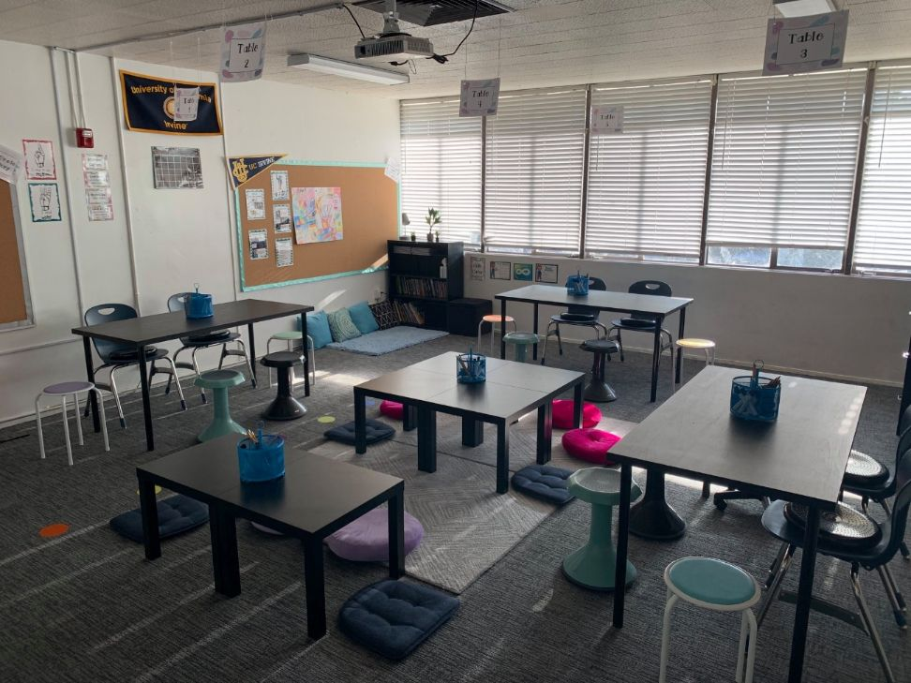
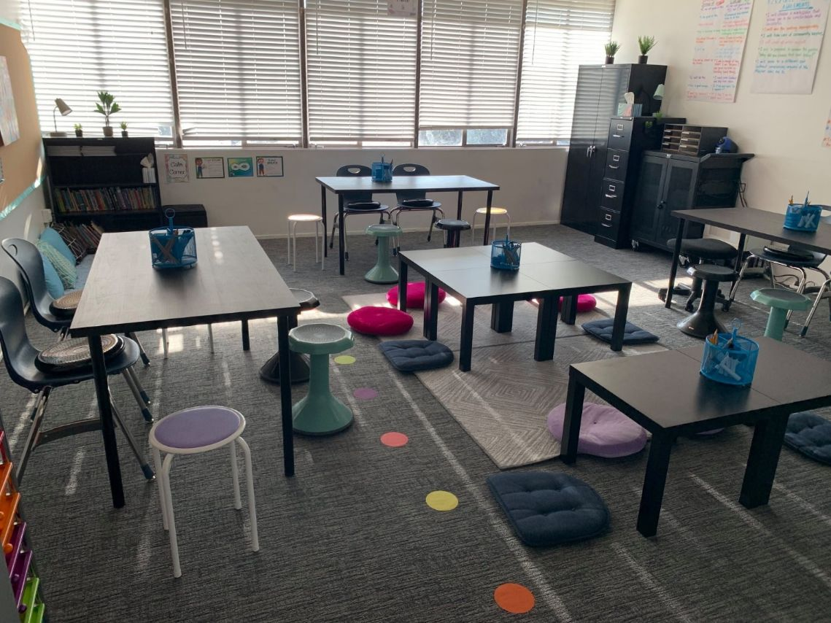

Slide 67
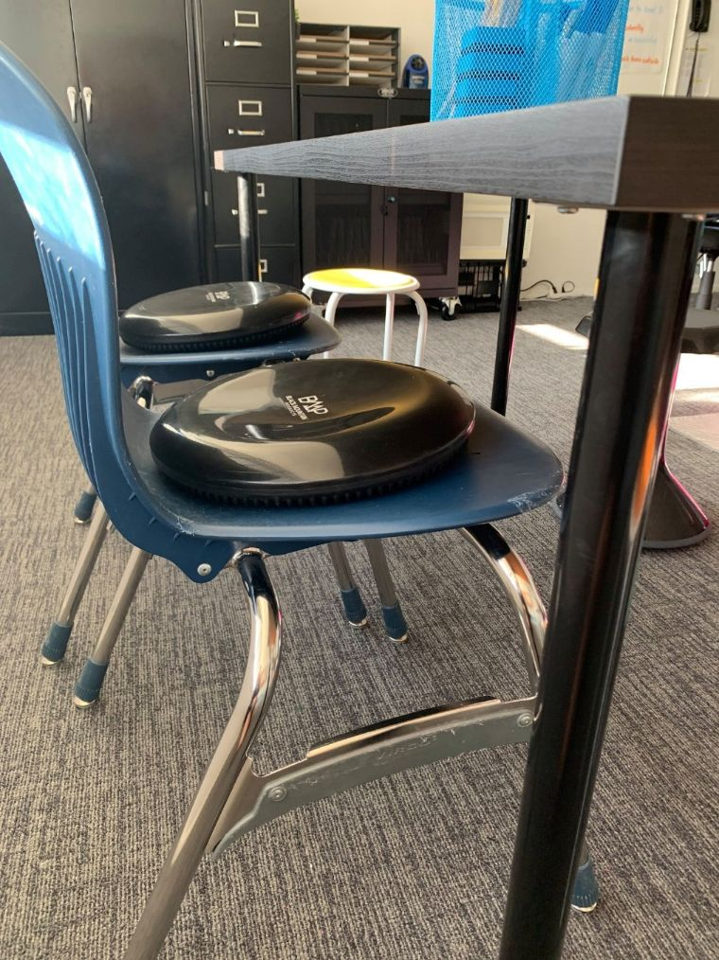
Therapy cushions can help

Slide 68
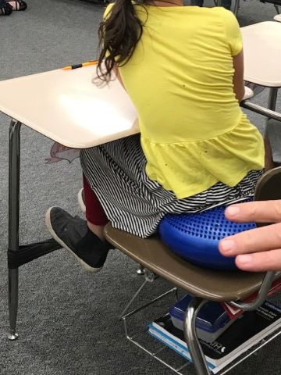

Slide 69
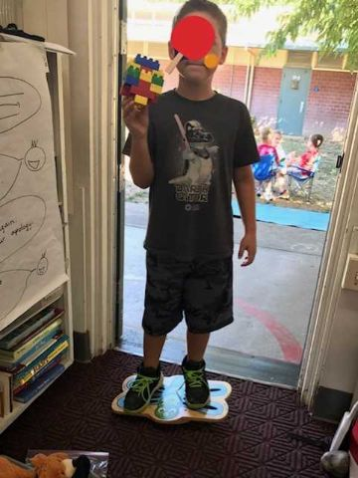
Children can stand on balance boards

Slide 70
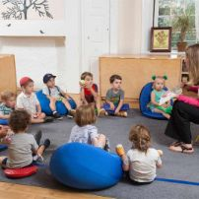
School Modifications
Strategies to improve focus
  Metronome
  Water/snack/gum chewing
  Minimize visual distractions
  Alternative seating
  Frequent movement breaks
  Circle time – defined boundaries
  Weighted lap pads
  Sensational Brain

Slide 71
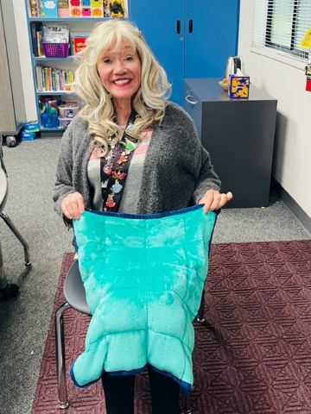
Our students really benefit from weighted blankets—they settle and calm them

Slide 72
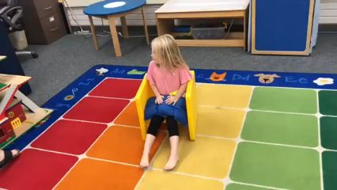
School Modifications
General sensory strategies
  Establish eye contact before stating directions
  Encourage child to repeat back to you
  Deep breathing can be calming and relaxing

Slide 73
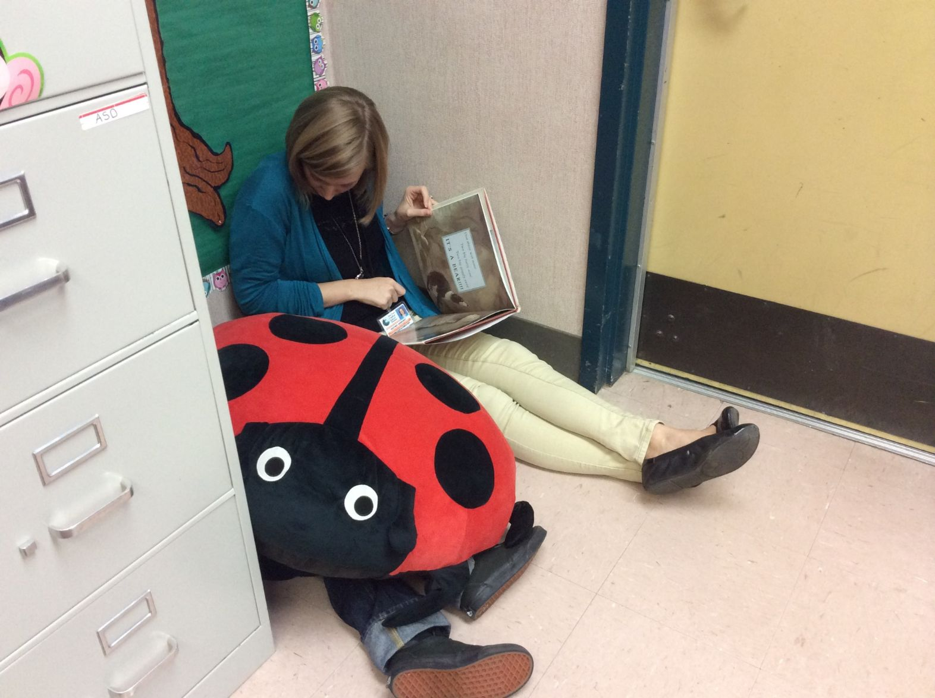

Slide 74
School modifications (cont.)
  Schedule – allows opportunities for recess/play
    >10 minutes
    At least every 90 minutes for younger kids
    Every 2 hours for older kids
        Sensational Brain

Slide 75
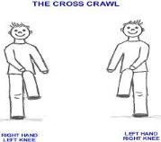
With Brain Gym, we can do cross crawls and waves to cross midline and increase alertness

Slide 76
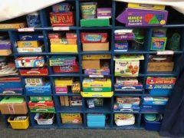
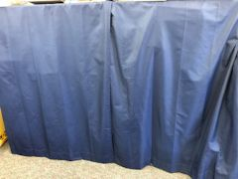
Visual Strategies
Reduce clutter
Toys hidden in rice/bean buckets
Visual Schedule
Lighting
Clothing/jewelry
Secure posters
Close curtains
Scavenger hunt
Bubble timer
Notes:
Cover bookshelves
Reduce toys in room /on table (Sac State)
Bright lights increases arousal level
Use soft/natural light
Clothing/jewelry – too busy?
Visual countdown app
Calming videos

Slide 77
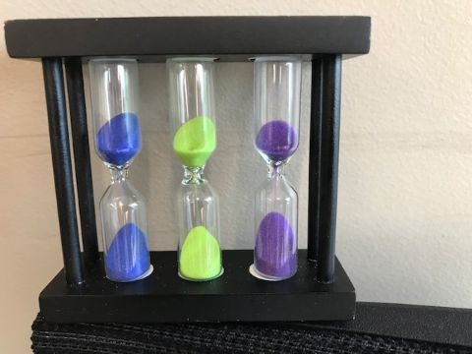
Timers work well because they give visual boundaries

Slide 78
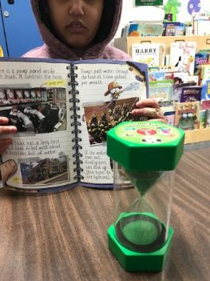
For this girl with intellectual disability, the timer worked well to encourage her to complete tasks

Slide 79
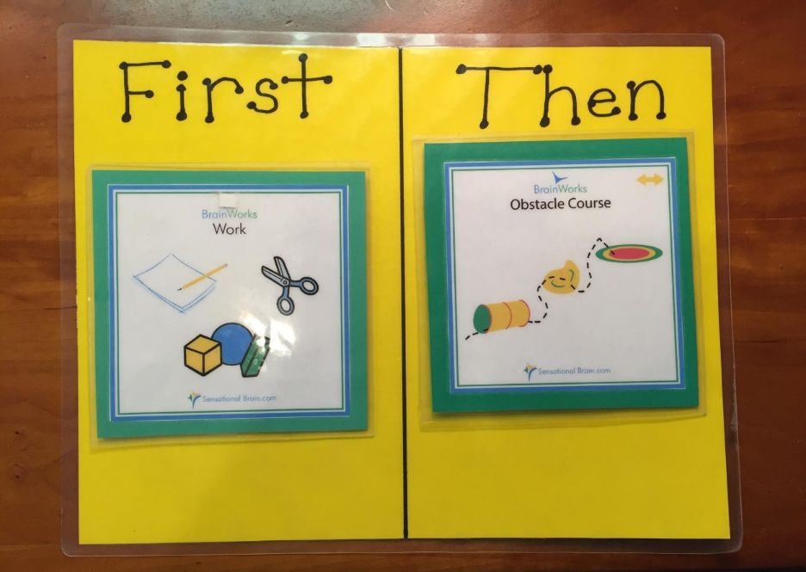
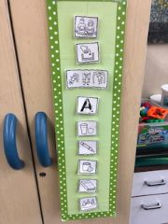
Visual Strategies

Slide 80
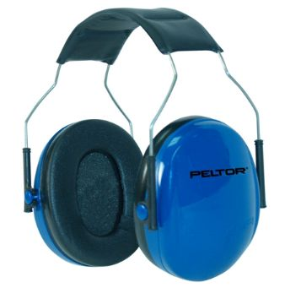
Auditory Supports
Calming music (Mozart)
Incorporate music into tasks/routines/transitions
Eliminate distracting environmental noise
Anticipate loud noises
Preparing for transitions
Reduce voice volume/rate of speech

Slide 81

Olfactory (Smell) Supports
Identify odors that are more alerting (i.e. citrus) or calming (i.e. lavender or vanilla)
Avoid wearing perfumes/colognes
Play “guess that smell” with Q tips
Essential oils

Slide 82


Taste Supports
Chewing licorice/gum/pretzels
Fingers/cloth massage around mouth
Mixed textures
Allow snacks during difficult times
Offer alternatives to biting/chewing
Be aware of preferred taste/allergies

Slide 83
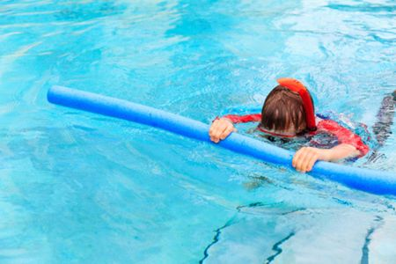

Meier:
Children with SPD often like to chew things for extra sensory stimulation
Mark would chew his sleeve and even Styrofoam flotation devices

Slide 84
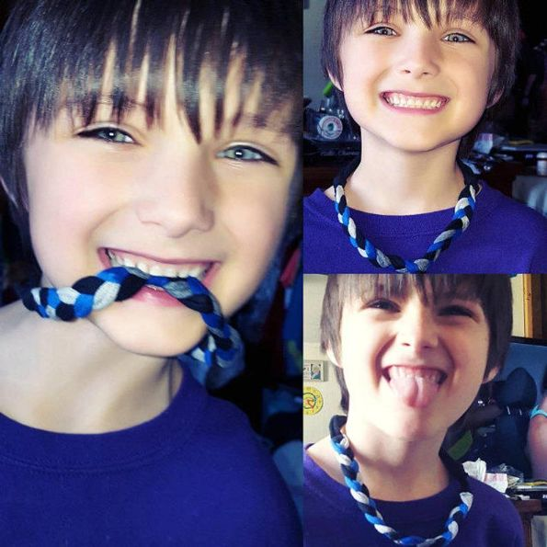

We need to provide children with appropriate, clean items to chew on (Chewlry)

Slide 85
Tactile Supports
Finger Painting
Toys hidden in rice/bean buckets (sensory bins)
Firm Touch
Fidget Ball
Play dough
Dress up
Approach children from the front
Provide space

Slide 86
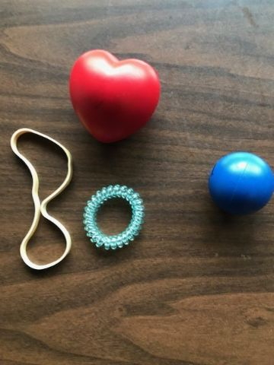
Fidget toys can calm children and keep their hands busy, thus focusing their attention

Slide 87

Vestibular Supports
Give movement breaks
Calming movements (swinging)
Change positions with activities
Animal walks
Sliding/rolling
Rock or hop on appropriate size ball
Balance activities
Beam
Hop on one foot
Scavenger hunts

Slide 88
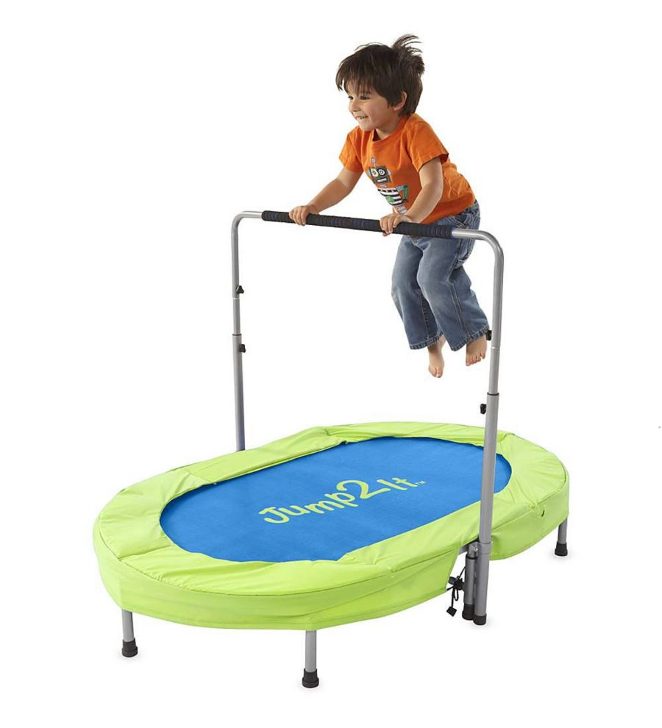
Vestibular support—jump on a miniature trampoline

Slide 89
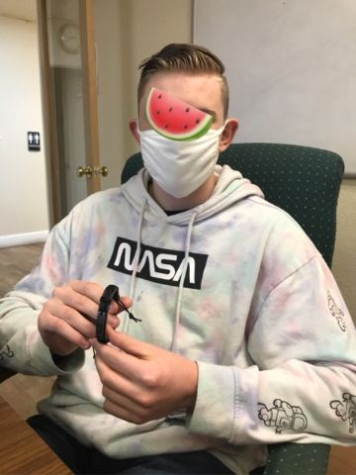
“Emelin” has Tourette’s and SPD
I asked the high security school to order him a miniature trampoline and he said he uses it daily—very helpful

Slide 90
Proprioceptive Supports
Heavy work activities
Deep pressure
Wheelbarrow walking, jumping, hopping
Resistive play
Hide toys under cushions
Heavier activity between transitions
Swimming
Obstacle course

Slide 91


Slide 92


Slide 93
Sensory Integration strategies embedded throughout the day, as needed, can easily work with other programs in which an individual may be participating

Slide 94
This youtube video shows how to incorporate sensory activities into therapy
https://www.youtube.com/watch?v=vM2MGreq88Q
Speech & sensory therapy made 'fun' for kids

Slide 95
IV. Specific Therapy Ideas for Integrating Language, Sensory, and Fine Motor Skills
Many children with developmental language disorder (DLD) have deficits in listening and speaking
They may have SPD and fine motor deficits as well
Fine motor deficits directly impact writing

Slide 96
Is it possible that this is why…
So many children with DLD also have fine motor deficits?

Slide 97
In this section….
We will discuss specific activities that address all 3 areas: language, sensory skills, and fine motor skills
For each activity, specific suggestions will be given for integrating all 3 skill areas into one fun, easy, inexpensive activity!

Slide 98
In terms of language, we will focus especially on:
Listening and following directions
Auditory memory
Developing new vocabulary words
Describing objects according to label, size, shape, color, function, how they feel
Working on basic concepts such as over, under, on top, bottom, left, right, side—spatial terms

Slide 99
We also need to focus on:
Parts of speech like verbs, nouns, adjectives
Verbs or action words are especially important because it is well-documented that children with DLD have difficulty with verbs
Expanding expressive language
Knowledge of categories
Opposites
Synonyms—very important for building more sophisticated vocabulary

Slide 100
We will also discuss social skills including:
Turntaking
Topic maintenance

Slide 101

It’s also important to incorporate math and counting:

Slide 102
Fine Motor/ Writing Problems
Our primary goals are to help the child:
Achieve appropriate body positioning
Achieve good shoulder stability
Increase muscle tone in the small muscles of the hand

Slide 103
Appropriate body positioning includes:
Having a child do prone activities on his/her stomach to strengthen trunk muscles
Having the child sit at 90 degree angles: sitting straight with his hips and knees at a 90-degree position; feet flat on the floor
If the child’s feet don’t touch the floor, put books or a box under her feet
To improve postural control, use a pillow or seat cushion

Slide 104


To improve shoulder stability:
Wheelbarrow walks—hold the child’s feet and have him walk on his hands
Have the child do pushups against the wall
Encourage prone or quadraped position—when watching TV/reading etc., lie on the floor propped on elbows

Slide 105


Slide 106
Sensory Play at Home: Proprioceptive Games
https://www.youtube.com/watch?v=SWtmkjd45so

Slide 107
There are many activities to increase muscle tone in the small muscles of the hand!
Increasing muscle tone and strength in the small muscles of the hand will not only help writing, but overall manual dexterity as well

Slide 108

Egg Carton Activities—use clothespins to move the objects

Slide 109
Have the child:
Move small objects from one hole to another, emphasizing concepts like left, right, up, down, forward, back
Label each object and tell its function—what it does—and what it is made of
Give the child directions of increasing length and complexity such as “Put a cotton ball under a straw.” “Put two cotton balls on top of a bottle lid.”

Slide 110

Use a zippered bag/purse to target spatial concepts

Slide 111

Have the child stretch various sizes of rubber bands and target opposites: big/little, wide/narrow, long/short

Slide 112


Kinetic Sand Activities

Slide 113


Slide 114



Slide 115


Slide 116

Finding /r/ objects in the sand

Slide 117

For this nonverbal 9-year old Ukrainian boy who has never been in school before, tying a book about marine life with a kinetic sand activity to teach classroom vocabulary

Slide 118
Go to Celeste Roseberry Youtube channel
https://www.youtube.com/watch?v=qYDBuWJlsJI&t=13s
Intervention for vocabulary and phonological awareness skills
This student has been diagnosed with a learning disability, and we are using kinetic sand

Slide 119

Strawberry Baskets and Clothespins

Slide 120
Incorporate language by having the child:
Follow directions: “Pick up the orange frog and put it in the second strawberry basket.”
“Pick up two objects and put them in the first strawberry basket.”
“Count and tell me how many items are in the second strawberry basket.”

Slide 121


Slide 122



Slide 123



Slide 124



Slide 125


Slappy Hands (available online)

Slide 126


Slide 127
Language activities:
“How does the slappy hand feel? Is it hard or soft? Is it stretchy? What color is it? Tell me a sentence about the slappy hand.”
“Slap the hand onto a picture/word in the middle of the page. Now the bottom of the page. Now the top of the page.”

Slide 128

Don’t Break the Ice for fine motor control

Slide 129


Washing hands is an excellent opportunity to address sequencing, vocabulary, and hygiene!

Slide 130


Some of my children resist handwashing and sanitizing gel…

Slide 131

“Sarah” washes the baby:

Slide 132

Kids loooove shaving cream! And our little therapy room smells heavenly!

Slide 133


Slide 134



Shaving cream gives good tactile feedback in writing letters and words:

Slide 135


Hi-Ho Cherry-O

Slide 136


Booby Trap

Slide 137

With a game like this, work on:
Colors, shapes (circle), opposites
Opposites: big-little, tight-loose, easy-hard

Slide 138

Velcro pictures build narrative skills and sequencing

Slide 139

Pushing toothpicks into Styrofoam can incorporate concepts like push, poke, hole, toothpick, wood, soft

Slide 140


Chinese checkers can incorporate vocabulary such as forward, backward, over, under, jump

Slide 141


Books with tabs incorporate concepts like lift, open, close, inside as well as names and functions of items on the page

Slide 142


Touch and feel books are always a hit

Slide 143

Couldn’t live without my pop its!

Slide 144



Slide 145


The preschool special day class at my school does a great job:

Slide 146

Squeezing cream or toothpaste out of tubes incorporates concepts like squeeze, tube, cream, soft, squishy

Slide 147


Fragrant paint dots are fun too:
Do A Dot Art

Slide 148

This child is working on /sh/ production and makes a dot while she drills

Slide 149

Use Qtips to make fun designs

Slide 150

The child can put their hand into a jar of jewels and other objects

Slide 151

She can divide them into categories

Slide 152

She can label and describe each category

Slide 153

There are many uses for colored blocks!

Slide 154

Children can put them into color categories

Slide 155

Which is first? Second? Third?
Which one is in the middle?

Slide 156

Which is first? Last? Touch from left to right. Which is on the left? Right?

Slide 157

Which are the same? Which are different?

Slide 158

Tall? Taller? Tallest? (comparatives and superlatives)

Slide 159

Play dough

Slide 160

Long-longer-longest

Slide 161

Bubble wrap is fun! Talk about concepts like pinch, pop, clear/transparent, round, bubble

Slide 162

The child can blow bubbles and pop them with his fingers, discussing the concepts just mentioned

Slide 163

We have children create seasonal decorations with markers and stickers

Slide 164


Tossing a ball back and forth works on turntaking and concepts like throw, up, down, across, over, under

Slide 165

We can discuss coloring inside the lines

Slide 166

We can target words like open, close, inside, over, under

Slide 167

Melissa and Doug Latches

Slide 168


Slide 169


Target words: big/little, side, top, bottom, throw, toss, fly, catch, squeeze

Slide 170


Slide 171

Sensory bins with shredded paper are sanitary and fun!

Slide 172

When children are done with the session, we can recycle the paper and get fresh, clean paper for the next group

Slide 173

The children draw out an object and describe it: label, function, composition, color, etc. They also use the word in a sentence with their target sound like /r/

Slide 174


Slide 175


Jackie works on vocabulary, expressive language, and counting

Slide 176


Slide 177


Slide 178

Magnetic boards and sticker boards target spatial terms, categories, narratives

Slide 179



Slide 180

We use an M & M machine as a reward and discuss concepts like twist, turn, candy, red, blue, delicious, good behavior

Slide 181

Puppets can be used for role play, verbs, and more!

Slide 182


The child can tear off bits of masking tape and stick them to various objects; they then label the object and describe it according to function

Slide 183

Soft sensory balls can encourage vocabulary words like colors, soft, squishy, and others

Slide 184


Slide 185

Use an activity like this to target adjectives as well as verbs and spatial concepts

Slide 186

Sidewalk chalk encourages letter and word recognition

Slide 187


Slide 188


This group has very challenging behavior, but they looooove sidewalk chalk! ☺

Slide 189

Cooking/baking is excellent for following directions, sequencing, and measurement (e.g., 1 cup of flour)

Slide 190

Children are often fascinated by skeleton bones, which can help them with science and anatomy

Slide 191

Tiddly Winks targets concepts like inside, outside, line, center

Slide 192

Using instruments can target auditory memory for sequences

Slide 193


Slide 194


Slide 195

Reach into a bag and describe objects by how they feel

Slide 196

Other ideas for incorporating sensory activities and materials:

Slide 197

Chairs welded together for children who tip their chairs back

Slide 198

Beanbag chairs on the floor allow for more movement

Slide 199

Coloring an Easter egg with chalk

Slide 200


Slide 201

Wooden doll house with objects

Slide 202


Slide 203


Legos always work!

Slide 204

Key and wooden car

Slide 205

Manipulatives for math concepts

Slide 206

Getting toys out of a bag

Slide 207

Kitchen hands-on activities to build vocabulary

Slide 208


Slide 209


Play Zoo to target vocabulary

Slide 210


Fidget Toys

Slide 211


Targeting wh-questions by squashing play dough!

Slide 212


Slide 213


This autistic boy loves this sensory game!

Slide 214


Slide 215


Do-a-Dots for older students during drill for R and K; they have DLD and are in the special day class

Slide 216

This very active kindergartener fronts velars; it’s hard to keep him focused, but he loves to color ☺

Slide 217

ASHA Leader 1/24—Tearing it up for Core Words and More—Language, speech sound targets, and more!

Slide 218


Camouflage science project

Slide 219



Slide 220



Slide 221




Slide 222



Slide 223
Unmute or type into Chat…
And share some ideas that you have used in your own practice to integrate sensory materials and activities into your speech-language therapy

Slide 224
In sum….
Sensory integration involves the neurological process that organizes sensations from one’s own body and the environment into useable information
  It involves information filtering and processing
  Sensory integration activities incorporating fine motor and language skills are fun, useful, and easy to implement as a part of speech-language therapy!

Slide 225
A great youtube video for how to integrate sensory activities into speech-language therapy
https://www.youtube.com/watch?v=1AERJdldapQ
How To Use Sensory Play for Language Speech Therapy Tips

Slide 226
In this seminar, we took time to:
I. Define sensory integration and its systems
II. Discuss the term SPD
III. Explain the relationship of SPD to speech and language
IV. Share practical activities and materials to use in speech and language therapy for children with accompanying SPD and fine motor deficits

Slide 227

Thank you for all you do for the children!

Slide 228
References
Delgado-Lobete, L. et al. (2020). Sensory processing patterns in developmental coordination disorder, attention deficit hyperactivity disorder and typical development. Research in Developmental Disabilities, vol. 100. https://doi.org/10.1016/j.ridd.2020.103608t
Galina-Simal et al. (2020). Sensory processing disorder; Key points of a frequent alteration in neurodevelopmental disorders. Cogent Medicine, 7:1736829. https://doi/org/10.1080/2331205X.2020.173682
Meier, M. (2020). Chewing devices for individuals with sensory processing disorder. South Carolina Junior Academy of Science. https://scholarexchange.furman.edu/scjas

Slide 229
Resources
Sensory Integration and the Child
By A. Jean Ayres
An Introduction to Sensory Integration
By Nan Arkwright
The Out-of-Sync Child
By Carol Kranowitz
A Parents Guide to Understanding Sensory Integration
By Sensory Integration International
Building Bridges Through Sensory Integration
by Ellen Yack, Shirley Sutton, and Paula Aquilla
Pre-Feeding Skills
by Suzanne Evans Morris, PH.D. CCC-SLP & Marsha Dunn Klein, M.Ed., OTR/L

Slide 230
Resources (cont.)
Building Bridges Through Sensory Integration
By Ellen Yack, Shirley Sutton, and Paula Aquilla
Pre-Feeding Skills
By Suzanne Evans Morris, PH.D. CCC-SLP & Marsha Dunn Klein, M.Ed., OTR/L
Self-Reg How to Help Your Child (and You) Break the Stress Cycle and Successfully Engage With Life
By Dr. Stuart Shanker
Raising a Sensory Smart Child
By Lindsey Biel, M.A. OTR/L and Nancy Penske

Slide 231
Resources (cont.)
American Occupational Therapy Association
http://www.aota.org
Phone: 301-652-2682
American Occupational Therapy Association of California http://www.healthcaresource.com/otac/
Phone: 916-567-7000
Sensory Integration International
http://home.earthlink.net/sensoryint/
Phone: 310-787-8805

Slide 232
Resources (cont.)
Sensory Resources
http://
www.sensoryresources.com/
Phone 1-888-357-5867
Southpaw Enterprises (SI Products and Resources)
http://www.spouthpawenterprises.com/html/home.asp
Phone 1-800-228-1698
Sensational Brain Co.
www.sensationalbrain.com

Slide 233
Resources (cont.)
www.sensorysmarts.com
Wild, Gwen, MOT, OTR/L and Jones, Lyle, MBA (2012) Parent’s Perception of Effectiveness of Sensory Diets for Children: A Multiple Case Study Analysis
Arnie and His School Tools
By Jennifer Veenendall
Sensational Kids: Hope and Help for Children with Sensory Processing Disorder (SPD)
by Lucy Jane Miller

Slide 234
Resources (cont.)
STAR Institute (2022). Understanding sensory processing disorder. https://sensoryhealth.org/basic/understanding-sensory-processing-disorder
Ginsburg, J. (2022). Is your client an Avoider or Seeker? Sensory or Bystander? The ASHA Leader, 27(4), July/August 2022, pp. 28-29.

