Slide 1
Chapter 12
LANGUAGE SKILLS IN ADOLESCENTS AND ADULTS

Slide 2
In chapter 12, the Gender Differences section is not on the exam (pp. 397-bottom of p. 399)

Slide 3
PowerPoint Outline
I. Introduction
II. Bilingualism
III. Literacy
IV. Syntax and morphology
V. Semantics
VI. Pragmatics

Slide 4
I. INTRODUCTION

Slide 5
With aging…

Slide 6
A study in Aging, Neuropsychology, and Cognition (2024): https://www.tandfonline.com/toc/nanc20/31/1

Slide 7
This 2024 study found that:

Slide 8
II. BILINGUALISM

Slide 9
Research in Canada (Ellen Bialystok) showed:

Slide 10
III. LITERACY
A. Foundations

Slide 11
B. Paper vs. Digital Books, Social Media, and Screen Time**
Posnick-Goodwin. The great divide: Print or digital? California Educator, 19(7), 37-39.
Looked at the preferences of current students and research about digital vs. print books

Slide 12
Posnick-Goodwin :

Slide 13
Naomi Baron Words Onscreen

Slide 14
Baron (continued; this slide not on exam)**
It takes 33 pounds of minerals to make a single eReader compared with 2/3 of a pound to make a printed book
Minerals for the eReader include rare minerals like columbite-tantalite, generally mined in African conflict-filled areas where profits support warlords

Slide 15
Baron (continued; this slide not on exam)**
Producing an eReader requires 100 kilowatt-hours of fossil fuels, which produce 66 pounds of carbon dioxide compared to 2 kilowatt hours and 100 times less in greenhouse gases for a printed paper book
Recycling an eReader to extract its minerals is usually done in poor countries by children who are exposed to huge health risks from toxins
Paper books can be recycled as a renewable resource

Slide 16
Take a moment…**
Write what you think are the merits of print/paper vs. digital books
For students with language impairment, which do you think might be better? Why?

Slide 17
osmotogether.com/blogs/news/average-screen-time-for-teenagers-in-2025=Currently%2C%20more%20than%20half%20of,HALF%20of%20their%20waking%20hours.**
Currently, more than half of US teens spend an average of 7 hours and 3 minutes of daily screen time. Considering the amount of sleep teenagers need, that's almost HALF of their waking hours. (2025)

Slide 18
New slide not on exam--in 2025:
Social media is a huge trend for this generation. Instagram, Snapchat, and TikTok are, by far, the most frequently used platforms. One-quarter of Gen Zers spend five hours or more per day on TikTok. TikTok continues to soar in popularity among members of Generation Z (911% in 5 years).

Slide 19
In 2025:

Slide 20
Take a moment for a writing reflection--what would you do?:**
You are working with Eddie, a 15 year old with a language impairment and with few friends. He is not adept at using social media, and doesn’t like to talk to people. As part of your therapy, will you try to get him onto social media? Why or why not?

Slide 21
IV. SYNTAX AND MORPHOLOGY

Slide 22
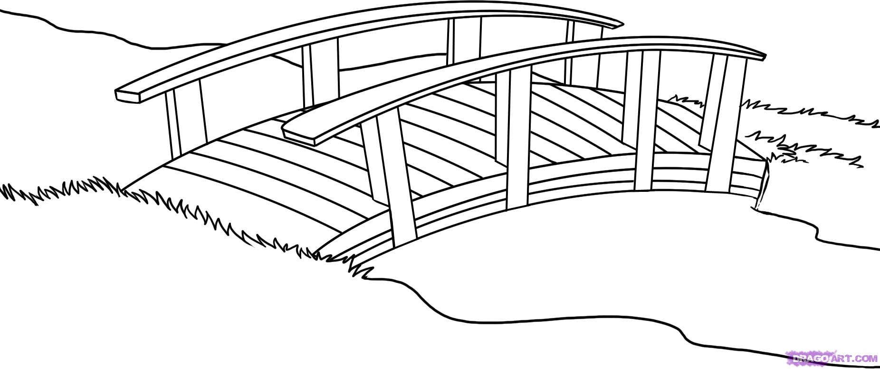
Utterance 2
Utterance 1

Slide 23
Adverbial disjuncts… (p. 403)

Slide 24
Adverbial conjuncts:

Slide 25
V. SEMANTICS

Slide 26
Cognitive-linguistic disorders most common in older adults:

Slide 27
VI. PRAGMATICS
A. Conversational Abilities

Slide 28
Example:**
Speaker A: “Can you believe that Game of Thrones is going into another season?”
Speaker B: “Yeah, some of my favorites are going into another season too. Can’t wait till the next season of Big Bang Theory. I wonder what’s going to happen with Sheldon and Amy.”

Slide 29
B. Narratives

Slide 30
C. Speaking Styles

Slide 31
PowerPoint Outline
I. Introduction
II. Bilingualism
III. Literacy
IV. Syntax and morphology
V. Semantics
VI. Pragmatics

