Slide 1
LINKING LANGUAGE INTERVENTION TO ENGLISH LANGUAGE ARTS STANDARDS IN THE COMMON CORE

Slide 2
Moore & Montgomery:

Slide 3
In 2025:** https://worldpopulationreview.com/state-rankings/common-core-states
41 states and the District of Columbia use Common Core

Slide 4
Power Point Outline**
I. Review of Purpose of Common Core State Standards
II. Practical Intervention Strategies: Speaking and Listening Standards
III. Practical Intervention Strategies: Language Standards

Slide 5
I. PURPOSE COMMON CORE STATE STANDARDS (REVIEW)
A. Introduction

Slide 6
B. English Language Arts Standards

Slide 7
C. Speaking and Listening Standards

Slide 8
D. Language Standards

Slide 9
II. PRACTICAL INTERVENTION STRATEGIES: SPEAKING AND LISTENING STANDARDS

Slide 10
A. Presentation of Knowledge and Ideas—Complete Sentences**
1. (3rd grade, standard 6) “The student will speak in complete sentences when appropriate to task and situation in order to provide requested detail or clarification.”

Slide 12
How do we decide when to use complete sentences?

Slide 13
Therapy activity (to do together in class ☺ )**
Using the 3x5 index cards, create
1 card that says “fragment”
1 card that says “complete”
Create 5 cards with fragments, and 5 cards with complete sentences
With a partner, play the game! The SLP holds up the 2 cards, and the child has to put the fragment cards in one pile and the complete sentence cards in the other pile

Slide 14
The child (a classmate) has to tell why it is not a correct or complete sentence:**
It does not have a subject or predicate
It does not express a complete thought
It does not provide enough information or detail

Slide 15
B. Presentation of Knowledge and Ideas--Formal Vs. Informal

Slide 16
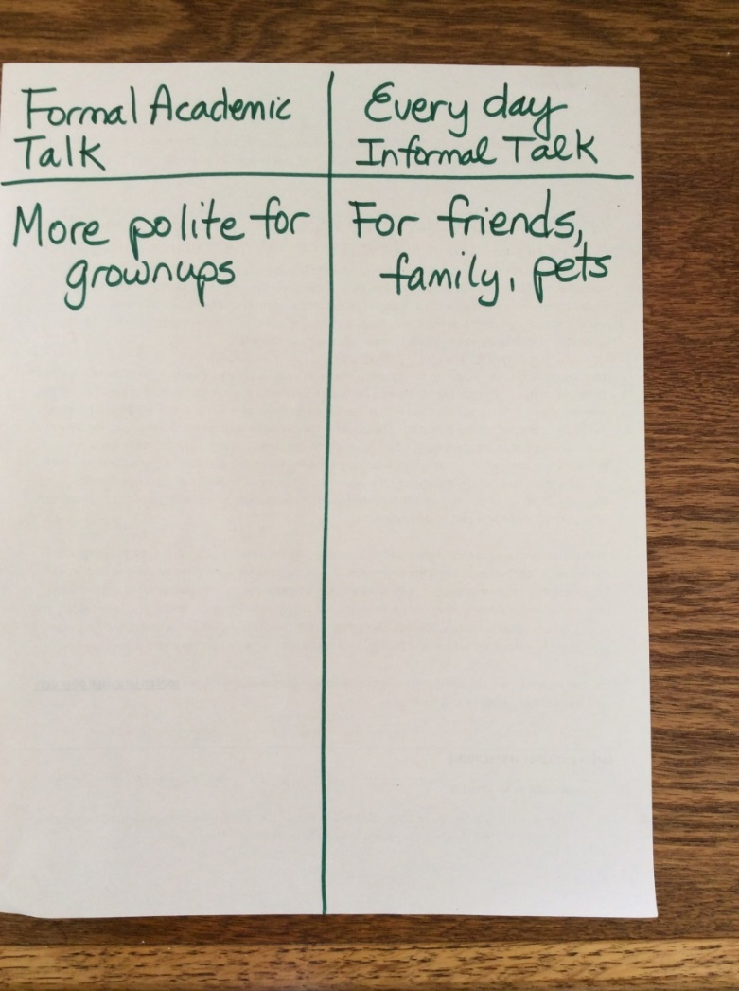
Teach students that informal speaking is for**

Slide 17
Informal speaking:

Slide 18
Formal speaking:

Slide 19
C. Comprehension and Collaboration**
“The student will engage effectively in a wide range of collaborative discussions (one-on-one, in groups, and teacher-led) with diverse partners on grade level topics and texts, building on each others’ ideas and expressing their own clearly.”

Slide 20
Talk about rules for successful conversations:

Slide 21
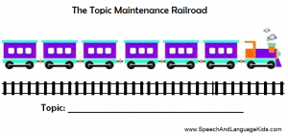
The Topic Maintenance Railroad (SpeechAndLanguageKids.com 2025)

Slide 22
Show the child the train and explain to** him that each of the train cars represents what we say about that topic. If you say something that isn’t about the topic, then the train car falls off the track. Try to keep all of the train cars on the track. If the child is struggling, print off the train and write what he says during a conversation above each train car and then discuss whether they are about the topic or not.

Slide 23
Try setting some goals with your child** such as how many turns your child will stay on topic. You can tell your child “There are six cars on this train. Let’s see if you can think of 6 things to say about our topic.” Then, celebrate with your child once he fills up the train but only write down the things your child says that are on topic.

Slide 24
Once your child begins to understand** this analogy, you can begin to use it in other settings as well. For example, when your child changes the subject unexpectedly, you can say something like “Wait a minute! We were talking about pizza. You changed the topic. Did your train fall off the track?”

Slide 25
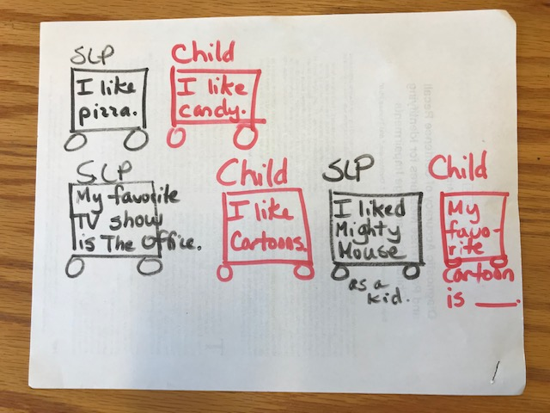
Right where you are, draw a train on a piece of paper—2 cars, then 4 cars, then 6 cars; we will share
Pretend you are the SLP and child and think of a topic
Have the “child” add on and write in what she says

Slide 26
https://www.youtube.com/watch?v=3RjRZ9jMfs0
Social Skills Training: Taking Turns Speaking
Youtube video

Slide 27
III. PRACTICAL INTERVENTION STRATEGIES: LANGUAGE STANDARDS

Slide 28
A. The student will demonstrate command of the conventions of standard English grammar and usage when writing or speaking**

Slide 29
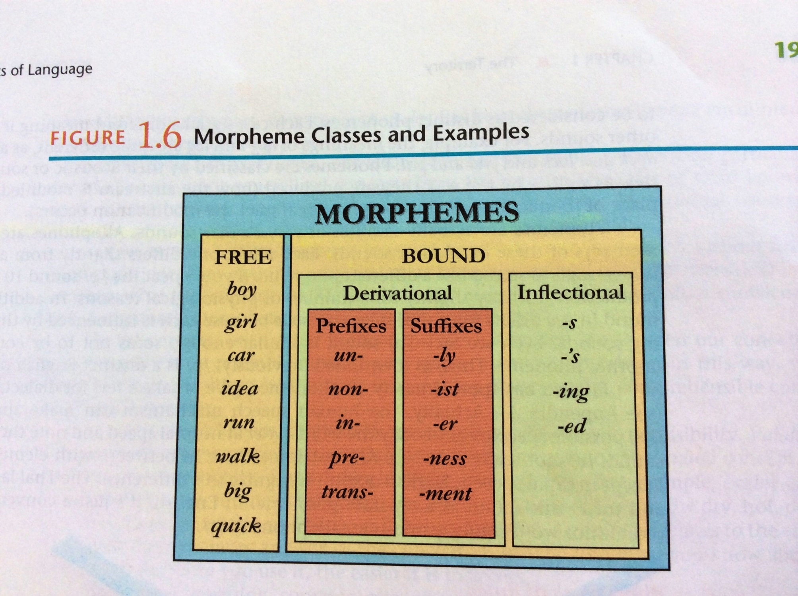
**

Slide 30
Derivational morphemes…

Slide 31
Inflectional morphemes…

Slide 32
Apel et al. (2022). Morphological awareness performance profiles of first- through sixth-grade students. Journal of Speech, Language, and Hearing Research (65), 10701086.**
They tested the MA skills of 4,059 students in grades 1-6
There were different profiles of performance and they identified 6 different subgroups of students

Slide 33
Apel et al. 2022 concluded:

Slide 34
Passaretti et al. (2023). Reporting of classroom-based morphological awareness instruction and intervention for K-3d grade students in the literature: A scoping review. Language, Speech, and Hearing Services in School, 54, 648-669.

Slide 35
Passaretti et al. 2023 found that it is most effective to include activities that target:

Slide 36
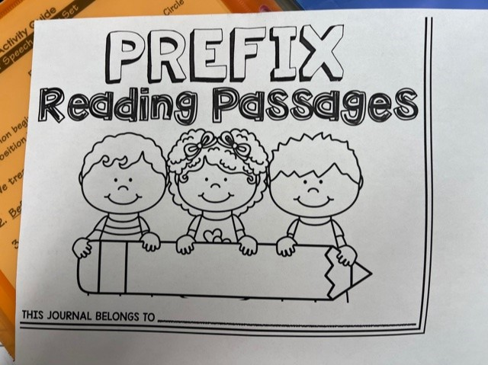
A wonderful program to target morphological awareness:

Slide 37
Forms and their functions:

Slide 38
What are some examples of irregular nouns? Irregular past tense verbs?

Slide 39
B. The student will determine or clarify the meaning of unknown and multiple meaning words and phrases based on grade-level content**

Slide 40
1. Common prefixes and their meanings (derivational morphemes)

Slide 41
2. Common suffixes and their meanings (derivational morphemes)**
-ful (to be full of) e.g., hopeful, joyful
-ous (to be full of) e.g., nervous, joyous
-less (none, without) e.g., careless, homeless
-able (to be able to) e.g., believable, teachable
-ment (state of) e.g., government, achievement

Slide 42
Group Activity**
Pick 2 pages out of your children’s book
Use post its to show 3 different affixes
Share them with us and tell us what the word means

Slide 43
Change! ☺ You are in 4th grade
Listen to the Diwali story read by Dr. R.
Write down all the words you hear that contain bound morphemes

Slide 44
3. Words with multiple meanings (example from grades 6-8)**
Dread suit
Date like
Crane lash
Company mint
Charge monitor
Column minor
Chair patient
tackle
strike
terrific
trace

Slide 45
On index cards…**
Choose 2 words and write down what each one can mean
Use each word in a sentence

Slide 46
C. The student will demonstrate understanding of figurative language, word relationships, and nuances in word meanings
1. Idioms

Slide 47
http://examples.yourdictionary.com/idioms-for-kids.html**
Give it a shot – Try
Speak your mind - Say what you really feel
A piece of cake - Very easy
Slipped my mind - I forgot
Cross your fingers - For good luck
Be in hot water - Be in trouble
It cost an arm and a leg - It was expensive
It’s in the bag - It’s a certainty
Get cold feet - Be nervous
A rip off - Too expensive
Get a kick out of – Enjoy

Slide 48
Read between the lines - Find the hidden** meaning
Have mixed feelings - Unsure how you feel
Draw a blank - Can’t remember
Have a change of heart - Changed your mind
Be second to none - Be the best
Get your act together - Behave properly
Play it by ear – Improvise
Have second thoughts - Have doubts
A basket case - A crazy person
Have a shot at - Have a chance
Be in the same boat - Be in the same situation

Slide 49
2. Antonyms and Synonyms**

Slide 50
Antonyms examples are:**
Problem-solution
Strong-weak
Vanish-appear
Show-hide
Raw-cooked
Seldom-often
Unique-common
Vacant-full
Deep-shallow
Complex-simple
Create-destroy

Slide 51
Synonyms examples are: **
Careful-cautious
Decrease-lessen
Mistake-error
Hurry-rush
Work-labor
Ornament-decoration
Answer-Solution
Pain-Ache
Bother-annoy
Need-require
Leave-depart
Faithful-loyal

Slide 52
Write 4 sentences**
2 sentences need to use one synonym (the more sophisticated one) Circle the synonym.
He was cautious when he crossed the road.
The fly annoyed me when it flew around my head.
The 2 other sentences need to use a pair of antonyms—circle the antonyms.
I don’t want to be weak; I want to be strong, so I work out.
The parking lot was vacant, but it got full fast.

Slide 53
Youtube example of using Fancy Nancy for synonyms:
Building Vocabulary Skills
https://www.youtube.com/watch?v=8EjEDfqDfbQ

Slide 54
Remember Free Rice ☺
https://play.freerice.com/categories/english-vocabulary

Slide 55
Power Point Outline
I. Review of Purpose of Common Core State Standards
II. Practical Intervention Strategies: Speaking and Listening Standards
III. Practical Intervention Strategies: Language Standards

