Slide 1
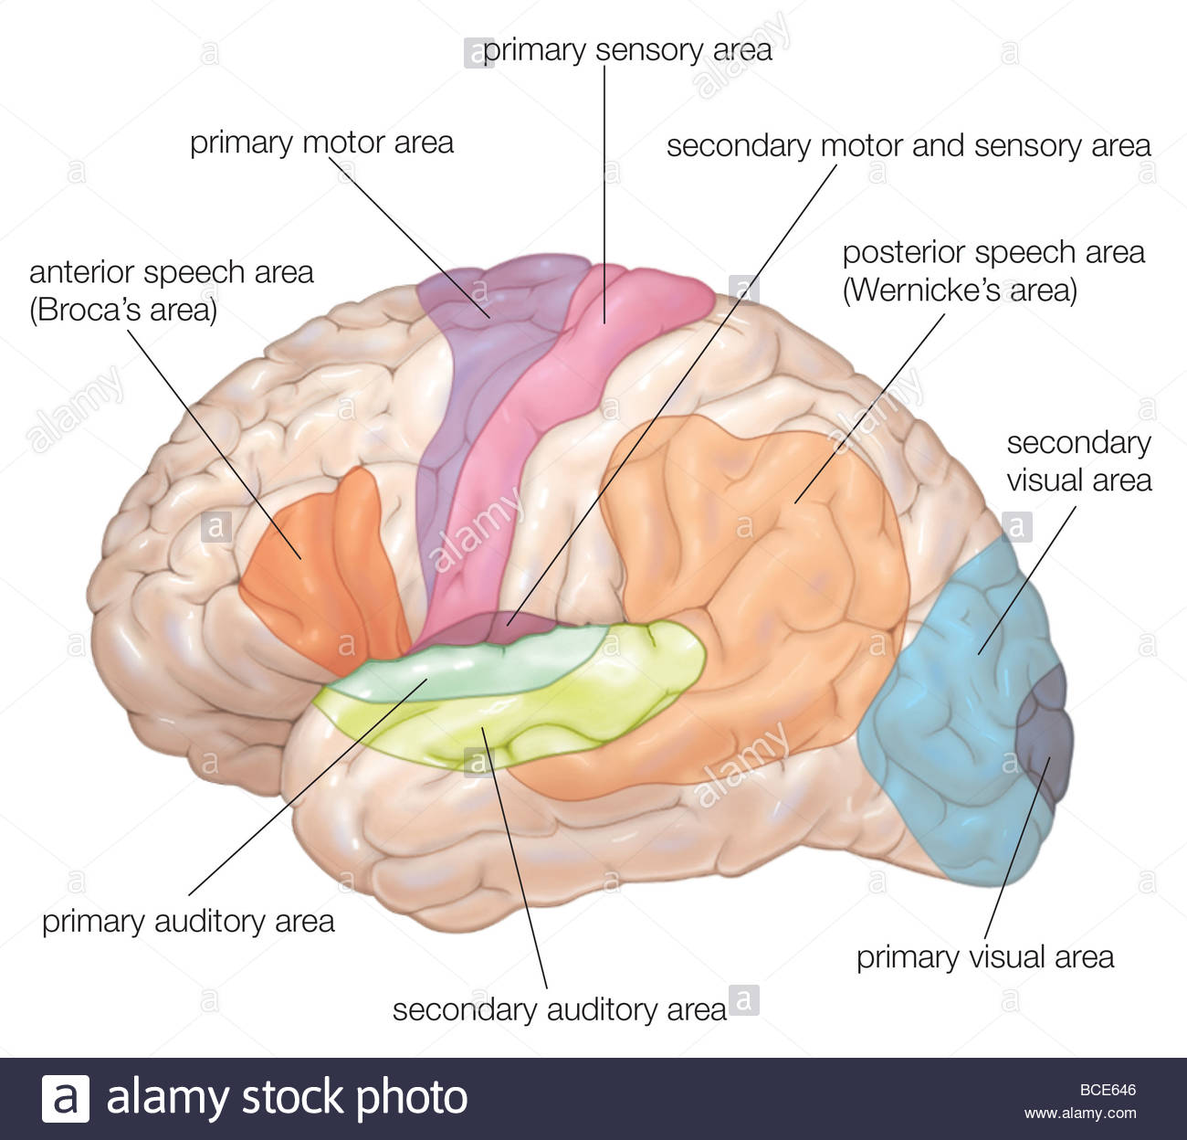
NEUROLOGICAL BASES OF SPEECH AND LANGUAGE

Slide 2
PowerPoint Outline:**
I. Introduction
II. Components of the central nervous system
III. Cerebellum
IV. Cerebrum
V. Lobes of the brain
VI. Brain functions: left and right hemispheres
VII. Language comprehension
VIII. Language production
IX. Working memory

Slide 3
General facts:

Slide 4
I. INTRODUCTION

Slide 5
Neurolinguistics is:**
The study of the neuroanatomy, physiology, and biochemistry of language

Slide 6
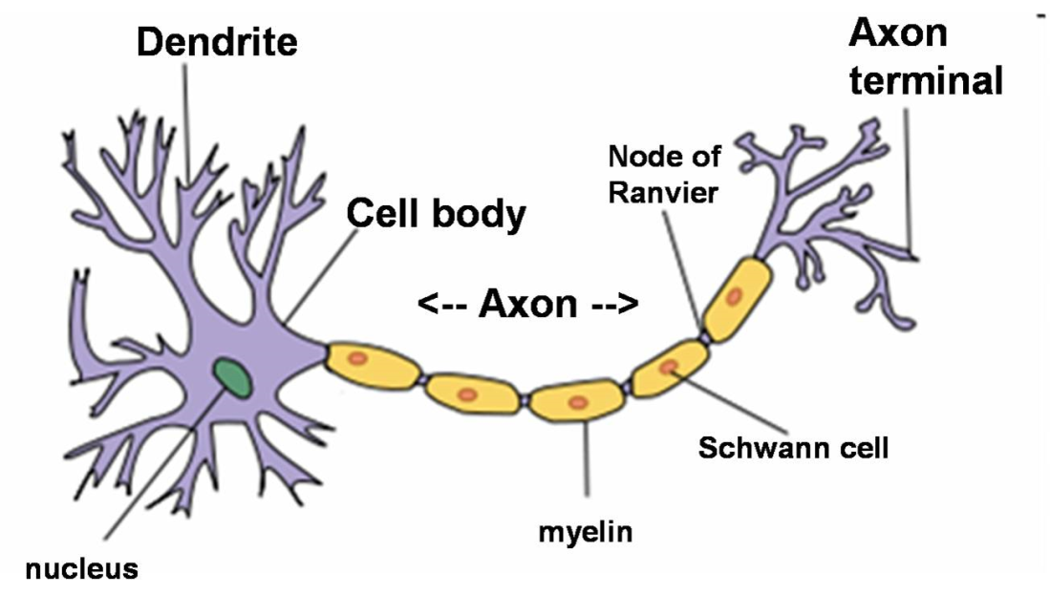
II. COMPONENTS OF THE CENTRAL NERVOUS SYSTEM
A. Neurons
Neuron, or nerve cell--basic unit of CNS

Slide 7
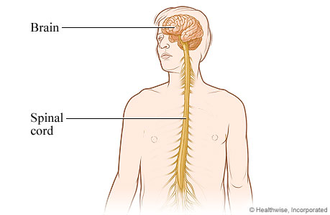
B. Central Nervous System

Slide 8
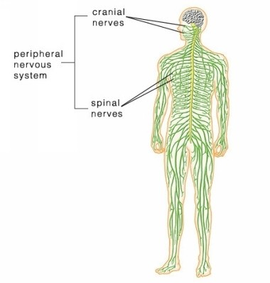
C. Peripheral Nervous System

Slide 9
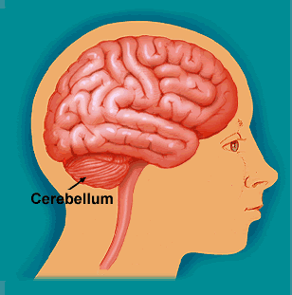
III. CEREBELLUM (part of CNS)**
At base of brain
Coordinates control of fine, complex motor activities
Controls balance

Slide 10
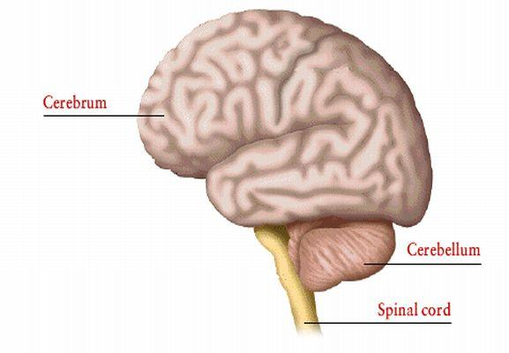
IV. CEREBRUM

Slide 11
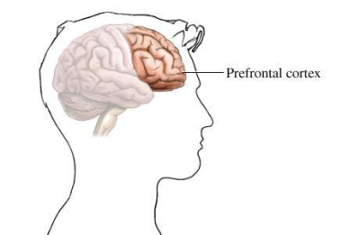
The prefrontal cortex is very important for:

Slide 12
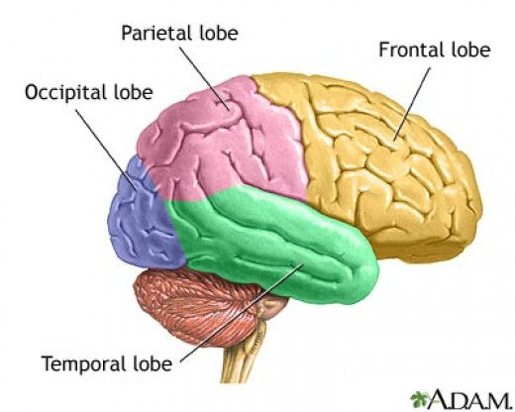
V. LOBES OF THE BRAIN**
The brain has 4 lobes: frontal, parietal, occipital, and temporal
FPOT

Slide 13
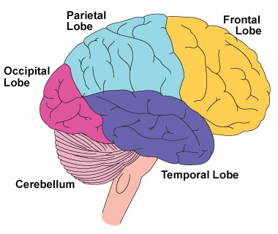
The frontal lobe’s main function:

Slide 14
Persons with damage to the frontal lobe…

Slide 15
The parietal lobe’s main function:

Slide 16
The occipital lobe’s main function:

Slide 17
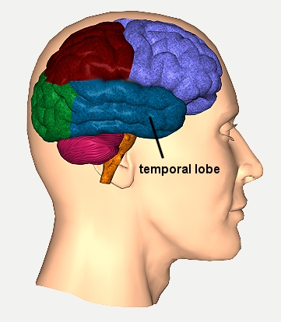
The temporal lobe’s main function:

Slide 18
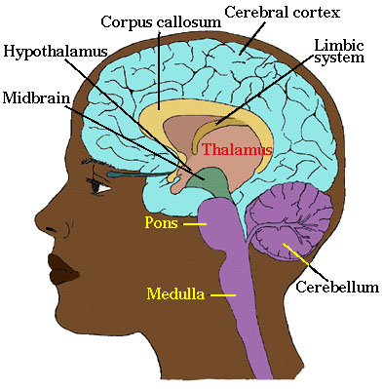
VI. BRAIN FUNCTIONS: LEFT AND RIGHT HEMISPHERES

Slide 19
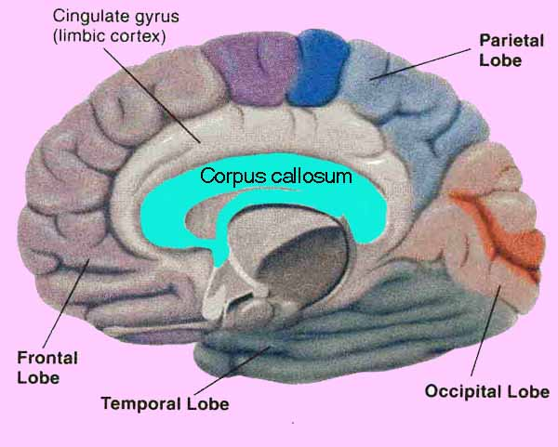
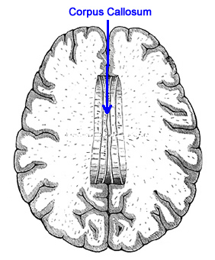
Other views of the corpus callosum:

Slide 20
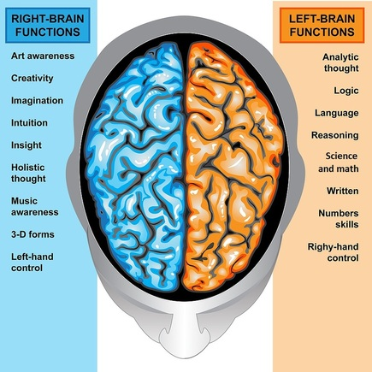

Slide 21
A. Right Hemisphere—Dominant for:

Slide 22
B. Left Hemisphere—Dominant for:

Slide 23
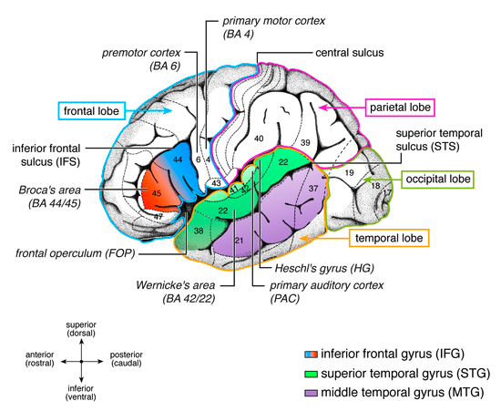
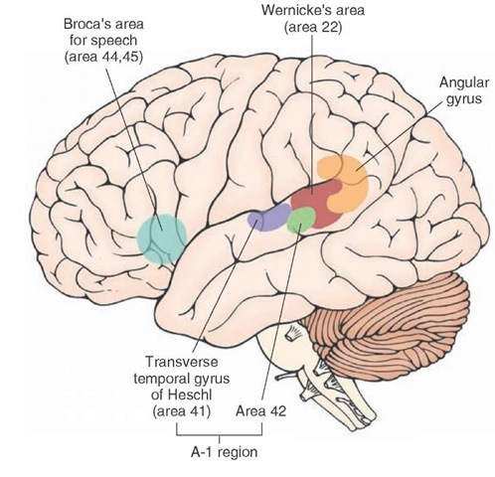
VII. LANGUAGE COMPREHENSION

Slide 24
Heschl’s gyrus and surrounding areas…

Slide 25
Linguistic input is further separated….

Slide 26
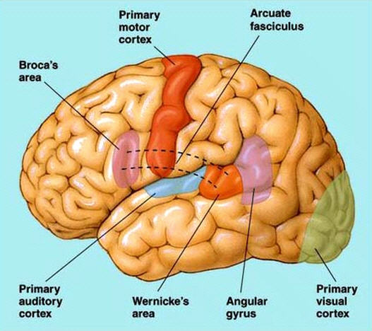
VIII. LANGUAGE PODUCTION

Slide 27
A person with Wernicke’s aphasia…

Slide 28
Youtube video: Grace stroke survivor Broca’s
Notice how she struggles and it is an effort to talk
She leaves out small “function words”
https://www.youtube.com/watch?v=khOP2a1zL9s

Slide 29
Youtube video Wernicke’s fluent aphasia
Notice how “empty” his speech is
If you were across a crowded room and couldn’t hear him, you’d probably never know anything was wrong
https://www.youtube.com/watch?v=3oef68YabD0

Slide 30
Youtube https://www.youtube.com/watch?v=B1SBFUgluK0
Speech-Language Therapy: Working with a Patient with Fluent Aphasia
She shows some actual therapy techniques that are working

Slide 31
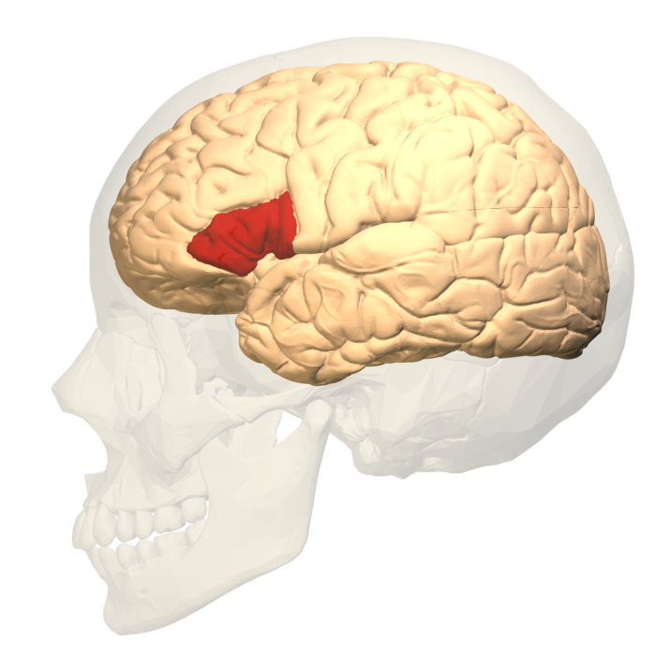
IX. WORKING MEMORY (WM)

Slide 32
Working memory is essential in:

Slide 33
Working memory is absolutely crucial to success in school**

Slide 34
Today we’ve covered a lot!

Slide 35
PowerPoint Outline:**
I. Introduction
II. Components of the central nervous system
III. Cerebellum
IV. Cerebrum
V. Lobes of the brain
VI. Brain functions: left and right hemispheres
VII. Language comprehension
VIII. Language production
IX. Working memory

