Slide 1
Intervention for Social Skills: Creating and Maintaining Friendships

Slide 2
PowerPoint Outline**
I. Need for Social Skills Intervention
II. Assessment
III. Positive Skills for Making Friends
IV. Positive Skills for Keeping Friends

Slide 3
I. Need for Social Skills Intervention

Slide 4
Student Profile:

Slide 5
We know that:**
Children with DLD have difficulty gaining access to conversations
Thus—barge in and interrupt, or are isolated and withdrawn

Slide 6
St. Clair, M.C., Forrest, C.L., Yew, S.G.K., & Gibson, J. Early risk factors and emotional difficulties in children at risk of developmental language disorder: A population cohort study. Journal of Speech, Language, and Hearing Research, 15;62(8), 2750-2771.

Slide 7
St. Clair et al.:**
884 children with DLD were evaluated for this study (ages 3-11 years)
They had increased levels of emotional problems compared to the general population
Increased emotional difficulties found in children with DLD are likely a function of early language difficulties influencing other domains of development

Slide 8
St. Clair et al:

Slide 9
Students who can benefit:**
DLD
ASD
Learning disability
Intellectual disability

Slide 10
Lyons, R., & Roulstone, S. Well-being and resilience in children with speech and language disorders. Journal of Speech, Language, and Hearing Research.**
Examined children with SLI or speech sound disorder and analyzed data to find themes relating to potential risk factors to well-being and protective strategies.

Slide 11
Lyons & Roulstone:

Slide 12
Phillips**
Show social skill videos
Videos are very helpful because they depersonalize emotions and don’t make students feel judged

Slide 13
Kathryn Phillips**
Show video clips of Donkey annoying Shrek
While I show this 1½ minute video, write down several behaviors Donkey is displaying that annoy Shrek and Fiona. Why are they annoying? ☺
https://www.youtube.com/watch?v=Gn51xYvJhQI

Slide 14
Big Bang Theory for older students**
Sheldon and Amy first date
TBBT Penny drives Sheldon and Amy to Date !!
List the things Amy and Sheldon do that are awkward
https://www.youtube.com/watch?v=BxzULjCvsCI

Slide 15
Singer, I., Klatte, I.S., Welbie, M.,** Conssen, I.C., & Gerrits, E. (2020). A multidisciplinary Delphi consensus study of communicative participation in young children with language disorders. Journal of Speech, Language, and Hearing Research, 63, 1793-1806.

Slide 16
This slide not on exam**
The Delphi technique (also referred to as Delphi procedure or process), is a method of congregating expert opinion through a series of iterative questionnaires, with a goal of coming to a group consensus

Slide 17
not on exam:
Iterative approach: continuing improvement

Slide 18
Singer et al. 2020:**
This was a Dutch study
They created an online Delphi study with 47 panel members---parents, young adults with language impairment, teachers, SLPs, linguists, researchers
The panel said that when treating children with LI, improving actual participation in real life communication activities was more important than language structure (e.g., syntax and morphology)

Slide 19
Singer et al. 2020—the most important skills to target in tx—the child:

Slide 20
Levey 2024—other important skills for treatment to ensure successful peer acceptance:

Slide 21
Bruinsma et al. (2024). Communication in the daily life of children with DLD: Parents’ and teachers’ perspectives. Language, Speech, and Hearing Services in Schools, 55, 105-129.**
Parents and teachers of 5-6 year old children with DLD filled out questionnaires
Parents saw the biggest problem as communication with strangers
Teachers: if children had expressive disorder only, there were limitations in specific situations only
For those with receptive and expressive language limitations, all situations were hard

Slide 22
II. Assessment**
Test of Pragmatic Language:2 (TOPL:2)
The CELF:5 has a checklist
You can have parents and teachers fill out surveys**
Informal observations**

Slide 23
III. Positive Skills for Making Friends

Slide 24
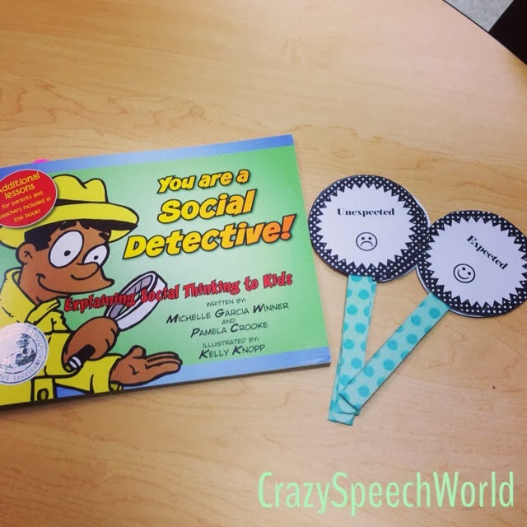
This was on Pinterest—kids hold up the popsicle stick for expected and unexpected behaviors

Slide 25
A. Being Interested in Others**
Objective: The student will identify several techniques for showing interest in others
Rationale: The best way to make friends is to show interest in other people. People love to have others notice them and want to know more about them.

Slide 26
Thinking Questions**
Why is it important to have friends?
How could you show someone you’d like to become friends?
Why is this better than just going up to someone and talking about yourself?

Slide 27
From the Big Bang Theory
Please pass the butter
You may have seen this in CSAD 112
https://www.youtube.com/watch?v=p1jzdSzGHnA

Slide 28
Activity: See your book page “Being interested in others”
Be the SLP and the child
Then share with us

Slide 29
B. Being Interesting**
Objective: The student will list 10 things about him- or herself that would be considered unique or interesting
Rationale: People are attracted to interesting people. Help your students think about things about themselves that are unique and appealing.

Slide 30
Thinking Questions:**
How are you different than anyone else in this room?
What are some differences you’re proud of?
What are some ways that you are like others? What could you talk about together?

Slide 31
C. Spending Time with Others**
Objective: The student will identify several ways that friends could spend time together
Rationale: People who spend time engaging in the same activity automatically have a common interest. In this lesson, students are asked to start thinking about places or situations involving spending time with others.

Slide 32
Thinking Questions**
Where are some places that you and others might go for fun?
To make new friends, how could you spend time and get to know them better?

Slide 33
Activity**
Use the worksheet in your book called Spending Time with Others
Have the “child” read the conversations and try to decide where the conversations are taking place and how the characters are spending time together.

Slide 34
D. Inviting Others into Your Group**
Objective: The student will list examples of polite ways to invite someone else to join a group.
Rationale: Sometimes groups are formed by choice, other times at random. New students might feel shy and hesitant to join a new group. Inviting others in is the socially mature thing to do. It helps us grow!

Slide 35
Thinking Questions**
What if you wanted to invite someone to sit with your group at lunch, but others in your group said no?
What good things could happen if you let someone new join your group?

Slide 36
Together, do the worksheet in your book:
What are some good ways of inviting others into your group?

Slide 37
E. Helping Out**
Objective: The student will identify specific ways to help someone who is in a problem situation.
Rationale: Helping others out of an embarrassing or tough situation is one way to make a friend. What are some ways you can help someone else out?

Slide 38
Thinking Questions**
What would you do if you saw someone who needed help?
What are some problems you could help out with?
How would the person feel?

Slide 39
Activity**
Using your book sheet “Helping Out,” have the “student” draw a picture of how they might help someone in each situation.
What would the student say to the person they were helping?
Then share with us

Slide 40
F. Listening**
Objective: The student will identify comments made by a character who appears to be listening to another character.
Rationale: Many people like to talk; few like to listen. But because people like being listened to, listening is a good way to make friends. A way to show that you are listening is to make a comment or ask a question about what the other person is talking about.

Slide 41
Thinking Questions**
How could you show that you are listening to someone and are interested in them?
If you aren’t interested in what someone is saying, is it OK to pretend that you are?

Slide 42
Activity**
Do the Listening worksheet from your book.
Ask the child: How did the listeners show they were listening? How were their comments polite and appropriate? Which one asked for more information? How did each make the talker feel?

Slide 43
G. What is Encouragement?**
Objective: The student will identify a character giving an encouraging statement to another.
Rationale: Many students don’t know what it is to encourage others. Instead of giving others a little boost to make them feel good, it’s “me first.”

Slide 44
Thinking Questions**
When have you felt discouraged?
What does encouragement mean?
If you encourage someone, how do they feel?

Slide 45
Activity**
In your book, complete the activity What is Encouragement? Then share with us.

Slide 46
H. Saying Nice Things**
Objective: The student will state an example of a polite command that could be made in given situations.
Rationale: If you make a nice comment to someone, that lets them know you’d like to be friends. People like to hear nice things about themselves. Sometimes a compliment is a perfect way to start a friendship!

Slide 47
Thinking Questions**
What is a compliment?
Are there situations where you can say something nice to someone else?
Why is that a good way to make friends?

Slide 48
Activity**
With a partner, work on the Saying Nice Things page from the book.

Slide 49
IV. Positive Skills for Keeping Friends

Slide 50
A. Let Others Choose Sometimes**
Objective: The student will identify reasons for letting someone else choose what to do.
Rationale: Some students like to always be in control and in charge. This lesson helps students think about what it’s like to be around someone who’s bossy.

Slide 51
Thinking Questions**
How would you feel if you were with someone who always wanted to make the decisions?
Why is it important to let others have their way sometimes?

Slide 52
Activity**
Go to your page Let Others Choose Sometimes
To follow up, go through each situation again, and this time, rephrase the bossy person’s desires into statements and questions that take the other person’s feelings into account

Slide 53
B. Sharing Friends**
Objective: The student will identify ways that a friend can be shared with another person
Rationale: When someone has a best friend, it can be hard to see that friend with someone else. But friends are not property we own. A good friend will share their friends with others with a good attitude.

Slide 54
Thinking Questions**
Why is it fun to have a best friend?
Why do you think it is hard to share your friend with others?
If your friend gets invited to something you don’t, how can you help your friend feel good and stay friends with you?

Slide 55
Activity**
On the Sharing Friends worksheet, have the student view the situation from the perspective of the character with the star beside him.
It is OK if the starred person feels left out, but what positive ways could she handle the situation?

Slide 56
C. Don’t Hang On or Beg**
Objective: The student will identify situations in which the character is hanging on or begging
Rationale: Some students want so badly to have a friend that they actually smother the other person with attention. A good friend shares. A good friend also doesn’t hang on or beg when they want something.

Slide 57
Thinking Questions**
What happens if you want your friend to do something with you really badly but he or she can’t?
If your friend already told you no, what are some good ways to show you can handle this without begging?

Slide 58
D. Don’t Badmouth**
Objective: The student will identify statements that are badmouthing or derogatory to someone else.
Rationale: If you say bad things about someone else, it will get back to you. If you say something bad to one person, she might tell someone else or even the person you were talking about.

Slide 59
Thinking Questions**
What does “badmouth” mean?
Have you ever bad mouthed someone and regretted it? What happened?

Slide 60
Activity**
Carry out the “Badmouth” activity and then share with the class

Slide 61
E. Friends Don’t Get You in Trouble!**
Objective: The student will recognize characteristics of friends who do not try to involve him or her in situations that could cause problems or get him or her in trouble.
Rationale: Students need to watch out for friends whose intent is to get them into trouble.

Slide 62
Thinking Questions**
Have you ever been in a situation where a friend asked you to do something wrong for him?
What can you do?

Slide 63
PowerPoint Outline**
I. Need for Social Skills Intervention
II. Assessment
III. Positive Skills for Making Friends
IV. Positive Skills for Keeping Friends

