Slide 1
Vocabulary Intervention for Students with Developmental Language Disorders

Slide 2
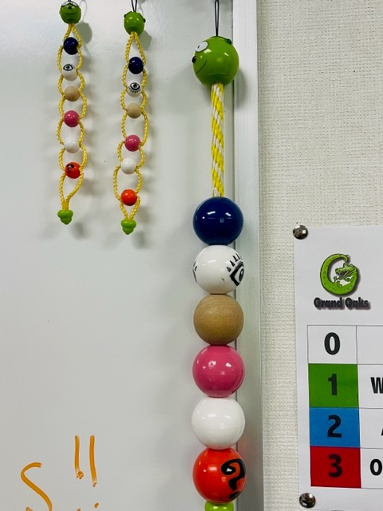

Slide 3
PowerPoint Outline
I. Introduction: Assessment
II. Foundations: A Rationale for Vocabulary Intervention & Basic Principles
III. Early Intervention with Preschool Children
IV. Specific Intervention Targets for Older Students K-12
V. Methods for Intervention
VI. Morphological Awareness Activities

Slide 4
I. Introduction--Assessment

Slide 5
ASHA Leader:

Slide 6
Your book discusses dynamic assessment:

Slide 7
That said, I really like**
Expressive Vocabulary Test-2 (EVT-2)—the new EVT-3 is out through Pearson! ☺
Peabody Picture Vocabulary Test-4; the new PPVT-5 is out through Pearson as well
There’s also the Expressive One Word Picture Vocabulary Test and the Receptive OWPVT

Slide 8
Your book page 326 mentions vocabulary tests**
For test 3, just know the ones on this PPt

Slide 9
II. Foundations: A Rationale for Vocabulary Intervention and Basic Principles

Slide 10
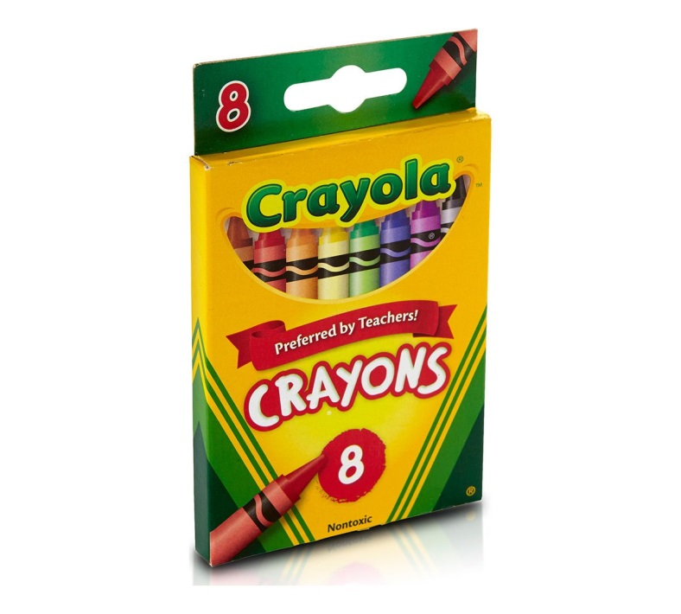
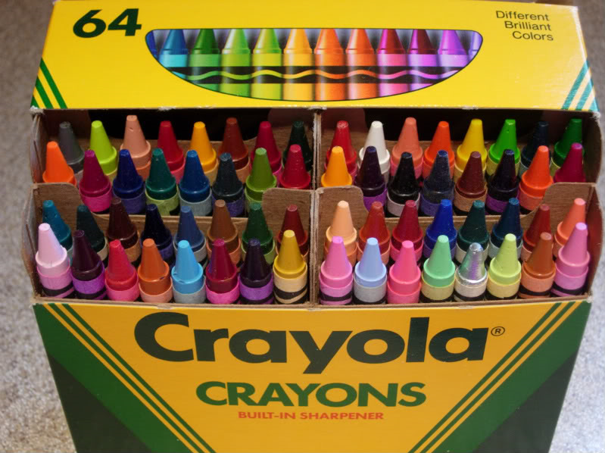
Unfortunately, low-SES and SLI children have lower vocabularies:**
Low-SES and DLD children
Typically-developing middle- and upper-SES

Slide 11
Interestingly, studies have shown that vocabulary and phonological awareness (PA) are also related

Slide 12
Children with DLD…

Slide 13
Holly Storkel and colleagues ASHA:

Slide 14
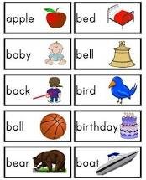
Storkel & Farquarhson ASHA:

Slide 15
We want to intervene as early as possible…**
Vocab development in the preschool years provides a foundation for reading and overall academic success
Intervention can occur in:
--Classrooms
--Small groups in classrooms
--1:1 in pullout

Slide 16
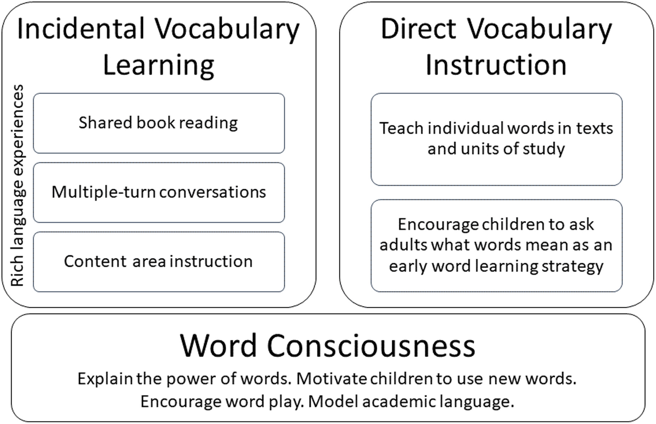
Going Nuts for Words: Recommendations for Teaching Young Students Academic Vocabulary (2024; https://ila.onlinelibrary.wiley.com/doi/10.1002/trtr.1967

Slide 17
Research has shown:

Slide 18
B. Assessment of Vocabulary Skills of Young Children**
Some instruments go down to age 3
Parent report is ideal (can use MacArthur-Bates Inventory, Ages & Stages Questionnaire)
Language sample
I love the BOEHM Test of Basic Concepts (ages 3;0-5;11, available in Spanish)

Slide 19
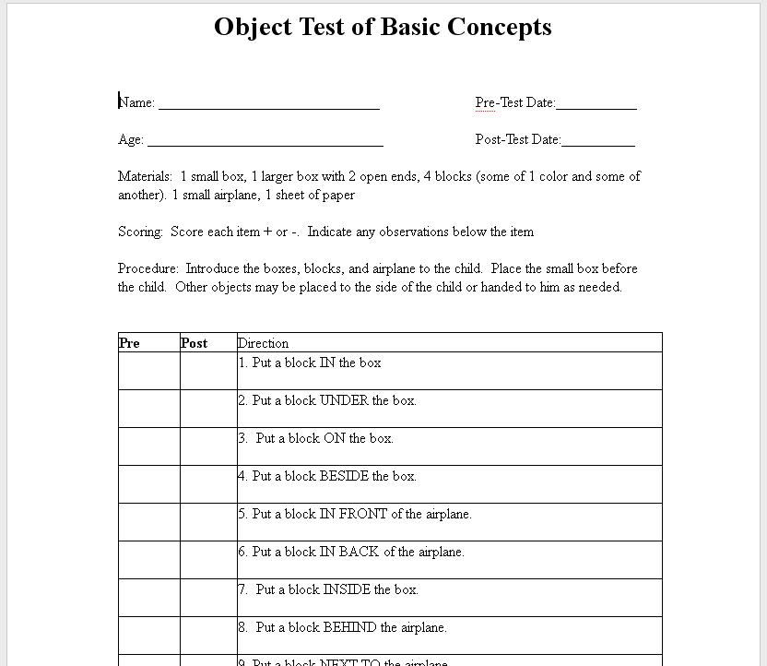

Slide 20
It is good to have a general idea of the norms of how many expressive words children should have by what ages: (please know for Test 3)

Slide 21
C. Intervention to Boost Young Children’s Vocabulary**
Of course, talking to them and reading to them is critical
We have discussed extending what they say
I personally believe that actual objects are superior to pictures on an iPad—hands-on is king

Slide 22
We know that:

Slide 23
Aguilar, J.M., Plante, E., & Sandoval, M. Exemplar variety facilitates retention of word learning by children with specific language impairment. Language, Speech, and Hearing Services in Schools, 49(1), 72-84.**
They taught new words to 4- and 5-year old children with DLD. Half the children were presented with the same objects corresponding to the words, and half the children were presented with new objects (for the same words) over several training sessions.

Slide 24
Aguilar et al. found:

Slide 25
So….**
We need multiple repetitions and multiple exemplars!

Slide 26
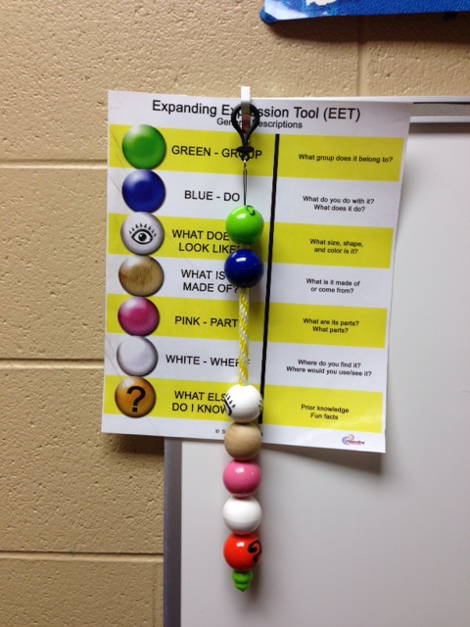
According to your book…

Slide 27
Work on basic concepts is crucial** (these words are not on the exam ☺)
Spatial
Above below beside
After between bottom
Around center corner
Back far near
Before first second
Behind front in
Below out
beside

Slide 28
It is crucial to involve parents—how do we do this?**
Parent involvement in carryover --always a major issue for SLPs
True even with teletherapy on Zoom

Slide 29
Soto et al. (2020). Iterative development of a home review program to promote preschoolers’ vocabulary skills: Social validity and learning outcomes. Language, Speech, and Hearing Services in Schools, 51, 371-389.**
The subjects were 4-5 years old and from low-SES, “high stress homes”
The researchers recommended targeting Tier 2 vocabulary

Slide 30
Soto et al. 2020 recommended the following successful strategies for increasing parent involvement in doing home carryover vocab activities:

Slide 31
It is not enough…**
To just send home worksheets!

Slide 32
Specific Therapy Activities: (Judy Montgomery— The Bridge of Vocabulary, available from Pearson Inc.)**
Activity 1: For teaching verbs: (which are hard for children with DLD)
Objective: the child will supply verbs or actions associated with different nouns
Show a picture: “Here is a picture of a boy. What can the boy do? Sleep, eat, sing, play, etc.
Give the child a piece of cereal or token for each thing they say

Slide 33
Vocabulary Activity 2--opposites:**
Objective: The student will use antonyms to describe the size and position of stick figures
Put stick figures in random order
Introduce terms: short-tall, first-last, close-far, small-big, above-below, before-after
Ask the student to point to the correct figures and have them follow directions with them

Slide 34
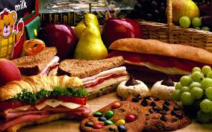
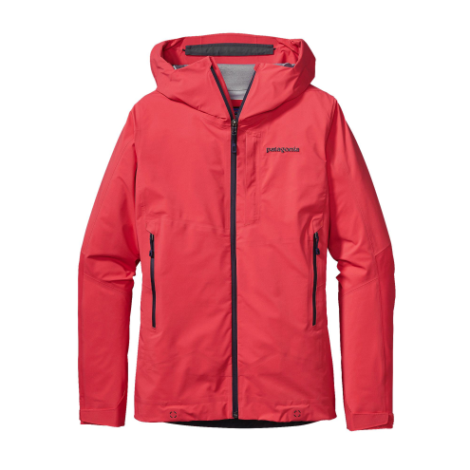
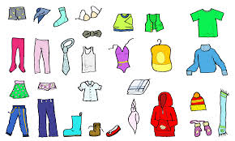
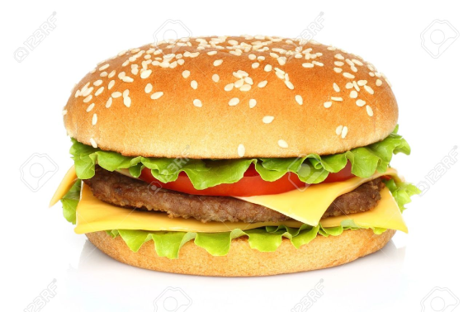
Vocabulary Activity 3—Matching Categories**
Get pictures and write the category on each one
Print pictures that go with the categories and have children match them
Food
clothes

Slide 35
Important categories for young children:**
Colors Weather
Shapes Emotions
Food Body parts
Clothes
Transportation/vehicles
Animals
School items
Furniture

Slide 36
Vocabulary Activity 4—Odd Man Out**
Listen. I am going to read you 4 words. One of them doesn’t match. When you hear a word that doesn’t match, clap/raise your hand.
Blue, red, yellow, 6
Boat, truck, cat, car
Spoon, flower, grass, tree
It is very important to ask WHY the item doesn’t match

Slide 37
Vocabulary Activity 5: The Mind Reading Game**
Pick objects or pictures of things already taught
“I am thinking of something round, red, and crunchy that we eat. It is __________.”

Slide 38
Vocabulary Activity 6: ABC From Ant to Zebra**
Make a book out of blank pieces of paper stapled together
You can also use a cheap notebook from Dollar Tree
On each page, write a letter at the top
When kids learn new words that begin with that letter, they write them on the page
They can also glue pictures that start with that letter onto the page

Slide 39
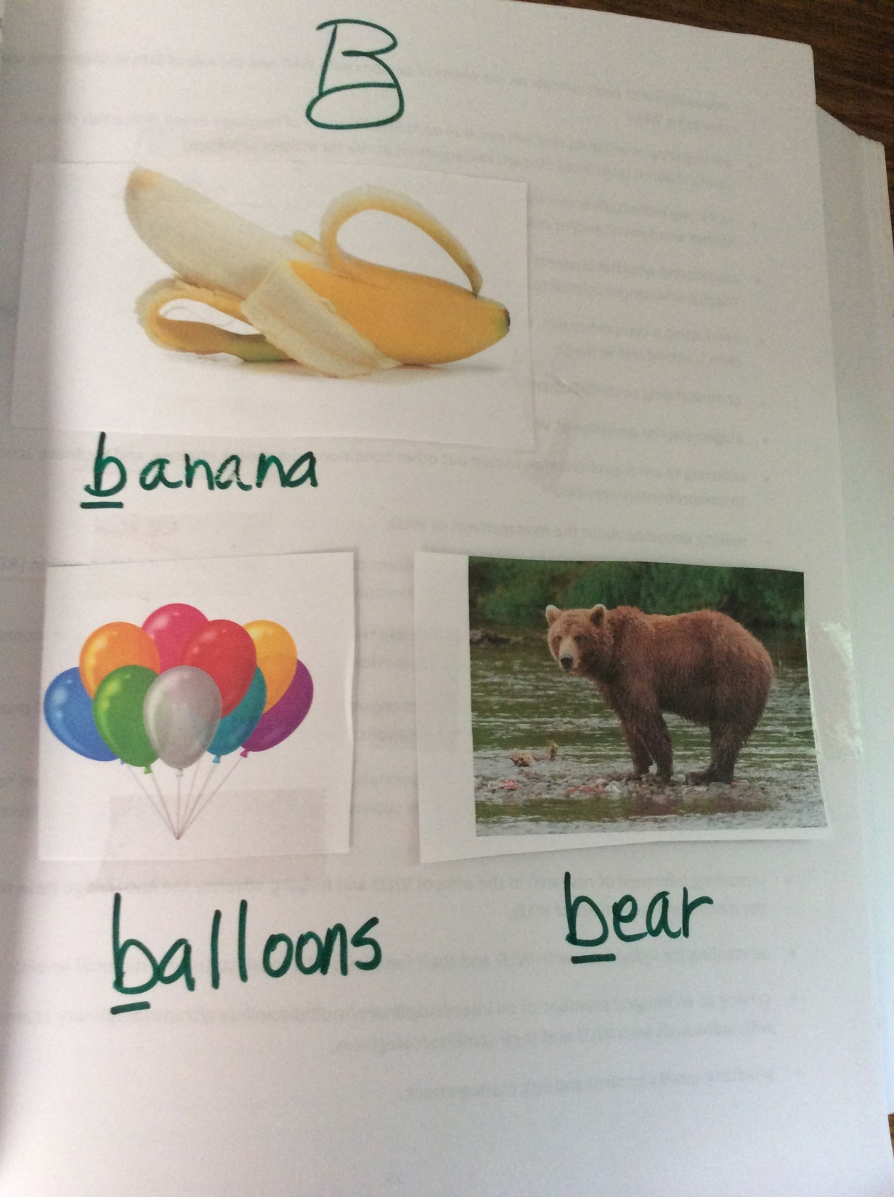

Slide 40
Resources I like**
I loooove this!
http://www.enchantedlearning.com/Dictionary.html
I also love Active games for Preschoolers
http://kids.health.org/parent/growth/learning/games.preschool.html

Slide 41
IV. Specific Intervention Targets for Older Students (K-12)
We have talked in other classes about Tier 2 words—to review:

Slide 42
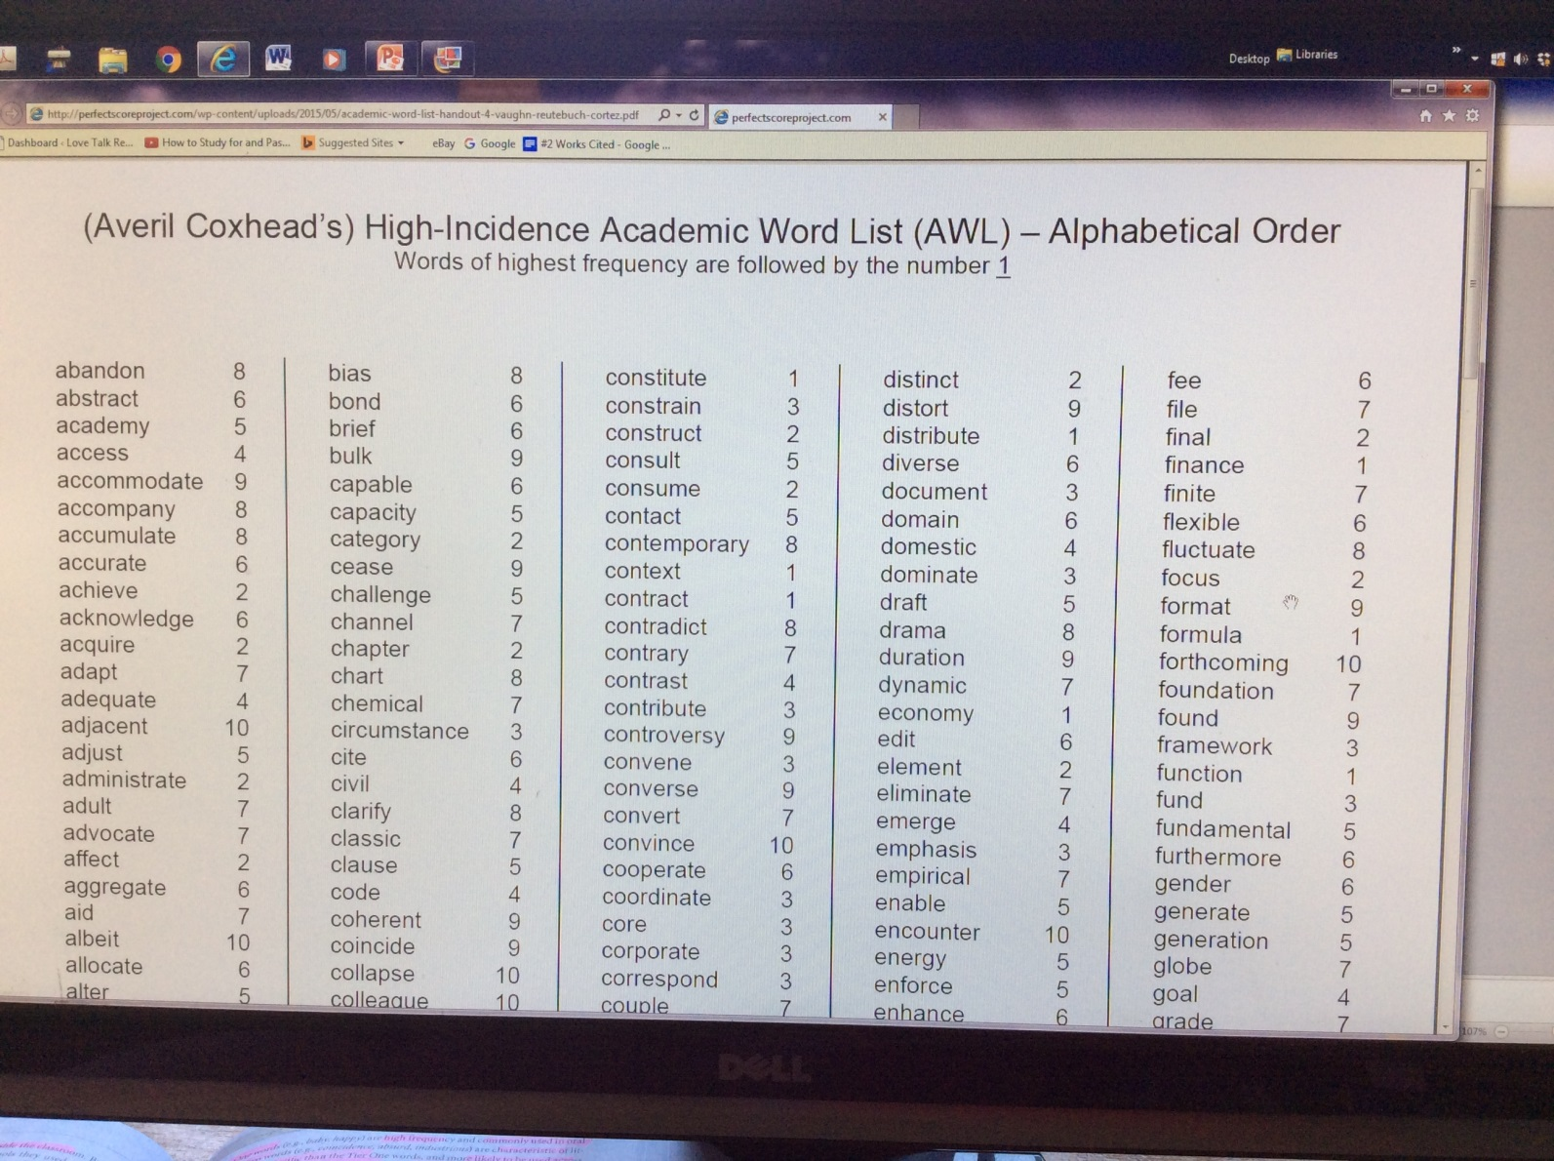
Sources for finding these words:**

Slide 43
McGregor et al. (2021, April). The challenge of rich vocabulary instruction for children with developmental language disorder. Language, Speech, and Hearing Services in Schools, 52, 467-484.**
They worked with children with DLD
These subjects participated in a language intervention which was embedded in a science camp

Slide 44
McGregor et al. 2021:

Slide 45
Let’s turn to your book of case studies….
And do the Tier 2 word science worksheet

Slide 46
Levin et al. (2022). Evaluating the effect of rich vocabulary instruction and retrieval practice on the classroom vocabulary skills of children with DLD. Language, Speech, and Hearing Services in Schools, 53, 542-560.**
In this study, they taught new vocabulary to 11 Swedish-speaking students with DLD (average age=14 years old).
This was done in the students’ classrooms as part of their scheduled lessons in Swedish.
They presented 20 Tier 2 words under 2 conditions

Slide 47
Levlin et al. 2022 found that “rich practice” (RP) was most effective; RP is characterized by:

Slide 48
Levlin et al. 2022 continued—RP:

Slide 49
Your book mentions a study

Slide 50
For example, the student says:**
“In speech we learned the word curious. Our class was curious about marine life, so we watched a movie about it.”
“We said that review means to look at something again. I brought our class story so you can review it with me.”

Slide 51
One study found that on SLPs’ caseloads in schools…

Slide 52
Marante, L., & Hall-Mills, S. (2024). Exploring SLPs’ perception of IEP goals for vocabulary intervention for school-age children with language disorders. LSHSS, 35, 366-380.

Slide 53
Youtube Video
How to conduct curriculum-based therapy
Celeste Roseberry youtube channel
https://www.youtube.com/watch?v=I6ruNrBTUf8

Slide 54
V. Methods for Intervention**
A. Increase Incidental Exposure
Multiple exposures are key
For young children, this can occur through talking and reading
Oral language in the classroom is another way
We want to be sure the words are produced in different contexts

Slide 55
I like the book’s idea of a Teacher’s Word Wall in the classroom:**
Happy Amazing Hard
Pleased Astonishing Difficult
Joyful Impressive Strenuous
Thrilled Stunning Laborious

Slide 56
B. Teach New Words Directly**
Add explanations during reading
Do review that includes new examples of how to use the words
Use words in context
Please know Table 9.5 for the exam (Example activities for robust vocabulary instruction—page 339)

Slide 57
Visual organizers are terrific!**
We will use some visual organizers from your copy book to illustrate how to use various visual organizers with children
In the book, you have 2 copies of each organizer—one to keep as a clean copy for future use, and one to write on in here ☺

Slide 58
C. Increase Awareness and Ownership**
Try to tap into children’s own learning goals—easier said than done
Why should they learn these words? What’s in it for them?
How can we motivate kids, especially those whose role models are not formally educated?

Slide 59
One expert at a workshop I attended said:**
Don’t use “practice;” use rehearse
“We are going to rehearse just like musicians and athletes do.”

Slide 60
Teach children to infer meaning from context**
“Look at the words around this one. Can they help us understand what this word means?”
“What do you think the word means? Can you guess?”

Slide 61
Example: Here’s the story—the unknown vocab word is in red:**
Maria had enjoyed a good day at school playing with her friends. She had liked what they had done in class that day, too. The teacher spent time reading to the class, and there wasn’t too much homework. Maria was looking forward to all the leisure time she would have that evening. It would be fun to relax with her family and go to bed early.

Slide 62
Children can also infer word meaning….**
Through morphological awareness—breaking down the word into its parts
I like the book’s idea of explaining parts of words like Leggo pieces that can be arranged and re-arranged

Slide 63
(not on exam)
One kindergarten Common Core State Standard is:
[Students will] use the most frequently-occurring inflections and affixes (e.g., -ed, -s, re-, un- pre-, -ful, -less) as a clue to the meaning of an unknown word.

Slide 64
VI. Morphological Awareness Activities**
We discussed this in undergrad classes
Your book cites a study, Bowers et al.
They did a meta-analysis of 22 studies and found that children who received specific intervention for identifying affixes in complex words made greater gains than controls in reading, spelling, and vocab knowledge
Children with reading impairments benefitted the most

Slide 65
Apel, K., Brimo, D., Diehm, E., & Apel, L. Morphological awareness intervention with kindergarteners and first- and second-grade students from low socioeconomic status homes: A feasibility study. Language, Speech, and Hearing Services in Schools, 44, 161-173.**
They carried out a 9-week intervention to increase children’s awareness of affixes as well as the relationship between base words and their inflected and derived forms (derivational and inflectional bound morphemes)
Groups of 4-5 students got tx 4 times a week for 25 minutes a day

Slide 66
Remember:**
Derivational morphemes can alter base words by modifying their meaning or changing them to a different word class
Teach—teacher
Hope-Hopeless
Attach--Attachment

Slide 67
The researchers:**
Targeted low-SES students because they are known to be at risk
Taught kids as young as kindergarten; previous studies had generally not started teaching MA till 3rd grade because people thought younger children couldn’t benefit

Slide 68
Apel et al. found:

Slide 69
Kenn Apel presented at ASHA—here are some helpful, fun tx ideas:**
Post its or cards where students create their own words
Prefix Base/Root Suffix
Re- cycle -ly
Im- friend -er
Dis- teach -ship
In- hard able

Slide 70
Listen For It**
Students listen to a story and put a thumb up for every instance of a word containing the target affix and then explain what it means
Put your thumb up when you hear Dr. R. say a word with -ing

Slide 71
Affix Book**
Students define the affix and write sample words or paste in pictures that contain words of the target affix

Slide 72
Word Generating**
Given an affix, students generate as many words as they can that contain that affix
Common prefixes: re-, in-, dis-, im-
Common suffixes: -tion, -y, -ly, -ant, -less, -er, -ment, -ful, -ness, -able, -ous, -ish, -ist, -ing

Slide 73
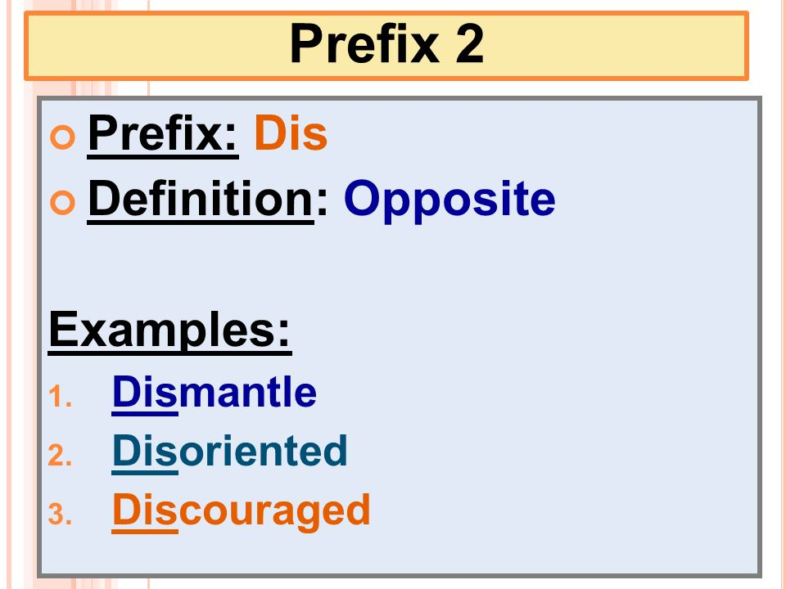
Let’s do this right now—write as many words as you can with the prefix -dis

Slide 74
PowerPoint Outline
I. Introduction: Assessment
II. Foundations: A Rationale for Vocabulary Intervention
III. Early Intervention with Preschool Children
IV. Specific Intervention Targets for Older Students K-12
V. Methods for Intervention
VI. Morphological Awareness Activities

Slide 75
Harvest Festival haunted house!
On the back of your paper, write 6 harvest nouns, 5 verbs, and 5 adjectives
On the front of your paper, write 6 affixes and cover each with a post it for the “window”
When you are done creating your house, take turns being the SLP and the child. Ask “what word is this? What part of speech is it? Let’s look at the affixes and open the windows. Does this affix go with your word? Why or why not?”
Write as many new words as you can!

