Slide 1
Evidence that a Greater Presence of Latinx Faculty or Administrators Raise the Completion Rates of Community College Students
Rob Wassmer, Ph.D.
Professor and Core Faculty, Ed.D. Program
Department of Public Policy and Administration
California State University, Sacramento
Meredith Galloway, Ed.D.
Curriculum Coordinator, and Educator
Westlake Charter School (Sacramento, CA)

Slide 2
Presentation (30 minutes)
Background
Previous Research
Theoretical Framework
Regression Model
Data
Regression Results
Policy Implications
Questions?/Discussion (Remainder)

Slide 3
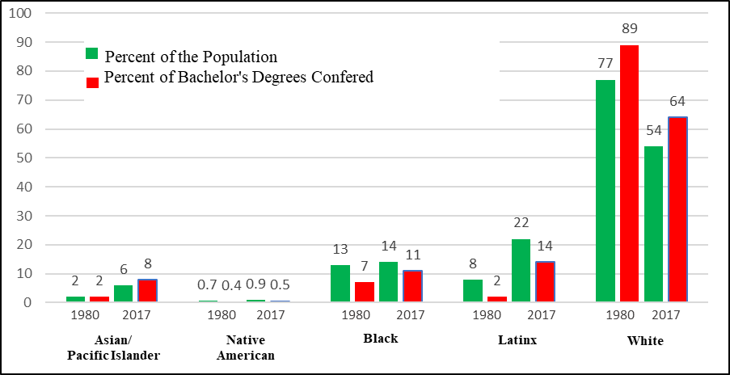
Background

Slide 4
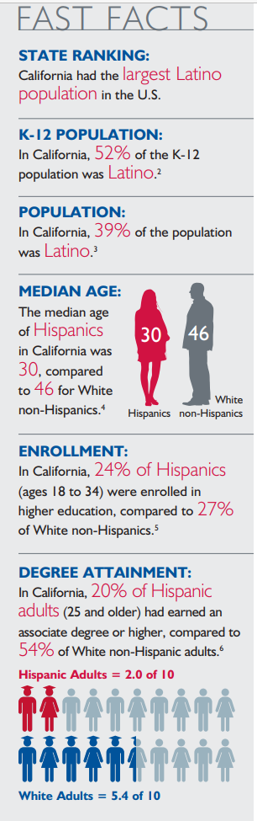

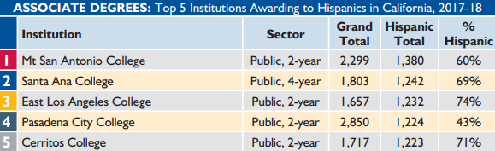
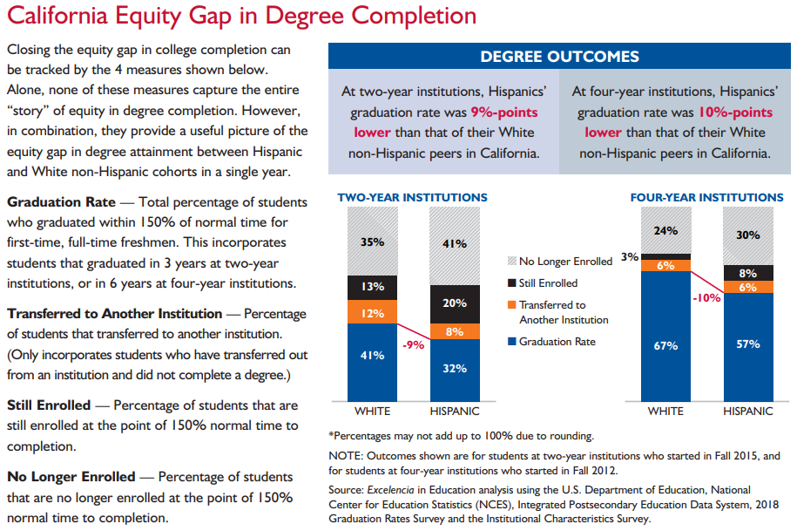

Slide 7
Previous Research
Qualitative (sample)
  Interviews establish
    Black and Latinx community college students value faculty diversity (Jordan 2008; Lucero et al. 2017)
    Black male community college students desire greater faculty diversity, if faculty-student relationship-building is the goal (Pickett et al. 2017)
    Social capital better generated for all if diverse college students matched with an equally diverse set of administrators and faculty (Turner 2013, Johnson 2010, and Vasquez-Heilig et al., 2019)
    Role of faculty as validating agents for academic self-concept at a Hispanic Serving Institutions (Alcantar & Hernandez, 2018)
    Knowledge, appreciation, and sensitivity to Latinx cultures and an understanding of the preferred learning styles of such students create classroom environments that engage them (Cejda & Hoover, 2010)
  Irony of an under representation of Latinx faculty and administrators at Hispanic Serving Institutions (Contreras, 2017)
    What happens if raise this representation?

Slide 8
Quantitative (sample)
  Latinx students attending an institution at which 25 percent or more of their peers also identified as the same, raise odds of third-year persistence by 150 percent (Crisp and Nora, 2010)
  TN Star Experiment data, own-race K-3 teacher (here, either Black or white) exerts a return of four to five percentile points for math and two to three percentile points in reading when compared to other-race matched students (Dee, 2004)
  K-12 Black teachers (relative to white) are more effective at raising test scores of Black students with 0.10 increase SD of std test scores. Latinx teachers with Latinx students, the size of the detected effect was 0.02 increase SD (Hanushek et al., 2005)
  De Anza Community College in Bay Area, raising share of Black instructors by one standard deviation would increase the retention rate by 2.5 percentage points (from a base of 62 percent) closing about a third of the white to Black retention gap – but some evidence of white students worse academic performance with Black instructor (Fairlie, Hoffman, and Oreopoulos, 2014)

Slide 9
Theoretical Framework
Institutional Departure Model (Tinto, 1975 & 1993)
  Higher education exit due to a lack of integration into social & academic institutional environments from HS to four-year residential college
  Important that integration occurs in first year
  13 testable propositions mainly not confirmed using CC student data
    College experience of commuter students that are more likely to live with family
Tinto Rethought for CC (Braxton et al., 2004)
  Causal factors degerming student departure in commuter colleges
    Student Entry Characteristics, Internal Campus Environment, and the External Environment
    Acting upon Institutional Commitment to determine the degree of persistence and ultimate completion
Social-Academic Integration Model (Deil-Amen, 2011)
  Institutional agents (faculty and administrators) offer needed validation of students of color at two-year places of higher education, and hence a factor of importance to their persistence and eventual academic success

Slide 10
Regression Model
Dependent Variable
  Six-year cohort completion rate of first-year, first-time students declaring goals of
    Certificate, associate’s degree, university transfer or transfer ready
  (1) Cohort Completion Rate =
    f (Student Cohort Characteristics, Institutional Characteristics, External Characteristics).
And College-Specific Fixed Effects

Slide 11
Data
Table 1: Descriptive Statistics.
(528 Observations drawn from 108 CA Community Colleges and Five Cohorts
starting in the fall of 2007, 2008, 2009, 2010, and 2011)
Variable Name | Mean | Standard Deviation | Minimum | Maximum
Dependent
All_Overall_Comp_Rate | 46.54 | 7.93 | 23.26 | 67.10
Latinx_ Overall_Comp_Rate | 40.25 | 6.14 | 18.0 | 57.90
All_Acad_Prepared_Comp_Rate | 68.13 | 7.05 | 36.70 | 83.80
Latinx_Acad_Prepared_Comp_Rate | 63.50 | 9.75 | 20.00 | 100.00
All_Acad_UnPrepared_Comp_Rate | 39.65 | 6.50 | 20.45 | 60.30
Latinx_Acad_UnPrepared_Comp_Rate | 35.38 | 5.66 | 16.30 | 52.70
All_Econ_Advantage_Comp_Rate | 52.47 | 9.45 | 25.64 | 80.90
Latinx_Econ_Advantage_Comp_Rate | 42.94 | 12.07 | 7.10 | 100.00
All_Econ_DisAdvantage_Comp_Rate | 44.29 | 7.27 | 22.48 | 62.74
Latinx_Econ_DisAdvantage_Comp_Rate | 39.68 | 6.09 | 18.40 | 59.30

Slide 12
Regression Results
Also tried interactions terms with Latinx_Percentage students and data set All Student Cohorts.
 |  |  | Dependent Variable
Explanatory Variable | Overall_ Comp_Rate | Acad_Prep_ Comp_Rate | Acad_UnPrep _Comp_Rate | Econ_Adv_ Comp_Rate | Econ_DisAdv _Comp_Rate
Faculty_Full_Time_Percentage | 0.050** (0.19) | 0.065 (0.053) | 0.080*** (0.020) | 0.219*** (0.050) | 0.036* (0.020)
Latinx_Faculty_Full_Time_Percentage | 0.211** (0.088) | 0.565*** (0.115) | 0.113 (0.085) | 0.399*** (0.133) | 0.240*** (0.088)
Latinx_Faculty_Part_Time_Percentage | 0.043 (0.047) | -0.560*** (0.049) | 0.086** (0.041) | -0.140 (0.128) | -0.003 (0.048)
Latinx_Admin_Percentage | 0.035*** (0.013) | 0.121*** (0.018) | 0.020** (0.009) | 0.128** (0.062) | 0.031*** (0.007)

Slide 13

Summary of Fixed-Effects, Panel-Data Regression Results
Latinx Cohorts
Explanatory Variable | Overall | Academically Prepared | Academically Unprepared | Economically Advantaged | Economically Disadvantaged
Latinx Full-Time Faculty % | positive | positive | none | positive (negative beyond 56% Latinx students) | positive
Latinx Part-Time Faculty % | none | negative | positive | negative (positive beyond 53% Latinx students) | none
Latinx Administrator % | positive | positive | negative (positive beyond 31% Latinx students) | positive | positive
All Race/Ethnicity Cohorts
Explanatory Variable | Overall | Academically Prepared | Academically Unprepared | Economically Advantaged | Economically Disadvantaged
Latinx Full-Time Faculty % | negative (positive beyond 45% Latinx students) | negative | negative (positive beyond 41% Latinx students) | negative | none
Latinx Part-Time Faculty % | positive | negative (positive beyond 49% Latinx students) | positive | negative (positive beyond 48% Latinx students) | positive
Latinx Administrator % | positive | positive | positive | positive | positive

Slide 14
Policy Implications
• A higher percentage of Latinx administrators, at the margin, increases the community college completion rates of both Latinx student cohorts and all race/ethnicity cohorts.
• If the percentage of full-time professors that are Latinx increases at a community college, at the margin, the result is likely to be an improvement in nearly all Latinx cohort completion rates. Expect this action to do the same for the overall and academically prepared completion rates of all race/ethnicity cohorts if Latinx students at the college are in the majority.
• Increase the percentage of part-time instructors that are Latinx and expect, at the margin, a positive influence on the completion rates of the academically unprepared Latinx cohort and the economically advantaged Latinx cohort if greater than half of the students at college Latinx. This same expansion of Latinx part-time faculty representation likely raises the whole race/ethnicity cohort completion rates for the overall group, academically unprepared, and economically disadvantaged. For the academically prepared and economically disadvantaged, the expectation is that hiring more Latinx part-time instructors increases these cohort completion rates if again, Latinxs are the student majority at the college.

Slide 15
Questions?/Discussion
Paper’s current status is revise and resubmit at “Educational Policy”
  Send me an email if want a copy of presentation or working paper
Any questions?
Your reactions to the results?

