Slide 1
PART 3: STRATEGIC ACTIONS:
STRATEGY IMPLEMENTATION
CHAPTER 12
STRATEGIC LEADERSHIP

Slide 2
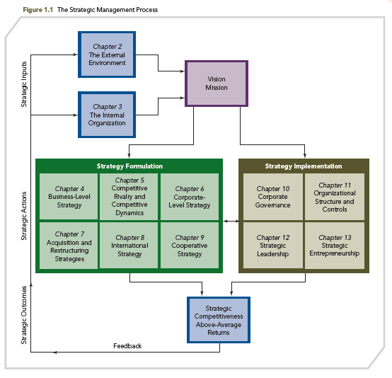
THE STRATEGIC MANAGEMENT PROCESS

Slide 3
KNOWLEDGE OBJECTIVES
● Define strategic leadership and describe top-level managers’ importance.
● Explain what top management teams are and how they affect firm performance.
● Describe the managerial succession process using internal and external managerial labor markets.
● Discuss the value of strategic leadership in determining the firm’s strategic direction.

Slide 4
KNOWLEDGE OBJECTIVES
● Describe the importance of strategic leaders in managing the firm’s resources.
● Define organizational culture and explain what must be done to sustain an effective culture.
● Explain what strategic leaders can do to establish and emphasize ethical practices.
● Discuss the importance and use of organizational controls.

Slide 5
SUCCESSION AT HP: CAN THE NEW CEO SAVE THE COMPANY’S SOUL?
OPENING CASE
■ HP’s culture of innovation suffered under Mark Hurd, the former CEO’s leadership.
■ Hurd was efficiency oriented and had made the company money by tightly controlling costs.
■ Former SAP CEO Leo Apotheker was named as CEO successor and had the opportunity to “reboot” the company and its culture.

Slide 6
SUCCESSION AT HP: CAN THE NEW CEO SAVE THE COMPANY’S SOUL?
OPENING CASE
■ Having lost its culture of innovation, HP’s strategic redirection into software and cloud computing needed to be successful.
■ With a merciless market, the expectation of strong performance exists even though major strategic changes take time to produce fruitful results.
■ Apotheker’s strategic leadership is being tested in the midst of layoff rumors and profit target reductions.

Slide 7
INTRODUCTION
● Effective strategic leadership is the foundation for successfully using the strategic management process.
● Strategic leaders guide the firm in ways that result in forming a vision and mission.
● This guidance often finds leaders thinking of ways to create goals that stretch everyone in the organization to improve performance.
● Moreover, strategic leaders facilitate the development of appropriate strategic actions and determine how to implement them.
● Leaders can make a major difference in how a firm performs.

Slide 8
STRATEGIC LEADERSHIP AND STYLE
Strategic leadership: the ability to anticipate, envision, maintain flexibility, and empower others to create strategic change as necessary
Multifunctional task
  Managing through others
  Managing an entire enterprise rather than a functional subunit
  Coping with change that is increasing in the global economy
  Most critical skill: attracting and managing human (includes intellectual) capital
  NOTE: Many examples of well-known CEOs are mentioned throughout the chapter to illustrate their leadership styles.

Slide 9
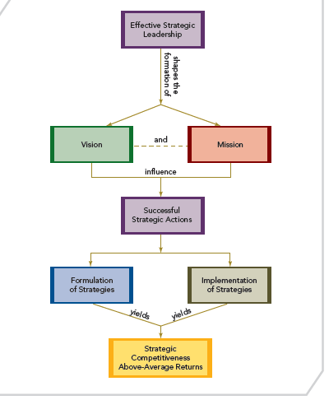
STRATEGIC LEADERSHIP AND STYLE
FIGURE 12.1
Strategic Leadership and the Strategic Management Process

Slide 10
STRATEGIC LEADERSHIP AND STYLE
EFFECTIVE STRATEGIC LEADERS
  Build strong ties with external stakeholders to gain access to information and advice
  Understand how their decisions impact their firm
  Sustain above-average performance
  Attract and manage human capital
  Do not delegate decision-making responsibilities
  Inspire and enable others to do excellent work and realize their potential
  Promote and nurture innovation through transformational leadership

Slide 11
THE ROLE OF TOP-LEVEL MANAGERS
● Managers use their discretion when making strategic decisions
● Primary factors that determine the amount of a manager’s decision-making discretion
  External environmental sources
  Organization’s characteristics
  Manager’s characteristics

Slide 12
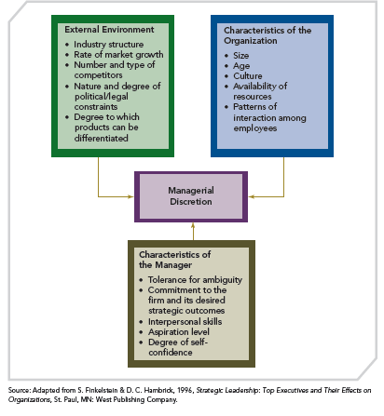
FACTORS AFFECTING MANAGERIAL DISCRETION
FIGURE 12.2
Factors Affecting Managerial Discretion

Slide 13
FACTORS AFFECTING MANAGERIAL DISCRETION
External
Environment
Industry structure
Rate of market growth
Number and type of competitors
Nature and degree of political/legal constraints
Degree to which products can be differentiated

Slide 14
FACTORS AFFECTING MANAGERIAL DISCRETION
External
Environment
Size
Age
Culture
Availability of resources
Patterns of interaction among employees
Characteristics of
the Organization

Slide 15
FACTORS AFFECTING MANAGERIAL DISCRETION
External
Environment
Tolerance for ambiguity
Commitment to the firm and its desired strategic outcomes
Interpersonal skills
Aspiration level
Degree of self-confidence
Characteristics of
the Organization
Characteristics of
the Manager

Slide 16
FACTORS AFFECTING MANAGERIAL DISCRETION
External
Environment
The degree of latitude for action when making strategic decisions, especially those concerned with effective implementation of strategies
How managers exercise discretion when determining appropriate strategic actions is critical to the firm’s success
Characteristics of
the Organization
Characteristics of
the Manager
Managerial
Discretion

Slide 17
TOP MANAGEMENT TEAMS
Top Management Teams
  Help avoid potential problem of CEO making decisions alone: managerial hubris
    Hubris: excessive pride leading to a feeling of invincibility
    Hubris can magnify the effects of decision-making biases
  Composed of key individuals who are responsible for selecting and implementing firm’s strategies; usually includes officers of the corporation (VP and above) and BOD

Slide 18
TOP MANAGEMENT TEAM, FIRM PERFORMANCE, AND STRATEGIC CHANGE
  Heterogeneous team: individuals with varied functional backgrounds, experiences, and education
  Team members: bring a variety of strengths, capabilities, and knowledge and provide effective strategic leadership when faced with complex environments and multiple stakeholder relationships to manage

Slide 19
TOP MANAGEMENT TEAM, FIRM PERFORMANCE, AND STRATEGIC CHANGE
  A HETEROGENEOUS TEAM
    Introduces a variety of perspectives
    Has a greater propensity for strong competitive action
    “Outside of the box thinking," leads to more creative decision making, innovation, and strategic change
    Offers various areas of expertise to identify environmental opportunities, threats, or the need for change
    Promotes debate, which leads to better strategic decisions, and higher firm performance
    May take longer to reach consensus

Slide 20
THE CEO AND TOP MANAGEMENT TEAM POWER
Higher performance is achieved when the board of directors (BOD) is more directly involved in shaping strategic direction
A powerful CEO may:
  Appoint sympathetic outside board members
  Have inside board members who report to the CEO
  Have long tenure, thus have greater influence on board decisions
  Be virtually independent of oversight by the BOD
  May also hold the position of chairman of the board (CEO duality)

Slide 21
THE CEO AND TOP MANAGEMENT TEAM POWER
    CEO Duality – CEO serves as CEO and BOD
      More common in the United States
      Occurs most often in the largest firms
      Increased shareholder activism recently brought the practice under scrutiny
      Criticized for causing poor performance and slow response to change
      BALANCE OF POWER BETWEEN THE BOD AND TOP MANAGEMENT IMPACTED BY:
      Resource abundance
        Environmental volatility and uncertainty

Slide 22
MANAGERIAL SUCCESSION
DEFINITION: preselect and shape the skills of tomorrow’s leaders
  Internal managerial labor market: opportunities for managerial positions to be filled from within the firm
  External managerial labor market: opportunities for managerial positions to be filled by candidates from outside of the firm
This decision impacts company performance and the ability to embrace change in today's competitive landscape
Succession, top management team composition, and strategy are intimately related

Slide 23
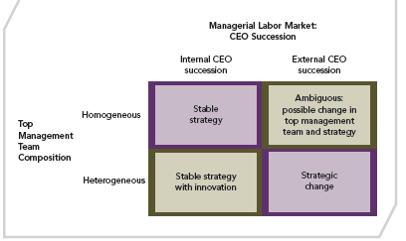
EFFECTS OF CEO SUCCESSION AND TOP MANAGEMENT TEAM COMPOSITION ON STRATEGY
FIGURE 12.3
Effects of CEO Succession and Top Management Team Composition on Strategy

Slide 24
MANAGERIAL SUCCESSION
Benefits of Internal Managerial Labor Market
  Continuity
  Continued commitment
  Familiarity
  Reduced turnover
  Retention of “private knowledge”
  Favored when the firm is performing well

Slide 25
MANAGERIAL SUCCESSION
Benefits of External Managerial Labor Market
  Long tenure with the same firm is thought to reduce innovation
  Outsiders bring diverse knowledge bases and social networks, which offer the potential for synergy and new competitive advantages
  Fresh paradigms
  Note: Opportunity cost for firms: Women as strategic leaders have been somewhat overlooked

Slide 26
KEY STRATEGIC LEADERSHIP ACTIONS
Certain actions characterize effective strategic leadership
  These actions interact with each other
  The most effective strategic leaders create options as the foundation for making effective decisions

Slide 27
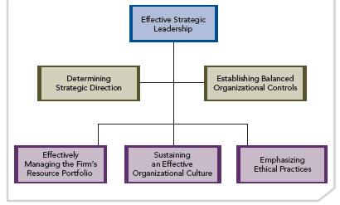
EXERCISE OF EFFECTIVE STRATEGIC LEADERSHIP
FIGURE 12.4
Exercise of Effective Strategic Leadership

Slide 28
KEY STRATEGIC LEADERSHIP ACTIONS
Determining Strategic Direction
● The strategic direction is framed within the context of the conditions (i.e., opportunities and threats) strategic leaders expect their firm to face in the next 3-5 years
● Ideal long-term strategic direction has two parts:
■ Core ideology
■ Envisioned future
● Serves as a guide to a firm’s strategy implementation process, including motivation, leadership, employee empowerment, and organizational design

Slide 29
KEY STRATEGIC LEADERSHIP ACTIONS
  Effectively Managing the Firm’s Resource Portfolio
  Most important task - effectively managing the firm’s portfolio of resources
  Resources defined as financial, human, social, and organizational capital
    Effective strategic leaders manage their firm’s resource portfolio by:
      Organizing the resources into capabilities
      Structuring the firm to facilitate using those capabilities
      Managing each type of resource as well as the integration of resources, e.g., using financial capital to enhance human capital capabilities (training and development)
      Choosing strategies through which the capabilities are successfully leveraged to create value for customers

Slide 30
KEY STRATEGIC LEADERSHIP ACTIONS
Exploiting and Maintaining Core Competencies
Core competencies
  Resources and capabilities that serve as a source of competitive advantage for a firm over its rivals
  Relate to an organization’s functional skills, such as manufacturing, finance, marketing, and research and development
  Leadership must verify that the firm’s competencies are emphasized when implementing strategy
  Firms must continuously develop/change their core competencies to prevail over competitors

Slide 31
KEY STRATEGIC LEADERSHIP ACTIONS
    Developing Human Capital and Social Capital
    Human capital: knowledge and skills of a firm’s entire workforce, requiring investment in training and development
    Social capital: relationships inside and outside the firm that help it accomplish tasks and create value for customers and shareholders
    Cooperative strategies, e.g., strategic alliances, may leverage complementary resources to develop social capital

Slide 32
KEY STRATEGIC LEADERSHIP ACTIONS
    Developing Human Capital and Social Capital
    Firms with strong social capital can access multiple capabilities, providing them with important flexibility to take advantage of opportunities and respond to challenges
    Social capital created through alliances is pivotal to:
      Large multinational firms when entering new foreign markets
      Entrepreneurial firms for resource access, venture capital, or other types of resources

Slide 33
KEY STRATEGIC LEADERSHIP ACTIONS
  Sustaining an Effective Organizational Culture
  Organizational culture: the complex set of ideologies, symbols, and core values shared throughout the firm
  Influences the way business is conducted
  Helps regulate and control employees’ behavior
  Strong organizational culture may be a competitive advantage

Slide 34
KEY STRATEGIC LEADERSHIP ACTIONS
Sustaining an Effective Organizational Culture
ENTREPRENEURIAL MIND-SET
    ● Source of growth and innovation
    ● May be encouraged and promoted by strategic leaders
● An organizational culture can encourage (or discourage) strategic leaders from pursuing (or not pursuing) entrepreneurial opportunities
  Fostering an Entrepreneurial Mind-Set: Five Dimensions
  Autonomy
  Innovativeness
  Risk taking
  Proactiveness
  Competitive aggressiveness

Slide 35
ENTREPRENEURIAL MIND-SET: FIVE DIMENSIONS
AUTONOMY
Employees are allowed to take actions that are free of organizational constraints; permits individuals and groups to be self-directed

Slide 36
ENTREPRENEURIAL MIND-SET: FIVE DIMENSIONS
AUTONOMY
Reflects a firm’s tendency to engage in and support new ideas, novelty, experimentation, and creative processes that may result in new products, services, or technological processes
Cultures with a tendency toward innovativeness encourage employees to think beyond existing knowledge, technologies, and parameters to find creative ways to add value
INNOVATIVENESS

Slide 37
ENTREPRENEURIAL MIND-SET: FIVE DIMENSIONS
AUTONOMY
Reflects a willingness by employees and their firm to accept risks when pursuing entrepreneurial opportunities
Examples of RISKS
  Assuming significant levels of debt
  Allocating large amounts of resources to projects that may not be completed
INNOVATIVENESS
RISK TAKING

Slide 38
ENTREPRENEURIAL MIND-SET: FIVE DIMENSIONS
AUTONOMY
Ability to be a market leader rather than a follower
Proactive organizational cultures constantly use processes to anticipate future market needs and to satisfy them before competitors learn how to do so
INNOVATIVENESS
RISK TAKING
PROACTIVENESS

Slide 39
ENTREPRENEURIAL MIND-SET: FIVE DIMENSIONS
AUTONOMY
INNOVATIVENESS
RISK TAKING
Propensity to take actions that allow the firm to consistently and substantially outperform its rivals.
PROACTIVENESS
COMPETITIVE
AGGRESSIVENESS

Slide 40
KEY STRATEGIC LEADERSHIP ACTIONS
  Sustaining an Effective Organizational Culture
  CHANGING THE ORGANIZATIONAL CULTURE AND RESTRUCTURING
    More difficult to change culture than maintain it
    Sometimes change must occur
    Effective strategic leaders recognize when change in culture is needed
      Requires effective communicating and problem solving
      Selecting the right people
      Engaging in effective performance appraisals
      Measuring individual performance toward goals that fit with new values
      Using appropriate reward systems

Slide 41
KEY STRATEGIC LEADERSHIP ACTIONS
Emphasizing Ethical Practices
Effectiveness of strategy implementation processes increases when based on ethical practices
Ethical practices create social capital and goodwill for the firm

Slide 42
KEY STRATEGIC LEADERSHIP ACTIONS
Emphasizing Ethical Practices
Actions that foster an ethical organizational culture:
  Establish and communicate ethics-related goals
  Revise, update, and disseminate code of conduct
  Develop and implement methods and procedures to use in achieving firm’s ethical standards
  Create/use specific reward systems that recognize acts of courage
  Create a working environment where all are treated with dignity

Slide 43
KEY STRATEGIC LEADERSHIP ACTIONS
  Establishing Balanced Organizational Controls
  Controls: formal, information-based procedures used by managers to maintain or alter patterns in organizational activities
Controls help strategic leaders:
  ● Build credibility
  ● Demonstrate the value of strategies to the firm’s stakeholders
  ● Promote and support strategic change

Slide 44
KEY STRATEGIC LEADERSHIP ACTIONS
    Establishing Balanced Organizational Controls
    ● Financial Controls
      Focus on short-term financial outcomes
      Produce risk-averse managerial decisions because financial outcomes may be caused by events beyond managers’ direct control
    ● Strategic Controls
      Focus on the content of strategic actions rather than their outcomes
      Encourage decisions that incorporate moderate and acceptable levels of risk

Slide 45
KEY STRATEGIC LEADERSHIP
ACTIONS
Establishing Balanced Organizational Controls
THE BALANCED SCORECARD
  Framework to evaluate if firms have achieved the appropriate balance among the strategic and financial controls to attain the desired level of firm performance
  Most appropriate for evaluating business-level strategies; it can also be used with the other strategies firms implement (e.g., corporate-level, international, and cooperative)
  Prevents overemphasis of financial controls at the expense of strategic controls

Slide 46
KEY STRATEGIC LEADERSHIP ACTIONS
Establishing Balanced Organizational Controls
THE BALANCED SCORECARD
    ● Premise is that firms jeopardize their future performance when financial controls are emphasized at the expense of strategic controls
    ● This is because financial controls focus on historical outcomes, and do not address future performance drivers
    ● An overemphasis on financial controls may promote managerial behavior that sacrifices long-term, value-creating potential for short-term performance gains
    ● An appropriate balance of strategic controls and financial controls, rather than an overemphasis on either, allows firms to achieve higher levels of performance

Slide 47
KEY STRATEGIC LEADERSHIP ACTIONS
Establishing Balanced Organizational Controls
THE BALANCED SCORECARD
Four perspectives of the balanced scorecard
  ➢ Financial
  ➢ Customer
  ➢ Internal Business Processes
  ➢ Learning and Growth

Slide 48
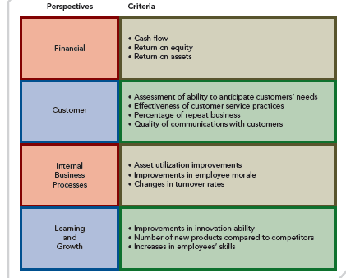
STRATEGIC CONTROLS AND FINANCIAL CONTROLS IN A BALANCED SCORECARD FRAMEWORK
FIGURE 12.5
Strategic Controls and Financial Controls in a Balanced Scorecard Framework

