Slide 1
PART 1:
STRATEGIC MANAGEMENT INPUTS
CHAPTER 3
THE INTERNAL ENVIRONMENT: RESOURCES, CAPABILITIES, & CORE COMPETENCIES

Slide 2
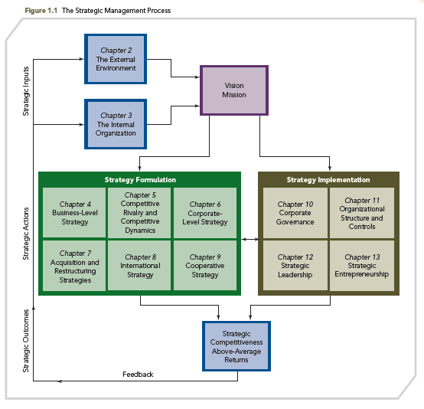
THE STRATEGIC MANAGEMENT PROCESS

Slide 3
KNOWLEDGE OBJECTIVES
● Explain why firms need to study and understand their internal organization.
● Define value and discuss its importance.
● Describe the differences between tangible and intangible resources.
● Define capabilities and discuss their development.
● Describe four criteria used to determine whether resources and capabilities are core competencies.

Slide 4
KNOWLEDGE OBJECTIVES
● Explain how firms analyze their value chain for the purpose of determining where they are able to create value when using their resources, capabilities, and core competencies.
● Define outsourcing and discuss reasons for its use.
● Discuss the importance of identifying internal strengths and weaknesses.
● Discuss the importance of avoiding core rigidities.

Slide 5
OPENING CASE
SUBWAY RESTAURANTS:
CORE COMPETENCIES AS THE FOUNDATION FOR SUCCESS
1965: Subway opened its first shop
Current portfolio of almost 35,000 units located in 98 countries
More store locations than McDonald’s
Subway’s focus on “Eat Fresh,” high-quality foods, continuous training, customer service, and “non-traditional” store locations illustrate Subway’s core competencies and the foundation for competitive advantage, underscoring key chapter concepts

Slide 6
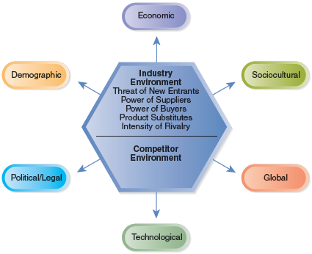
EXTERNAL ANALYSES’ OUTCOMES
Opportunities and Threats
By studying the external environment, firms identify what they MIGHT CHOOSE TO DO

Slide 7
INTERNAL ANALYSES’ OUTCOMES
Unique Resources, Capabilities, and Competencies
(required for sustainable competitive advantage)
By studying the internal environment, firms identify what they CAN DO

Slide 8
STRATEGIC COMPETITIVENESS AND ABOVE-AVERAGE RETURNS RESULT WHEN:
INTERNAL ORGANIZATION
What a firm can do:
What a firm might do:
EXTERNAL ENVIRONMENT
Function of resources, capabilities, and core competencies
Function of opportunities in the firm’s external environment
MATCHES
©2013 Cengage Learning. All Rights Reserved. May not be copied, scanned, or duplicated, in whole or in part, except for use as permitted in a license distributed with a certain product or service or otherwise on a password-protected website for classroom use.

Slide 9
COMPETITIVE ADVANTAGE
KEY POINTS
■ No competitive advantage lasts forever
■ Over time, rivals use their own unique resources, capabilities, and core competencies to duplicate the focal firm’s ability to create value for customers
■ With globalization, sustainable competitive advantage is especially challenging

Slide 10
■ Firms must exploit their current advantages while simultaneously using their resources and capabilities to form new advantages that can lead to future competitive success
■ INNOVATION and PEOPLE are critical resources for organizations in their quest for competitive advantage
COMPETITIVE ADVANTAGE
KEY POINTS

Slide 11
COMPETITIVE ADVANTAGE
SUSTAINABILITY
Sustainability of a competitive advantage is a function of:
  The rate of core competence obsolescence due to environmental changes
  The availability of substitutes for the core competence
  The imitability of the core competence

Slide 12
ANALYZING THE INTERNAL ORGANIZATION
The Context of Internal Analysis
Global Economy
  Traditional sources of advantages can be overcome by competitors’ international strategies and by the flow of resources throughout the global economy
Global Mindset
  The ability to study an internal environment in ways that are not dependent on the assumptions of a single country, culture, or context
Analysis Outcome
  Understanding how to leverage the firm’s bundle of heterogeneous resources and capabilities

Slide 13
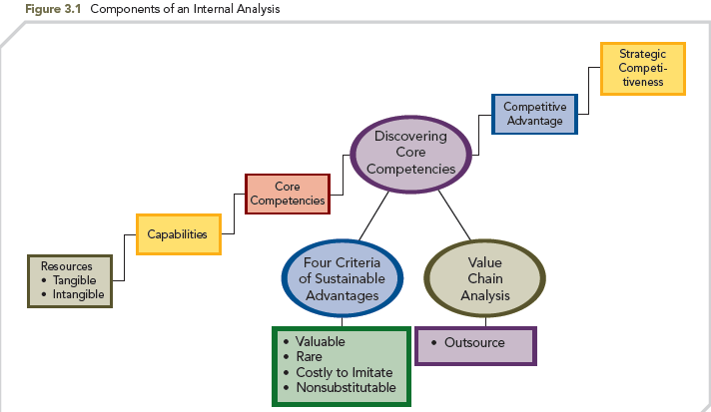
COMPETITIVE ADVANTAGE
Components of Internal Analysis Leading to Competitive Advantage and Strategic Competitiveness
FIGURE 3.1
Components of an Internal Analysis

Slide 14
ANALYZING THE INTERNAL ORGANIZATION
Creating Value
By innovatively bundling and leveraging their resources and capabilities; by exploiting their core competencies or competitive advantages, firms create value.
Value is measured by:
  Product performance characteristics
  Product attributes for which customers are willing to pay
Superior value → Above-average returns

Slide 15
ANALYZING THE INTERNAL ORGANIZATION
  The Challenge of Analyzing the Internal Organization
  Strategic decisions
  ● Are non-routine
  ● Have ethical implications
  ● Significantly influence the firm’s ability to earn above-average returns
    Strategic leaders make effective decisions regarding the firm’s resources, capabilities, and core competencies and decide on their use

Slide 16
ANALYZING THE INTERNAL ORGANIZATION
  The Challenge of Analyzing the Internal Organization
  Managers face uncertainty on many fronts
    ● Proprietary technologies
    ● Changes in economic and political trends, societal values and shifts in customer demands
    ● Environment – increasing complexity
  Intraorganizational conflict
    ● Results from decisions about core competencies and how to develop them

Slide 17
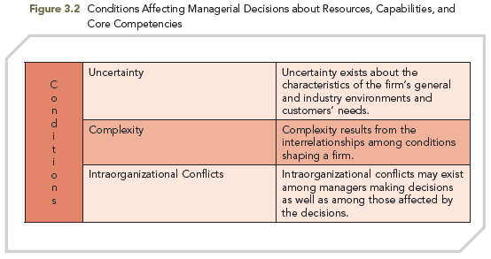
ANALYZING THE INTERNAL ORGANIZATION
FIGURE 3.2
Conditions Affecting Managerial Decisions About Resources, Capabilities, and Core Competences

Slide 18
ANALYZING THE INTERNAL ORGANIZATION
  The Challenge of Analyzing the Internal Organization
  Learning
    ● Generated by making and correcting mistakes; can be important in creating new capabilities and core competencies
    Judgment is required under these conditions
    ● Decision makers often take intelligent risks
    ● With good judgment, successful strategic leaders achieve strategic competitiveness

Slide 19
RESOURCES, CAPABILITIES, AND CORE COMPETENCIES
Resources and superior capabilities that are sources of competitive advantage over a firm’s rivals
Core Competencies
An integrated and coordinated set of actions taken to exploit core competencies and gain competitive advantage
Capabilities
Providing value to customers and gaining competitive advantage by exploiting core competencies in individual product markets
Resources
Tangible
Intangible

Slide 20
RESOURCES, CAPABILITIES, AND CORE COMPETENCIES
Core Competencies
RESOURCES
  Are the source of a firm’s capabilities
  Are broad in scope
  Cover a spectrum of individual, social, and organizational phenomena
  Represent inputs into a firm’s production process
  Alone, do not yield a competitive advantage, i.e., by themselves do not allow firms to create value that results in above-average returns
Capabilities
Resources
Tangible
Intangible

Slide 21
RESOURCES, CAPABILITIES, AND CORE COMPETENCIES
TYPES OF RESOURCES
Tangible Resources
  Assets that can be seen, touched, and quantified
  Intangible Resources
  Assets rooted deeply in the firm’s history, accumulated over time
  In comparison to ‘tangible’ resources, usually can’t be seen or touched
Compared to tangible resources, intangible resources are a superior source of core competencies

Slide 22
RESOURCES, CAPABILITIES AND, CORE COMPETENCIES
TYPES OF RESOURCES
Tangible Resources
    FINANCIAL RESOURCES - the firm’s capacity to borrow and generate internal funds
    ORGANIZATIONAL RESOURCES - formal reporting structures
    PHYSICAL RESOURCES - sophistication and location of a firm’s plant and equipment; distribution facilities; product inventory
    TECHNOLOGICAL RESOURCES - stock of technology, such as patents, trademarks, copyrights, and trade secrets

Slide 23
RESOURCES, CAPABILITIES AND, CORE COMPETENCIES
TYPES OF RESOURCES
  Intangible Resources
    HUMAN RESOURCES - knowledge; trust; skills; collaborative abilities
    INNOVATION RESOURCES - scientific capabilities; capacity to innovate
    REPUTATIONAL RESOURCES - brand name; perceptions of product quality, durability, and reliability; positive reputation with stakeholders, e.g., suppliers/customers

Slide 24
RESOURCES, CAPABILITIES, AND CORE COMPETENCIES
CAPABILITIES
■ Emerge over time through complex interactions among tangible and intangible resources
■ Stem from employees
        Unique skills and knowledge
        Functional expertise
  ■ Are activities that a firm performs exceptionally well relative to rivals
  ■ Are activities through which the firm adds unique value to its goods or services over an extended period of time
Core Competencies
Capabilities
Resources
Tangible
Intangible

Slide 25
RESOURCES, CAPABILITIES, AND CORE COMPETENCIES
CAPABILITIES (cont’d)
■ Exist when resources have been purposely integrated to achieve a specific task or set of tasks
■ Are often developed in specific functional areas
  Distribution
  Human resources
  Management information systems
  Marketing
  Management
  Manufacturing
  Research & Development
Core Competencies
Capabilities
Resources
Tangible
Intangible

Slide 26
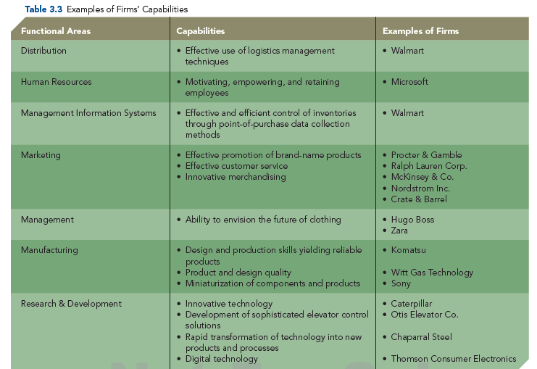
RESOURCES, CAPABILITIES AND, CORE COMPETENCIES
TABLE 3.3
Examples of Firms’ Capabilities

Slide 27
BUILDING CORE COMPETENCIES
Core Competencies
  TWO TOOLS FIRMS USE TO IDENTIFY AND BUILD CORE COMPETENCIES:
  Four Specific Criteria of Sustainable Competitive Advantage that can be used to determine which capabilities are core competencies
  Value Chain Analysis - this tool helps select the value-creating competencies that should be maintained, upgraded, or developed and those that should be outsourced
Capabilities
Resources
Tangible
Intangible

Slide 28
BUILDING CORE COMPETENCIES
The Four Criteria of Sustainable Competitive Advantage
Capabilities must fulfill four specific criteria in order to be
CORE COMPETENCIES
  Valuable
  Rare
  Costly-to-imitate
  Nonsubstitutable capabilities

Slide 29
BUILDING CORE COMPETENCIES
The Four Criteria of Sustainable Competitive Advantage
VALUABLE CAPABILITIES
• Help a firm neutralize threats or exploit opportunities
RARE CAPABILITIES
• Are not possessed by many others
TABLE 3.4
The Four Criteria of Sustainable Competitive Advantage

Slide 30
BUILDING CORE COMPETENCIES
The Four Criteria of Sustainable Competitive Advantage
COSTLY-TO-IMITATE CAPABILITIES
• Historical: A unique and a valuable organizational culture or brand name
• Ambiguous cause: The causes and uses of a competence are unclear
• Social complexity: Interpersonal relationships, trust, and friendship among managers, suppliers, and customers
TABLE 3.4
The Four Criteria of Sustainable Competitive Advantage

Slide 31
BUILDING CORE COMPETENCIES
The Four Criteria of Sustainable Competitive Advantage
NONSUBSTITUTABLE CAPABILITIES
    No strategic equivalent
    Firm-specific knowledge
    Organizational culture
    Superior execution of the chosen business model
TABLE 3.4
The Four Criteria of Sustainable Competitive Advantage

Slide 32
BUILDING CORE COMPETENCIES
The Four Criteria of Sustainable Competitive Advantage
SUSTAINABLE COMPETITIVE ADVANTAGE
  Exists only when competitors cannot duplicate a firm’s strategy or when they lack the resources to attempt imitation
  Exists until competitors can successfully imitate a good, service, or process
  Lasts for a relatively long period of time if all four of the criteria discussed are satisfied

Slide 33
BUILDING CORE COMPETENCIES
The Four Criteria of Sustainable Competitive Advantage
COMPETITIVE CONSEQUENCES
  Focus on capabilities that yield competitive parity and either temporary or sustainable competitive advantage
PERFORMANCE IMPLICATIONS
  Parity = average returns
  Temporary advantage = average to above average returns
  Sustainable advantage = above average returns using valuable, rare, costly-to-imitate, and nonsubstitutable capabilities

Slide 34
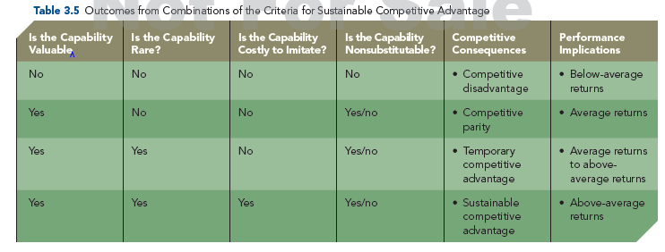
BUILDING CORE COMPETENCIES
TABLE 3.5
Outcomes from Combinations of the Criteria for Sustainable Competitive Advantage

Slide 35
BUILDING CORE COMPETENCIES
VALUE CHAIN ANALYSIS
Allows the firm to understand the parts of its operations that create value and those that do not
A template that firms use to:
    Understand their cost position
    Facilitate the implementation of a chosen business-level strategy

Slide 36
BUILDING CORE COMPETENCIES
VALUE CHAIN ANALYSIS
  Both value chain (primary) and support activities should be analyzed
  Competitive landscape demands that value chains and supply chains be examined in a global context
  Each activity should be examined relative to competitor’s abilities and rated as superior, equivalent, or inferior

Slide 37
BUILDING CORE COMPETENCIES
VALUE CHAIN ANALYSIS
  To become a core competence and a source of competitive advantage, a capability must allow the firm:
  1. to perform an activity in a manner that provides superior value relative to competitors, or
  2. to perform a value-creating activity that competitors cannot perform

Slide 38
BUILDING CORE COMPETENCIES
VALUE CHAIN ANALYSIS
  VALUE CHAIN ACTIVITIES: activities the firm completes in order to produce products and then sell, distribute, and service those products in ways that create value for customers
  SUPPORT FUNCTIONS: activities the firm completes in order to support the work being done to produce, sell, distribute, and service the products the firm is producing

Slide 39
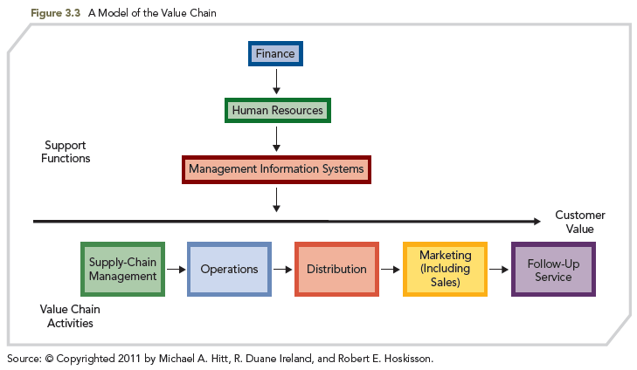
BUILDING CORE COMPETENCIES
FIGURE 3.3
A Model of the Value Chain

Slide 40
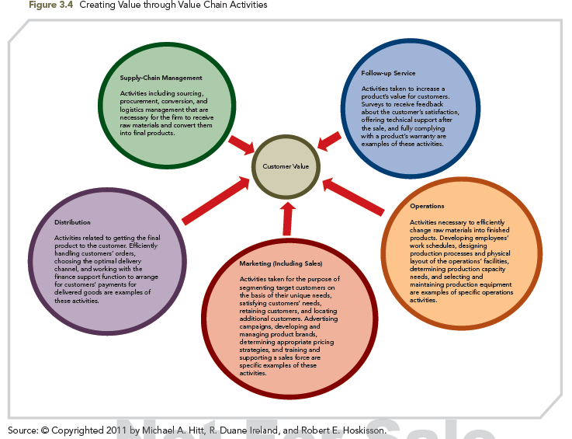
BUILDING CORE COMPETENCIES
VALUE CHAIN ANALYSIS
FIGURE 3.4
Creating Value through Value Chain Activities

Slide 41
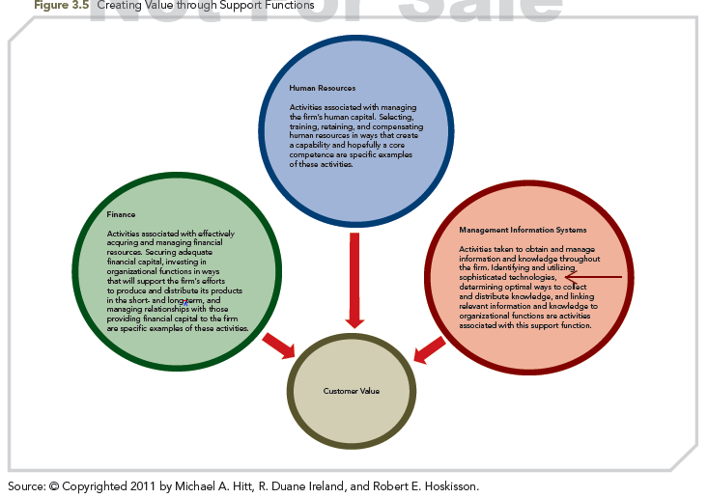
BUILDING CORE COMPETENCIES
FIGURE 3.5
Creating Value through Support Functions

Slide 42
BUILDING CORE COMPETENCIES
VALUE CHAIN ANALYSIS
SOCIAL CAPITAL - when firms have strong positive alliances with suppliers and customers
TRUST - is required to build social capital whereby resources such as knowledge are transferred across organizations
JUDGMENT - pivotal in evaluating a firm’s capability to execute its value chain activities and support functions

Slide 43
OUTSOURCING
Definition: purchase of a value-creating activity or support function from an external supplier
  Effective execution includes an increase in flexibility and risk mitigation, and a reduction in capital investment
  Global industries trend continues at a rapid pace
  Firms must outsource activities where they cannot create value or are at a substantial disadvantage compared to competitors

Slide 44
OUTSOURCING
STRATEGIC RATIONALES
  ■ Few organizations are competitively superior in all value chain activities and support functions
  ■ By outsourcing activities where it lacks competence, the firm can fully concentrate on those areas in which it can create value
■ Freeing resources for other purposes
  redirects efforts from non-core activities toward those that serve customers more effectively
.

Slide 45
OUTSOURCING
STRATEGIC RATIONALES
  ■ Specialty suppliers can perform outsourced capabilities more efficiently.
■ Sharing risks - reduces investment requirements and makes firm more flexible, dynamic, and better able to adapt to changing opportunities
■ Providing access to world-class standards –
  the specialized resources of outsourcing providers makes world-class capabilities available to firms
.

Slide 46
OUTSOURCING
■ Outsource those value chain activities and support functions that are NOT a source of core competence
■ Concerns: innovation, technological uncertainty, and job loss; usually revolves around firm’s innovative ability and loss of jobs to external supplier
■ Offshoring - foreign supply source

Slide 47
COMPETENCIES, STRENGTHS, WEAKNESSES, AND STRATEGIC DECISIONS
Firms must identify their strengths and weaknesses
Appropriate resources and capabilities are needed to develop desired strategy and create value for customers and other stakeholders

Slide 48
COMPETENCIES, STRENGTHS, WEAKNESSES, AND STRATEGIC DECISIONS
The “right” resources (as opposed to “many” resources) are those with the potential to be formed into core competencies as the foundation for competitive advantage
Tools (e.g., outsourcing) can help a firm focus on core competencies as the source for competitive advantage

Slide 49
COMPETENCIES, STRENGTHS, WEAKNESSES, AND STRATEGIC DECISIONS
Core competencies have potential to become CORE RIGIDITIES
Former core competencies that now generate inertia and stifle innovation
External environmental conditions and events impact a firm’s core competencies

Slide 50
COMPETENCIES, STRENGTHS, WEAKNESSES, AND STRATEGIC DECISIONS
INTERNAL ORGANIZATION
What a firm can do:
What a firm might do:
EXTERNAL ENVIRONMENT
Function of resources, capabilities, and core competencies
Function of opportunities in the firm’s external environment
STRATEGY
©2013 Cengage Learning. All Rights Reserved. May not be copied, scanned, or duplicated, in whole or in part, except for use as permitted in a license distributed with a certain product or service or otherwise on a password-protected website for classroom use.

