Slide 1
PART 2: STRATEGIC ACTIONS:
STRATEGY FORMULATION
CHAPTER 5
COMPETITIVE RIVALRY AND COMPETITIVE DYNAMICS

Slide 2
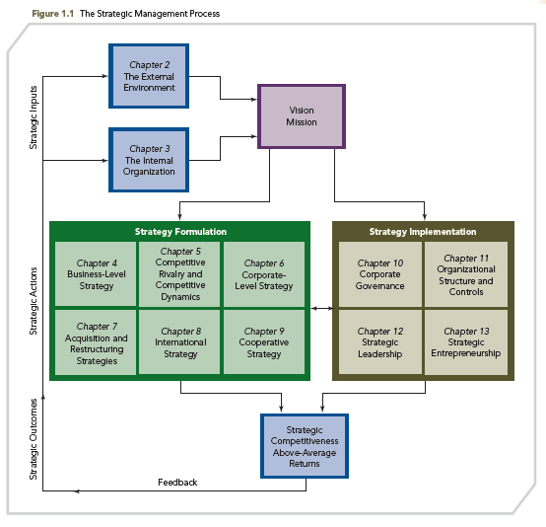
THE STRATEGIC MANAGEMENT PROCESS

Slide 3
KNOWLEDGE OBJECTIVES
● Define competitors, competitive rivalry, competitive behavior, and competitive dynamics.
● Describe market commonality and resource similarity as the building blocks of a competitor analysis.
● Explain awareness, motivation, and ability as drivers of competitive behaviors.

Slide 4
KNOWLEDGE OBJECTIVES
● Discuss factors affecting the likelihood a competitor will take competitive actions.
● Describe factors affecting the likelihood a competitor will respond to actions taken against it.
● Explain the competitive dynamics in each of slow-cycle, fast-cycle, and standard-cycle markets.

Slide 5
DISRUPTIVE INNOVATION: WINNING RIVALRY BATTLES AGAINST COMPETITORS
OPENING CASE
■ Clayton Christensen, a Harvard professor and author of The Innovator’s Dilemma, defines “disruptive innovation” as:
“an innovation that makes it so much simpler and so much more affordable to own and use a product that a whole new population of people can now have one.

Slide 6
DISRUPTIVE INNOVATION: WINNING RIVALRY BATTLES AGAINST COMPETITORS
OPENING CASE
EXAMPLES OF DISRUPTIVE INNOVATION
■ Xerox was disrupted by Canon
■ Apple’s iPhone has disrupted the cell phone and personal computer markets, creating the smartphone segment
■ As the iPad continues to improve its graphics power, game platform hardware and software producers are threatened

Slide 7
DISRUPTIVE INNOVATION: WINNING RIVALRY BATTLES AGAINST COMPETITORS
OPENING CASE
EXAMPLES OF DISRUPTIVE INNOVATION
■ In the video-on-demand market, Walmart’s Vudu, a non-subscription video streaming service, may disrupt Apple’s iTune service
■ Clayton Christensen suggests disruptive innovations include “the personal computer, the router, Toyota’s automobiles, Kodak’s original camera, Xerox’s original photocopier, and Canon’s desktop photocopier.”

Slide 8
COMPETITORS
IMPORTANT DEFINITIONS
COMPETITORS:
firms operating in the same market, offering similar products, and targeting similar customers
EXAMPLES:
■ Southwest, Delta, United, Continental, and JetBlue
■ PepsiCo and Coca-Cola Company
■ Apple’s family of products (Macs, iPads, iPods, and iPhones) compete in the video game market with standalone and mobile game platforms from Sony, Microsoft, and Nintendo

Slide 9
COMPETITIVE RIVALRY COMPETITIVE BEHAVIOR
IMPORTANT DEFINITIONS
■ COMPETITIVE RIVALRY: the ongoing set of competitive actions and competitive responses that occur among firms as they maneuver for an advantageous market position
■ COMPETITIVE BEHAVIOR: the set of competitive actions and responses the firm takes to build or defend its competitive advantages and to improve its market position

Slide 10
COMPETITIVE RIVALRY DURING RECESSION
IMPORTANT DEFINITIONS
Competitive rivalry often increases during recession
  Customers change buying behavior
  Look for ways to escape daily negative environment
    Movie ticket sales increase
    Candy consumption increases
Bottled water sales declined two percent in 2008
  Bottled water distributors introduced new products
  Address plastic bottle concerns
  Competition from tap water filter manufacturers

Slide 11
MULTIMARKET COMPETITION COMPETITIVE DYNAMICS
IMPORTANT DEFINITIONS
■ MULTIMARKET COMPETITION: firms competing against each other in several product or geographic markets
■ COMPETITIVE DYNAMICS: all competitive behavior, that is, the total set of actions and responses taken by all firms competing within a market

Slide 12
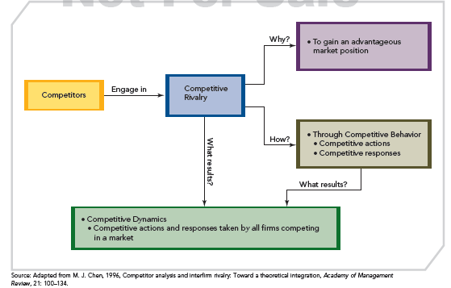
COMPETITORS TO COMPETITIVE DYNAMICS
FIGURE 5.1
From Competitors to Competitive Dynamics

Slide 13
COMPETITIVE DYNAMICS VERSUS RIVALRY
COMPETITIVE DYNAMICS
COMPETITIVE RIVALRY
Ongoing actions and responses taking place between an individual firm and its competitors for advantageous market position
Ongoing actions and responses taking place among all firms competing within a market for advantageous positions

Slide 14
COMPETITIVE RIVALRY’S EFFECT ON STRATEGY
Success of a strategy is determined by:
  The firm’s initial competitive actions
  How well it anticipates competitors’ responses to them
  How well the firm anticipates and responds to its competitors’ initial actions
Competitive rivalry:
  Affects all types of strategies
  Has the strongest influence on the firm’s business-level strategy or strategies

Slide 15
A MODEL OF COMPETITIVE RIVALRY
Firms are mutually interdependent
  A firm’s competitive actions have noticeable effects on competitors
  A firm’s competitive actions elicit competitive responses from competitors
  Firms are affected by each other’s actions and responses
  Over time firms take competitive actions and reactions

Slide 16
A MODEL OF COMPETITIVE RIVALRY (CONT’D)
  Firm level rivalry is usually dynamic and complex
  Foundation for successfully building and using capabilities and core competencies to gain an advantageous market position
  Sequence of events (next slide) are the components of this chapter
  Marketplace success is a function of both individual strategies and the consequences of their use

Slide 17
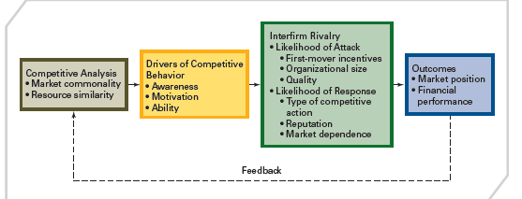
A MODEL OF COMPETITIVE RIVALRY
FIGURE 5.2
A Model of Competitive Rivalry

Slide 18
COMPETITOR ANALYSIS
Competitor analysis is used to help a firm understand its competitors.
The firm studies competitors’ future objectives, current strategies, assumptions, and capabilities.
With the analysis, a firm is better able to predict competitors’ behaviors when forming its competitive actions and responses.

Slide 19
COMPETITOR ANALYSIS
MARKET COMMONALITY AND RESOURCE SIMILARITY
  Two components to assess:
  MARKET COMMONALITY and RESOURCE SIMILARITY
  The question: To what extent are firms competitors?
  ● Competitor: high market commonality & high resource similarity
    EXAMPLE: Dell and HP are direct competitors
    ● Combination of market commonality & resource similarity indicate a firm’s direct competitors
  DIRECT COMPETITION DOES NOT ALWAYS IMPLY INTENSE RIVALRY

Slide 20
COMPETITOR ANALYSIS
MARKET COMMONALITY
Market commonality is concerned with:
  The number of markets with which a firm and a competitor are jointly involved
  The degree of importance of the individual markets to each competitor
Firms competing against one another in several or many markets engage in multimarket competition
  A firm with greater multimarket contact is less likely to initiate an attack, but more likely to respond aggressively when attacked

Slide 21
COMPETITOR ANALYSIS
RESOURCE SIMILARITY
Resource Similarity
  How comparable the firm’s tangible and intangible resources are to a competitor’s in terms of both types and amounts
Firms with similar types and amounts of resources are likely to:
  Have similar strengths and weaknesses
  Use similar strategies
Assessing resource similarity can be difficult if critical resources are intangible rather than tangible

Slide 22
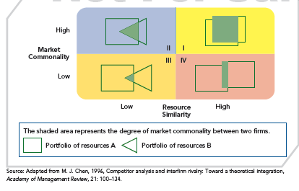
A FRAMEWORK OF COMPETITOR ANALYSIS
FIGURE 5.3
A Framework of Competitor Analysis

Slide 23
DRIVERS OF COMPETITIVE ACTIONS AND RESPONSES
Awareness
Awareness is
  the extent to which competitors recognize the degree of their mutual interdependence that results from:
    Market commonality
    Resource similarity

Slide 24
DRIVERS OF COMPETITIVE ACTIONS AND RESPONSES
Awareness
Motivation concerns
  the firm’s incentive to take action
  or to respond to a competitor’s attack
  and relates to perceived gains and losses
Motivation

Slide 25
DRIVERS OF COMPETITIVE ACTIONS AND RESPONSES
Awareness
Ability relates to
  each firm’s resources
  the flexibility these resources provide
Without available resources the firm lacks the ability to
  attack a competitor
  respond to the competitor’s actions
Motivation
Ability

Slide 26
DRIVERS OF COMPETITIVE ACTIONS AND RESPONSES
Awareness
A firm is more likely to attack the rival with whom it has low market commonality than the one with whom it competes in multiple markets.
Given the strong competition under market commonality, it is likely that the attacked firm will respond to its competitor’s action in an effort to protect its position in one or more markets.
Motivation
Ability
Market Commonality

Slide 27
DRIVERS OF COMPETITIVE ACTIONS AND RESPONSES
Awareness
The greater the resource imbalance between the acting firm and competitors or potential responders, the greater will be the delay in response by the firm with a resource disadvantage.
When facing competitors with greater resources or more attractive market positions, firms should eventually respond, no matter how challenging the response.
Motivation
Ability
Market Commonality
Resource Dissimilarity

Slide 28
COMPETITIVE RIVALRY
The ongoing competitive action/response sequence between a firm and a competitor affects the performance of both firms.
Understanding a competitor’s awareness, motivation, and ability helps the firm predict the likelihood of an attack and response to actions initiated by the firm or other competitors.
The predictions drawn from studying competitors in terms of awareness, motivation, and ability are grounded in market commonality and resource similarity.

Slide 29
COMPETITIVE RIVALRY
STRATEGIC AND TACTICAL ACTIONS
Competitive Action
  A strategic or tactical action the firm takes to build or defend its competitive advantages or improve its market position
Competitive Response
  A strategic or tactical action the firm takes to counter the effects of a competitor’s competitive action

Slide 30
COMPETITIVE RIVALRY
STRATEGIC AND TACTICAL ACTIONS
Strategic Action (or Response)
  A market-based move that involves a significant commitment of organizational resources and is difficult to implement and reverse
Tactical Action (or Response)
  A market-based move that is taken to fine-tune a strategy
    Usually involves fewer resources
    Is relatively easy to implement and reverse

Slide 31
LIKELIHOOD OF ATTACK
In addition to:
  ● Market commonality
  ● Resource similarity
  ● Awareness
  ● Motivation
  ● Ability
  Other factors also affect the likelihood that a competitor will use strategic and tactical actions to attack its competitors:
● First-mover incentives
● Organizational size
● Quality

Slide 32
LIKELIHOOD OF ATTACK
First-Mover Incentives
First movers allocate funds for:
  Product innovation and development
  Aggressive advertising
  Advanced research and development
First movers can gain:
  The loyalty of customers who may become committed to the firm’s goods or services
  Market share that can be difficult for competitors to take during future competitive rivalry
First Mover
A firm that takes an initial competitive action in order to build or defend its competitive advantages or to improve its market position

Slide 33
LIKELIHOOD OF ATTACK
First-Mover Incentives
First movers:
  Often build on a strategic foundation of superior research and development skills
  Tend to be aggressive and willing to experiment with innovation
  Tend to take higher, yet reasonable, risks
  Need to have liquid resources (slack) that can be quickly allocated to support actions
  Benefits can be substantial, but beware of the learning curve!

Slide 34
LIKELIHOOD OF ATTACK
Second mover responds to first mover, typically through imitation
Is more cautious than first movers
  Tends to study customer reactions to product innovations
  Tends to learn from the mistakes of first movers, reducing its risks
  Takes advantage of time to develop processes and technologies that are more efficient than first movers, reducing its costs
  Can avoid both the mistakes and the huge spending of the first movers
  Will not benefit from first mover advantages, lowering potential returns
First-Mover Incentives
Second Mover

Slide 35
LIKELIHOOD OF ATTACK
First-Mover Incentives
Late mover responds to a competitive action only after considerable time has elapsed since first and second movers have taken action
Any success achieved will be slow in coming and much less than that achieved by first and second movers
Late mover’s competitive action allows it to earn only average returns and delays its understanding of how to create value for customers
Has substantially reduced risks and returns
Second Mover
Late Mover

Slide 36
LIKELIHOOD OF ATTACK
First-Mover Incentives
Small firms are more likely:
  To launch competitive actions
  To be quicker
  To be nimble and flexible competitors
  To rely on speed and surprise to defend their competitive advantage
  To have flexibility needed to launch a greater variety of competitive actions
Second Mover
Late Mover
Organizational Size - Small

Slide 37
LIKELIHOOD OF ATTACK
First-Mover Incentives
Large firms are more likely to initiate competitive as well as strategic actions over time
Large organizations often have greater slack resources
They tend to rely on a limited variety of competitive actions, which can ultimately reduce their competitive success
Think and act big and we’ll get smaller. Think and act small and we’ll get bigger.
Herb Kelleher Former CEO, Southwest Airlines
Walmart has the flexibility required to take many types of competitive actions that few—if any—of its competitors can undertake, and does it at a reduced cost
Second Mover
Late Mover
Organizational Size - Large

Slide 38
LIKELIHOOD OF ATTACK
First-Mover Incentives
Quality exists when the firm’s goods or services meet or exceed customers’ expectations
Product quality dimensions include:
Second Mover
Late Mover
Performance
Features
Flexibility
Durability
Conformance
Serviceability
Aesthetics
Perceived quality
Organizational Size
Quality
(Product)

Slide 39
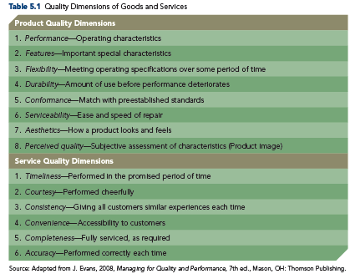
PRODUCT QUALITY DIMENSIONS
TABLE 5.1
Quality Dimensions of Goods and Services

Slide 40
LIKELIHOOD OF ATTACK
First-Mover Incentives
Service quality dimensions include:
  Timeliness
  Courtesy
  Consistency
  Convenience
  Completeness
  Accuracy
Second Mover
Late Mover
Organizational Size
Quality
(Service)

Slide 41
QUALITY
■ Customer perception that the firm's goods or services perform in ways that are important to customers, meeting or exceeding their expectations.
■ From a strategic perspective, quality is the outcome of how a firm completes its primary and support activities.
■ Quality is a universal theme in the global economy and is a necessary but insufficient condition for competitive success.
■ Quality is possible only when top-level managers support it and when its importance is institutionalized throughout the entire organization and its value chain.

Slide 42
LIKELIHOOD OF RESPONSE
In addition to market commonality, resource similarity, awareness, motivation, and ability, firms evaluate the following three factors to predict how a competitor is likely to respond to competitive actions:
  1. Type of Competitive Action
  2. Actor’s Reputation 3. Dependence on the Market
  A firm is likely to respond when the action significantly strengthens or inaction weakens the firm's competitive position.

Slide 43
LIKELIHOOD OF RESPONSE (CONT’D)
Strategic actions receive strategic responses
  Strategic actions elicit fewer total competitive responses due to the significant resources required and their irreversibility
  The time needed to implement and assess a strategic action delays competitor’s responses
Tactical responses are taken to counter the effects of tactical actions
  A competitor likely will respond quickly to a tactical action
Type of Competitive Action
The success of a firm’s competitive action is affected by the likelihood that a competitor will respond to it as well as by the type (strategic or tactical) and effectiveness of that response.

Slide 44
LIKELIHOOD OF RESPONSE (CONT’D)
Type of Competitive Action
An actor is the firm taking an action or response
Reputation is the positive or negative attribute ascribed by one rival to another based on past competitive behavior
The firm studies responses that a competitor has taken previously when attacked to predict likely responses.
Actor’s Reputation

Slide 45
LIKELIHOOD OF RESPONSE (CONT’D)
Type of Competitive Action
Market dependence is the extent to which a firm’s revenues or profits are derived from a particular market
In general, firms can predict that competitors with high market dependence are likely to respond strongly to attacks threatening their market position
Actor’s Reputation
Dependence on the Market

Slide 46
COMPETITIVE DYNAMICS
■ Competitive rivalry concerns the ongoing actions and responses between a firm and its DIRECT COMPETITORS for an advantageous market position.
■ Competitive dynamics concern the ongoing actions and responses AMONG ALL FIRMS competing within a market for advantageous positions.
■ Building and sustaining competitive advantages are at the core of competitive rivalry, in that advantages are the key to creating value for shareholder.

Slide 47
COMPETITIVE DYNAMICS
■ Competitive behaviors differ across market types.
■ Competitive dynamics differ in slow-cycle, fast-cycle, and standard-cycle markets.
■ The sustainability of the firm’s competitive advantages differs across the three market types.
■ The degree of sustainability differs by market type and is affected by how quickly competitive advantages can be imitated and how costly it is to do so.

Slide 48
COMPETITIVE DYNAMICS VERSUS RIVALRY
COMPETITIVE RIVALRY
(Individual firms)
  Market commonality and resource similarity
  Awareness, motivation, and ability
  First mover incentives, size, and quality
COMPETITIVE DYNAMICS
(All firms)
  Market speed (slow-cycle, fast-cycle, and standard-cycle
  Effects of market speed on actions and responses of all competitors in the market

Slide 49
COMPETITIVE DYNAMICS
Competitive advantages are shielded from imitation for long periods of time and imitation is costly.
Competitive advantages are sustainable in slow-cycle markets.
Build a unique and proprietary capability that yields competitive advantage, creating sustainability (i.e., proprietary and difficult for competitors to imitate).
Once a proprietary advantage is developed, competitive behavior should be oriented to protecting, maintaining, and extending that advantage.
Organizational structure should be used to effectively support strategic efforts.
Slow-Cycle Markets

Slide 50
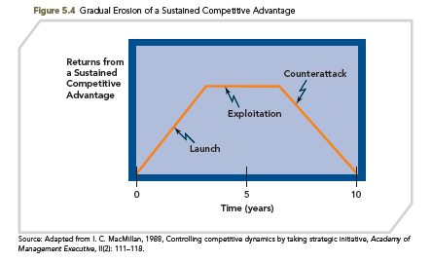
COMPETITIVE DYNAMICS
FIGURE 5.4
Gradual Erosion of a Sustained Competitive Advantage

Slide 51
COMPETITIVE DYNAMICS
The firm’s competitive advantages are not shielded from imitation.
Technology is non-proprietary.
Imitation is rapid and inexpensive.
Competitive advantages are not sustainable.
  Reverse engineering.
  Market volatility.
Focus: Learning how to rapidly and continuously develop new competitive advantages that are superior to those they replace (creating innovation).
Slow-Cycle Markets
Fast-Cycle Markets

Slide 52
COMPETITIVE DYNAMICS
  Avoid loyalty to any one product, possibly cannibalizing on own current products to launch new ones before competitors learn how to do so through successful imitation.
  Continually try to move on to another temporary competitive advantage before competitors can respond to the previous one.
Slow-Cycle Markets
Fast-Cycle Markets

Slide 53
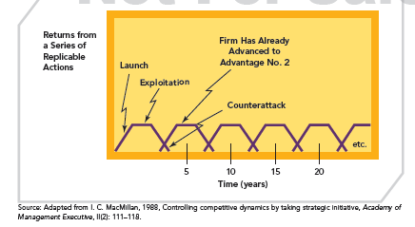
COMPETITIVE DYNAMICS
FIGURE 5.5
Developing Temporary Advantages to Create Sustained Advantage

Slide 54
COMPETITIVE DYNAMICS
Firm’s competitive advantages are moderately shielded from imitation
Imitation is moderately costly
Competitive advantages partially sustainable if quality is continuously upgraded
Firms
  Seek large market shares; mass markets
  Develop economies of scale
  Gain customer loyalty through brand names
  Carefully control operations
  Manage a consistent experience for the customer
Slow-Cycle Markets
Fast-Cycle Markets
Standard-Cycle Markets

Slide 55
COMPETITIVE DYNAMICS
IMITATION
COMPETITIVE ADVANTAGE
Slow and Costly Proprietary rights A costly-to-imitate resource/capability usually results from unique historical conditions, causal ambiguity, and/or social complexity | Sustained competitive advantage is most achievable in this market
Rapid and Inexpensive | Not sustainable Reverse engineering
Faster and less costly than in slow-cycle markets; and slower and more expensive than in fast-cycle markets | Partially sustainable
Slow-Cycle Markets
Fast-Cycle Markets
Standard-Cycle Markets

