Slide 1
PART 2: STRATEGIC ACTIONS:
STRATEGY FORMULATION
CHAPTER 8
INTERNATIONAL STRATEGY

Slide 2
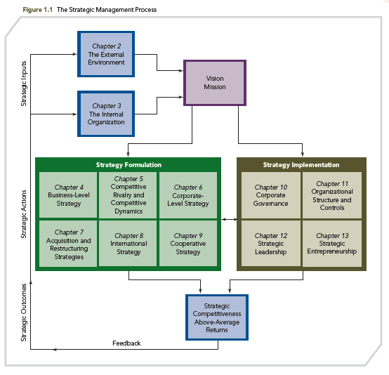
THE STRATEGIC MANAGEMENT PROCESS

Slide 3
KNOWLEDGE OBJECTIVES
● Explain incentives that can influence firms to use an international strategy.
● Identify three basic benefits firms achieve by successfully implementing an international strategy.
● Explore the determinants of national advantage as the basis for international business-level strategies.
● Describe the three international corporate-level strategies.
● Discuss environmental trends affecting the choice of international strategies, particularly international corporate-level strategies.

Slide 4
KNOWLEDGE OBJECTIVES
● Explain the five modes firms use to enter international markets.
● Discuss the two major risks of using international strategies.
● Discuss the strategic competitiveness outcomes associated with international strategies particularly with an international diversification strategy.
● Explain two important issues firms should have knowledge about when using international strategies.

Slide 5
INTERNATIONAL STRATEGY: CRITICAL TO STARBUCKS’ FUTURE SUCCESS
OPENING CASE
■ From launching its operations in 1971 to currently being one of the world’s most recognized brands, Starbucks has over 17,000 locations in some 50 countries; global growth is paramount
■ This case highlights the increasing importance of international markets for Starbucks
■ China and India are especially pivotal markets
■ Starbucks uses an international differentiation business-level strategy and a transnational international corporate-level strategy in China

Slide 6
INTERNATIONAL STRATEGY: CRITICAL TO STARBUCKS’ FUTURE SUCCESS
OPENING CASE
■ Starbucks’ international differentiation strategy underscores unique products and customer experiences, with a commensurate premium price.
■ Its transnational strategy leverages Starbucks’ core competencies to standardize its operations to gain global efficiencies, while decentralizing decision-making responsibilities in China so that some products can be customized to meet local consumers’ unique needs.

Slide 7
DOMESTIC VERSUS GLOBAL MARKETS
DOMESTIC
MARKETS
GLOBAL
MARKETS
Unstable
Stable
Predictable
Unpredictable
Complex and risky
Less complex
Globalization is enabling global markets
Globalization is reducing the number of domestic-only markets

Slide 8
INTRODUCTION
The purpose of this chapter is to discuss how international strategies can be a source of global strategic competitiveness. It addresses:
  Factors that influence firms to identify international opportunities
  Three basic benefits that can accrue to firms that successfully use international strategies
  International business-level strategies and international corporate-level strategies
  Five modes of entry firms consider when deciding how to enter international markets
  Economic and political risks when implementing international strategies
  Outcomes firms seek when using international strategies
  International strategy: challenges to be mindful of

Slide 9
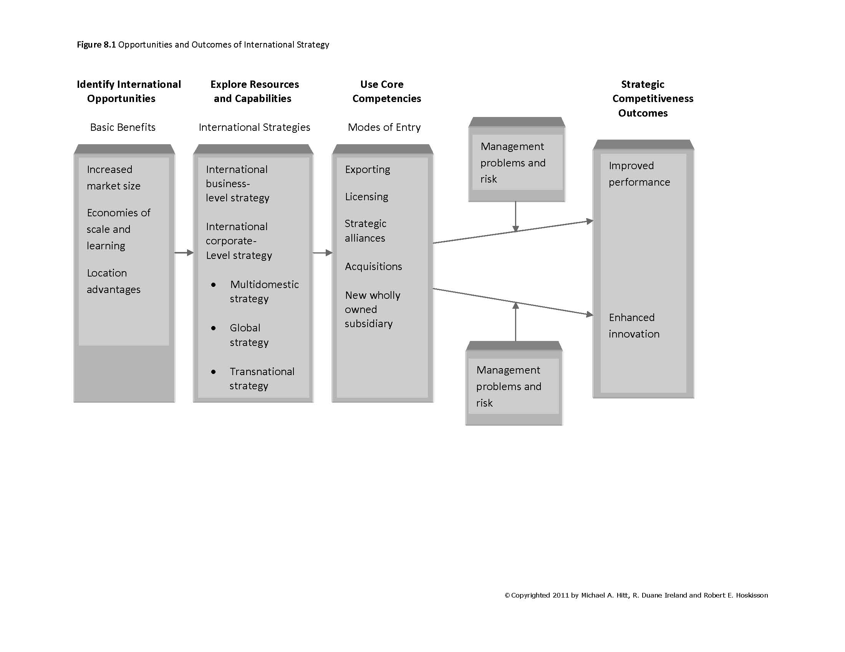
OPPORTUNITIES AND OUTCOMES OF INTERNATIONAL STRATEGY
FIGURE 8.1
Opportunities and Outcomes of International Strategy
©Copyrighted 2011 Michael A. Hitt, R. Duane Ireland and Robert E. Hoskisson

Slide 10
IDENTIFYING INTERNATIONAL OPPORTUNITIES
International Strategy: a strategy through which the firm sells its goods or services outside its domestic market
Reasons for having an international strategy
  International markets yield new opportunities
  Needed resources can be secured
  Greater potential product demand
  Borderless demand for globally branded products
  Pressure for global integration
  New market expansion extends product life cycle

Slide 11
IDENTIFYING INTERNATIONAL OPPORTUNITIES
  Many firms choose direct investment in assets over indirect investment because it:
  ● Provides better protection for assets
  ● Develops relationships with key resources faster
  ● May provide reduction in risk due to direct connections

Slide 12
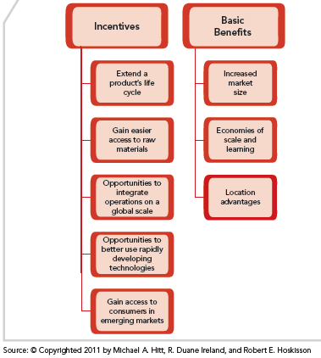
INCENTIVES AND BASIC BENEFITS OF INTERNATIONAL STRATEGY
FIGURE 8.2
Incentives and Basic Benefits of International Strategy

Slide 13
IDENTIFYING INTERNATIONAL OPPORTUNITIES
INCENTIVES TO USE INTERNATIONAL STRATEGIES
● Firms derive three basic benefits by successfully using international strategies:
1. increased market size
2. increased economies of scale and learning
3. development of a competitive advantage through location (e.g., access to low-cost labor, critical resources, or customers)
● Raymond Vernon states that the classic rationale for international diversification is to:
4. extend the product’s life cycle

Slide 14
IDENTIFYING INTERNATIONAL OPPORTUNITIES
CLASSIC RATIONALE: EXTENDING THE PRODUCT’S LIFE CYCLE
Product demand
develops and firm
exports products
Foreign
competition
begins production
Firm introduces
innovation in
domestic market
Firm begins
production abroad
Production is standardized and relocated to low cost countries

Slide 15
IDENTIFYING INTERNATIONAL OPPORTUNITIES
THREE BASIC BENEFITS OF INTERNATIONAL STRATEGY
1. INCREASED MARKET SIZE
  ● Domestic market may lack the size to support efficient scale manufacturing facilities
  ● Generally, larger international markets offer higher potential returns and pose less risk for firms
  ● The strength of international markets may facilitate efforts to more effectively sell and/or produce products that create value for customers

Slide 16
IDENTIFYING INTERNATIONAL OPPORTUNITIES
THREE BASIC BENEFITS OF INTERNATIONAL STRATEGY
2. ECONOMIES OF SCALE AND LEARNING
  ● Expanding size or scope of markets helps achieve economies of scale in manufacturing as well as marketing, R&D, or distribution
  ● Costs are spread over a larger sales base
    ● Profit per unit is increased

Slide 17
IDENTIFYING INTERNATIONAL OPPORTUNITIES
THREE BASIC BENEFITS OF INTERNATIONAL STRATEGY
2. ECONOMIES OF SCALE AND LEARNING
  ● Firms may also be able to exploit core competencies in international markets through resource and knowledge sharing between units and network partners across country borders
  ● By sharing resources and knowledge in this manner, firms can learn how to create synergy, which in turn can help each firm learn how to produce higher-quality products at a lower cost

Slide 18
IDENTIFYING INTERNATIONAL OPPORTUNITIES
THREE BASIC BENEFITS OF INTERNATIONAL STRATEGY
2. ECONOMIES OF SCALE AND LEARNING
  ● Working in multiple international markets also provides firms with new learning opportunities
  ● Increasing the firm’s R&D ability can contribute to its efforts to enhance innovation, which is critical to both short- and long-term success
  ● However, to take advantage of international R&D investments, firms need to already have a strong system in place to absorb resulting R&D knowledge

Slide 19
IDENTIFYING INTERNATIONAL OPPORTUNITIES
THREE BASIC BENEFITS OF INTERNATIONAL STRATEGY
3. LOCATION ADVANTAGES
  ● Certain markets may offer superior access to critical resources, e.g., raw materials, lower-cost labor, energy, suppliers, key customers
      ● Cultural influences may be advantageous—a strong cultural match facilitates international business transactions
      ● Physical distances influence firms’ location choices, i.e., transportation costs

Slide 20
INTERNATIONAL STRATEGIES
Firms choose one or both of two basic types of international strategies:
business level and corporate level
International business-level strategies
  Cost leadership
  Differentiation
  Focused cost leadership
  Focused differentiation
  Integrated cost leadership/differentiation

Slide 21
INTERNATIONAL STRATEGIES
International Corporate-level strategies
  Multidomestic
  Global
  Transnational (the combination of the multidomestic and global strategies)
  Each international strategy the firm uses must be based on one or more core competencies

Slide 22
INTERNATIONAL STRATEGIES
INTERNATIONAL BUSINESS-LEVEL STRATEGY
● International firms first develop domestic strategies (at the business level and at the corporate level if the firm has diversified at the product level).
  ● Firms may be able to leverage some of their domestic capabilities and core competencies as the foundation for their international competitive success, however, this type of domestic-global translation diminishes as geographic diversity increases.

Slide 23
INTERNATIONAL STRATEGIES
INTERNATIONAL BUSINESS-LEVEL STRATEGY
  ● Home country is usually the most important source of competitive advantage:
    Domestic resources and capabilities are the building blocks for international capabilities and core competencies.
  ● This reasoning is grounded in Michael Porter’s analysis of why some nations/industries are more competitive than others within nations or in other nations.

Slide 24
INTERNATIONAL STRATEGIES
INTERNATIONAL BUSINESS-LEVEL STRATEGY
● International business-level strategy is selected based on structural characteristics of an economy, as identified by Porter’s four determinants of national advantage (see Figure 8.3).
● Porter’s core argument is that conditions/ factors in a firm’s domestic market either help or hinder the firm’s international business-level strategy implementation.

Slide 25
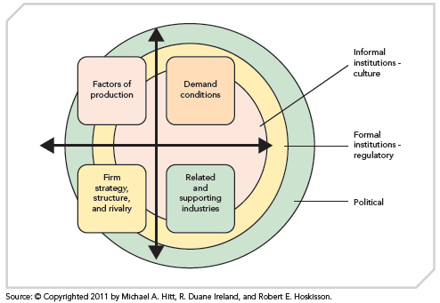
INTERNATIONAL STRATEGIES
DETERMINANTS OF NATIONAL ADVANTAGE
FIGURE 8.3
Determinants of National Advantage

Slide 26
INTERNATIONAL STRATEGIES
DETERMINANTS OF NATIONAL ADVANTAGE
Factors of production
  The inputs necessary to compete in any industry
    ➢ Labor ➢Land ➢Natural resources
    ➢ Capital ➢Infrastructure
Basic factors
  Natural and labor resources
Advanced factors
  Digital communication systems and an educated workforce

Slide 27
INTERNATIONAL STRATEGIES
DETERMINANTS OF NATIONAL ADVANTAGE
Demand conditions: characterized by the nature and size of buyers’ needs in the home market for the industry’s goods or services
    Size of the market segment can lead to scale-efficient facilities
    Efficiency can lead to domination of the industry in other countries
    Specialized demand may create opportunities beyond national boundaries

Slide 28
INTERNATIONAL STRATEGIES
DETERMINANTS OF NATIONAL ADVANTAGE
Related and supporting industries: supporting services, facilities, suppliers, etc.
    Support in design
    Support in distribution
    Related industries as suppliers and buyers

Slide 29
INTERNATIONAL STRATEGIES
DETERMINANTS OF NATIONAL ADVANTAGE
Firm strategy, structure, and rivalry: the pattern of strategy, structure, and rivalry among firms
    Common technical training
    Methodological product and process improvement
    Cooperative and competitive systems

Slide 30
INTERNATIONAL STRATEGIES
DETERMINANTS OF NATIONAL ADVANTAGE
Firm strategy, structure, and rivalry
EXAMPLES
  Germany - the excellent technical training system fosters a strong emphasis on continuous product and process improvements
  Japan - unusual cooperative and competitive systems facilitate the cross-functional management of complex assembly operations
  Italy - the national pride of the country’s designers spawns strong industries in shoes, sports cars, fashion apparel, and furniture
  U.S. - Competition among computer manufacturers and software producers accelerates development in these industries

Slide 31
INTERNATIONAL STRATEGIES
INTERNATIONAL CORPORATE-LEVEL STRATEGY
The type of corporate strategy selected will have an impact on the selection and implementation of the business-level strategies
  Some strategies provide individual country units with the flexibility to choose their own strategies
  Other strategies dictate business-level strategies from the home office and coordinate resource sharing across units

Slide 32
INTERNATIONAL STRATEGIES
INTERNATIONAL CORPORATE-LEVEL STRATEGY
Focuses on the scope of operations:
  Product diversification
  Geographic diversification
Required when the firm operates in:
  Multiple industries, and
  Multiple countries or regions
Headquarters unit guides the strategy
  However, business or country-level managers can have substantial strategic input

Slide 33
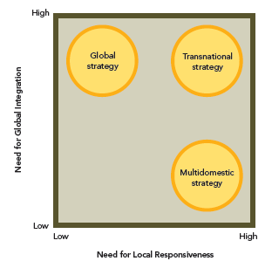
INTERNATIONAL STRATEGIES
INTERNATIONAL CORPORATE-LEVEL STRATEGY
FIGURE 8.4
International Corporate-Level Strategies

Slide 34
INTERNATIONAL STRATEGIES
INTERNATIONAL CORPORATE-LEVEL STRATEGIES
MULTIDOMESTIC STRATEGY
Multidomestic
strategy
Strategy and operating decisions are decentralized to strategic business units (SBU) in each country
Products and services are tailored to local markets
Business units in each country are independent
Assumes markets differ by country or regions
Focus on competition in each market
Prominent strategy among European firms due to broad variety of cultures and markets

Slide 35
INTERNATIONAL STRATEGIES
INTERNATIONAL CORPORATE-LEVEL STRATEGIES
MULTIDOMESTIC STRATEGY
Multidomestic
strategy
Strategy results in less knowledge sharing for the corporation as a whole
Strategy isolates the firm from global competitive forces
  Establish protected market positions
  Compete in industry segments most affected by differences among local countries
  Deals with uncertainty from differences across markets

Slide 36
INTERNATIONAL STRATEGIES
INTERNATIONAL CORPORATE-LEVEL STRATEGIES
GLOBAL STRATEGY
Global
strategy
Firm offers standardized products across country markets, with the competitive strategy being dictated by the home office
Strategic and operating decisions are centralized at the home office
Involves interdependent SBUs operating in each country
Home office attempts to achieve integration across SBUs, adding management complexity
Produces lower risk

Slide 37
INTERNATIONAL STRATEGIES
INTERNATIONAL CORPORATE-LEVEL STRATEGIES
GLOBAL STRATEGY
Global
strategy
Facilitated by improved global reporting standards (i.e., accounting and financial)
Emphasizes economies of scale
Less responsive to local market opportunities
Requires resource sharing and coordination across borders (hard to manage)
Offers less effective learning processes (pressure to conform and standardize)
Strategy more effective in areas where regional integration is occurring

Slide 38
INTERNATIONAL STRATEGIES
INTERNATIONAL CORPORATE-LEVEL STRATEGIES
TRANSNATIONAL STRATEGY
Transnational
strategy
Seeks to achieve both global efficiency and local responsiveness—competing goals
Requires both:
  Centralization - global coordination and control
  Decentralization - local flexibility
Global competitive landscape fosters intense competition, thus pressures to reduce costs, while at the same time information sharing has intensified the desire for specialized, customized, differentiated products

Slide 39
INTERNATIONAL STRATEGIES
INTERNATIONAL CORPORATE-LEVEL STRATEGIES
TRANSNATIONAL STRATEGY
Transnational
strategy
Firm must pursue organizational learning to achieve competitive advantage
Challenging, but becoming increasingly necessary to compete in international markets
Increasingly popular as a strategy

Slide 40
INTERNATIONAL STRATEGIES
INTERNATIONAL CORPORATE-LEVEL STRATEGIES
MULTIDOMESTIC
GLOBAL
TRANSNATIONAL
KEY ASSUMPTION: universal demand → need for global integration
KEY ASSUMPTION: country/cultural differences → need for local responsiveness
ADVANTAGE: BOTH
ADVANTAGE: local responsiveness
ADVANTAGE: global efficiencies
local responsiveness and global efficiencies

Slide 41
INTERNATIONAL STRATEGIES
INTERNATIONAL CORPORATE-LEVEL STRATEGIES
MULTIDOMESTIC
GLOBAL
TRANSNATIONAL
EXAMPLE: CEMEX is a global building materials company that centralizes operations in order to gain scale economies, among other benefits
EXAMPLE: Starbucks in China standardizes operations while simultaneously decentralizes some decision-making for local responsiveness
EXAMPLE: Unilever is transitioning from a multidomestic strategy to a transnational strategy

Slide 42
ENVIRONMENTAL TRENDS
LIABILITY OF FOREIGNESS
TWO NEW TRENDS
Brazil, Russia, India, and China (BRIC) represent major international market opportunities and threats.
1. Liability of foreignness: costs associated with entering foreign markets
Increased after terrorists’ attacks and Iraq War
Four types of distances:
  Cultural differences
  Administrative (unfamiliar operating environments)
  Geographic (challenges of distance coordination)
  Economic

Slide 43
ENVIRONMENTAL TRENDS
REGIONALIZATION
TWO NEW TRENDS
2. Regionalization
Global strategies not as prevalent today; difficult to implement even with Internet-based strategies
Regional focus allows firms to marshal resources to compete effectively in regional markets
Increases understanding of market: cultures, legal and social norms

Slide 44
ENVIRONMENTAL TRENDS
REGIONALIZATION
TWO NEW TRENDS
2. Regionalization (cont’d)
    Achieve some economies through coordination and sharing of resources
    Trade agreements (e.g., EU, OAS, NAFTA) promote trade flows across country boundaries with their respective regions
    Most firms enter regional markets sequentially, beginning in more familiar markets, introducing their largest and strongest lines of business first

Slide 45
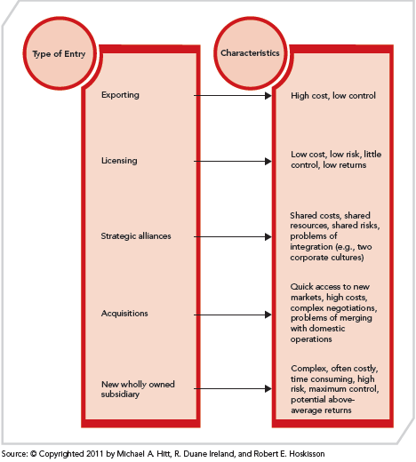
CHOICE OF INTERNATIONAL ENTRY MODE
FIGURE 8.5
Modes of Entry and Their Characteristics

Slide 46
CHOICE OF INTERNATIONAL ENTRY MODE
Following the selection of an international strategy, the five main entry modes are:
  Exporting
  Licensing
  Strategic Alliances
  Acquisitions
  New Wholly Owned Subsidiary

Slide 47
CHOICE OF INTERNATIONAL ENTRY MODE
EXPORTING
LICENSING
STRATEGIC ALLIANCES
ACQUISITIONS
NEW WHOLLY
OWNED SUBSIDIARY
RISK
INCREASES
CONTROL
INCREASES
©Copyrighted 2011 Marta Szabo White, Ph.D.

Slide 48
CHOICE OF INTERNATIONAL ENTRY MODE
EXPORTING
1. Exporting: the firm sends products it produces in its domestic market to international markets
  Involves low expense to establish operations in host country
  Often involves contractual agreements
  Involves high transportation costs
  Tariffs maybe imposed
  Low control over marketing and distribution

Slide 49
CHOICE OF INTERNATIONAL ENTRY MODE
LICENSING
2. Licensing: an agreement is formed that allows a foreign company to purchase the right to manufacture and sell a firm’s products within a host country’s market or a set of markets

Slide 50
CHOICE OF INTERNATIONAL ENTRY MODE
LICENSING
2. Licensing (cont’d)
  Involves low cost to expand internationally
  Allows licensee to absorb risks
  Has low control over manufacturing and marketing
  Offers lower potential returns (shared with licensee)
  Involves risk of licensee imitating technology and product for own use
  May have inflexible ownership arrangement

Slide 51
CHOICE OF INTERNATIONAL ENTRY MODE
STRATEGIC ALLIANCES
3. Strategic alliance: collaboration with a partner firm for international market entry
  Involves shared risks and resources
  Facilitates development of core competencies
  Involves fewer resources and costs required for entry
  May involve possible incompatibility, conflict, or lack of trust with partner
  Is difficult to manage

Slide 52
CHOICE OF INTERNATIONAL ENTRY MODE
ACQUISITIONS
4. Acquisitions
Cross-border acquisition: a firm from one country acquires a stake in or purchases 100% of a firm located in another country
  Allows for quick access to market
  Involves possible integration difficulties
  Is costly (debt financing)
  Has complex negotiations and transaction requirements

Slide 53
CHOICE OF INTERNATIONAL ENTRY MODE
NEW WHOLLY OWNED SUBSIDIARY
5. New Wholly Owned Subsidiary
Greenfield venture: a firm invests directly in another country/market by establishing a new wholly owned subsidiary
  Is costly
  Involves complex processes
  Allows for maximum control
  Has the highest potential returns
  Carries high risk

Slide 54
CHOICE OF INTERNATIONAL ENTRY MODE
DYNAMICS OF MODE OF ENTRY
Use the best suited mode of entry to the situation at hand; affected by several factors:
  Export, licensing, and strategic alliance: good tactics for early market development
  Strategic alliance: used in more uncertain situations

Slide 55
CHOICE OF INTERNATIONAL ENTRY MODE
DYNAMICS OF MODE OF ENTRY
  Wholly owned subsidiary may be preferred if:
        Intellectual Property (IP) rights in emerging economy are not well protected
        Number of firms in industry is accelerating
        Need for global integration is high
  Acquisitions or Greenfield ventures: secure a stronger presence in international markets

Slide 56
CHOICE OF INTERNATIONAL ENTRY MODE
EXPORTING
What’s the best solution?
Situation
Optimal Solution
The firm has no foreign manufacturing expertise and requires investment only in distribution.
Exporting

Slide 57
CHOICE OF INTERNATIONAL ENTRY MODE
LICENSING
What’s the best solution?
Situation
Optimal Solution
The firm needs to facilitate the product improvements necessary to enter foreign markets.
Licensing

Slide 58
CHOICE OF INTERNATIONAL ENTRY MODE
STRATEGIC ALLIANCES
What’s the best solution?
Situation
Optimal Solution
The firm needs to connect with an experienced partner already in the targeted market.
Strategic Alliance

Slide 59
CHOICE OF INTERNATIONAL ENTRY MODE
STRATEGIC ALLIANCES
What’s the best solution?
Situation
Optimal Solution
The firm needs to reduce its risk through the sharing of costs.
Strategic Alliance

Slide 60
CHOICE OF INTERNATIONAL ENTRY MODE
STRATEGIC ALLIANCES
What’s the best solution?
Situation
Optimal Solution
The firm is facing uncertain situations such as an emerging economy in its targeted market.
Strategic Alliance

Slide 61
CHOICE OF INTERNATIONAL ENTRY MODE
ACQUISITIONS
What’s the best solution?
Situation
Optimal Solution
The firm must act quickly to gain rapid access to this new market, where corruption is not an issue.
Acquisition

Slide 62
CHOICE OF INTERNATIONAL ENTRY MODE
WHOLLY OWNED SUBSIDIARY
What’s the best solution?
Situation
Optimal Solution
The firm’s intellectual property rights in an emerging economy are not well protected, the number of firms in the industry is growing fast, and the need for global integration is high.
Wholly Owned Subsidiary
(Greenfield Venture)

Slide 63
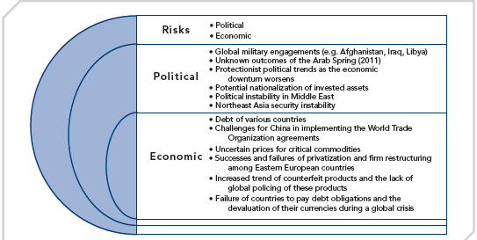
RISKS IN AN INTERNATIONAL ENVIRONMENT
FIGURE 8.6
Risks in the International Environment

Slide 64
RISKS IN AN INTERNATIONAL ENVIRONMENT: POLITICAL RISKS
Political risks: disruption of MNC operations by political forces or events whether they occur in host countries or home country, or result from changes in the international environment
Prior to implementing any of the five modes of international entry, political risk analysis should be conducted, where the firm examines potential sources and factors of noncommercial disruptions of their foreign investments and the operations.

Slide 65
RISKS IN AN INTERNATIONAL ENVIRONMENT: POLITICAL RISKS
International strategy implementation may be disrupted by the following examples of political risk:
● Government instability
  ● Conflict or war
  ● Government regulations
  ● Conflicting and diverse legal authorities
  ● Potential nationalization of private assets
  ● Government corruption
  ● Changes in government policies

Slide 66
RISKS IN AN INTERNATIONAL ENVIRONMENT: ECONOMIC RISKS
Economic risks: fundamental weaknesses in a country or region’s economy with the potential to adversely impact the successful implementation of a firm’s international strategies
International strategy implementation may be disrupted by the following examples of economic risk:
● Foremost economic risk - currency volatility
  ● Currency effect on the prices of globally manufactured goods, thus exports/imports

Slide 67
RISKS IN AN INTERNATIONAL ENVIRONMENT: ECONOMIC RISKS
International strategy implementation may be disrupted by the following examples of economic risk (cont’d):
  ● Government oversight and control of economic/financial capital.
  ● Weak Intellectual Property (IP) rights protections, impact FDI attractiveness.
  ● Investment losses due to political risks
  ● Terrorism
  ● Security risk of foreign firms acquiring key natural resources or strategic IP.

Slide 68

EXAMPLES OF POLITICAL AND ECONOMIC RISKS
?
?
?
?
?

Slide 69
STRATEGIC COMPETITIVENESS OUTCOMES
INTERNATIONAL DIVERSIFICATION AND RETURNS
International diversification: firm expands sales of its goods or services across the borders of global regions and countries into different geographic locations or markets
From Figure 8.1, the benefits of implementing international strategies are critical to strategic competitiveness, as measured by improved performance and enhanced innovation.

Slide 70
STRATEGIC COMPETITIVENESS OUTCOMES
INTERNATIONAL DIVERSIFICATION AND RETURNS
Implementation follows the selection of international strategy and mode of entry:
  International diversification and returns
  International diversification and innovation
  Complexity of managing multinational firms

Slide 71
STRATEGIC COMPETITIVENESS OUTCOMES
INTERNATIONAL DIVERSIFICATION AND RETURNS
  ● As international diversification increases, firms’ returns initially decrease, but then increase quickly as the firm learns to manage international expansion.
  ● Firms that are broadly diversified into multiple international markets usually achieve the most positive stock returns, especially when they diversify geographically into core business areas.

Slide 72
STRATEGIC COMPETITIVENESS OUTCOMES
INTERNATIONAL DIVERSIFICATION AND RETURNS
  Many factors contribute to the positive effects of international diversification:
    Private versus government ownership
    Economies of scale and experience
    Location advantages
    Increased market size
    Opportunity to stabilize returns, which helps reduce a firm’s overall risk

Slide 73
STRATEGIC COMPETITIVENESS OUTCOMES
ENHANCED INNOVATION
  Exposure to new products and markets
  Opportunity to integrate new knowledge into operations
  Generation of resources to sustain innovation efforts
  The relationship among international geographic diversification, innovation, and returns is complex

Slide 74
STRATEGIC COMPETITIVENESS OUTCOMES
ENHANCED INNOVATION
  ● Some level of performance is necessary to provide the resources the firm needs to diversify geographically; in turn, geographic diversification provides incentives and resources to invest in R&D.
  ● Effective R&D should enhance the firm’s returns, which then provides more resources for continued geographic diversification and investment in R&D.

Slide 75
THE CHALLENGE OF INTERNATIONAL STRATEGIES
THE COMPLEXITY OF MANAGING INTERNATIONAL STRATEGIES
Complexity of managing multinational firms–six considerations:
  Geographic dispersion
  Costs of coordination
  Logistical costs
  Trade barriers
  Cultural diversity
  Host government

Slide 76
THE CHALLENGE OF INTERNATIONAL STRATEGIES
LIMITS TO INTERNATIONAL EXPANSION
There are several reasons that explain the limits to the positive effects of the diversification associated with international strategies:
  Geographic dispersion
  Trade barriers
  Logistical costs
  Cultural diversity and barriers
  Complexity of competition
  Relationship between firm and host country
  Other country differences

