Slide 1
PART 2: STRATEGIC ACTIONS:
STRATEGY FORMULATION
CHAPTER 9
COOPERATIVE STRATEGY

Slide 2
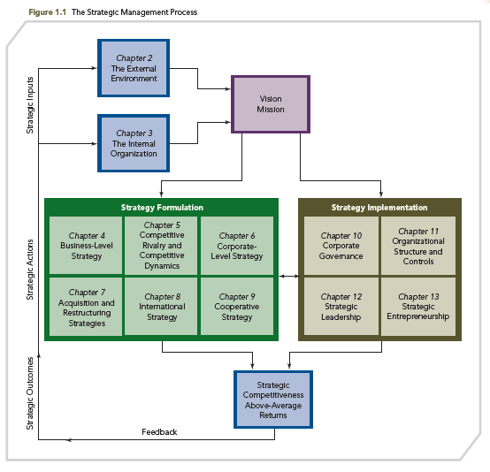
THE STRATEGIC MANAGEMENT PROCESS

Slide 3
KNOWLEDGE OBJECTIVES
● Define cooperative strategies and explain why firms use them.
● Define and discuss the three major types of strategic alliances.
● Name the business-level cooperative strategies and describe their use.
● Discuss the use of corporate-level cooperative strategies in diversified firms.

Slide 4
KNOWLEDGE OBJECTIVES
● Understand the importance of cross-border strategic alliances as an international cooperative strategy.
● Explain cooperative strategies’ risks
● Describe two approaches used to manage cooperative strategies.

Slide 5
THE RENAULT-NISSAN ALLIANCE: COLLABORATING TO SUCCEED
OPENING CASE
■ The 1999 French-based Renault and Japanese-based Nissan alliance was launched because each firm lacked the necessary size to develop economies of scale and economies of scope, critical components in the global automobile market.
■ Renault has a 44.3% stake in Nissan while Nissan has a 15% stake in Renault, with Brazilian-born Carlos Ghosn as CEO for both companies.

Slide 6
THE RENAULT-NISSAN ALLIANCE: COLLABORATING TO SUCCEED
OPENING CASE
■ Three guiding values for this synergistic alliance:
1. Trust (work fairly, impartially, and professionally)
2. Respect (honor commitments, liabilities, and responsibilities)
3. Transparency (be open, frank, and clear)
■ Renault-Nissan B.V., a key reason for the alliance’s success, is a strategic management firm, responsible for strategies, synergies, and combining resources, capabilities, and core competencies.

Slide 7
THE RENAULT-NISSAN ALLIANCE: COLLABORATING TO SUCCEED
OPENING CASE
■ This opening case underscores the complexities of cooperative relationships and highlights the many challenges of this corporate-level alliance, and the business-unit level, horizontal alliances.
■ Under CEO Ghosn’s leadership, each company maintains its separate identify while capitalizing upon their collaboration.

Slide 8
INTRODUCTION
COOPERATIVE STRATEGY
Firms collaborate for the purpose of working together to achieve a shared objective.
Cooperating with other firms is a strategy that:
  Creates value for a customer
  Exceeds the cost of constructing customer value in other ways
  Establishes a favorable position relative to competitors

Slide 9
INTRODUCTION
COOPERATIVE STRATEGY
Examples of cooperative behavior known to contribute to alliance success:
  Actively solving problems
  Being trustworthy
  Consistently pursuing ways to combine partners’ resources and capabilities to create value
Collaborative (Relational) Advantage
  A competitive advantage developed through a cooperative strategy

Slide 10
STRATEGIC ALLIANCES AS A PRIMARY TYPE OF COOPERATIVE STRATEGY
Strategic alliance: cooperative strategy in which firms combine resources and capabilities to create a competitive advantage
Three types of strategic alliances
  Joint venture
  Equity strategic alliance
  Nonequity strategic alliances, which include:
    Licensing agreements
    Distribution agreements
    Supply contracts
    Outsourcing commitments

Slide 11
TYPES OF MAJOR STRATEGIC ALLIANCES
Joint venture: two or more firms create a legally independent company to share resources and capabilities to develop a competitive advantage
  Optimal when firms need to combine their resources and capabilities to create a competitive advantage that is substantially different from individual advantages, and when highly uncertain, hypercompetitive markets are targeted.

Slide 12
TYPES OF MAJOR STRATEGIC ALLIANCES
2. Equity strategic alliance: two or more firms own different percentages of the company they have formed by combining some of their resources and capabilities for the purpose of creating a competitive advantage
  Many foreign direct investments, such as those companies from multiple countries are making in China, are completed through an equity strategic alliance

Slide 13
TYPES OF MAJOR STRATEGIC ALLIANCES
3. Nonequity strategic alliance: two or more firms develop a contractual relationship to share some of their unique resources and capabilities to create a competitive advantage
  Separate independent company NOT established, thus no equity positions: less formal, fewer partner commitments, and intimate relationship among partners is not fostered

Slide 14
TYPES OF MAJOR STRATEGIC ALLIANCES
1. Joint Venture
  EXAMPLE: 1999 - Germany’s Siemens AG and Japan’s Fujitsu Ltd. each owned 50 percent of the joint venture Fujitsu Siemens Computers B.V., later to become Fujitsu Technology Solutions when Fujitsu bought Siemens’ share of the joint venture.
2. Equity Strategic Alliance
  EXAMPLE: Japanese telecom operator NTT DOCOMO Inc. and Chinese Internet search operator Baidu Inc. established an equity strategic alliance in China to distribute games and other mobile-phone content.
3. Nonequity Strategic Alliance
  EXAMPLES: Licensing agreements, distribution agreements, and supply contracts. Hewlett-Packard (HP) actively uses this type of cooperative strategy to license some of its intellectual property.

Slide 15
TYPES OF MAJOR STRATEGIC ALLIANCES
  Nonequity Strategic Alliance
  Outsourcing, a type of nonequity strategic alliance, is the purchase of a value-creating primary or support activity from another firm.
  Dell Inc. and most other computer firms outsource most or all of their production of laptop computers and often form nonequity strategic alliances.
  To protect IP, modularity is employed, which prevents the contracting partner from gaining too much knowledge or from sharing certain aspects of the business the outsourcing firm does not want revealed.

Slide 16
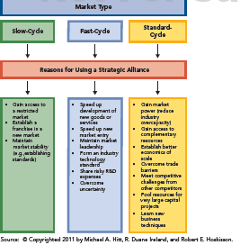
REASONS FIRMS DEVELOP STRATEGIC ALLIANCES
FIGURE 9.1
Reasons for Strategic Alliances by Market Type

Slide 17
REASONS FIRMS DEVELOP STRATEGIC ALLIANCES
  Most firms lack the full set of resources and capabilities needed to reach their objectives
  Cooperative behavior allows partners to create value that they could not develop by acting independently
  Collaborative strategies are particularly valuable for small firms with constrained resources for reaching new customers and broadening their distribution channels
  Aligning stakeholder interests (both inside and outside the organization) can reduce environmental uncertainty

Slide 18
REASONS FIRMS DEVELOP STRATEGIC ALLIANCES
  Alliances can:
    provide a new source of revenue (can account for 25% or more of a firm’s sales revenue)
    be a vehicle for firm growth
    enhance the speed and depth of responding to market opportunities, technological changes, and global conditions
    allow firms to gain new knowledge and experiences to increase competitiveness

Slide 19
REASONS FIRMS DEVELOP STRATEGIC ALLIANCES
In summary, strategic alliances:
  Can reduce competition and enhance a firm’s competitive capabilities
  Create an avenue for the firm to gain access to resources
  Allow a firm to take advantage of opportunities, build strategic flexibility, and innovate
The competitive market conditions:
  Slow-cycle markets
  Fast-cycle markets
  Standard-cycle markets

Slide 20
REASONS FIRMS DEVELOP STRATEGIC ALLIANCES
Slow-cycle markets – firm’s competitive advantages are shielded from imitation for relatively long periods of time and where imitation is costly
  These markets are close to monopolistic conditions. Railroads and, historically, telecommunications, utilities, financial services, and steel manufacturers are industries characterized as slow-cycle markets.

Slide 21
REASONS FIRMS DEVELOP STRATEGIC ALLIANCES
Slow-cycle markets are becoming rare due to:
  Privatization of industries and economies
  Rapid expansion of the Internet's capabilities
  Quick dissemination of information
  Speed with which advancing technologies permit imitation of even complex products)
  Cooperative strategies can help firms transition from sheltered markets to more competitive ones.

Slide 22
REASONS FIRMS DEVELOP STRATEGIC ALLIANCES
Market
Reason
Slow-cycle
Gain access to a restricted market
Establish a franchise in a new market
Maintain market stability (e.g., establishing standards)

Slide 23
REASONS FIRMS DEVELOP STRATEGIC ALLIANCES
Fast-cycle markets: hypercompetitive, unstable, unpredictable, and complex
Firm’s competitive advantages are not shielded from imitation, preventing their long-term sustainability.
These conditions virtually preclude establishing long-lasting competitive advantages, forcing firms to constantly seek sources of new competitive advantages while creating value by using current ones.

Slide 24
REASONS FIRMS DEVELOP STRATEGIC ALLIANCES
Fast-cycle markets
“Collaboration mindset” is paramount.
Alliances between firms with current excess resources and capabilities and those with promising capabilities help companies compete in fast-cycle markets to effectively transition from the present to the future and to gain rapid entry into new markets.

Slide 25
REASONS FIRMS DEVELOP STRATEGIC ALLIANCES
Market
Reason
Fast-cycle
Speed up development of new goods or service
Speed up new market entry
Maintain market leadership
Form an industry technology standard
Share risky R&D expenses
Overcome uncertainty

Slide 26
REASONS FIRMS DEVELOP STRATEGIC ALLIANCES
Standard-cycle markets
Competitive advantages are moderately shielded from imitation in these markets, typically allowing them to be sustained for a longer period of time than in fast-cycle market situations, but for a shorter period of time than in slow-cycle markets.

Slide 27
REASONS FIRMS DEVELOP STRATEGIC ALLIANCES
Standard-cycle markets
Alliances are more likely to be made by partners that have complementary resources and capabilities, e.g., airline alliances provide opportunities to reduce costs and have access to additional international routes.

Slide 28
REASONS FIRMS DEVELOP STRATEGIC ALLIANCES
Market
Reason
Gain market power (reduce industry overcapacity)
Gain access to complementary resources
Establish economies of scale
Overcome trade barriers
Meet competitive challenges from other competitors
Pool resources for very large capital projects
Learn new business techniques
Standard-cycle

Slide 29
BUSINESS-LEVEL COOPERATIVE STRATEGY
BUSINESS-LEVEL COOPERATIVE STRATEGY: firms combine some of their resources and capabilities for the purpose of creating a competitive advantage by competing in one or more product markets

Slide 30
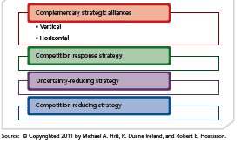
BUSINESS-LEVEL COOPERATIVE STRATEGY
FIGURE 9.2
Business-Level Cooperative Strategies

Slide 31
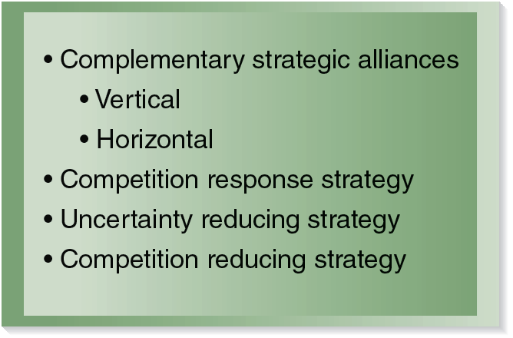
BUSINESS-LEVEL COOPERATIVE STRATEGY
FIGURE 9.1
Business-Level Cooperative Strategies

Slide 32
BUSINESS-LEVEL COOPERATIVE STRATEGY
Complementary
Strategic
Alliances
Firms share some of their resources and capabilities in complementary ways to develop competitive advantages
Include distribution, supplier, or outsourcing alliances where firms rely on upstream or downstream partners to create value
Partners may have different
▪ Learning rates
    ▪ Capabilities to leverage
    ▪ Complementary resources
    ▪ Marketplace reputations
    ▪ Types of actions they can legitimately take
Two forms include vertical and horizontal

Slide 33
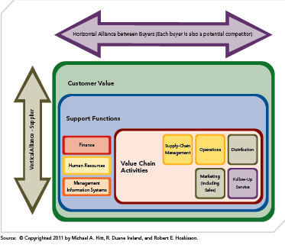
BUSINESS-LEVEL COOPERATIVE STRATEGY
FIGURE 9.3
Vertical and Horizontal ComplementaryStrategic Alliances

Slide 34
COMPLEMENTARY STRATEGIC ALLIANCES
Vertical Complementary Strategic Alliance
  Partnering firms share resources and capabilities from different stages of the value chain to create a competitive advantage
  Outsourcing is one example of this type of alliance
Horizontal Complementary Strategic Alliance
  Partnering firms share resources and capabilities from the same stage of the value chain to create a competitive advantage
  Commonly used for long-term product development and distribution opportunities
    The partners may become competitors, which requires a great deal of trust between the partners.

Slide 35
BUSINESS-LEVEL COOPERATIVE STRATEGY
Complementary
Strategic
Alliances
Competitors
    ▪ Initiate competitive actions to attack rivals
    ▪ Launch competitive responses to their competitor’s actions
Strategic alliances
    ▪ Can be used at the business level to respond to competitor’s attacks
    ▪ Primarily formed to take strategic vs. tactical actions
    ▪ Can be difficult to reverse,
    expensive to operate
Competition
Response Strategy

Slide 36
BUSINESS-LEVEL COOPERATIVE STRATEGY
Complementary
Strategic
Alliances
Are used to hedge against risk and uncertainty
These alliances are most noticed in fast-cycle markets
Uncertainty is reduced by combining knowledge and capabilities
▪ For example, when entering new product markets, emerging economies, and establishing technology standards, these are unknown areas, so by partnering with a firm in the respective industry, a firm’s uncertainty (risk) is reduced.
Competition
Response Strategy
Uncertainty
Reducing Strategy

Slide 37
BUSINESS-LEVEL COOPERATIVE STRATEGY
Complementary
Strategic
Alliances
Collusive strategies differ from strategic alliances in that they are usually illegal
Created to avoid destructive or excessive competition
Explicit collusion: Direct negotiation among firms to establish output levels and pricing agreements that reduce industry competition. (illegal)
Tacit collusion: Indirect coordination of production and pricing decisions by several firms, which impacts the degree of competition faced in the industry.
Mutual forbearance: (tacit collusion) Firms do not take competitive actions against rivals they meet in multiple markets.
Competition
Response Strategy
Uncertainty
Reducing Strategy
Competition
Reducing Strategy

Slide 38
ASSESSING BUSINESS-LEVEL COOPERATIVE STRATEGIES
  Used to develop competitive advantages for contributing to successful positions and performance in individual product markets.
  Developing a competitive advantage using a strategic alliance, the integrated resources and capabilities must be valuable, rare, imperfectly imitable, and nonsubstitutable.
  Vertical alliances have greatest probability of creating competitive advantage; horizontal are sometimes difficult to maintain since they are usually between competitors.

Slide 39
ASSESSING BUSINESS-LEVEL COOPERATIVE STRATEGIES
  Strategic alliances designed to respond to competition and reduce uncertainty are more temporary than complementary (horizontal and vertical) strategic alliances.
  Of the four business-level cooperative strategies, the competition reducing strategy has the lowest probability of creating a sustainable competitive advantage; it also tends to be temporary.

Slide 40
CORPORATE-LEVEL COOPERATIVE STRATEGIES
  CORPORATE-LEVEL COOPERATIVE STRATEGY is a strategy through which a firm collaborates with one or more companies for the purpose of expanding its operations
  ● Helps a firm diversify itself in terms of products offered, markets served, or both
  ● Requires fewer resource commitments
  ● Permits greater flexibility in terms of efforts to diversify partners’ operations

Slide 41

CORPORATE-LEVEL COOPERATIVE STRATEGIES
FIGURE 9.4
Corporate-Level Cooperative Strategies

Slide 42
CORPORATE-LEVEL COOPERATIVE STRATEGIES
Firms share some of their resources and capabilities to diversify into new product or market areas
Allows a firm to expand into new product or market areas without completing a merger or acquisition
Provides some of the potential synergistic benefits of a merger or acquisition, but with less risk and greater levels of flexibility
Permits a “test” of whether a future merger between the partners would benefit both parties
Diversifying
Strategic Alliance

Slide 43
CORPORATE-LEVEL COOPERATIVE STRATEGIES
Diversifying
Strategic Alliance
Firms share some of their resources and capabilities to create economies of scope
Creates synergy across multiple functions or multiple businesses between partner firms
Synergistic
Strategic Alliance

Slide 44
CORPORATE-LEVEL COOPERATIVE STRATEGIES
Firm uses a franchise as a contractual relationship to describe and control the sharing of its resources and capabilities with partners
      Franchise: contractual agreement between two legally independent companies whereby the franchisor grants the right to the franchisee to sell the franchisor's product or do business under its trademarks in a given location for a specified period of time
Spreads risks and uses resources, capabilities, and competencies without merging or acquiring another company
Diversifying
Strategic Alliance
Synergistic
Strategic Alliance
Franchising

Slide 45
ASSESSING CORPORATE-LEVEL COOPERATIVE STRATEGIES
Compared to business-level strategies
  ➢ Broader in scope
  ➢ More complex therefore more costly
  Costs incurred regardless of type selected
  Important to monitor expenditures!
Can lead to competitive advantage and value when:
Successful alliance experiences are internalized

Slide 46
ASSESSING CORPORATE-LEVEL COOPERATIVE STRATEGIES
Can lead to competitive advantage and value when (cont’d):
  The firm uses such strategies to develop useful knowledge about how to succeed in the future
  The firm gains maximum value from this knowledge by organizing it and verifying that it is always properly distributed to those involved with forming and using alliances

Slide 47
INTERNATIONAL COOPERATIVE STRATEGY
CROSS-BORDER STRATEGIC ALLIANCE: an international cooperative strategy in which firms with headquarters in different nations combine some of their resources and capabilities to create a competitive advantage
● These alliances are sometimes formed instead of mergers and acquisitions, which can be riskier
● Cross-border alliances can be complex and hard to manage

Slide 48
INTERNATIONAL COOPERATIVE STRATEGY
Why form cross-border strategic alliances?
A firm may form cross-border strategic alliances to leverage core competencies that are the foundation of its domestic success to expand into international markets.
  Multinational corporations outperform firms that operate only domestically.
  Due to limited domestic growth opportunities, firms look outside their national borders to expand business.
  Some foreign government policies require investing firms to partner with a local firm to enter their markets.

Slide 49
NETWORK COOPERATIVE STRATEGY
Network cooperative strategy: a cooperative strategy wherein several firms agree to form multiple partnerships to achieve shared objectives
  Stable alliance network
  Dynamic alliance network
Effective social relationships and interactions among partners are keys to a successful network cooperative strategy.
Firms involved in networks of alliances use heterogeneous knowledge and are more innovative.

Slide 50
NETWORK COOPERATIVE STRATEGY
There are disadvantages to participating in networks, as a firm can be locked into its partnerships, precluding the development of alliances with others.
In certain network configurations, such as Japanese keiretsus, firms in a network are expected to help other firms in that network whenever support is required.
Such expectations can become a burden and negatively affect the focal firm’s performance over time.

Slide 51
NETWORK COOPERATIVE STRATEGY
Stable Alliance
Network
Long-term relationships that often appear in mature industries where demand is relatively constant and predictable
Stable networks are built for exploitation of the economies (of scale and/or scope) available between the firms

Slide 52
NETWORK COOPERATIVE STRATEGY
Stable Alliance
Network
Arrangements that evolve in industries with rapid technological change leading to short product life cycles
Primarily used to stimulate rapid, value-creating product innovation and subsequent successful market entries
Purpose is often exploration of new ideas
Dynamic Alliance
Network

Slide 53
COMPETITIVE RISKS WITH COOPERATIVE STRATEGIES
  Partners may choose to act opportunistically
  Partner competencies may be misrepresented
  Partner may fail to make available the complementary resources and capabilities that were committed
  One partner may make investments specific to the alliance while the other partner may not

Slide 54
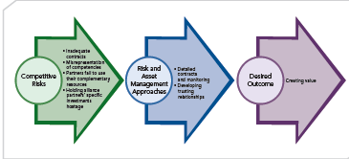
COMPETITIVE RISKS WITH COOPERATIVE STRATEGIES
FIGURE 9.5
Managing Competitive Risks in Cooperative Strategies

Slide 55
MANAGING COOPERATIVE STRATEGIES
Two primary approaches:
  Cost minimization
  Opportunity maximization

Slide 56
MANAGING COOPERATIVE STRATEGIES
1. Cost minimization
  Relationship with partner is formalized with contracts
  Contracts specify how cooperative strategy is to be monitored and how partner behavior is to be controlled
  Goal is to minimize costs and prevent opportunistic behaviors by partners
  Costs of monitoring cooperative strategy are greater
  Formalities tend to stifle partner efforts to gain maximum value from their participation

Slide 57
MANAGING COOPERATIVE STRATEGIES
2. Opportunity maximization
  Focus: maximizing partnership's value-creation opportunities
  Informal relationships and fewer constraints allow partners to:
    take advantage of unexpected opportunities
    learn from each other
    explore additional marketplace possibilities
  Partners need a high level of trust that each party will act in the partnership's best interest, which is more difficult in international situations

