Slide 1
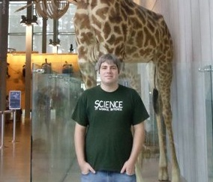
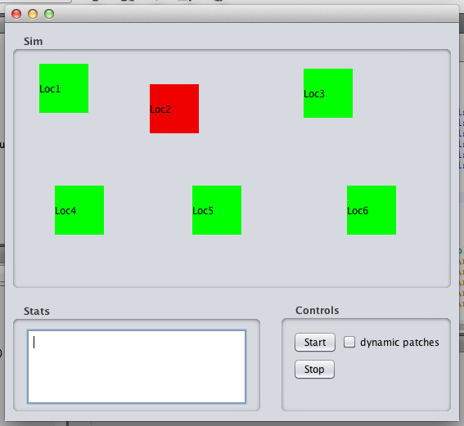
A metapopulation simulation including spatial heterogeneity, among and between patch heterogeneity
Travis J. Lawrence
Department of Biological Science, California State University, Sacramento
Sacramento, CA 95819
INTRODUCTION
A metapopulation is a population of populations (Levins 1969). The metapopulation has distinct subpopulations that occupy spatially separated habitat patches. These patches are surrounded by unsuitable habitat, but movement between patches does occur and it is this interaction among patches that maintains the metapopulation. This type of population structure relies on the interaction between patches via dispersal of individuals among patches.
Levins’ (1969) original model had constant extinction and recolonization probabilities for each patch within the metapopulation and simplified the spatial context of the patches assuming equal isolation and area. It is these simplified approaches to extinction, recolonization and spatial context that I am going to expand on to better represent realistic ecological conditions.
Results and Discussion
The simulation is functional and is calculating all the values according to the methods described. Given this, it seems safe to say that it is capable of a basic representation of among and within patch heterogeneity and spatial heterogeneity. Without raw data from real life populations it is impossible to say how well this simulation emulates real populations. Even though, it does allow enough flexibility in the coding to easily accommodate different life history modes that could effect among and within patch heterogeneity and spatial heterogeneity. For instance if a species was less or more affected by distance between patches a scaling factor could easily be applied to the distance between patches reflecting this life history trait.
The next step for this project is to obtain data from real life metapopulations to see how well this simulation can emulate the observed data. Beyond this, I think it would be a worthy pursuit to include population level processes in the patches (i.e. logistic growth, carrying capacity, and stochastic effects) to replace the simplified extinct probability of the patch. This could lead to better understanding of how patch level processes interact and affect metapopulation.
METHODS
To model among patch heterogeneity a random number between 0 and 1 was randomly assigned to each patch has its probability of going extinct. To model within patch heterogeneity every fourth time increments new values for the probability of extinction were given to each patch using the same method to assign the initial value. To include spatial heterogeneity the habitat patches can be manually positioned in two dimensions on the metapopulation grid (figure 1) and the Euclidean distances between patches are calculated at run time.
During each time increment, for patches that are occupied, a random number between 0 and 1 was generated. If the random number was less than the probability of extinction for the patch that patch went extinct. Each of the remaining occupied patches attempts to recolonize each of empty patches. To determine if a patch is successfully colonized the distance between the two patches, scaled to be between 0 and 1, multiplied by the probability of extinct of the empty patch is compared to a randomly generated number between 0 and 1. If the product of the scaled distance and the empty patches probability is less than the randomly generated number then the patch is successfully occupied. After each run of 50 time increments the summary statistic percent time occupied, values for the probability of extinct, and the distance between each patch is displayed in the “Stats” text box.
Figure 1 Screen capture of the simulation

