Slide 1
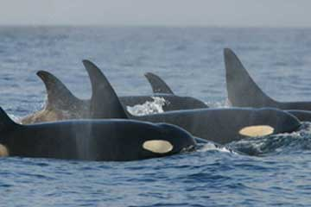
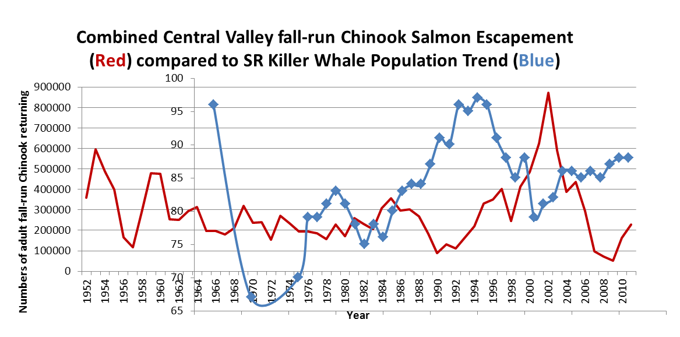
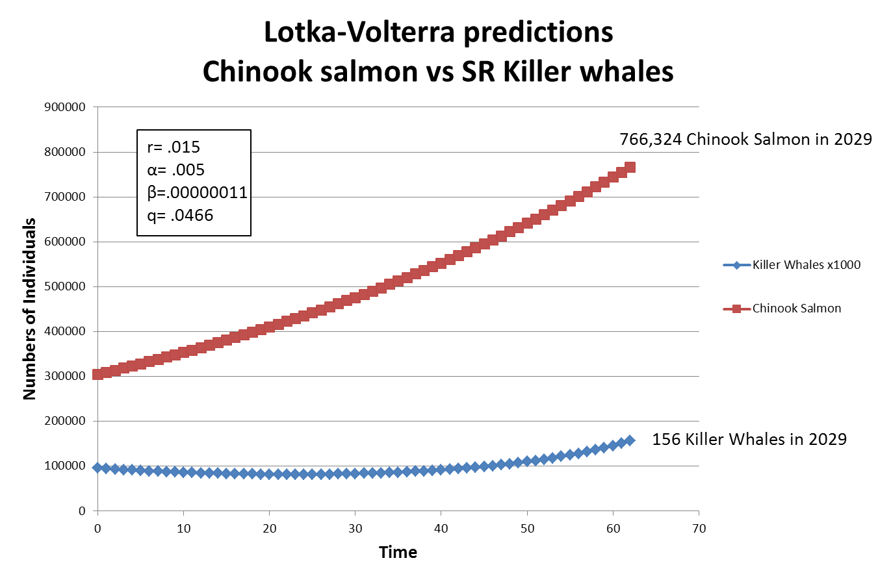
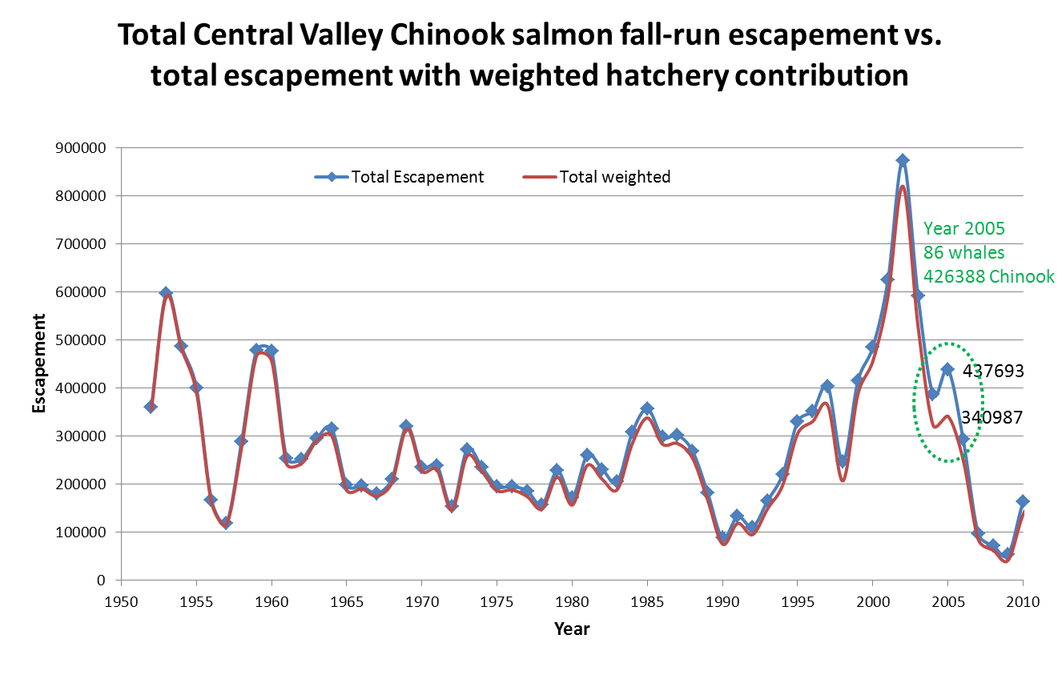
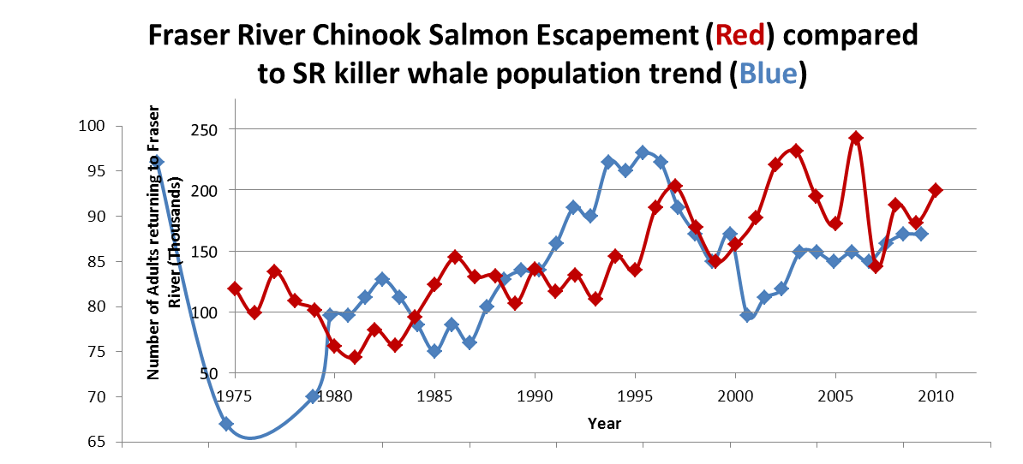
Predator Prey relationship between Southern Resident Killer Whales and Chinook Salmon
QUESTIONS:
1. Is there a population level relationship between
Central Valley fall-run Chinook salmon and Southern
Resident (SR) killer whales?
2. Can we project the SR killer whale population using
the Lotka-Volterra model and assess whether the
SR killer whale population recovery goal is reasonably
attainable
3. Is the increasing contribution of hatchery produced
Chinook salmon influencing the SR Killer whale population
Erin Strange - Bio 260 – Spring 2012
The population trend relationship between Central Valley fall-run Chinook salmon and Southern resident (SR) killer whales is not apparent (Figure 1). The relationship between the Fraser River Chinook salmon and SR killer whales, however, appears to follow a similar increase and decrease pattern with a 2 to 3 year delay (Figure 2). These relationships reflect the fact that the Fraser River salmon are a primary food resource for the SR killer whales, whereas the Central Valley fall-run are not. Prey abundance is only one factor influencing the SR killer whale population.
The Lotka-Volterra model predicted that the recovery target of 155 SR killer whales by the year 2029 was reasonable if the Fraser River Chinook salmon population steadily increased overtime to 756,324 fish. The Fraser River Chinook salmon population is currently increasing.
Figure 1. SR Killer whale population numbers overlaid on Central Valley fall-run Chinook salmon escapement data.
Figure 2. SR Killer whale population numbers overlaid on Fraser River Chinook salmon escapement data.
The total Central Valley fall-run
Chinook salmon escapement
did not diverge from the total
escapement using a
weighting factor for the
hatchery component in
most years. In 2005, the
total salmon numbers
would have supported the
existing killer whale
population, while the salmon
population with the weighted
hatchery component would not.

