Slide 1
Zwitterionic Stationary Phase in HPLC by Addison Beckemeyer & Thao Tran

Slide 2
Zwitterionic Stationary Phase in HPLC Outline
Introduction
Theory
Advantages and Disadvantages
Some Applications
Conclusions
References
Questions

Slide 3
Zwitterionic Stationary Phase in HPLC Introduction
Knox and Jurand (1981)
Separation of nucleotides on a reversed-phase column
Used a zwitterion (11-aminodecanoic acid) and ammonium phosphate as the eluent
Results –
Formation of a quadrupole between the zwitterion eluent and the zwitterionic nucleotides
Retention of nucleotide was due to the 11-aminodecanoic acid that was adsorbed by the stationary phase
Main goals was to determine if the quadrupolar solute retention mechanism could be validated

Slide 4
Zwitterionic Stationary Phase in HPLC Introduction
Yu and Hartwick (1989)
Supposedly 1st to use a zwitterion stationary phase in HPLC
Packed silica column with zwitterion chain attached
Coated column with zwitterionic surfactant
Separation of an organic mixture
Ammonium phosphate buffer and methanol/water as the eluent
Results –
Retention of charged analytes was based a combination of electrostatic and hydrophobic interactions

Slide 5
Zwitterionic Stationary Phase in HPLC Introduction
Limitation of Others LC methods
Normal/Reversed Phase –
Cations/Anions are not retained
Size Exclusion
Coarse separation (not very selective)
Ion Exchange
High salt concentration needed
Limitation of Others Stationary Phases
Ligand exchange
Less effective of separating zwitterionic compounds
Affinity Chromatography
Difficult to separate cations/anions and neutral all at once

Slide 6
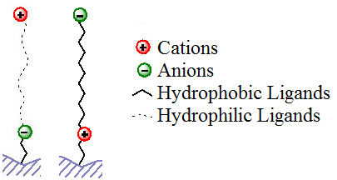
Zwitterionic Stationary Phase in HPLC Theory
Zwitterionic Stationary Phase
Silica-based stationary phase having covalently bound zwitterionic functional groups as well as hydrophobic and hydrophilic sites

Slide 7


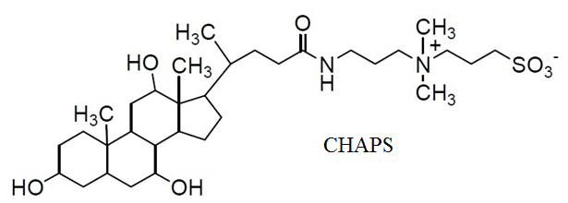
Zwitterionic Stationary Phase in HPLC Theory
3 main types of zwitterionic surfactant:
Sulfobetaine –
Steroidal (CHAPS or CHAPSO₂) –
Phosphocholine –

Slide 8
Zwitterionic Stationary Phase in HPLC Theory
Unique Properties of Zwitterion Stationary Phase
Balanced stoichiometry and a zero net charge
Weak electrostatic interactions with charged analytes
Separation may be performed in totally aqueous buffers
Retention of anions or cations is determined based on the charged group nearest the hydrophobic C₁₈ chain
Sulfobetaine – anions are retained more strongly
Phosphocholine – cations are retained more strongly
Retention also based on the pH

Slide 9
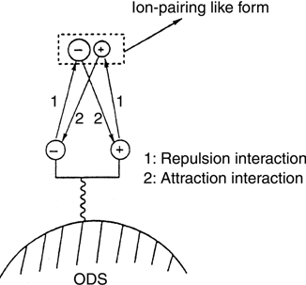
Zwitterionic Stationary Phase in HPLC Theory
Mechanism of how the zwitterionic separation works
Quadrupole Ion-Pairing
When separating anions and cations, they make “ion-pairing like” form

Slide 10
Zwitterionic Stationary Phase in HPLC Theory
Hydrophobic:
Very similar to reversed-phase HPLC but the ligands are less hydrophobic allowing for more moderate elution conditions.
Hydrophilic:
“Ionic interaction superimposed on hydrophilic interaction can effectively improve the separation selectivity”
Absence of hydrophobic interactions leads to higher recovery
Separations not contingent on one factor (hydrophobicity)
Hydrophilic Interaction Chromatography is more effective for biological samples
ZIC – HILIC column
Notes:
Most biological zwitterionic compounds are polar so therefore, it tends to have better interaction with hydrophlic chain compared to the hydrophoic .

Slide 11
Zwitterionic Stationary Phase in HPLC Advantages and Disadvantages
Advantages:
Selectivity benefits by charge and hydrophilicity working together
Interacts with charged compounds via weak electrostatic interaction, as opposed to the strong electrostatic interactions obtained with plain silica, amino HILIC phase, and IEC.
Easily prepared by coating a reversed-phase HPLC column
Disadvantages:
Cost compared to size-exclusion and ion exchange
There are a lot of factors to control so it is difficult to optimized

Slide 12
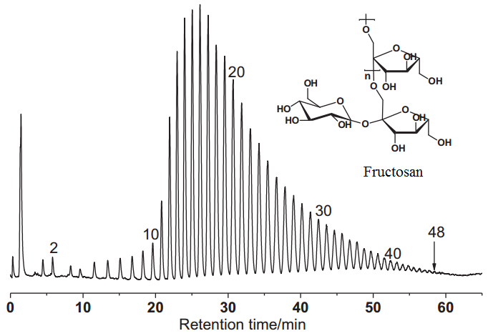
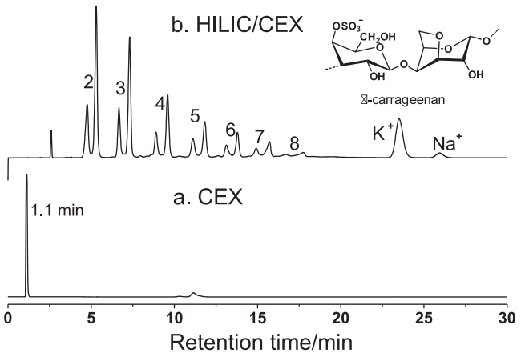
Zwitterionic Stationary Phase in HPLC Applications
Separation of oligomers
Far more selective compared to IEC
Can run a gradient

Slide 13
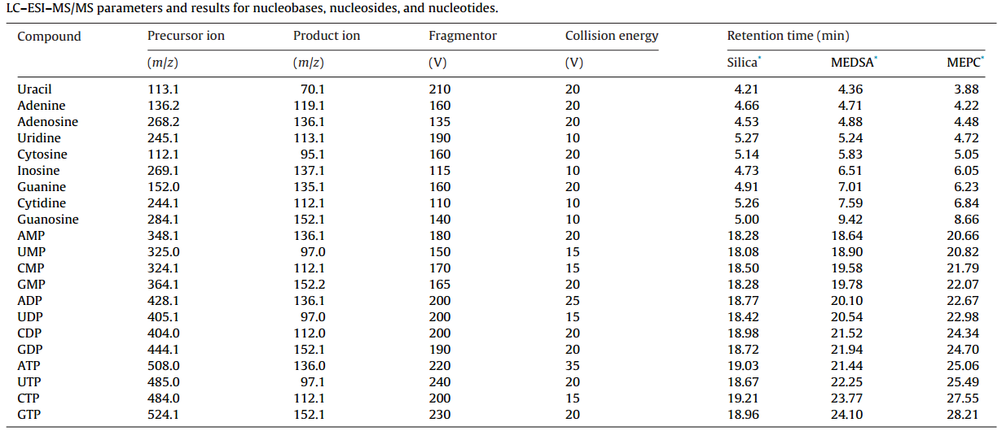
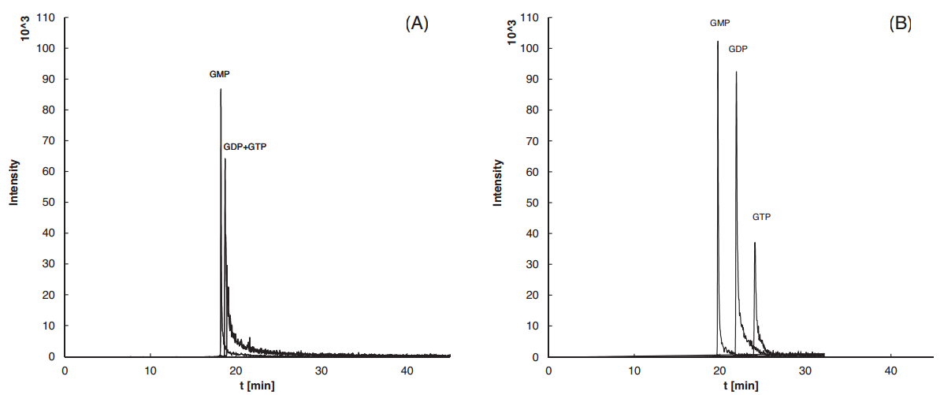
Zwitterionic Stationary Phase in HPLC Applications

Slide 14
Zwitterionic Stationary Phase in HPLC Conclusions
Separation of a mixture of cations, anions and neutral analytes are better on the zwitterion stationary phase
Highly selective separation of biological compounds
Ionic strength of both the zwitterion stationary phase and analytes can be adjust by pH
Mainly this method is advantageous due to both electrostatic interactions coupled with hydrophobicity

Slide 15
Zwitterionic Stationary Phase in HPLC References
Fritz, J.S.; Gjerde, D.T. Ion Chromatography, 4th ed.; Wiley-VCH: Weinheim, 2009, 251-261
Yu, L.; Hartwick, R. J. Chromatogr. Sci. 1989, 27, 176-185
Shen, A.; et. al. J. Chromatogr. A. 2013, 1314, 63-69
Moravcova, D.; et. Al. J. Chromatogr. A. 2014, 1373, 90-96

Slide 16
Questions??

