Slide 1
CANOPY ENTHUSIASTS
by Alina Gomenyuk, Alyssa Valdez, Johnny Facio, Lynne Gutierrez

Slide 2
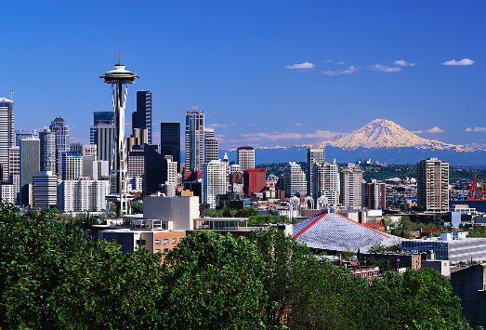
Canopy Enthusiasts
Corporation that manufactures pop-up canopies with a solar powered outlet.
By using Green Energy we are helping to promote social and environmental responsibilities.

Slide 3
The Formalities...
Proprietary Rights: Alyssa Valdez inspired the creation of Canopy Enthusiasts and holds all rights such as intellectual property, design and technical documentation. Non-Disclosure Agreements are fully enforced.
Executive Management Team
J. Facio Human Resources Manager
A. Gomenyuk Supply Chain Manager
L. Gutierrez Sales/Marketing Rep.
A. Valdez Owner/Accountant

Slide 4
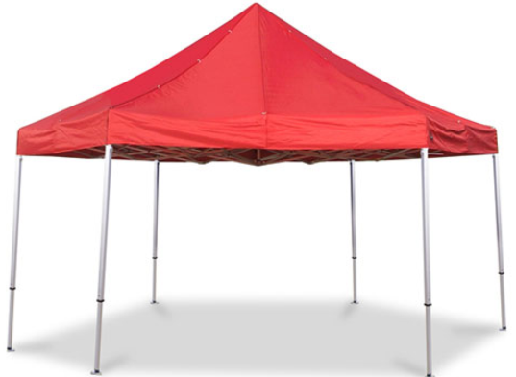
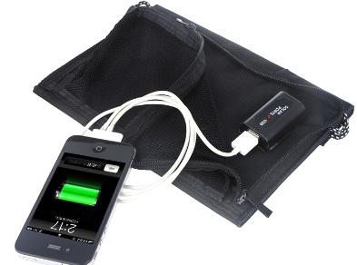
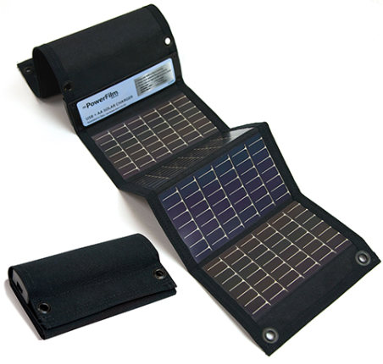
CANOPY FEATURES:
Two sizes available 10X10 and 12X12
Aluminum frame and carry case for ease of transport
Portable solar panels that allow for easy set up
Multiple adapters for charging electronic devices

Slide 5
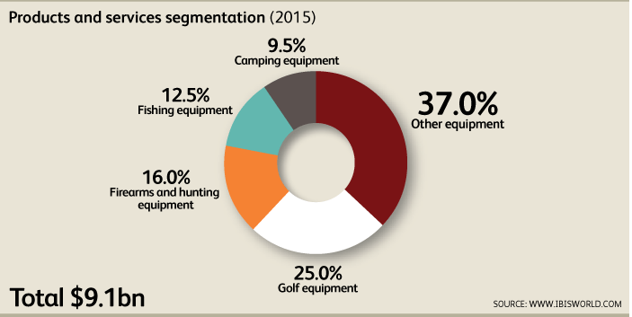
Industry and Market Analysis
Industry: Sporting Goods
Market Size in the U.S. $9.1 billion
Our subset would put us into camping equipment which is 9.5% or $864 million of the Sporting Goods industry.
Beginning hopes, to capture .1% or $864K of Camping equipment.
The market growth rate for sporting goods manufacturing is 0.6% annually between 2015-2020

Slide 6
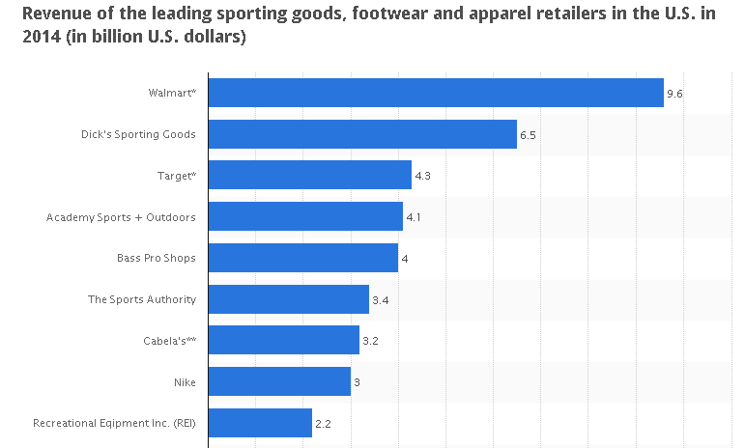
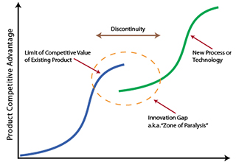
Industry and Market Analysis…..continued

Slide 7
Target Audience and Competitors
Target Audience: Big Box Stores and Sporting Goods Stores. This will help reach a broad range of customers at various income levels.
Competitors: All of the competitors below have been in the industry for at least 5 years and have established brand recognition and licensing rights.

Slide 8
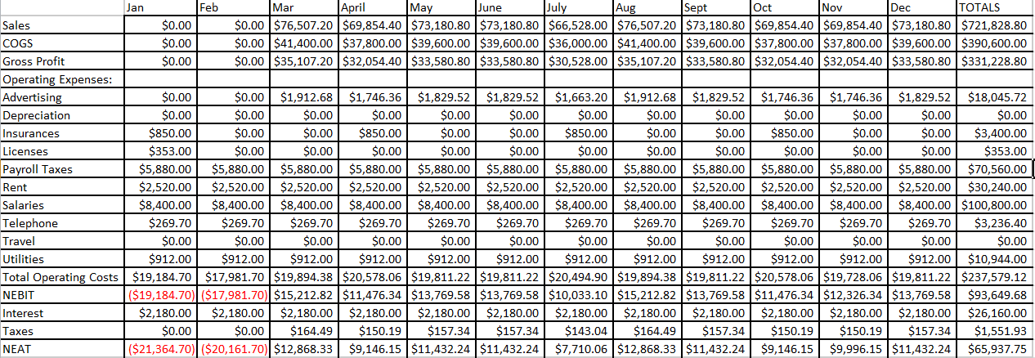
Financial Statement
One year

Slide 9
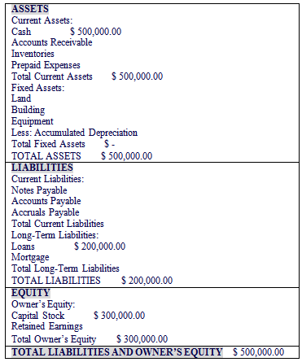
Balance Sheet Day 1

Slide 10
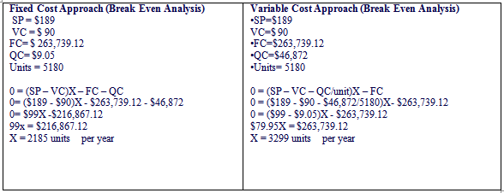
Financials
 | Revenue
Year 1: | $722,000
Year 2: | $877,200
Year 3: | $885,980.35

Slide 11
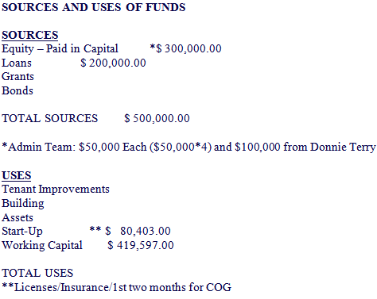
Hang in there almost done...

Slide 12
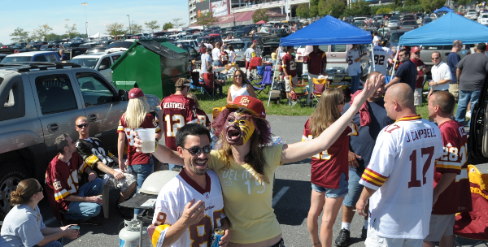
CANOPY ENTHUSIASTS

