Slide 1
The Entrepreneurial Mind-Set in Individuals: Cognition and Ethics

Slide 2
Chapter Objectives
To describe the entrepreneurial mind-set and entrepreneurial cognition
To identify and discuss the most commonly cited characteristics found in successful entrepreneurs
To discuss the “dark side” of entrepreneurship
To identify and describe the different types of risk entrepreneurs face as well as the major causes of stress for these individuals and the ways they can handle stress
To discuss the ethical dilemmas confronting entrepreneurs

Slide 3
Chapter Objectives (cont’d)
To study ethics in a conceptual framework for a dynamic environment
To present strategies for establishing ethical responsibility and leadership
To examine entrepreneurial motivation

Slide 4
The Entrepreneurial Mind-Set
Entrepreneurial Mind-Set
  Describes the most common characteristics associated with successful entrepreneurs as well as the elements associated with the “dark side” of entrepreneurship.
Who Are Entrepreneurs?
  Independent individuals, intensely committed and determined to persevere, who work very hard.
  They are confident optimists who strive for integrity.
  They burn with the competitive desire to excel and use failure as a learning tool.

Slide 5
Entrepreneurial Cognition
Cognition
Social Cognition Theory
Entrepreneurial Cognition
  The mental functions, processes (thoughts), and states of intelligent humans—attention, remembering, producing and understanding language, solving problems, and making decisions.
  Posits that knowledge structures (mental models of cognitions) can be ordered to optimize personal effectiveness within given situations.
  The knowledge structures that people use to make assess ments, judgments, or decisions involving opportunity evaluation, venture creation, and growth.

Slide 6
Metacognitive Perspective
Cognitive Adaptability
  The ability to be dynamic, flexible, and self-regulating in one’s cognitions given dynamic and uncertain task environments.
Metacognitive Model
  Describes the higher-order cognitive process that results in the entrepreneur framing a task effectually, and thus why and how a particular strategy was included in a set of alternative responses to the decision task (metacognition).

Slide 7


Sources of Research on Entrepreneurs
Research and Popular Publications
Direct
Observation
Speeches, Seminars and Presentations
The Entrepreneurial Mindset

Slide 8
Sources of Research on Entrepreneurs (cont’d)
Publications
  Technical and professional journals
  Textbooks on entrepreneurship
  Books about entrepreneurship
  Biographies or autobiographies of entrepreneurs
  Compendiums about entrepreneurs
  News periodicals
  Venture periodicals
  Newsletters
  Proceedings of conferences
  The Internet
Direct Observation of Practicing Entrepreneurs
  Interviews
  Surveys
  Case studies
Speeches, Seminars, and Presentations by Practicing Entrepreneurs

Slide 9
Characteristics of the Entrepreneurial Mind-Set
Determination and perseverance
Drive to achieve
Opportunity orientation
Initiative and responsibility
Persistent problem solving
Seeking feedback
Internal locus of control
Tolerance for ambiguity
Calculated risk taking
High energy level
Creativity and innovativeness
Vision
Passion
Independence
Team building

Slide 10

Outline of the Entrepreneurial Organization
Imagination
Flexibility
Willingness to accept risks
Notes:
8

Slide 11
2.1 Characteristics Often Attributed to Entrepreneurs
Confidence
Perseverance, determination
Energy, diligence
Resourcefulness
Ability to take calculated risks
Dynamism, leadership
Optimism
Need to achieve
Versatility; knowledge of product, market, machinery, technology
Creativity
Ability to influence others
Ability to get along well with people
Initiative
Flexibility
Intelligence
Orientation to clear goals
Positive response to challenges
Independence
Responsiveness to suggestions and criticism
Time competence, efficiency
Ability to make decisions quickly
Responsibility
Foresight
Accuracy, thoroughness
Cooperativeness
Profit orientation
Ability to learn from mistakes
Sense of power
Pleasant personality
Egotism
Courage
Imagination
Perceptiveness
Toleration of ambiguity
Aggressiveness
Capacity for enjoyment
Efficacy
Commitment
Ability to trust workers
Sensitivity to others
Honesty, integrity
Maturity, balance
Source: John A. Hornaday, “Research about Living Entrepreneurs,” in Encyclopedia of Entrepreneurship, ed. Calvin Kent, Donald Sexton, and Karl Vesper, © 1982, 26–27. Adapted by permission of Prentice-Hall, Englewood Cliffs, NJ.

Slide 12
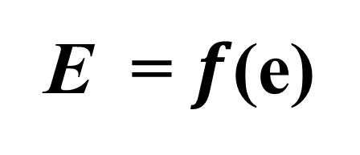
Entrepreneurship Theory
Entrepreneurs cause entrepreneurship.
  Entrepreneurship is a function of the entrepreneur:
  Entrepreneurship is characterized as the interaction of skills related to inner control, planning and goal setting, risk taking, innovation, reality perception, use of feedback, decision making, human relations, and independence.

Slide 13
Dealing with Failure:
The Grief Recovery Process
Loss
Orientation
  Involves focusing on the particular loss to construct an account that explains why the loss occurred.
Restoration
Orientation
  Involves both distracting oneself from thinking about the failure event and being proactive towards secondary causes of stress.

Slide 14
The Entrepreneurial Experience
Entrepreneurs
  Create ventures much as an artist creates a painting.
  Are formed by the lived experience of venture creation.
Experiential Nature of Creating
a Sustainable Enterprise
  Emergence of the opportunity
  Emergence of the venture
  End emergence of the entrepreneur

Slide 15
The Dark Side of Entrepreneurship
The Entrepreneur’s Confrontation with Risk
  Financial risk versus profit (return) motive varies in entrepreneurs’ desire for wealth.
  Career risk—loss of employment security
  Family and social risk—competing commitments of work and family
  Psychic risk—psychological impact of failure on the well-being of entrepreneurs

Slide 16
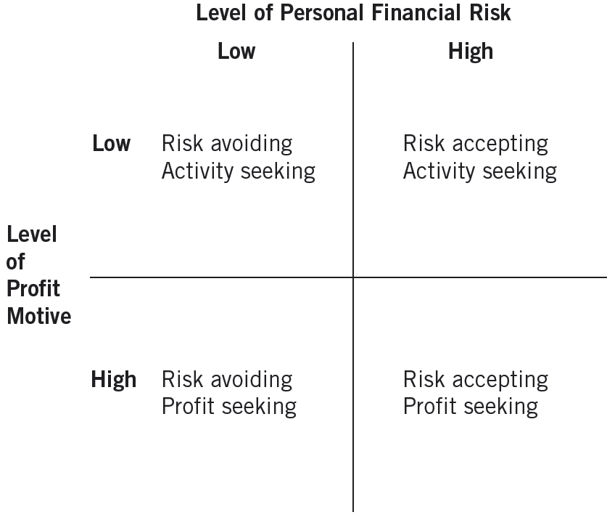
2.1 Typology of Entrepreneurial Styles
Source: Thomas Monroy and Robert Folger, “A Typology of Entrepreneurial Styles: Beyond Economic Rationality,” Journal of Private Enterprise IX(2) (1993): 71.

Slide 17
Entrepreneurs: Type A Personalities
Chronic and severe sense of time urgency.
Constant involvement in multiple projects subject to deadlines.
Neglect of all aspects of life except work.
A tendency to take on excessive responsibility, combined with the feeling that “Only I am capable of taking care of this matter.”
Explosiveness of speech and a tendency to speak faster than most people.

Slide 18
Stress and the Entrepreneur
Entrepreneurial Stress
  The extent to which entrepreneurs’ work demands and expectations exceed their abilities to perform as venture initiators, they are likely to experience stress.
Sources of Entrepreneurial Stress
  Loneliness
  Immersion in business
  People problems
  Need to achieve

Slide 19
Dealing with Stress
Networking
Exercising
rigorously
Getting away
from it all
Delegating
Communicating
with employees
Finding satisfaction outside the company

Slide 20
The Entrepreneurial Ego
Self-Destructive Characteristics
  Overbearing need for control
  Sense of distrust
  Overriding desire for success
  Unrealistic externalized optimism

Slide 21
Entrepreneurial Ethics
Ethics
  Provides the basic rules or parameters for conducting any activity in an “acceptable” manner.
  Represents a set of principles prescribing a behavioral code of what is good and right or bad and wrong
  Defines “situational” moral duty and obligations.
Sources of Ethical Dilemmas
  Pressure from inside and outside interests
  Changes in societal values, mores, and norms

Slide 22
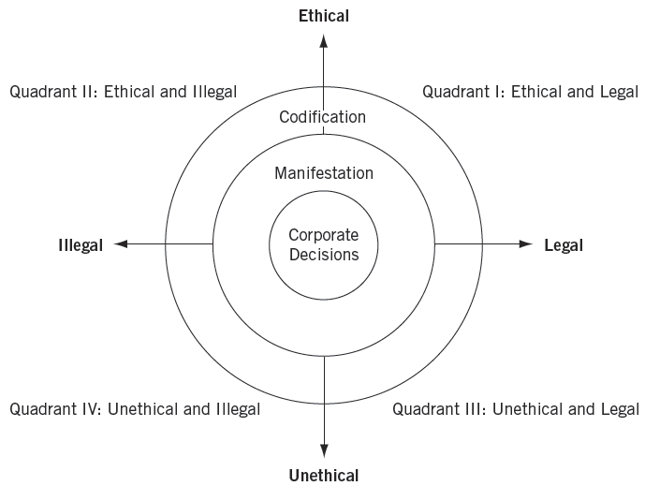
2.2 Classifying Decisions Using a Conceptual Framework
Source: Verne E. Henderson, “The Ethical Side of Enterprise,” Sloan Management Review (Spring 1982): 42.

Slide 23
Entrepreneurial Ethics (cont’d)
Ethical rationalizations used to justify questionable conduct involve believing that the activity:
  Is not “really” illegal or immoral.
  Is in the individual’s or the firm’s best interest.
  Will never be found out.
  Helps the firm so the firm will condone it.

Slide 24
^{Table} 2.2 Types of Morally Questionable Acts
Type | Direct Effect | Examples
Nonrole | Against the firm | Expense account cheating Embezzlement Stealing supplies
Role failure | Against the firm | Superficial performance appraisal Not confronting expense account cheating Palming off a poor performer with inflated praise
Role distortion | For the firm | Bribery Price fixing Manipulating suppliers
Role assertion | For the firm | Investing in unethically governed countries Using nuclear technology for energy generation Not withdrawing product line in face of initial allegations of inadequate safety
Source: James A. Waters and Frederick Bird, “Attending to Ethics in Management,” Journal of Business Ethics 5 (1989): 494.

Slide 25
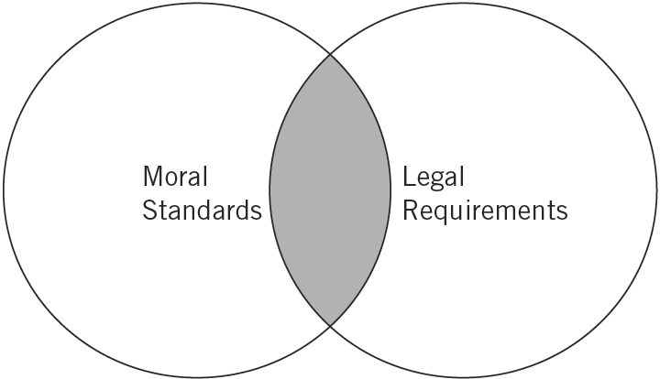
2.3 Overlap Between Moral Standards and Legal Requirements
Ethical
Dilemmas

Slide 26
Reasons for Unethical Behaviors Occur
Greed
A reliance on other social institutions to convey and reinforce ethics
Distinctions between activities at work and activities at home
Survival
(bottom-line thinking)
Lack of a foundation in ethics

Slide 27
Entrepreneurial Ethics (cont’d)
  Extended consequences
  Multiple alternatives
  Mixed outcomes
  Uncertain ethical consequences
  Personal implications
Complexity of Ethical Decisions

Slide 28
Establishing a Strategy for Ethical Enterprise
Ethical Code of Conduct
  Is a statement of ethical practices or guidelines to which an enterprise adheres.
  Are becoming more prevalent in industry.
  Are proving to be more meaningful in terms of external legal and social development.
  Are more comprehensive in terms of their coverage.
  Are easier to implement in terms of the administrative procedures used to enforce them.

Slide 29
“Always Do the Right Thing”
Reasons for management to adhere to a high moral code:
  It is good business because unethical practices have a corrosive effect not only on the firm itself, but on free markets and free trade which are fundamental to the survival of the free enterprise system.
  Improving the moral climate of the firm will eventually win back the public’s confidence in the firm.

Slide 30
Ethical Responsibility
Establish a strategy for ethical responsibility that encompasses:
Ethical consciousness
Ethical process and structure
Institutionalization

Slide 31
Ethical Considerations of
Corporate Entrepreneurs
Organizational barriers that invite unethical behaviors:
  Systems
  Structures
  Policies and Procedures
  Culture
  Strategic Direction
  People
Promote ethical employee behaviors by:
  Providing flexibility, innovation, and support of initiative and risk taking
  Removing barriers for entrepreneurial middle managers
  Including an ethical component to corporate training

Slide 32
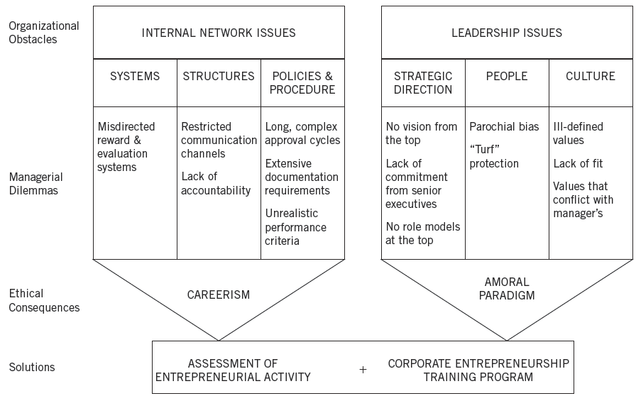
2.4 Ethical Challenges for Corporate Entrepreneurship
Unethical
Consequences
Source: Donald F. Kuratko and Michael G. Goldsby, “Corporate Entrepreneurs or Rogue Middle Managers? A Framework for Ethical Corporate Entrepreneurship,” Journal of Business Ethics 55 (2004): 18.

Slide 33
Ethical Leadership by Entrepreneurs
The value system of an owner/entrepreneur is the key to establishing an ethical organization.
  A code of ethics provides a clear understanding of the need for:
    Ethical administrative decision-making
    Ethical behavior of employees
    Explicit rewards and punishments based on ethical behavior

Slide 34
Entrepreneurial Motivation
Entrepreneurial Motivation
  The quest for new-venture creation as well as
  the willingness to sustain that venture
    Personal characteristics, personal environment, business environment, personal goal set (expectations), and the existence of a viable business idea
Entrepreneurial Persistence
  An entrepreneur’s choice to continue with an entrepreneurial opportunity regardless of counterinfluences or other enticing alternatives

Slide 35
Key Terms and Concepts
career risk
code of conduct
dark side of entrepreneurship
drive to achieve
entrepreneurial behavior
entrepreneurial experience
entrepreneurial mind-set
entrepreneurial motivation
entrepreneurial persistence
ethics
failure
family and social risk
financial risk
grief recovery
opportunity orientation
psychic risk
rationalizations
risk
role assertion
role distortion
role failure
stress
tolerance for ambiguity
vision

