Slide 1
The Entrepreneurial
Mind-Set in Organizations: Corporate Entrepreneurship

Slide 2
Chapter Objectives
To understand the entrepreneurial mindset in organizations
To illustrate the need for entrepreneurial thinking in organizations
To define the term corporate entrepreneurship
To describe the corporate obstacles preventing innovation within corporations
To highlight the considerations involved in reengineering corporate thinking
To describe the specific elements of a corporate entrepreneurial strategy

Slide 3
Chapter Objectives (cont’d)
To examine the methods of developing managers for corporate entrepreneurship
To illustrate the interactive process of corporate entrepreneurship

Slide 4
The Entrepreneurial Mindset in Organizations
Factors in the emergence of the entrepreneurial economy:
  The rapid evolution of knowledge and technology promoted high-tech entrepreneurial start-ups.
  Demographic trends adding fuel to the proliferation of newly developing ventures.
  The venture capital market became an effective funding mechanism.
  American industry began to learn how to manage entrepreneurship.

Slide 5
Corporate Innovation Philosophy
Important practices for establishing
an innovation-driven organization:
  Set explicit goals.
  Create a system of feedback and positive reinforcement.
  Emphasize individual responsibility.
  Provide rewards based on results.
  Do not punish failures.

Slide 6
Assessing Support for Corporate Innovation
Does the firm encourage entrepreneurial thinking?
Does the firm provide ways for innovators to stay with their ideas?
Are people permitted to do the job in their own way, or are they constantly stopping to explain their actions and ask for permission?
Has the firm evolved quick and informal ways to access the resources to try new ideas?
Has the firm developed ways to manage many small and experimental innovations?

Slide 7
Assessing Support for Innovation (cont’d)
Is the system set up to encourage risk taking and to tolerate mistakes?
Are people in the firm more concerned with new ideas or with defending their turf?
How easy is it to form functionally complete, autonomous teams in the firm’s corporate environment?

Slide 8
3.1 Rules for an Innovative Environment
Encourage action.
Use informal meetings whenever possible.
Tolerate failure, and use it as a learning experience.
Persist in getting an idea to market.
Reward innovation for innovation’s sake.
Plan the physical layout of the enterprise to encourage informal communication.
Expect clever bootlegging of ideas—secretly working on new ideas on company time as well as personal time.
Put people on small teams for future-oriented projects.
Encourage personnel to circumvent rigid procedures and bureaucratic red tape.
Reward and promote innovative personnel.
Source: Reprinted by permission of the publisher from “Corporate Venturing Obstacles: Sources and Solutions,” by Hollister B. Sykes and Zenas Block, Journal of Business Venturing (winter 1989): 161. Copyright © 1989 by Elsevier Science Publishing Co., Inc.

Slide 9
Encouraging an Intrapreneurial Environment
Steps to help restructure corporate thinking and encourage an intrapreneurial environment:
  Early identification of potential innovators
  Top management sponsorship of innovative projects
  Creation of innovation goals in strategic activities
  Promotion of entrepreneurial thinking through experimentation
  Development of collaboration between innovators and the organization at large

Slide 10
Benefits of an Entrepreneurial Philosophy
Leads to the development of new products and services and helps the organization expand and grow.
Creates a work force that can help the enterprise maintain its competitive posture.
Promotes a climate conducive to high achievers and helps the enterprise motivate and keep its best people.

Slide 11



Corporate Entrepreneurship and Innovation
Strategic
Renewal
Innovation
Corporate Venturing
Corporate Entrepreneurship

Slide 12
Defining the Concept of Corporate Entrepreneurship and Innovation
Corporate Entrepreneurship
  A process whereby an individual or a group of individuals, in association with an existing organization, creates a new organization or instigates renewal or innovation within the organization.
Corporate Entrepreneurship Strategy
  A vision-directed, organization-wide reliance on entrepreneurial behavior that purposefully and continuously rejuvenates the organization and shapes the scope of its operations through the recognition and exploitation of entrepreneurial opportunity.

Slide 13
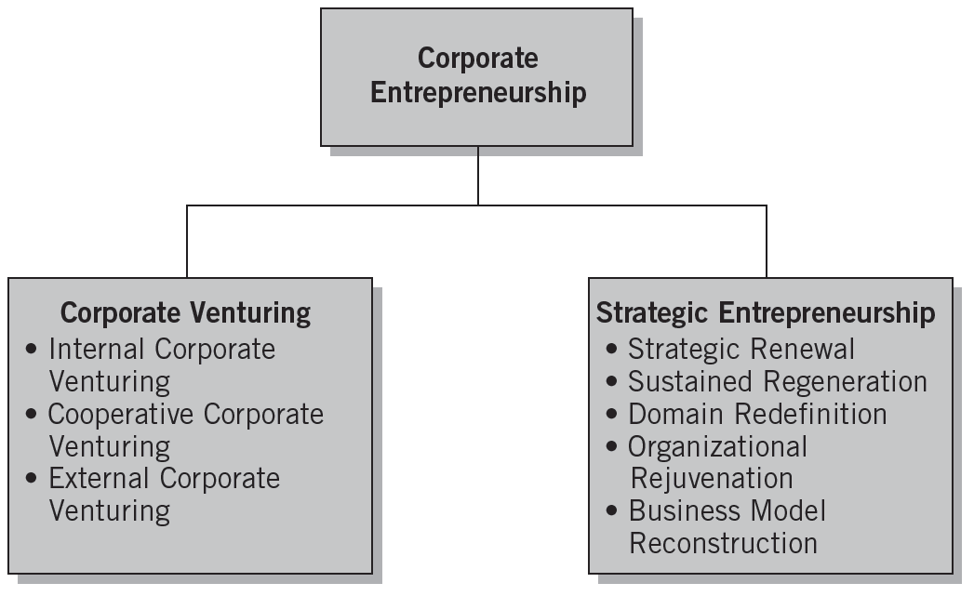
3.1 Defining Corporate Entrepreneurship
Source: Michael H. Morris, Donald F. Kuratko, and Jeffrey G. Covin, Corporate Entrepreneurship & Innovation (Mason, OH, Thomson), 2008, p. 81.

Slide 14
The Need for Corporate Entrepreneuring
Rapid growth in the number of new and sophisticated competitors
Sense of distrust in the traditional methods of corporate management
An exodus of some of the best and brightest people from corporations to become small business entrepreneurs
International competition
Downsizing of major corporations
An overall desire to improve efficiency and productivity

Slide 15
^{Table} 3.2 Sources of and Solutions to Obstacles in Corporate Venturing
Traditional Management Practices | Adverse Effects | Recommended Actions
Enforce standard procedures to avoid mistakes | Innovative solutions blocked, funds misspent | Make ground rules specific to each situation
Manage resources for efficiency and ROI | Competitive lead lost, low market penetration | Focus effort on critical issues (e.g., market share)
Control against plan | Facts ignored that should replace assumptions | Change plan to reflect new learning
Plan for the long term | Nonviable goals locked in, high failure costs | Envision a goal, then set interim milestones, reassess after each
Manage functionally | Entrepreneur failure and/or venture failure | Support entrepreneur with managerial and multidiscipline skills
Avoid moves that risk the base business | Missed opportunities | Take small steps, build out from strengths
Protect the base business at all costs | Venturing dumped when base business is threatened | Make venturing mainstream, take affordable risks
Judge new steps from prior experience | Wrong decisions about competition and markets | Use learning strategies, test assumptions
Compensate uniformly | Low motivation and inefficient operations | Balance risk and reward, employ special compensation
Promote compatible individuals | Loss of innovators | Accommodate “boat rockers” and “doers”
Source: Reprinted by permission of the publisher from “Corporate Venturing Obstacles: Sources and Solutions,” by Hollister B. Sykes and Zenas Block, Journal of Business Venturing (winter 1989): 161. Copyright © 1989 by Elsevier Science Publishing Co., Inc.

Slide 16
Successful Innovative Companies
Factors in large corporations that are successful innovators:
  Atmosphere and vision
  Orientation to the market
  Small, flat organizations
  Multiple approaches
  Interactive learning
  Skunk Works

Slide 17
Conceptualizing Corporate
Entrepreneurship Strategy
Corporate Entrepreneurship Strategy
  A vision-directed, organization-wide reliance on entrepreneurial behavior that purposefully and continuously rejuvenates the organization and shapes the scope of its operations through the recognition and exploitation of entrepreneurial opportunity.
  It requires the creation of congruence between the entrepreneurial vision of the organization’s leaders and the entrepreneurial actions of those throughout the organization.

Slide 18
Modeling the Corporate Entrepreneurship Strategy Process
Corporate entrepreneurship strategy is manifested through the presence of three elements:
  An entrepreneurial strategic vision
  A pro-entrepreneurship organizational architecture
  Entrepreneurial processes and behavior as exhibited throughout the organization

Slide 19
Modeling the Corporate Entrepreneurship Strategy Process (cont’d)
Linkages in the model:
  Individual entrepreneurial cognitions of the organization’s members
  External environmental conditions that invite entrepreneurial activity
  Top management’s entrepreneurial strategic vision for the firm
  Organizational architectures that encourage entrepreneurial processes and behavior
  The entrepreneurial processes that are reflected in entrepreneurial behavior
  Organizational outcomes resulting from entrepreneurial actions.

Slide 20
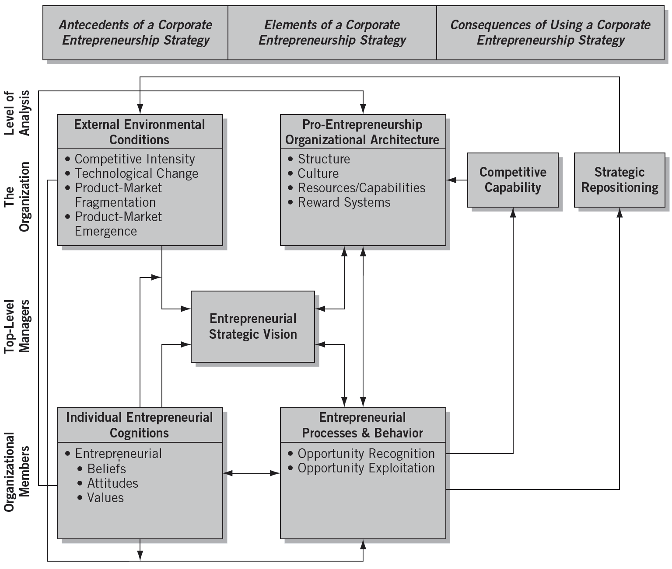
^{Figure} 3.2 An Integrative Model of Corporate Entrepreneurship Strategy
Source: Duane Ireland, Jeffery G. Covin, and Donald F. Kuratko, “Conceptualizing Corporate Entrepreneurship Strategy,” Entrepreneurship Theory and Practice 33, no. 1 (2009): 24.

Slide 21
Conceptualizing a Corporate
Entrepreneurship Strategy (cont’d)
Critical steps of a corporate entrepreneurial strategy:
  Developing the vision
  Encouraging innovation
  Structuring for an intrapreneurial climate
  Developing individual managers for corporate entrepreneurship
  Developing venture teams.

Slide 22
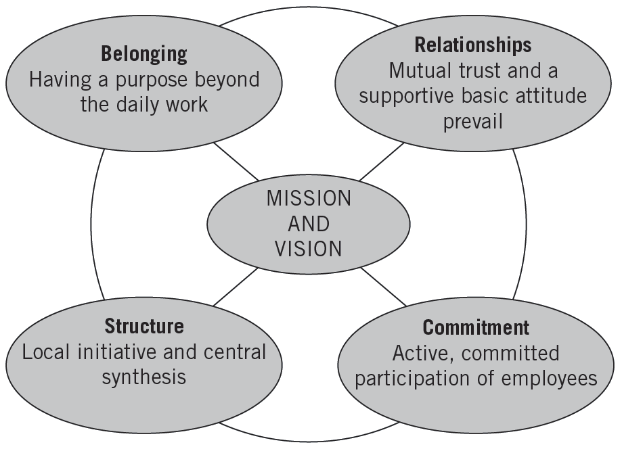
^{Figure} 3.3 Shared Vision
Source: Jon Arild Johannessen, “A Systematic Approach to the Problem of Rooting a Vision in the Basic Components of an Organization,” Entrepreneurship, Innovation, and Change (March 1994): 47. Reprinted with permission from Plenum Publishing Corporation.

Slide 23
Types of Innovation
Radical Innovation
  The launching of inaugural breakthroughs.
  These innovations take experimentation and determined vision, which are not necessarily managed but must be recognized and nurtured.
Incremental Innovation
  The systematic evolution of a product or service into newer or larger markets.
  Many times the incremental innovation will take over after a radical innovation introduces a breakthrough.

Slide 24
^{Table} 3.3 Objectives and Programs for Venture Development
Objectives | Programs
Make sure that current systems, structures, and practices do not present insurmountable roadblocks to the flexibility and fast action needed for innovation. | Reduce unnecessary bureaucracy, and encourage communication across departments and functions.
Provide the incentives and tools for intrapreneurial projects. | Use internal “venture capital” and special project budgets. (This money has been termed intracapital to signify a special fund for intrapreneurial projects.) Allow discretionary time for projects (bootlegging time).
Seek synergies across business areas so new opportunities are discovered in new combinations. | Encourage joint projects and ventures among divisions, departments, and companies. Allow and encourage employees to discuss and brainstorm new ideas.
Source: Adapted by permission of the publisher from “Supporting Innovation and Venture Development in Established Companies,” by Rosabeth Moss Kanter, Journal of Business Venturing (winter 1985): 56–59. Copyright © 1985 by Elsevier Science Publishing Co., Inc.

Slide 25
^{Table} 3.4 Developing and Supporting Radical and Incremental Innovation
Radical | Incremental
Stimulate through challenges and puzzles. | Set systematic goals and deadlines.
Remove budgetary and deadline constraints when possible. | Stimulate through competitive pressures.
Encourage technical education and exposure to customers. | Encourage technical education and exposure to customers.
Allow technical sharing and brainstorming sessions. | Hold weekly meetings that include key management and marketing staff.
Give personal attention—develop relationships of trust. | Delegate more responsibility.
Encourage praise from outside parties. | Set clear financial rewards for meeting goals and deadlines.
Have flexible funds for opportunities that arise.
Reward with freedom and capital for new projects and interests.
Source: Adapted from Harry S. Dent, Jr., “Growth through New Product Development,” Small Business Reports (November 1990): 36.

Slide 26
3M’s Innovation Rules
Don’t kill a project
Tolerate failure
Keep divisions small
Motivate the champions
Stay close to the customer
Share the wealth

Slide 27
Structuring for a Corporate
Entrepreneurial Environment
Reestablishing the drive to innovate:
  Invest heavily in entrepreneurial activities that allow new ideas to flourish in an innovative environment.
  Provide nurturing and information-sharing activities.
  Employee perception of an innovative environment is critical.
Corporate Venturing
  Institutionalizing the process of embracing the goal of growth through development of innovative products, processes, and technologies with an emphasis on long-term prosperity.

Slide 28
Preparing for Failure
“Learning from Failure”
  Recognizing the importance of managing the grief process that occurs from project failure.
  Understanding how organizational routines and rituals are likely to influence the grief recovery.
  Ensuring that the organization’s social support system can encourage greater learning, foster motivational outcomes, and increase coping self-efficacy in affected individuals.

Slide 29
Developing Individual Managers for Corporate Entrepreneurship
Corporate Innovation Training Program:
  The Entrepreneurial Experience
  Innovative Thinking
  Idea Acceleration Process
  Barriers and Facilitators to Innovative Thinking
  Sustaining Innovation Teams (I-Teams)
  The Innovation Action Plan

Slide 30
Corporate Entrepreneurship
Assessment Instrument (CEAI)
Key Internal Climate Factors in Determining an Organization’s Readiness for Entrepreneurial Activity:
  Top management support
  Autonomy/work discretion
  Rewards/reinforcement
  Time availability
  Internal organizational boundaries

Slide 31
Facilitating Corporate Entrepreneurial Behavior
Organizations foster entrepreneurial behavior by:
  Encouraging—not mandating—innovative activity
  Human resource policies for “selected rotation”
  Committing to projects long enough for momentum to occur.
  Bet on people, not on analysis.
Rewarding Entrepreneuring:
  Allow inventor to take charge of the new venture
  Grant discretionary time to work on future projects
  Make intracapital available for future research ideas

Slide 32
^{Table} 3.5 Corporate Innovator’s Commandments
Come to work each day willing to give up your job for the innovation.
Circumvent any bureaucratic orders aimed at stopping your innovation.
Ignore your job description–do any job needed to make your innovation work.
Build a spirited innovation team that has the “fire” to make it happen.
Keep your innovation “underground” until it is prepared for demonstration to the corporate management.
Find a key upper-level manager who believes in you and your ideas and will serve as a sponsor to your innovation.
Permission is rarely granted in organizations, thus always seek forgiveness for the “ignorance” of the rules that you will display.
Always be realistic about the ways to achieve the innovation goals.
Share the glory of the accomplishments with everyone on the team.
Convey the innovation’s vision through a strong venture plan.

Slide 33
Developing Innovative (I) Teams
Innovative (I) Team
  A semi-autonomous self-directing, self-managing, high-performing group of two or more people who formally create and share the ownership of a new organization.
  The leader is called a “product champion” or an “corporate entrepreneur.”
Collective Entrepreneurship
  Individual skills are integrated into a group; this collective capacity to innovate becomes something greater than the sum of its parts.

Slide 34
Sustaining a Corporate Entrepreneurship Strategy
Sustained Corporate Entrepreneurship Model
  Based on theoretical foundations from previous strategy and entrepreneurship research.
  Considers the comparisons made at the individual and organizational level on organizational outcomes, both perceived and real, that influence the continuation of the entrepreneurial activity.
  Transformational trigger
    Something external or internal to the company that initiates the need for strategic adaptation or change.

Slide 35
Critical Strategic Entrepreneurship Roles
Senior-level Managers
Middle-level Managers
First-level Managers
  Have ratifying, recognizing, and directing roles that in turn are associated with particular managerial actions
  Endorse, refine, and guide entrepreneurial opportunities, and identify, acquire, and deploy resources needed to pursue opportunities
  Experiment with change, promote adjustment to change, and foster conformity in the development of competencies needed to execute the strategy

Slide 36
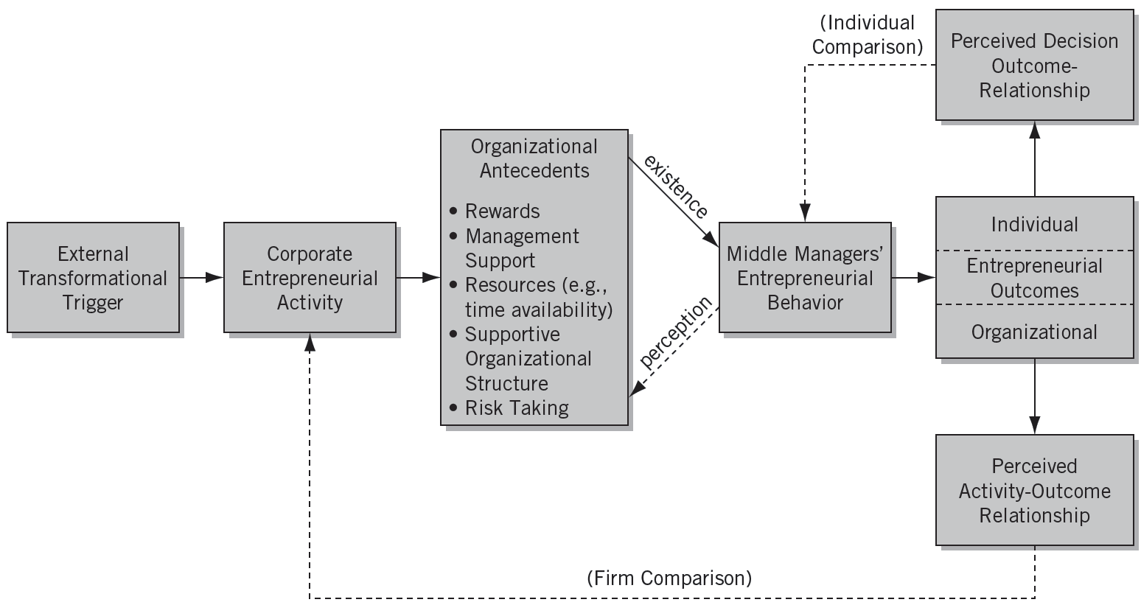
^{Figure} 3.4 A Model of Sustained Corporate Entrepreneurship
Source: Donald F. Kuratko, Jeffrey S. Hornsby, and Michael G. Goldsby, “Sustaining Corporate Entrepreneurship: Modeling Perceived Implementation and Outcome Comparisons at Organizational and Individual Levels,” International Journal of Entrepreneurship and Innovation 5(2) (May 2004): 79.

Slide 37
Key Terms and Concepts
bootlegging
champion
collective entrepreneurship
corporate entrepreneurship
Corporate Entrepreneurship Assessment Instrument (CEAI)
corporate venturing
entrepreneurial economy
incremental innovation
innovation (I) team
interactive learning
intracapital
intrapreneurship
radical innovation
intrapreneurship
Skunk Works
top management support

