Slide 1
Innovation: The Creative Pursuit of Ideas

Slide 2
Chapter Objectives
To explore the opportunity identification process
To define and illustrate the sources of innovative ideas for entrepreneurs
To examine the role of creativity and to review the major components of the creative process: knowledge accumulation, incubation process, idea experience, evaluation, and implementation
To present ways of developing personal creativity: recognize relationships, develop a functional perspective, use your “brains,” and eliminate muddling mind-sets

Slide 3
Chapter Objectives (cont’d)
To introduce the four major types of innovation: invention, extension, duplication, and synthesis
To review some of the major myths associated with innovation and to define the ten principles of innovation

Slide 4
Opportunity Identification: The Search for New Ideas
Opportunity identification is central to entrepreneurship and involves:
The creative pursuit of ideas
The innovation process
The first step for any entrepreneur is the identification of a “good idea.”
The search for good ideas is never easy.
Opportunity recognition can lead to both personal and societal wealth.

Slide 5
Entrepreneurial Imagination and Creativity
How entrepreneurs do what they do:
Creative thinking + systematic analysis = success
Seek out unique opportunities to fill needs and wants
Turn problems into opportunities
Recognize that problems are to solutions what demand is to supply

Slide 6
^{Table} 5.1 Sources of Innovative Ideas
Source | Examples
Unexpected occurrences | Unexpected success: Apple Computer (microcomputers) Unexpected tragedy: 9/11 terrorist attack
Incongruities | Overnight package delivery
Process needs | Sugar-free products Caffeine-free coffee Microwave ovens
Industry and market changes | Health care industry: changing to home health care
Demographic changes | Rest communities for older people
Perceptual changes | Exercise (aerobics) and the growing concern for fitness
Knowledge-based concepts | Mobile (cell phone) technology; pharmaceutical industry; robotics

Slide 7
Trends
Societal Trends
Aging demographics, health and fitness growth, senior living
Technology Trends
Mobile (cell phone) technology, e-commerce, Internet advances
Economic Trends
Higher disposable incomes, dual wage-earner families, performance pressures
Government Trends
Increased regulations, petroleum prices, terrorism

Slide 8
The Role of Creative Thinking
Creativity
The generation of ideas that result in the improved efficiency or effectiveness of a system.
Two important aspects of creativity exist:
Process
The process is goal oriented; it is designed to attain a solution to a problem.
People
The resources that determine the solution.

Slide 9
^{Table} 5.2 Two Approaches to Creative Problem Solving
Adaptor | Innovator
Employs a disciplined, precise, methodical approach | Approaches tasks from unusual angles
Is concerned with solving, rather than finding, problems | Discovers problems and avenues of solutions
Attempts to refine current practices | Questions basic assumptions related to current practices
Tends to be means oriented | Has little regard for means; is more interested in ends
Is capable of extended detail work | Has little tolerance for routine work
Is sensitive to group cohesion and cooperation | Has little or no need for consensus; often is insensitive to others
Source: Michael Kirton, “Adaptors and Innovators: A Description and Measure,” Journal of Applied Psychology (October 1976): 623. Copyright © 1976 by The American Psychological Association.

Slide 10
The Knowledge and Learning Process
Distilling Ideas into Opportunities
Personal work experience, and education
General industry knowledge
Prior market knowledge
Prior customer understanding
Specific interest knowledge

Slide 11
The Nature of the Creative Process
Creativity is a process that can be developed and improved. Some individuals have a greater aptitude for creativity than others.
Typical Creative Process
Phase 1: Background or knowledge accumulation
Phase 2: The incubation process
Phase 3: The idea experience
Phase 4: Evaluation and implementation

Slide 12
The Typical Creative Process
Phase 1 Background or knowledge accumulation
Phase 2 The incubation process
Phase 3 The idea experience
Phase 4 Evaluation and implementation

Slide 13
^{Table} 5.3 The Most Common Idea “Killers”
1. “Naah.”
2. “Can’t” (said with a shake of the head and an air of finality).
3. “That’s the dumbest thing I’ve ever heard.”
4. “Yeah, but if you did that . . .” (poses an extreme or unlikely disaster case).
5. “We already tried that—years ago.”
6. “I don’t see anything wrong with the way we’re doing it now.”
7. “We’ve never done anything like that before.”
8. “We’ve got deadlines to meet—we don’t have time to consider that.”
9. “It’s not in the budget.”
10. “Where do you get these weird ideas?”
Source: Adapted from The Creative Process, ed. Angelo M. Biondi (Hadley, MA: The Creative Education Foundation, 1986).

Slide 14
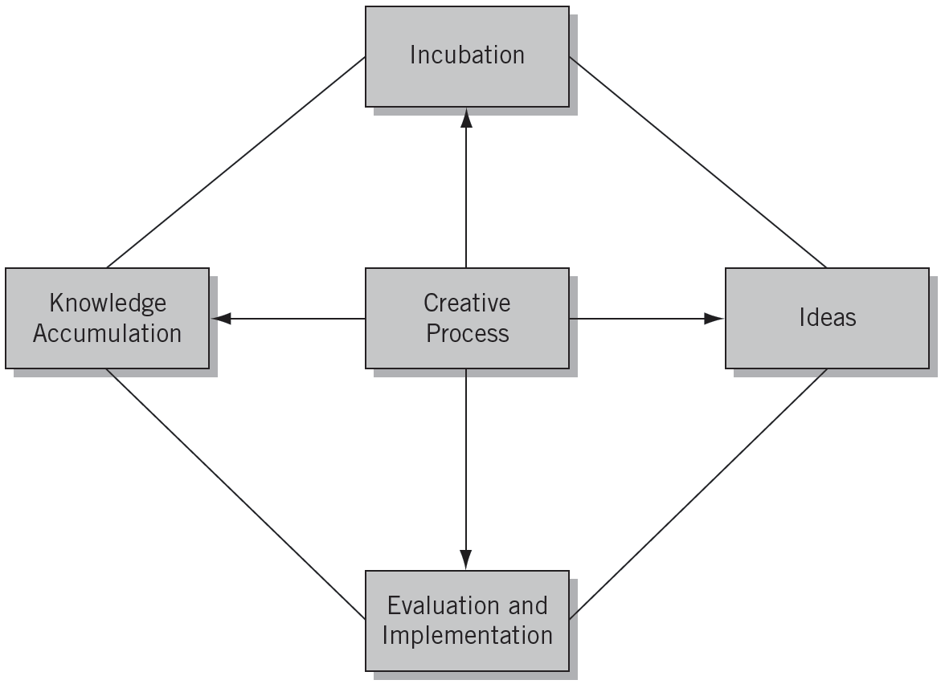
^{Figure} 5.1 The Critical Thinking Process

Slide 15
Developing Your Creativity
Recognizing Relationships
Looking for different or unorthodox relationships among the elements and people around you.
Developing a Functional Perspective
Viewing things and people in terms of how they can satisfy his or her needs and help complete a project.
Using Your Brains
The right brain helps us understand analogies, imagine things, and synthesize information.
The left brain helps us analyze, verbalize, and use rational approaches to problem solving.

Slide 16
A Creative Exercise
Think of and write down all of the functions you can imagine for the following items (spend five minutes on each item):
An egotistical staff member
A large pebble
A fallen tree branch
A chair
A computer “whiz kid”
An obsessively organized employee
The office “gossip”
An old hubcap
A new secretary
An empty roll of masking tape
A yardstick
An old coat hanger
The office “tightwad”
This exercise

Slide 17
^{Table} 5.4 Processes Associated with the Two Hemispheres of the Brain
Left Hemisphere | Right Hemisphere
Verbal | Nonverbal
Analytical | Synthesizing
Abstract | Seeing analogies
Rational | Nonrational
Logical | Spatial
Linear | Intuitive
 | Imaginative
Sources: Tasneem Sayeed, “Left vs. Right Brain: Which Hemisphere Dominates You?” Hub Pages, http://tasneemsayeed.hubpages.com/hub/Left_Right_Brain (Accessed February 10, 2012); Kendra Cherry, “Left Brain vs. Right Brain: Understanding the Myth and Reality of Left Brain and Right Brain Dominance,” About.com, http://psychology.about.com/od/cognitivepsychology/a/left-brain-right-brain.htm (Accessed February 10, 2012).

Slide 18
^{Table} 5.5 Ways to Develop Left- and Right-Hemisphere Skills
Left-Hemisphere Skills | Right-Hemisphere Skills
Step-by-step planning of your work and life activities Reading ancient, medieval, and scholastic philosophy, legal cases, and books on logic Establishing timetables for all of your activities Using and working with a computer program Detailed fantasizing and visualizing things and situations in the future Drawing faces, caricatures, and landscapes | Using metaphors and analogies to describe things and people in your conversations and writing Taking off your watch when you are not working Suspending your initial judgment of ideas, new acquaintances, movies, TV programs, and so on Recording your hunches, feelings, and intuitions and calculating their accuracy

Slide 19
Impediments to Creativity
Eliminating Muddling Mind-Sets
Either/or thinking (concern for certainty)
Security hunting (concern for risk)
Stereotyping (abstracting reality)
Probability thinking (seeking predictable results)

Slide 20
Arenas in Which People are Creative
Idea Creativity
Spontaneous Creativity
Material Creativity
Types of Creativity
Inner Creativity
Organization Creativity
Event Creativity
Relationship Creativity

Slide 21
The Creative Climate
Characteristics of a Creative Climate:
A trustful management that does not overcontrol the personnel
Open channels of communication among all business members
Considerable contact and communication with outsiders
A large variety of personality types
A willingness to accept change
An enjoyment in experimenting with new ideas
Little fear of negative consequences for making a mistake
The selection and promotion of employees on the basis of merit
The use of techniques that encourage ideas, including suggestion systems and brainstorming
Sufficient financial, managerial, human, and time resources for accomplishing goals

Slide 22
Innovation and the Entrepreneur
Innovation:
Is the process by which entrepreneurs convert opportunities (ideas) into marketable solutions.
Is a combination of the vision to create a good idea and the perseverance and dedication to remain with the concept through implementation.
Is a key function in the entrepreneurial process.
Is the specific function of entrepreneurship.

Slide 23
The Innovation Process
Types of Innovation
Invention
Extension
Duplication
Synthesis
Sources of Innovation
Unexpected occurrences
Incongruities
Process needs
Industry and market changes
Demographic changes
Perceptual changes
Knowledge-based concepts

Slide 24
^{Table} 5.6 Innovation in Action
Type | Description | Examples
Invention | Totally new product, service, or process | Wright brothers—airplane Thomas Edison—light bulb Alexander Graham Bell—telephone
Extension | New use or different application of an already existing product, service, or process | Ray Kroc—McDonald’s Mark Zuckerberg—Facebook Barry Sternlicht—Starwood Hotels & Resorts
Duplication | Creative replication of an existing concept | Wal-Mart—department stores Gateway—personal computers Pizza Hut—pizza parlor
Synthesis | Combination of existing concepts and factors into a new formulation or use | Fred Smith—Fed Ex Howard Schultz—Starbucks

Slide 25
The Major Misconceptions of Innovation
Innovation is planned and predictable
Technical specifications must be thoroughly prepared
Innovation relies on dreams and blue-sky ideas
Big projects will develop better innovations than smaller ones
Technology is the driving force of innovation success

Slide 26
Principles of Innovation
Be action oriented.
Make the product, process, or service simple and understandable.
Make the product, process, or service customer-based.
Start small.
Aim high.
Try/test/revise.
Learn from failures
Follow a milestone schedule.
Reward heroic activity.
Work, work, work.

Slide 27
Key Terms and Concepts
appositional relationship
creative process
creativity
duplication
either/or thinking
extension
functional perspective
incongruities
innovation
invention
left brain
muddling mind-sets
opportunity identification
probability thinking
right brain
stereotyping
synthesis

