Slide 1
Pathways to Entrepreneurial Ventures

Slide 2
Chapter Objectives
To describe the major pathways and structures for entrepreneurial ventures.
To present the factors involved in creating a new venture
To identify and discuss the elements involved in acquiring an established venture
To outline ten key questions to ask when buying an ongoing venture
To examine the underlying issues involved in the acquisition process
To define a franchise and outline its structure

Slide 3
Chapter Objectives (cont’d)
To examine the benefits and drawbacks of franchising
To present the franchise disclosure document (FDD) as a key item in franchises

Slide 4


The Pathways to New Ventures for Entrepreneurs
Creating the
New Venture
Acquiring an
Existing Venture
Pathways to New Ventures
Obtaining a
Franchise

Slide 5
Creating New Ventures
Approaches to Creating a New Venture
New-New Approach
New-Old Approach

Slide 6
^{Table} 7.1 Trends Creating Business Opportunities
Emerging Opportunities
Green Products Organic foods Organic fibers/textiles Alternative Energy Solar Biofuel Fuel cells Energy conservation | Health Care Healthy food School and govt.-sponsored programs Exercise Yoga Niche gyms Children Nonmedical Pre-assisted living Assisted living transition services | Niche Consumables Wine Chocolate Burgers Coffee houses Exotic salads | Home Automation and Media Storage Lighting control Security systems Energy management Comfort management Entertainment systems Networked kitchen appliances
Emerging Internet Opportunities |  |  | Emerging Technology Opportunities
Mobile Advertising Cell phones PDAs Concierge Services Niche Social Networks Seniors Music fans Groups of local users Pet owners Dating groups | Virtual Economies Online auctions Educational Tutoring Human Resources Services Matchmaking Virtual HR Online Staffing |  | Nanotechnology Wireless Technology
Source: Steve Cooper, Amanda C. Kooser, Kristin Ohlson, Karen E. Spaeder, Nichole L. Torres, and Sara Wilson, “2007 Hot List,” Entrepreneur (December 2006): 80–93.

Slide 7
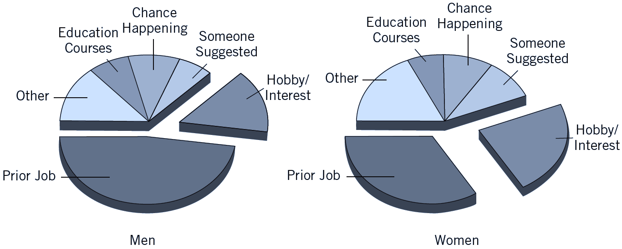
^{Figure} 7.1 Sources of New Business Ideas Among Men and Women
Source: William J. Dennis, A Small Business Primer (Washington, DC: National Federation of Independent Business, 1993) 27. Reprinted with permission.

Slide 8
Examining the Financial Picture
When Creating New Ventures
Upside gain and downside loss expectations
  The profits the business can make and the losses it can suffer.
    How much money will the enterprise take in if all goes well?
    How much will it gross if operations run as expected?
    How much will it lose if operations do not work out well?
Risk vs. reward analysis
  Points out the importance of getting an adequate return on the amount of money risked.

Slide 9
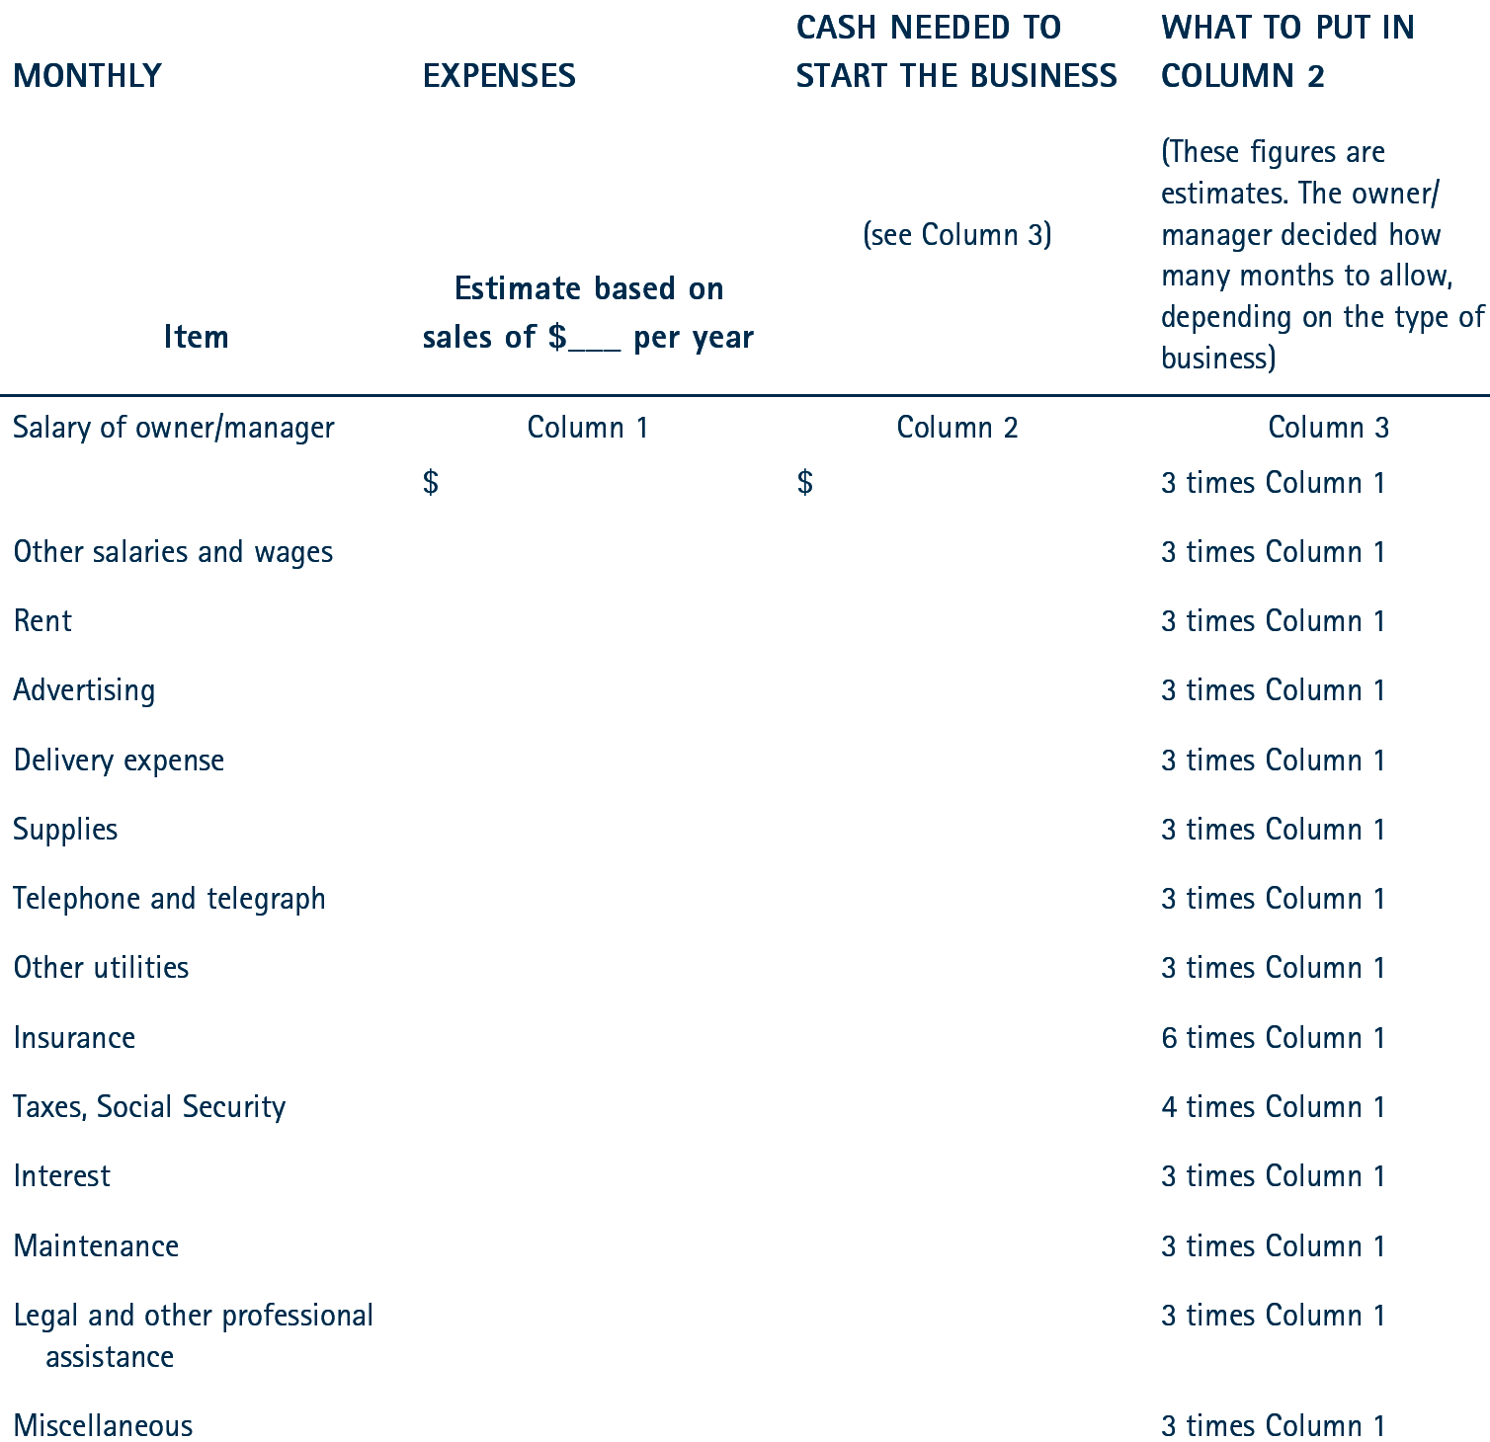
^{Table} 7.2 Checklist for Estimating Start-Up Expenses
Source: U.S. Small Business Administration, “Management Aids” MA. 2.025 (Washington, DC: U.S. Government Printing Office.)

Slide 10
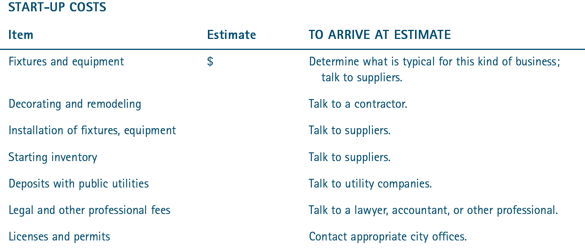
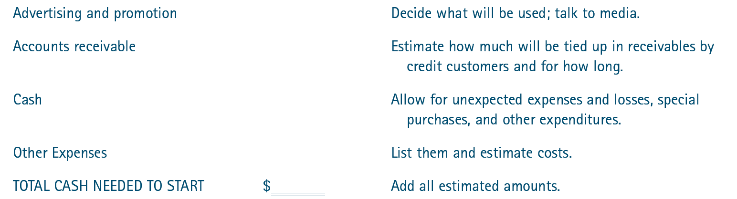
^{Table} 7.2 Checklist for Estimating Start-Up Expenses (cont’d)
Source: U.S. Small Business Administration, “Management Aids” MA. 2.025 (Washington, DC: U.S. Government Printing Office.)

Slide 11
Acquisition of an Established Business Venture
Personal
Preferences
Acquiring an
Established Entrepreneurial
Venture
Examination of Opportunities
Evaluation of
the Venture
Asking Key
Questions

Slide 12

Advantages of Acquiring an Ongoing Venture
Less fear about successful future operation
Reduced time
and effort
Purchasing at
a good price
Buying an Ongoing Venture

Slide 13
Evaluation of the Selected Venture
Factors Affecting Sale of the Venture
The business environment
Assets of the venture
Profits, sales, and operating ratios

Slide 14
Key Questions to Ask
Why is this business being sold?
What is the current physical condition of the business?
What is the condition of the inventory?
What is the state of the other assets of the business?
How many employees will remain with the business?
What type of competition does the business face?
What does financial picture of the business look like?

Slide 15
Negotiating the Deal
Information
Factors Affecting Negotiations
Time
Pressure
Alternatives

Slide 16
Considerations When Buying a Business
Request that the seller retain a minority interest in the business or make the final purchase price dependent on the performance of the business over a three-to-five-year span.
Be wary of any promises made without written corroboration.
Spend time reconstructing financial statements to determine how much cash is actually available.
Interview the owner, vendors, competitors, customers, and employees.

Slide 17
Franchising: The Hybrid
Franchising
  Any arrangement in which the owner of a trademark, trade name, or copyright has licensed others to use it in selling goods or services.
Franchisee
  A purchaser of a franchise
Franchisor
  The seller of the franchise

Slide 18
How Franchising Works
Franchisee Obligations:
  Make a financial investment in the operation.
  Obtain and maintain a standardized inventory and/or equipment package usually purchased from the franchisor.
  Maintain a specified quality of performance.
  Follow a franchise fee as well as a percentage of the gross revenues.
  Engage in a continuing business relationship.

Slide 19
How Franchising Works (cont’d)
Franchisor Provides:
  The company name that provides drawing power.
  Identifying symbols, logos, designs, and facilities.
  Professional management training for each independent unit’s staff.
  Sale of merchandise necessary for the unit’s operation, equipment to run the operation, and the food or materials needed for the final product.
  Financial assistance, if needed.
  Continuing aid and guidance to ensure that everything is done in accordance with the contract.

Slide 20
Franchising
Advantages
  Training and guidance
  Brand-name appeal
  A proven track record
  Financial assistance
Disadvantages
  Franchise fees
  Franchisor control
  Unfulfilled promises of franchisor

Slide 21
^{Table} 7.3 The Cost of Franchising
The basic franchising fee
Insurance
Opening product inventory
Remodeling and leasehold improvements.
Utility charges
Payroll
Debt service
Bookkeeping and accounting fees
Legal and professional fees
State and local licenses, permits, and certificates
Source: Donald F. Kuratko, “Achieving the American Dream as a Franchise,” Small Business Network (July 1987): 2. (updated by author, April, 2012).

Slide 22
Franchise Law
Franchise Disclosure Document (FDD)
  Is divided into 24 items that provide different segments of information for prospective franchisees.
  Was developed to provide guidance in complying with the Franchise Disclosure Rule that requires franchisors to make full presale
  disclosure about their franchises.

Slide 23
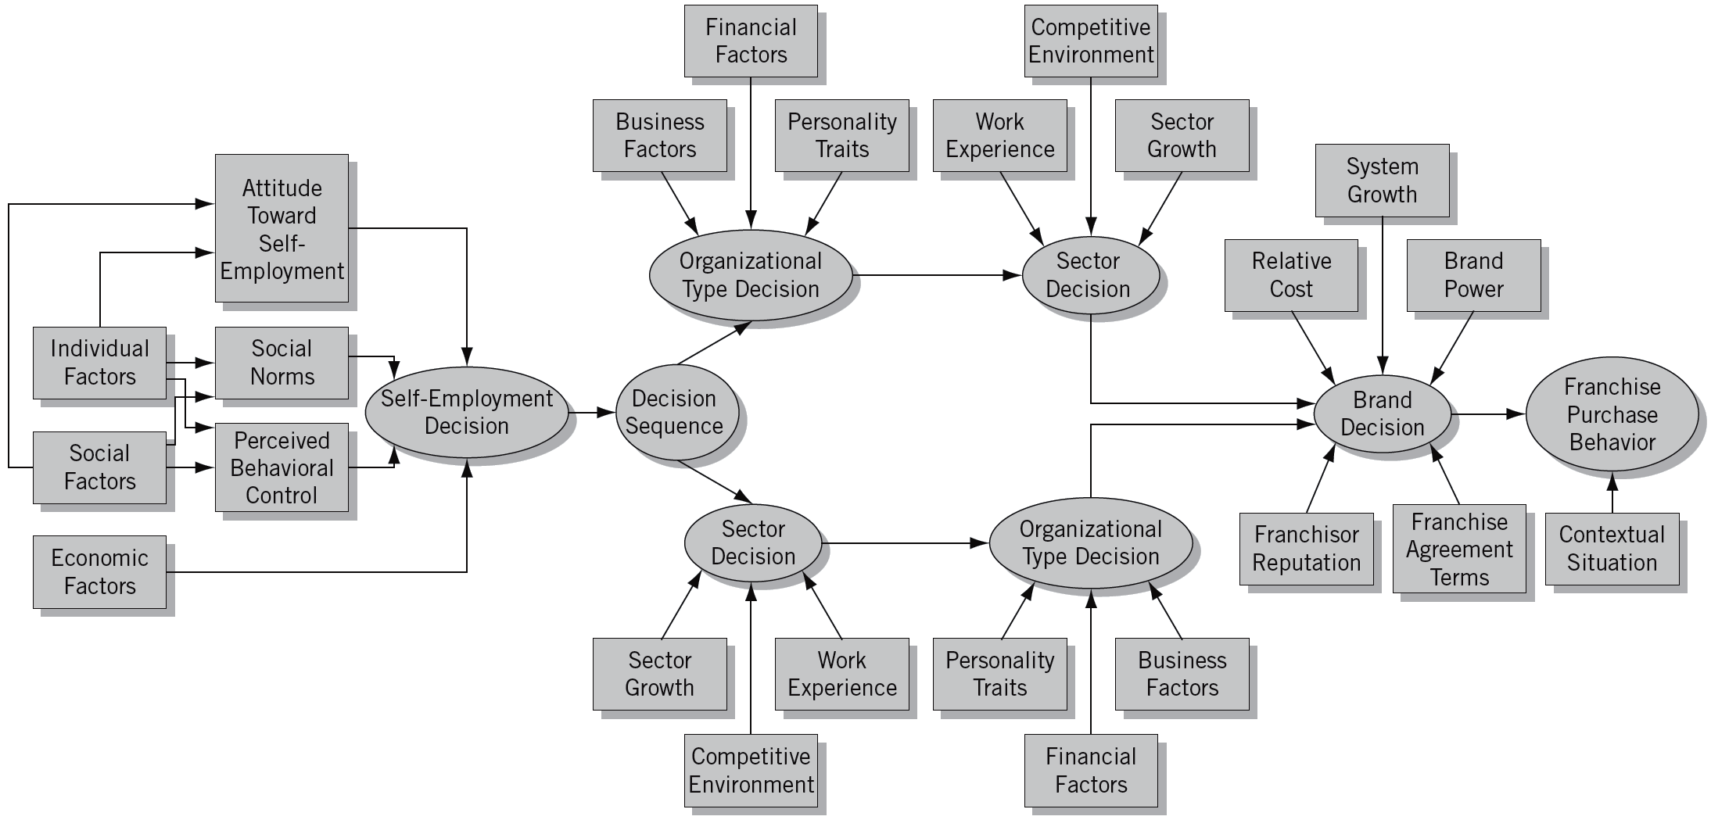
^{Figure} 7.2 The Decision to Purchase a Franchise: Process Model
-
Source: Patrick J. Kaufmann, “Franchising and the Choice of Self Employment,” Journal of Business Venturing, 14(4): 1999: 348.

Slide 24
^{Table} 7.4 World Wide Web Franchise Sites
Sites for franchising
http://www.betheboss.com
http://franchise1.com
http://www.franchiseworks.com/
http://franchise.org/

Slide 25
^{Table} 7.4 World Wide Web Franchise Sites (cont’d)
American Bar Association Forum on Franchising | www.abanet.org
U.S. Small Business Administration | www.sba.gov
Statistics – USA | www.stat-usa.gov
Entrepreneur Magazine | www.entrepreneur.com/franchises/bestofthebest/index.html
Minority Business Entrepreneur Magazine | www.mbemag.com
Franchise Times | www.franchisetimes.com
Franchise Update | www.franchise-update.com
Restaurant Business Magazine | www.restaurantbiz.com
Source Book Publications | www.worldfranchising.com
Federal Trade Commission | http://www.ftc.gov/bcp/franchise/netfran.shtm
Franchise.com | http://www.franchise.com/
World Franchising | http://www.worldfranchising.com/
Franchise Solution | http://www.franchisesolutions.com/
Franchise Opportunities | http://www.franchiseopportunities.com/
Franchise Trade | http://www.franchisetrade.com/
The Franchise Magazine | http://www.thefranchisemagazine.net/
Franchise Info Mall | http://www.franchiseinfomall.com/
Franchise Advantage | http://www.franchiseadvantage.com
US Franchise News | http://www.usfranchisenews.com/

Slide 26

Evaluating Franchising Opportunities
The Franchise Opportunity Decision
Finding Reliable Information
Investigating the Franchisor
Seeking Professional Help

Slide 27
Key Terms and Concepts
business broker
franchise
franchisee
franchise fee
franchisor
franchisor control
goodwill
legal restraint of trade
new-new approach
new-old approach
non-compete clause
profit trend
risk vs. reward
Uniform Franchise Offering Circular (UFOC)
unscrupulous practices
upside gain and downside loss

