Slide 1
Sources of Capital for Entrepreneurial Ventures

Slide 2
Chapter Objectives
To differentiate between debt and equity as methods of financing
To examine commercial loans and social lending as sources of capital
To review initial public offerings (IPOs) as a source of capital
To discuss private placements as an opportunity for equity capital
To study the market for venture capital and to review venture capitalists’ evaluation criteria for new ventures

Slide 3
Chapter Objectives (cont’d)
To discuss the importance of evaluating venture capitalists for a proper selection
To examine the existing informal risk-capital market (“angel capital”)

Slide 4
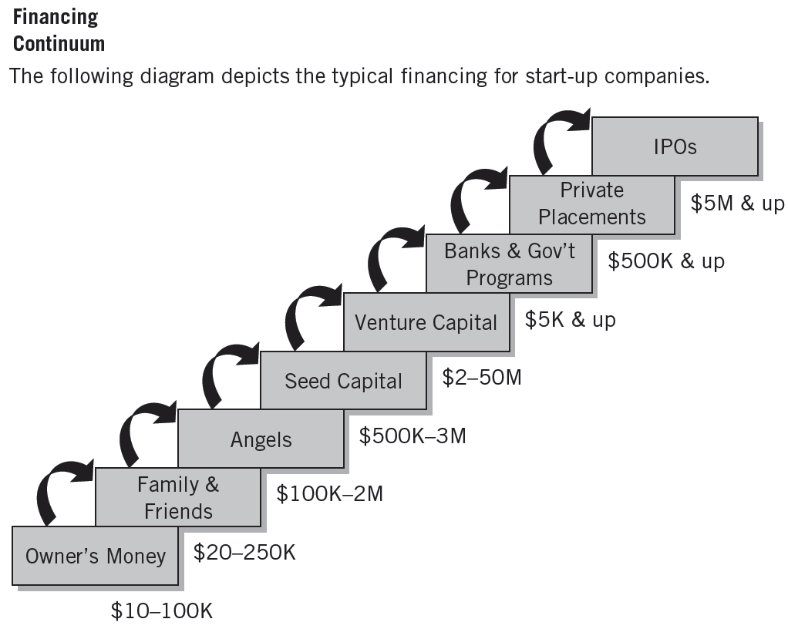
^{Figure} 8.1 Who Is Funding Entrepreneurial Start-Up Companies?
Source: “Successful Angel Investing,” Indiana Venture Center, March 2008.

Slide 5
Debt Versus Equity
Debt Financing
Secured financing of a new venture that involves a payback of the funds plus a fee (interest for the use of the money).
Equity Financing
Involves the sale (exchange) of some of the ownership interest in the venture in return for an unsecured investment in the firm.

Slide 6
Debt Financing
Commercial Banks
Make 1-5 year intermediate-term loans secured by collateral (receivables, inventories, or other assets).
Questions in securing a loan:
What do you plan to do with the money?
How much do you need?
When do you need it?
How long will you need it?
How will you repay the loan?

Slide 7
Debt Financing (cont’d)
Advantages
No relinquishment of ownership is required.
More borrowing allows for potentially greater return on equity.
low interest rates reduce the opportunity cost of borrowing
Disadvantages
Regular (monthly) interest payments are required.
Continual cash-flow problems can be intensified because of payback responsibility.
Heavy use of debt can inhibit growth and development.

Slide 8
Social Lending, or Crowdfunding
Sources of Social Lending
Are often Internet-based sites that pool money from investors willing to lend capital at agreed-upon rates.
Match borrowers and lenders based on loan size, risk tolerance, and social familiarity (e.g., co-workers, fellow alumni, hometown residents, etc.).
Possible Dangers
Low funding success rate
Business plan disclosure
No ongoing counseling relationship
Potential tax liability
Uncertain regulatory environment

Slide 9
^{Table} 8.1 Common Debt Sources
 | Business Type Financed |  | Financing Term
Debt Source | Start-Up Firm | Existing Firm | Short Term | Intermediate Term | Long Term
Trade credit | Yes | Yes | Yes | No | No
Commercial banks | Sometimes, but only if strong capital or collateral exists | Yes | Frequently | Sometimes | Seldom
Finance companies | Seldom | Yes | Most frequent | Yes | Seldom
Factors | Seldom | Yes | Most frequent | Seldom | No
Leasing companies | Seldom | Yes | No | Most frequent | Occasionally
Mutual savings banks and savings-and-loan associations | Seldom | Real estate ventures only | No | No | Real estate ventures only
Insurance companies | Rarely | Yes | No | No | Yes
Source: PricewaterhouseCoopers/National Venture Capital Association, MoneyTree™ Report, 2007.

Slide 10
Other Debt Financing Sources
Trade Credit
Credit given by suppliers who sell goods on account.
Accounts Receivable Financing
Short-term financing that involves either the pledge of receivables as collateral for a loan or the sale of receivables at a discounted value (factoring).
Factoring
The sale of accounts receivable at discounted values
Finance Companies
Asset-based lenders that lend money against assets such as receivables, inventory, and equipment.

Slide 11
Other Debt Financing Sources (cont’d)
Equity Financing
Gives investors a share of the ownership.
Loan with warrants provide the investor with the right to buy stock at a fixed price at some future date.
Convertible debentures are unsecured loans that can be converted into stock.
Preferred stock is equity that gives investors a preferred place among the creditors in the event the venture is dissolved.
Common stock is the most basic form of ownership and is often are sold through public or private offerings.

Slide 12
Equity Financing
Equity Financing
Money invested in the venture with no legal obligation for entrepreneurs to repay the principal amount or pay interest on it.
Funding sources: public offering and private placement
Public Offering
“Going public” refers to a corporation’s raising capital through the sale of its securities on the stock markets.
Initial Public Offerings (IPOs): new issues of common stock

Slide 13
Public Offerings
Advantages
Size of capital amount
Liquidity
Value
Image
Disadvantages
Costs
Disclosure
Requirements
Shareholder pressure

Slide 14
Private Placements
Regulation D
Securities and Exchange Commission (SEC) regulations for reports and statements required when selling stock to private parties—friends, employees, customers, relatives, and professionals.
Defines four separate exemptions, which are based on the amount of money being raised:
Rule 504a: placements of less than $500,000
Rule 504: placements up to $1,000,000
Rule 505: placements of up to $5 million
Rule 506: placements in excess of $5 million

Slide 15
Private Placements (cont’d)
Accredited Purchaser
Regulation D uses the term “accredited purchaser.” Included in this category are the following:
Institutional investors such as banks, insurance companies, venture capital firms.
Any person who buys at least $150,000 of the offered security and whose net worth, including that of his or her spouse, is at least 5 times the purchase price.
Any person who, together with his or her spouse, has a net worth in excess of $1 million at the time of purchase.

Slide 16
Investors
“Sophisticated” Investors
Wealthy individuals who invest regularly in new and early- and late-stage ventures and are knowledgeable about the technical and commercial opportunities and risks of the business in which they invest.

Slide 17
The Venture Capital Market
Venture Capitalists
Are valuable and powerful sources of equity funding for new ventures who provide:
Capital for start-ups and expansion
Market research and strategy
Management-consulting, audits and evaluation
Contacts—customers, suppliers, and businesspeople
Assistance in negotiating technical agreements
Help in establishing management and accounting controls
Help in employee recruitment and employee agreements
Help in risk management and with insurance programs
Counseling and guidance in complying with government regulations

Slide 18
^{Table} 8.2 Venture Capital Investments Comparison by Stages
Stage | Amount | Deals
Later Stage | $1.8 billion | 178
Early Stage | $2.3 billion | 364
Start up/Seed | $134 million | 80
Source: Adapted from: PricewaterhouseCoopers/National Venture Capital Association, MoneyTree™ Report, 2011.

Slide 19

Recent Developments in Venture Capital
More-Experienced Venture Investors
More-Specialized Venture Funds
Emergence of Feeder Funds
Decrease in Small Start-up Investments
More Sophisticated Legal Environment

Slide 20
Recent Developments in Venture Capital
More experienced investors
Stronger legal governance environment
Globalization of VCs
Venture Capital Trends
More direct involvement of VCs
More VC specialization
Reduced seed and start-up financing
Syndication of VC deals

Slide 21
Investment Agreement Provisions
Choice of securities
Preferred stock, common stock, convertible debt, and so forth
Control issues
Who maintains voting power
Evaluation issues and financial covenants
Ability to proceed with mergers and acquisitions
Remedies for breach of contract
Rescission of the contract or monetary damages

Slide 22
Dispelling Venture Capital Myths
Myth 1: Venture capital firms want to own control of your company and tell you how to run the business.
Myth 2: Venture capitalists are satisfied with a reasonable return on investment.
Myth 3: Venture capitalists are quick to invest.
Myth 4: Venture capitalists are interested in backing new ideas or high-technology inventions— management is a secondary consideration.
Myth 5: Venture capitalists need only basic summary information before they make an investment.

Slide 23
Factors in Successful Funding of Ventures
Characteristics of the Entrepreneurs
Success in Seeking Funding (Demand Side)
Characteristics of the Request
Sources of Advice
Characteristics of the Enterprise

Slide 24
Venture Capitalists and Business Plans
Proposal Size
Financial Projections
Investment Recovery
Competitive Advantage
Company Management

Slide 25
^{Figure} 8.2 Venture Capitalist System of Evaluating Product/Service and Management
Level 4 Fully developed product/service Established market Satisfied users | 4/1 | 4/2 | 4/3 | 4/4
Level 3 Fully developed product/service Few users as of yet Market assumed | 3/1 | 3/2 | 3/3 | 3/4
Level 2 Operable pilot or prototype Not yet developed for production Market assumed | 2/1 | 2/2 | 2/3 | 2/4
Level 1 Product/service idea Not yet operable Market assumed | 1/1 | 1/2 | 1/3 | 1/4
 | Level 1 Individual founder/ entrepreneur | Level 2 Two founders Other personnel not yet identified | Level 3 Partial management team—members identified to join company when funding received | Level 4 Fully staffed, experienced management team
Status of Product/Service
Riskiest
Riskiest
Status of Management
Source: Stanley Rich and David Gumpert, Business Plans That Win $$$ (New York: Harper & Row, 1985), 169. Reprinted by permission of Sterling Lord Literistic, Inc. Copyright © 1985 by Stanley Rich and David Gumpert.

Slide 26
^{Table} 8.3 Returns on Investment Typically Sought by Venture Capitalists
Stage Of Business | Expected Annual Return on Investment | Expected Increase on Initial Investment
Start-up business (idea stage) | 60% + | 10–15 × investment
First-stage financing (new business) | 40%–60% | 6–12 × investment
Second-stage financing (development stage) | 30%–50% | 4–8 × investment
Third-stage financing (expansion stage) | 25%–40% | 3–6 × investment
Turnaround situation | 50% + | 8–15 × investment
Source: W. Keith Schilit, “How to Obtain Venture Capital,” Business Horizons (May/June 1987): 78. Copyright © 1987 by the Foundation for the School of Business at Indiana University. Reprinted by permission.

Slide 27
^{Table} 8.4 Factors in Venture Capitalists’ Evaluation Process
Attribute | Level | Definition
Timing of entry | Pioneer | Enters a new industry first
 | Late follower | Enters an industry late in the industry’s stage of development
Key success factor stability | High | Requirements necessary for success will not change radically during industry development
 | Low | Requirements necessary for success will change radically during industry development
Educational capability | High | Considerable resources and skills available to overcome market ignorance through education
 | Low | Few resources or skills available to overcome market ignorance through education
Lead time | Long | An extended period of monopoly for the first entrant prior to competitors entering the industry
 | Short | A minimal period of monopoly for the first entrant prior to competitors entering this industry
Source: Dean A. Shepherd, “Venture Capitalists’ Introspection: A Comparison of ‘In Use’ and ‘Espoused’ Decision Policies,” Journal of Small Business Management (April 1999): 76–87; and “Venture Capitalists’ Assessment of New Venture Survival,” Management Science (May 1999): 621–632. Reprinted by permission. Copyright 1999, the Institute for Operation Research and the Management Sciences (INFORMS), 7240 Parkway Drive, Suite 310, Hanover MD 21076 USA.

Slide 28
^{Table} 8.4 Factors in Venture Capitalists’ Evaluation Process (cont’d)
Attribute | Level | Definition
Competitive rivalry | High | Intense competition among industry members during industry development
 | Low | Little competition among industry members during industry development
Entry wedge mimicry | High | Considerable imitation of the mechanisms used by other firms to enter this, or any other, industry—for example, a franchisee
 | Low | Minimal imitation of the mechanisms used by other firms to enter this, or any other, industry—for example, introducing a new product
Scope | Broad | A firm that spreads its resources across a wide spectrum of the market—for example, many segments of the market
 | Narrow | A firm that concentrates on intensively exploiting a small segment of the market—for example, targeting a niche
Industry-related competence | High | Venturer has considerable experience and knowledge with the industry being entered or a related industry
 | Low | Venturer has minimal experience and knowledge with the industry being entered or related industry
Source: Dean A. Shepherd, “Venture Capitalists’ Introspection: A Comparison of ‘In Use’ and ‘Espoused’ Decision Policies,” Journal of Small Business Management (April 1999): 76–87; and “Venture Capitalists’ Assessment of New Venture Survival,” Management Science (May 1999): 621–632. Reprinted by permission. Copyright 1999, the Institute for Operation Research and the Management Sciences (INFORMS), 7240 Parkway Drive, Suite 310, Hanover MD 21076 USA.

Slide 29
Criteria for Evaluating New-Venture Proposals
Major Categories of Venture Capitalist Screening Criteria:
Entrepreneur’s personality
Entrepreneur’s experience
Product or service characteristics
Market characteristics
Financial considerations
Nature of the venture team

Slide 30
^{Table} 8.5 Venture Capitalists’ Screening Criteria
Venture Capital Firm Requirements
Must fit within lending guidelines of venture firm for stage and size of investment
Proposed business must be within geographic area of interest
Prefer proposals recommended by someone known to venture capitalist
Proposed industry must be kind of industry invested in by venture firm
Nature of the Proposed Business
Projected growth should be relatively large within five years of investment
Economic Environment of Proposed Industry
Industry must be capable of long-term growth and profitability
Economic environment should be favorable to a new entrant
Proposed Business Strategy
Selection of distribution channel(s) must be feasible
Product must demonstrate defendable competitive position
Financial Information on the Proposed Business
Financial projections should be realistic
Proposal Characteristics
Must have full information
Should be a reasonable length, be easy to scan, have an executive summary, and be professionally presented
Proposal must contain a balanced presentation
Use graphics and large print to emphasize key points
Entrepreneur/Team Characteristics
Must have relevant experience
Should have a balanced management team in place
Management must be willing to work with venture partners
Entrepreneur who has successfully started previous business given special consideration
Source: John Hall and Charles W. Hofer, “Venture Capitalists’ Decision Criteria in New Venture Evaluation,” Journal of Business Venturing (January 1993): 37.

Slide 31
Venture Capitalist Evaluation Process
Stage 1: Initial Screening
This is a quick review of the basic venture to see if it meets the venture capitalist’s particular interests.
Stage 2: Evaluation of the Business Plan
This is where a detailed reading of the plan is done in order to evaluate the factors mentioned earlier.
Stage 3: Oral Presentation
The entrepreneur verbally presents the plan to the venture capitalist.
Stage 4: Final Evaluation
After analyzing the plan and visiting with suppliers, customers, consultants, and others, the venture capitalist makes a final decision.

Slide 32
^{Table} 8.6 Essential Elements for a Successful Presentation to a Venture Capitalist
TEAM MUST:
Be able to adapt
Know the competition
Be able to manage rapid growth
Be able to manage an industry leader
Have relevant background and industry experience
Show financial commitment to firm, not just sweat equity
Be strong with a proven track record in the industry unless the company is a start-up or seed investment
MARKET MUST:
Have current customers and the potential for many more
Grow rapidly (25% to 45% per year)
Have a potential market size in excess of $250 million
Show where and how you are competing in the marketplace
Have potential to become a market leader
Outline any barriers to entry
PRODUCT MUST:
Be real and work
Be unique
Be proprietary
Meet a well-defined need in the marketplace
Demonstrate potential for product expansion, to avoid being a one-product company
Emphasize usability
Solve a problem or improve a process significantly
Be for mass production with potential for cost reduction
BUSINESS PLAN MUST:
Tell the full story, not just one chapter
Promote a company, not just a product
Be compelling
Show the potential for rapid growth and knowledge of your industry, especially competition and market vision
Include milestones for measuring performance
Show how you plan to beat or exceed those milestones
Address all of the key areas
Detail projections and assumptions; be realistic
Serve as a sales document
Include a strong and well-written executive summary
Show excitement and color
Show superior rate of return (a minimum of 30% to 40% per year) with a clear exit strategy
Source: Andrew J. Sherman, Raising Capital, 2nd ed. AMACOM Books, 2005; p.175.

Slide 33
Informal Risk Capital
Business Angel Financing
Wealthy individuals who are looking for investment opportunities.
They are referred to as “business angels” or informal risk capitalists.
Types of Angel Investors
Corporate angels
Entrepreneurial angels
Enthusiast angles
Micromanagement angels
Professional angels

Slide 34
^{Table} 8.7 “Angel Stats”
Typical deal size | $500,000–$850,000
Typical recipient | Start-up firms
Cash-out time frame | 5 to 7 years
Expected return | 35% to 50% a year
Ownership stake | Less than 50%
Source: Jeffrey Sohl, University of New Hampshire’s Center for Venture Research, 2011; and the Halo Report, 2011.

Slide 35
^{Figure} 8.8 Pros and Cons of Dealing with Angel Investors
Pros | Cons
Angels engage in smaller financial deals. Angels prefer seed stage or start-up stage. Angels invest in various industry sectors. Angels are located in local geographic areas. Angels are genuinely interested in the entrepreneur. | Angels offer no additional investment money. Angels cannot offer any national image. Angels lack important contacts for future leverage. Angels may want some decision making with the entrepreneur. Angels are getting more sophisticated in their investment decisions.

Slide 36
Key Terms and Concepts
accounts receivable financing
accredited purchaser
angel capital
bootstrapping
business angel
crowdfunding
debt financing
direct public offering (DPO)
equity financing
factoring
finance companies
informal risk capitalist
initial public offering (IPO)
private placement
Regulation D
social lending
sophisticated investor
trade credit
venture capitalist

