Slide 1
Legal Challenges for Entrepreneurial Ventures

Slide 2
Chapter Objectives
To introduce the importance of legal issues to entrepreneurs
To examine patent protection, including definitions
and preparation
To review copyrights and their relevance to entrepreneurs
To study trademarks and their impact on new ventures
To examine the legal forms of organization—sole proprietorship, partnership, and corporation
To illustrate the advantages and disadvantages of each of these three legal forms

Slide 3
Chapter Objectives (cont’d)
To explain the nature of the limited partnership and limited liability partnerships (LLPs)
To examine how an S corporation works
To define the additional classifications of corporations, including limited liability companies (LLCs), B corporations, and low-profit, limited liability companies (L3Cs)
To present the major segments of the bankruptcy law that apply to entrepreneurs

Slide 4


Legal Challenges for the Entrepreneurial Venture
Inception of the Venture
The Ongoing Venture
Legal
Concepts
Growth and Continuity of the Venture

Slide 5
Major Legal Concepts and Entrepreneurial Ventures
Inception of an Entrepreneurial Venture
  Laws governing intellectual property
    Patents
    Copyrights
    Trademarks
  Forms of business organization
    Sole proprietorship
    Partnership
    Corporation
    Franchise
  Tax considerations
  Capital formation
  Liability questions

Slide 6
Major Legal Concepts and Entrepreneurial Ventures
Ongoing Venture: Business Development
and Transactions
  Personnel Law
    Hiring and firing policies
    Equal Employment Opportunity Commission
    Collective bargaining
  Contract Law
    Legal contracts
    Sales contracts
    Leases

Slide 7
Major Legal Concepts and Entrepreneurial Ventures
Growth and Continuity of
a Successful Entrepreneurial Venture
  Tax considerations
    Federal, state, and local
    Payroll
    Incentives
  Governmental regulations
    Zoning (property)
    Administrative agencies (regulatory)
    Consumer law
  Continuity of ownership rights
    Property laws and ownership
    Wills, trusts, and ownership
    Bankruptcy

Slide 8
Intellectual Property Protection: Patents
Patent
  Provides the owner with exclusive rights to hold, transfer, and license the production and sale of the product or process as an intellectual property right.
  Design patents last for 14 years; all others last for 20 years.
What Items Qualify for Patent Protection?
  Processes, machines, products, plants, compositions of elements (chemical compounds), and improvements on already existing items.

Slide 9
Securing a Patent
Rule 1: Pursue patents that are broad, are
commercially significant, and offer a
strong position.
Rule 2: Prepare a patent plan in detail.
Rule 3: Have your actions relate to your original
patent plan.
Rule 4: Establish an infringement budget.
Rule 5: Evaluate the patent plan strategically.

Slide 10
Securing a Patent: The Application
Patent Application
  Specification: the text of a patent and may include any accompanying illustrations.
    An introduction explaining why the invention will be useful.
    A description of prior art considered similar to the invention.
    A summary of the essence of the technology/invention, its differences from prior art and requisite features.
    A description of the invention, including anything remotely relevant, reference to variations, and number bounds.
    Examples and/or experimental results, in full detail.
  Claims: a series of short paragraphs, each of which identifies a particular feature or combination of features that is protected by the patent.

Slide 11
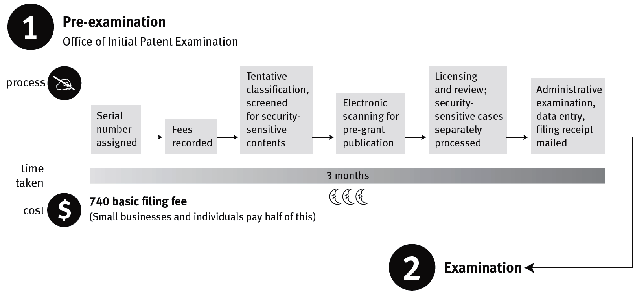
^{Figure} 9.1 The Patent Process: From Application to Allowance and Issue
Continued on following slide
Source: United States Patent Office, 2012.

Slide 12
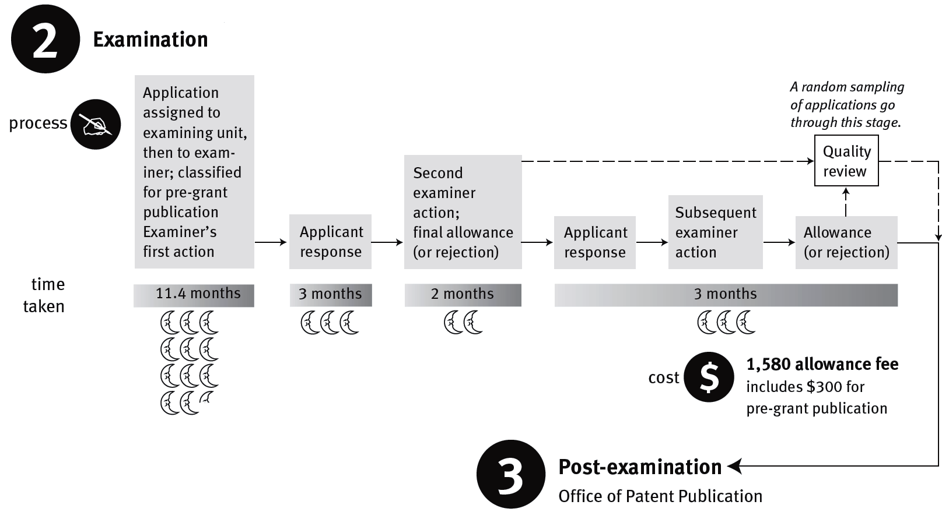
^{Figure} 9.1 The Patent Process: From Application to Allowance and Issue (cont’d)
Continued on following slide
Source: United States Patent Office, 2012.

Slide 13
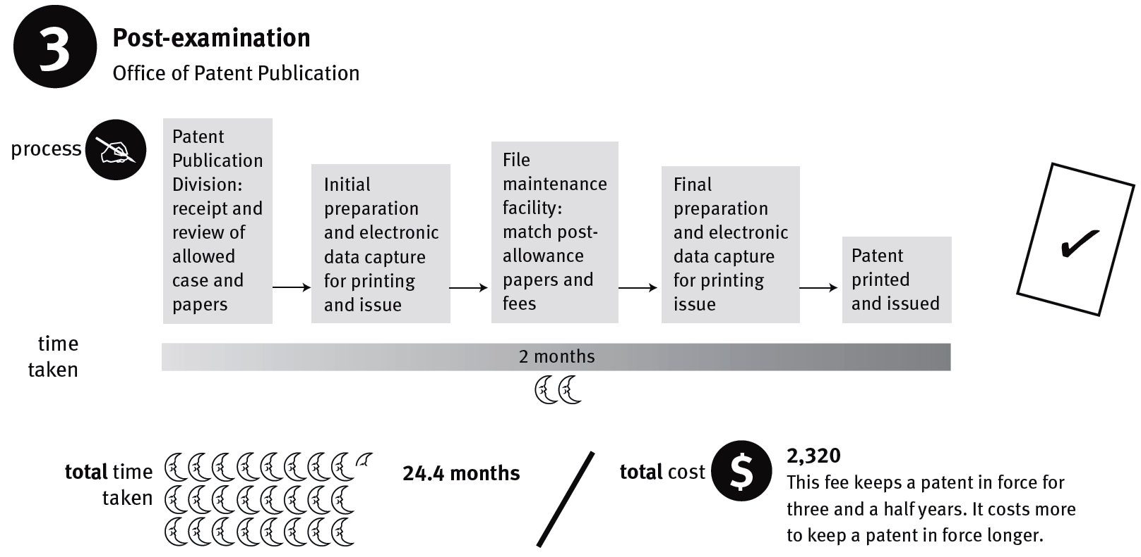
^{Figure} 9.1 The Patent Process: From Application to Allowance and Issue (cont’d)
Source: United States Patent Office, 2012.

Slide 14
Intellectual Property Protection: Copyrights
Copyright
  Provides exclusive rights to creative individuals for the protection of their literary or artistic productions.
  Duration: life of the author plus 70 years.
The copyright owner has the rights to:
  Reproduce the work
  Prepare derivative works based on it
  Distribute copies of the work by sale or otherwise
  Perform the work publicly
  Display the work publicly
  Sell or transfer individual rights

Slide 15
Intellectual Property Protection: Copyrights
Copyright Protection
  The material must be in a tangible form so it can be communicated or reproduced.
  It also must be the author’s own work and thus the product of his or her skill or judgment.
  Formal registration of a copyright is with the Copyright Office of the Library of Congress.

Slide 16
Copyrights (cont’d)
Fair Use Doctrine
  Reproduction of a copyright work for purposes such as criticism, comment, news reporting, teaching (including multiple copies for classroom use), scholarship, or research is not an infringement of copyright.
Protected Ideas?
  The Copyright Act specifically excludes copyright protection for any “idea, procedure, process, system, method of operation, concept, principle, or discovery, regardless of the form in which it is described, explained, illustrated, or embodied.”

Slide 17
Intellectual Property Protection: Trademarks
Trademark
  A distinctive name, mark, symbol, or motto identified with a company’s product(s) and registered at the Patent and Trademark Office
Advantages of Trademark Registration
  Nationwide constructive notice of the owner’s right to use the mark
  Bureau of Customs protection against importers using the mark
  Incontestability of the mark after five years

Slide 18
Intellectual Property Protection: Trademarks
Trademark Duration
  Current registrations are good for 10 years with the possibility for continuous renewal every 10 years.
  A trademark may be invalidated in four specific ways:
    Cancellation proceedings
    Cleaning-out procedure
    Abandonment
    Generic meaning

Slide 19
Trademarks (cont’d)
Avoiding the Trademark Pitfalls
  Rule 1: Never select a corporate name or a mark without first doing a trademark search.
  Rule 2: If your attorney says you have a potential problem with a mark, trust his or her judgment.
  Rule 3: Seek a coined or a fanciful name or mark before you settle for a descriptive or a highly suggestive one.
  Rule 4: Whenever marketing or other considerations dictate the use of a name or a mark that is highly suggestive of the product, select a distinctive logotype for the descriptive or suggestive words.
  Rule 5: Avoid abbreviations and acronyms wherever possible, and when no alternative is acceptable, select a distinctive logotype in which the abbreviation or acronym appears.

Slide 20
Trade Secrets
Trade Secret
  Business processes and information that cannot be patented, copyrighted, or trademarked but makes an individual company unique and has value to a competitor could be a trade secret.
Information Is Considered a Trade Secret:
  If it is not known by the competition.
  If the business would lose its advantage if the competition were to obtain it.
  If the owner has taken reasonable steps to protect the secret from disclosure.

Slide 21
Trade Secrets
Examples of Trade Secrets:
  Customer lists
  Strategic plans
  Research and development
  Pricing information
  Marketing techniques
  Production techniques

Slide 22
Trademark Protection on the Internet
Cyberlaw
  The emerging body of law governing cyberspace.
Domain Names (Internet Addresses)
  The principles of trademark law apply to domain names (Cybersquatters).
  Unauthorized use of another’s mark in a domain name may constitute trademark infringement.

Slide 23
^{Table} 9.2 Forms of Intellectual Property
 | Patent | Copyright
DEFINITION | A grant from the government that gives an inventor exclusive rights to an invention. | An intangible property right granted to authors and originators of a literary work or artistic production that falls within specified categories.
REQUIREMENTS | An invention must be: 1. Novel. 2. Not obvious. 3. Useful. | Literary or artistic works must be: Original. Fixed in a durable medium that can be perceived, reproduced, or communicated. Within a copyrightable category.
TYPES OR CATEGORIES | Utility (general). Design. Plant (flowers, vegetables, and so on). | Literary works (including computer programs). Musical works. Dramatic works. Pantomime and choreographic works. Pictorial, graphic, and sculptural works. Films and audiovisual works. Sound recordings.
HOW ACQUIRED | By filing a patent application with the U.S. Patent and Trademark Office and receiving that office’s approval. | Automatic (once in tangible form); to recover for infringement, the copyright must be registered with the U.S. Copyright Office.
Source: Kenneth W. Clarkson, Roger LeRoy Miller, Gaylord A. Jentz, and Frank B. Cross, West’s Business Law: Legal, Ethical, International, and E-Commerce Environment, 8th ed. (Mason, OH: Thomson/South-Western, http://www.thomsonrights.com, 2001), 125–26; and also updated in Kenneth W. Clarkson, Roger LeRoy Miller, and Frank B. Cross, West’s Business Law, 12th ed. (Mason, OH: South-Western/Cengage, 2012), 169. Reprinted with permission.

Slide 24
^{Table} 9.2 Forms of Intellectual Property (cont’d)
 | Trademarks (Service Marks and Trade Dress) | Trade Secrets
DEFINITION | Any distinctive word, name, symbol, or device (image or appearance), or combination thereof, that an entity uses to identify and distinguish its goods or services from those of others. | Any information (including formulas, patterns, programs, devices, techniques, and processes) that a business possesses and that gives the business an advantage over competitors who do not know the information or process.
REQUIREMENTS | Trademarks, service marks, and trade dresses must be sufficiently distinctive (or must have acquired a secondary meaning) to enable consumers and others to distinguish manufacturer’s, seller’s, or business user’s products or services from those of competitors. | Information and processes that have commercial value, that are not known or easily ascertainable by the general public or others, and that are reasonably protected from disclosure.
TYPES OR CATEGORIES | Strong, distinctive marks (such as fanciful, arbitrary, or suggestive marks). Marks that have acquired a secondary meaning by use. Other types of marks, including certification marks and collective marks. Trade dress (such as a distinctive decor, menu, style, or type of service). | Literary works (including computer programs). Musical works. Dramatic works. Pantomime and choreographic works. Pictorial, graphic, and sculptural works. Films and audiovisual works. Sound recordings.
HOW ACQUIRED | At common law, ownership is created by use of mark. Registration (either with the U.S. Patent and Trademark Office or with the appropriate state office) gives constructive notice of date of use. | Through the originality and development of information and processes that are unique to a business, that are unknown by others, and that would be valuable to competitors if they knew of the information and processes..
Source: Kenneth W. Clarkson, Roger LeRoy Miller, Gaylord A. Jentz, and Frank B. Cross, West’s Business Law: Legal, Ethical, International, and E-Commerce Environment, 8th ed. (Mason, OH: Thomson/South-Western, http://www.thomsonrights.com, 2001), 125–26; and also updated in Kenneth W. Clarkson, Roger LeRoy Miller, and Frank B. Cross, West’s Business Law, 12th ed. (Mason, OH: South-Western/Cengage, 2012), 169. Reprinted with permission.

Slide 25
Legal Structures for Entrepreneurial Ventures
A legal structure that will best suits the demands of the venture addresses:
  How easily the form of business organization
  can be implemented
  The amount of capital required to implement
  the form of business organization
  Legal considerations that might limit the options available to the entrepreneur
  The tax effects of the form of organization selected
  The potential liability to the owner of the form of organization selected

Slide 26
Primary Legal Forms of Organization
Sole proprietorship
Partnership
Corporation

Slide 27
Sole Proprietorships
Sole Proprietorship
  A business that is owned and operated by one person. The enterprise has no existence apart
  from its owner.
  To establish a sole proprietorship, a person merely needs to obtain whatever local and state licenses are necessary to begin operations.

Slide 28
Sole Proprietorships (cont’d)
Advantages
  Ease of formation
  Sole ownership of profits
  Decision making and control vested in one owner
  Flexibility
  Relative freedom from governmental control
  Freedom from corporate business taxes
Disadvantages
  Unlimited liability
  Lack of continuity
  Less available capital
  Relative difficulty obtaining long-term financing
  Relatively limited viewpoint and experience

Slide 29
Partnerships
Partnership
  An association of two or more persons acting
  as co-owners of a business for profit.
  The Revised Uniform Partnership Act (RUPA) acts the guide for legal requirements in forming partnerships.
Articles of Partnership
  Clearly outline the financial and managerial contributions of the partners and carefully delineate the roles in the partnership relationship.

Slide 30
Articles of Partnership Items
Name, purpose, domicile
Duration of agreement
Character of partners (general or limited, active or silent)
Contributions by partners (at inception, at later date)
Division of profits and losses
Draws or salaries
Rights of continuing partner(s)
Death of a partner (dissolution and windup)
Release of debts
Business expenses (method of handling)
Separate debts
Authority (individual partner’s authority on business conduct)
Books, records, and method of accounting
Sale of partnership interest
Arbitration
Settlement of disputes
Additions, alterations, or modifications of partnership
Required and prohibited acts
Absence and disability
Employee management

Slide 31
Partnerships (cont’d)
Advantages
  Ease of formation
  Direct rewards
  Growth and performance facilitated
  Flexibility
  Relative freedom from governmental control and regulation
  Possible tax advantage
Disadvantages
  Unlimited liability of
  at least one partner
  Lack of continuity
  Relative difficulty obtaining large sums of capital
  Bound by the acts of general partner
  Difficulty of disposing of partnership interest

Slide 32
Corporations
Corporation
  “An artificial being, invisible, intangible, and existing only in contemplation of the law”.
  –Supreme Court Justice John Marshall
  As such, a corporation is a separate legal entity apart from the individuals who own it.
Forming a Corporation
  Subscriptions for capital stock must be taken
  and a tentative organization created.
  Approval (a charter) must be obtained from the secretary of state in the state in which the corporation is to be formed.

Slide 33
Corporations (cont’d)
Advantages
  Limited liability
  Transfer of ownership
  Unlimited life
  Relative ease of securing capital in large amounts
  Increased ability and expertise
Disadvantages
  Activity restrictions
  Lack of representation
  Regulation
  Organizing expenses
  Double taxation

Slide 34
^{Table} 9.3 General Characteristics of Forms of Business
 | Sole Proprietorship | Partnership | Limited Liability Partnership | Limited Partnership | Limited Liability Limited Partnership | Corporation | S Corporation | Limited Liability Company
Formation | When one person owns a business without forming a corporation or LLC | By agreement of owners or by default when two or more owners conduct business together without forming a limited partnership, an LLC or a corporation | By agreement of owners; must comply with limited liability partnership statute | By agreement of owners; must comply with limited partnership statute | By agreement of owners; must comply with limited liability limited partnership statute | By agreement of owners; must comply with corporation statute | By agreement of owners; must comply with corporation state; must elect S Corporation status under Subchapter S of Internal Revenue Code | By agreement of owners; must comply with limited liability company statute
Duration | Terminates on death or withdrawal of sole proprietor | Usually unaffected by death or withdrawal of partner | Unaffected by death or withdrawal of partner | Unaffected by death or withdrawal of partner, unless sole general partner dissociates | Unaffected by death or withdrawal of partner, unless sole general partner dissociates | Unaffected by death or withdrawal of shareholder | Unaffected by death or withdrawal of shareholder | Usually unaffected by death or withdrawal of member
Management | By sole proprietor | By partners | By partners | By general partners | By general partners | By board of directors | By board of directors | By managers or members
Owner Liability | Unlimited | Unlimited | Mostly limited to capital contribution | Unlimited for general partners; limited to capital contribution for limited partners | Limited to capital contribution | Limited to capital contribution | Limited to capital contribution | Limited to capital contribution
Transferability of Owners’ Interest | None | None | None | None, unless agreed otherwise | None, unless agreed otherwise | Freely transferable, although shareholders may agree otherwise | Freely transferable, although shareholders usually agree otherwise | None, unless agreed otherwise
Source: Jane P. Mallor, A. James Barnes, Thomas Bowers, and Arlen W. Langvardt, Business Law: The Ethical, Global, and E-Commerce Environment, 15 ed. (McGraw Hill Irwin, 2013), 959. Reprinted with permission from The McGraw-Hill Companies.

Slide 35
^{Table} 9.3 General Characteristics of Forms of Business
 | Sole Proprietorship | Partnership | Limited Liability Partnership | Limited Partnership | Limited Liability Limited Partnership | Corporation | S Corporation | Limited Liability Company
Federal Income Taxation | Only sole proprietor taxed | Only partners taxed | Usually only partners taxed; may elect to be taxed like a corporation | Usually only partners taxed; may elect to be taxed like a corporation | Usually only partners taxed; may elect to be taxed like a corporation | Corporation taxed; shareholders taxed on dividends (double tax) | Only shareholders taxed | Usually only members taxed; may elect to be taxed like a corporation
Source: Jane P. Mallor, A. James Barnes, Thomas Bowers, and Arlen W. Langvardt, Business Law: The Ethical, Global, and E-Commerce Environment, 15 ed. (McGraw Hill Irwin, 2013), 959. Reprinted with permission from The McGraw-Hill Companies.

Slide 36
Partnerships and Corporations: Specific Forms
Limited Partnerships
  Have two or more partners without responsibility for management and without liability for losses beyond their investment with the right to share in the profits.
    Formed under The Uniform Limited Partnership Act (ULPA).
Limited Liability Partnership (LLP)
  Allows professionals the tax benefits of a partnership while avoiding personal liability for the malpractice of other partners.
Limited Liability Limited Partnership (LLLP)
  Has elected limited liability status for all of its partners, including general partners.

Slide 37
Partnerships and Corporations: Specific Forms
S Corporation
  Takes its name from Subchapter S of the Internal Revenue Code.
  Is commonly known as a “tax option corporation”—it is taxed similarly to a partnership.
  Avoids the imposition of income taxes at the corporate level yet retain the benefits of a corporate form (especially the limited liability).

Slide 38
Guidelines for S Corporations
The corporation must be a domestic corporation.
The corporation must not be a member of an affiliated group of corporations.
The shareholders of the corporation must be individuals, estates, or certain trusts. Corporations, partnerships, and nonqualifying trusts cannot be shareholders.
The corporation must have 100 or fewer shareholders.
The corporation must have only one class of stock, although not all shareholders may have the same voting rights.
No shareholder may be a nonresident alien.

Slide 39
Specific Forms of Partnerships and Corporations (cont’d)
Limited Liability Company (LLC)
  A hybrid form of business enterprise that offers the limited liability of a corporation but the tax advantages of a partnership.
  Disadvantage is that LLC statutes differ from state to state, and thus any firm engaged in multi-state operations may face difficulties.

Slide 40
^{Table} 9.4 Principal Characteristics of Limited Partnerships and LLLPs
A limited partnership or LLLP may be created only in accordance with a statute.
A limited partnership or LLLP has two types of partners: general partners and limited partners. It must have one or more of each type.
All partners, limited and general, share the profits of the business.
Each limited partner has liability limited to his capital contribution to the business. Each general partner of a limited partnership has unlimited liability for the obligations of the business. A general partner in an LLLP, however, has liability limited to his capital contribution.
Each general partner has a right to manage the business, and she is an agent of the limited partnership or LLLP. A limited partner has no right to manage the business or to act as its agent, but he does have the right to vote on fundamental matters. A limited partner they manage the business, yet retain limited liability for partnership obligations.
General partners, as agents, are fiduciaries of the business. Limited partners are not fiduciaries.
A partner’s rights in a limited partnership or LLLP are not freely transferable. A transferee of a general or limited partnership interest in not a partner, but is entitled only to the transferring partner’s share of capital and profits.
The death or other withdrawal of a partner does not dissolve a limited partnership or LLLP, unless there is no surviving general partner.
Usually, a limited partnership or LLLP is taxed like a partnership.
Source: Adapted from Jane P. Mallor, A. James Barnes, Thomas Bowers, and Arlen W. Langvardt, Business Law: The Ethical, Global, and E-Commerce Environment, 15 ed. (New York: McGraw Hill Irwin, 2013), 955–1024. Reprinted with permission from The McGraw-Hill Companies.

Slide 41
B Corporations
Certified B Corporations
  Are a new way for businesses to solve critical social and environmental problems by addressing two critical problems:
    Corporate laws that make it difficult for businesses to consider employee, community, and environmental interests in their decision making.
    The lack of transparent standards that can make it difficult to tell the difference between a socially proactive company and just good marketing.

Slide 42
L3C
LC3
  Is a low-profit, limited liability company that facilitates investments in socially beneficial, for-profit ventures.
  Is designed to attract private investments and philanthropic capital in ventures designed to provide a social benefit.
  Has an explicit primary charitable mission and only a secondary profit concern.
  Is able to form flexible partnerships where tiered ownership rights are set to meet the requirements of each partner

Slide 43
Bankruptcy
Bankruptcy
  When a venture’s financial obligations are greater than its assets and it is unable to meet its obligations.
The Bankruptcy Act
  A federal law that provides for specific procedures for handling insolvent debtors—those who are unable to pay debts as they become due.
    Ensures that the property of the debtor is distributed fairly to the creditors.
    Protects creditors from having debtors unreasonably diminish their assets.
    Protects debtors from extreme demands by creditors.

Slide 44
Bankruptcy (cont’d)
Chapter 7: Straight Bankruptcy
  Sometimes referred to as “liquidation.”
  Requires the debtor to surrender all property to a trustee appointed by the court.
Chapter 11: Reorganization
  The most common form of bankruptcy.
  Under this format, a debtor attempts to formulate a plan to pay a portion of the debts, have the remaining sum discharged, and continue to stay in operation.

Slide 45
Bankruptcy (cont’d)
Chapter 13: Adjustment of Debts
  Individuals or sole proprietors with unsecured debts of less than $360,475 or secured debts of less than $1,081,400 are eligible to file under a Chapter 13 procedure.
  In the petition the debtor declares an inability to pay his or her debts and requests some form of extension through future earnings (a longer period of time to pay) or a composition of debt (a reduction in the amount owed).

Slide 46
^{Table} 9.5 Bankruptcy: A Comparison of Chapters 7, 11, and 13
 | Chapter 7 | Chapter 11 | Chapter 13
PURPOSE | Liquidation | Reorganization | Adjustment
WHO CAN PETITION | Debtor (voluntary) or creditors (involuntary) | Debtor (voluntary) or creditors (involuntary) | Debtor (voluntary) only
WHO CAN BE A DEBTOR | Any “person” (including partnerships and corporations) except railroads, insurance companies, banks, savings and loan institutions, and credit unions. Farmers and charitable institutions cannot be involuntarily petitioned. | Any debtor eligible for Chapter 7 relief; railroads are also eligible. | Any individual (not partnerships or corporations) with regular income who owes fixed unsecured debt of less than $290,525 or secured debt of less than $871,550.
PROCEDURE LEADING TO DISCHARGE | Nonexempt property is sold with proceeds to be distributed (in order) to priority groups. Dischargeable debts are terminated. | A plan is submitted and, if it is approved and followed, debts are discharged. | A plan is submitted (must be approved if debtor turns over disposable income for three year period) and, if it is approved and followed, debts are discharged.
ADVANTAGES | On liquidation and distribution, most debts are discharged, and the debtor has an opportunity for a fresh start. | The debtor continues in business. Creditors can accept the plan, or it can be “crammed down” on them. The plan allows for a reorganization and liquidation of debts over the plan period. | The debtor continues in business or keeps possession of assets. If the plan is approved, most debts are discharged after a three year period.
Source: Roger LeRoy Miller and Gaylord A. Jentz, Fundamentals of Business Law, 6th ed. (Mason, OH: South-Western, a division of Thomson Learning: http://www.thomsonrights.com, © 2005), 438. Reprinted with permission.

Slide 47
Minimizing Legal Expenses
Establish the fee structure with an attorney beforehand.
Establish clear written agreements on all critical matters that affect business operations.
Always attempt to settle any dispute rather than litigate.
Have your attorney share forms in electronic format.
Use a less expensive attorney for small collections.
Suggest cost-savings to your attorney for business matters.
Always check with your attorney during normal business hours.
Consult with your lawyer on several matters at one time.
Keep abreast of legal developments in your field.
Handle some matters yourself.
Involve attorneys early when it is feasible

Slide 48
Key Terms and Concepts
abandonment
bankruptcy
Bankruptcy Act
B corporation
cancellation proceedings
claims
cleaning-out procedure
copyright
corporation
debtor-in-possession
fair use doctrine
generic meaning
infringement budget
intellectual property right
L3C
limited liability company (LLC)
limited liability limited partnership (LLLP)
limited liability partnership (LLP)
limited partnership
liquidation
partnership
patent
Patent and Trademark Office
Revised Uniform Limited Partnership Act (RULPA)
S corporation
sole proprietorship
specification
trademark
trade secrets
unlimited liability

