Slide 1
Valuation of Entrepreneurial Ventures

Slide 2
Chapter Objectives
To explain the importance of valuation
To describe the basic elements of due diligence
To examine the underlying issues involved in the acquisition process
To outline the various aspects of analyzing a business
To present the major points to consider when establishing a firm’s value
To highlight the available methods of valuing
a venture

Slide 3
Chapter Objectives (cont’d)
To examine the three principal methods currently used in business valuations
To consider additional factors that affect a venture’s valuation

Slide 4
The Importance of Business Valuation
Business valuation is essential when:
  Buying or selling a business, division, or major asset
  Establishing an employee stock option plan (ESOP)
  or profit-sharing plan for employees
  Raising growth capital through stock warrants or convertible loans
  Determining inheritance tax liability (potential estate tax liability)
  Giving a gift of stock to family members
  Structuring a buy/sell agreement with stockholders
  Attempting to buy out a partner
  Going public with the firm or privately placing the stock

Slide 5

Underlying Issues When Acquiring a Venture
Differing Goals of Buyer and Seller
Emotional Bias
of the Seller
Valuation of
the Venture
Reasons for
the Acquisition

Slide 6
Reasons for an Acquisition
Developing more growth-phase products by acquiring a firm that has developed new products in the acquirer’s industry
Increasing the number of customers by acquiring a firm whose current customers will broaden substantially the acquirer’s customer base
Increasing market share by acquiring a firm in the acquirer’s industry
Improving or changing distribution channels by acquiring a firm with recognized superiority in the acquirer’s current distribution channel

Slide 7
Reasons for an Acquisition (cont’d)
Expanding by product line by acquiring a firm whose products complement and complete the acquirer’s product line
Developing or improving customer service operations by acquiring a firm with an established service operation, as well as a customer service network that includes the acquirer’s products
Reducing operating leverage and increasing absorption of fixed costs by acquiring a firm that has a lower degree of operating leverage and can absorb the acquirer’s fixed costs

Slide 8
Reasons for an Acquisition (cont’d)
Using idle or excess plant capacity by acquiring a firm that can operate in the acquirer’s current plant facilities
Integrating vertically, either backward or forward, by acquiring a firm that is a supplier or distributor
Reducing inventory levels by acquiring a firm that is a customer (not an end user) and adjusting the acquirer’s inventory levels to match the acquired firm’s orders
Reducing indirect operating costs by acquiring a firm that will allow elimination of duplicate operating costs (for example, warehousing and distribution)
Reducing fixed costs by acquiring a firm that will permit elimination of duplicate fixed costs

Slide 9
Evaluation of an Acquisition
A firm’s potential to pay for itself during a reasonable period of time
The difficulties that the new owners will face during the transition period
The amount of security or risk involved in the transaction; changes in interest rates
The effect on the firm’s value if a turnaround is required
The number of potential buyers
Current managers’ intentions to remain with the firm
The taxes associated with the purchase or sale of the enterprise

Slide 10
Considering a Firm’s Operations and Potential
An Objective Evaluation of:
  Potential of the firm to pay for itself during a reasonable period of time
  Difficulties likely to occur during the transition period
  Security or risk of the transaction; interest rate changes
  Effect on the firm’s value if a turnaround is required
  Number of potential buyers
  Current managers’ intentions to remain with the firm
  Taxes associated with the purchase or sale of an enterprise

Slide 11
Due Diligence Questions
Why is this business being sold?
What is the physical condition of the business?
How many key personnel will remain?
What is the degree of competition?
What are the conditions of the lease?
Do any liens against the business exist?
Will the owner sign a covenant not to compete?
Are any special licenses required?
What are the future trends of the business?
How much capital is needed to buy?

Slide 12
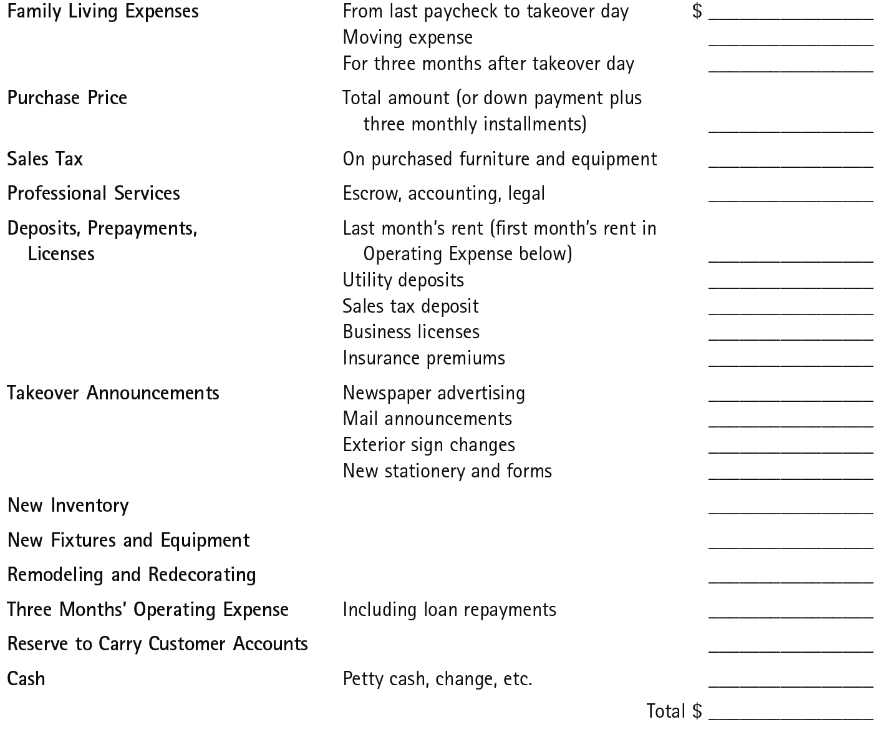
^{Figure} 14.1 Total Amount Needed to Buy a Business
NOTE: Money for living and business expenses for at least three months should be set aside in a bank savings account and not used for any other purpose. This is a cushion to help get through the start-up period with a minimum of worry. If expense money for a longer period can be provided, it will add to peace of mind and help the buyer concentrate on building the business.

Slide 13
Analyzing the Business
Many closely held ventures have the following shortcomings:
  Lack of management depth
  Undercapitalization
  Insufficient controls
  Divergent goals

Slide 14
Establishing a Firm’s Value
Valuation Methods
  Adjusted Tangible Book Value
    Computing a firm’s net worth as the difference between total assets and total liabilities; adjusting the value of assets to reflect their true economic worth such as balance sheet and income statement adjustments that include:
      bad debt reserves
      low-interest, long-term debt securities
      investments in affiliates
      loans and advances to officers, employees, or other companies

Slide 15
Establishing a Firm’s Value (cont’d)
Valuation Methods (cont’d)
  Price/Earnings Ratio (Multiple of Earnings) Method
    Useful in valuing publicly held corporations.
    Valuation is determined by dividing the market price of the common stock by the earnings per share.
    Major drawbacks:
      The stock of a private company is not publicly traded.
      The stated net income of a private company may not truly reflect its actual earning power.
      The sale of a large controlling block of stock of closely held business can command a premium.
      It is very difficult to find a truly comparable publicly held company, even in the same industry.

Slide 16
Establishing a Firm’s Value
Valuation Methods (cont’d)
  Discounted Earnings Method
    The firm’s discounted cash flows are dollars earned in the future (based on projections) that worth less than dollars earned today (due to the loss of purchasing power).
    “Timing” of projected income or cash flows is a critical factor.
  The process of discounting cash flows:
    Expected cash flow is estimated.
    An appropriate discount rate is determined.
    A reasonable life expectancy of the firm is determined.
    The firm’s value is determined by discounting the estimated cash flow by the appropriate discount rate over the expected life of the business.

Slide 17
^{Figure} 14.2 The Pricing Formula
Step 1. Determine the adjusted tangible net worth of the business (the total market value of all current and long-term assets less liabilities).
Step 2. Estimate how much the buyer could earn annually with an amount equal to the value of the tangible net worth invested elsewhere.
Step 3. Add to this a salary normal for an owner/operator of the business. This combined figure provides a reasonable estimate of the income the buyer can earn elsewhere with the investment and effort involved in working in the business.
Step 4. Determine the average annual net earnings of the business (net profit before subtracting owner’s salary) over the past few years.
Step 5. Subtract the total of earning power (2) and reasonable salary (3) from this average net earnings figure (4). This gives the extra earning power of the business.
Step 6. Use this extra earnings figure to estimate the value of the intangibles. This is done by multiplying the extra earnings by what is termed the “years-of-profit” figure.
Step 7. Final price equals adjusted tangible net worth plus value of intangibles (extra earnings times “years of profit”).

Slide 18
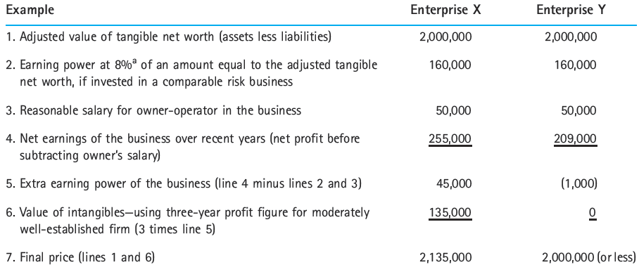
^{Figure} 14.2 The Pricing Formula (cont’d)
With Enterprise X, the seller receives a value for goodwill because the business is moderately well established and earning more than the buyer could earn elsewhere with similar risks and effort.
With Enterprise Y, the seller receives no value for goodwill because the business, even though it may have existed for a considerable time, is not earning as much as the buyer could through outside investment and effort. In fact, the buyer may feel that even an investment of $200,000—the current appraised value of net assets—is too much because it cannot earn sufficient return.
ª This is an arbitrary figure, used for illustration. A reasonable figure depends on the stability and relative risks of the business and the investment picture generally. The rate of return should be similar to that which could be earned elsewhere with the same approximate risk.

Slide 19
Term Sheets in Venture Valuation
Term Sheet
  Outlines the material terms and conditions of a venture agreement and guides legal counsel in the preparation of a proposed final agreement.
  Are very similar to letters of intent (LOI) in that they are both preliminary, mostly nonbinding documents meant to record two or more parties’ intentions to enter into a future agreement based on specified (but incomplete or preliminary) terms.

Slide 20
Terms in Letters of Intent (LOI)
Price/Valuation
Fully Diluted Ownership
Type of Security
  Convertible preferred stock
Liquidation Preference
Dividend Preference
  Cumulative
  Noncumulative and discretionary
Redemption Preferred
  Optional
  Mandatory
Conversion Rights
Antidilution Protection
  Price protection
    Ratchet protection
    Weighted average protection
Voting Rights
Right of First Refusal
Co-Sale Right
Registration Rights
  Piggyback rights
  Demand rights
Vesting on Founders’ Stock

Slide 21
Additional Factors in the Valuation Process
Additional factors that may influence
the final valuation of the venture:
  Avoiding start-up costs
    Buyers are willing to pay more than the evaluated price for an existing firm to avoid start-up costs.
  Accuracy of projections
    The sales and earnings of a venture are always projected on the basis of historical financial and economic data.
  Control factor
    The degree of control an owner legally has over the firm can affect its valuation; more control, more value.

Slide 22
Key Terms and Concepts
adjusted tangible book value
anti-dilution protection
business valuation
control factor
discounted earnings method
divergent goals
due diligence
emotional bias
fully diluted
letter of intent (LOI)
liquidation preference
price/earnings ratio (P/E)
term sheet
undercapitalization

