Slide 1
Savvy Clothing Exchange™
Feasibility Presentation
Brooke Palmiter & Stephanie Young

Slide 2
Business Concept
Savvy Clothing Exchange is a buy, sell, and trade retail store that gives people 35% in cash, or 50% in store credit for every piece of clothing (or accessory) that we decide to buy, based off of the designated price we intend to sell the item for.
Proprietary Rights: Trademark (logo), Copyright (business plan)
Structure: Limited Liability Company LLC
Distribution Role: Retailer, physical location & online ecommerce

Slide 3
Industry/Market Analysis
Market Size: IBISWorld reported that the Used Goods Industry is a multibillion-dollar industry that has annual sales revenue of roughly $15.1 billion with profits of around $636.1 million.
Growth Rate: 3% over the past five-years
Potential: The online & used goods retail segment has ample room for growth
Industry: Clothing & Used Goods
SIC 5932 & NAICS 453310

Slide 4
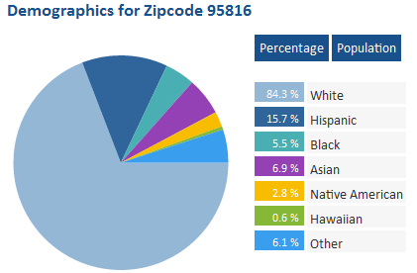
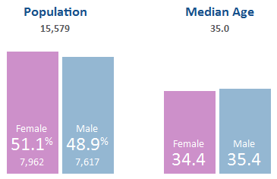
Market
Target Audience:
Men & Women 25-40
Fashion Conscious
Sustainable Consumers
Competition:
Freestyle
Goodwill
Crossroads
eBay
Poshmark
Indirect:
Buffalo Exchange
Non-used clothing Retailers (Nordstrom, etc.)

Slide 5
Management Team
General Manager, Stephanie Young - Stephanie will be taking this role due to her past experience in management positions throughout the service industry.
Operations Manager, Brooke Palmiter – Brooke has past qualifications in customer service based operations, and a keen ability to spot problematic areas of concern both on and off of the sales floor.
Sales & Marketing, Dan Young - Dan’s qualifications for distribution and marketing come from past positions working as a sales representative, and marketing manager.
Accounting & Legal, Outsource to fill the gaps – We will be making sure the candidates have past experience, are knowledgeable, & have a drive for results.

Slide 6
Financial Analysis
Breakeven: In month 11
Net Earnings Before Interest & Taxes:
Year 1: $9,177
Year 2: $21,814
Year 3: $25,700
TC = TR | $60,881 = $60,881
P = Selling Price per unit | P = $10
V = Variable Cost per unit. | V = $3.50
X = Number of Units Produced and Sold | X = 6,088.15
TR = Total Revenue = P * X | TR = $60,881
Start-Up Funds:
Partner’s Equity = $20,000
Loan = $30,000

Slide 7
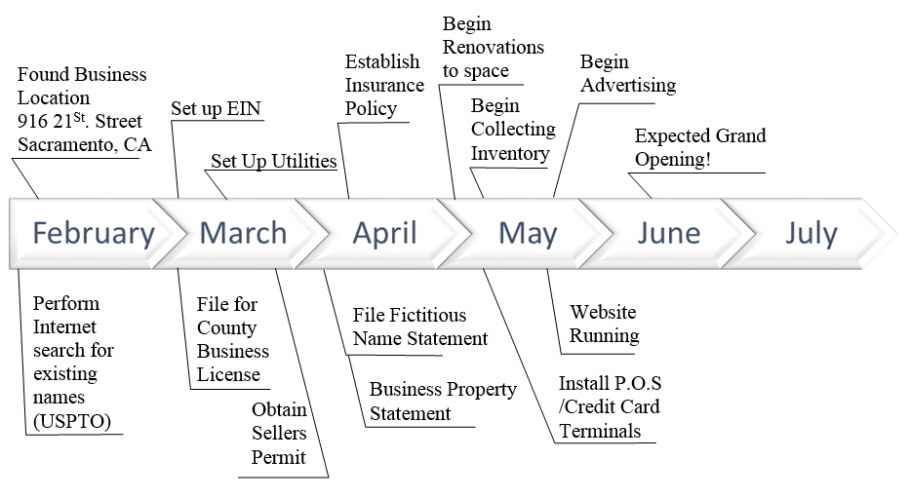
timeline

Slide 8
Exit strategy
We do not foresee exiting this business venture, we are hopeful and confident that our net income will continue to grow each year. Ultimately we would like to expand our operations to a second location, and aim to be recognized as a nationwide company.

