Slide 1
Tutoring Connections
Tetyana Chervenkova
Joshua Ayotte
Rima Hakim
Allie Webb

Slide 2
Business concept
A privately-operated college tutoring service located on ARC’s campus
Book by appointment or drop-in
Hourly rates, discounted for students in host campus
Buy as many hours as you want

Slide 3
Competitive Edge
Discounts will be highly attractive to students in the host college
High level of availability
Charge an hourly rate with no limit of hours
Highly selective about tutors, well-compensated to ensure quality tutoring

Slide 4
Industry Analysis
The third-party instruction industry includes
Academic tutoring
Driving schools
Professional education
Total:$9.3 billion
Growth: 1.7%
(IBISWorld, 2014)

Slide 5
Target Market
ARC has a current enrollment of 33,440 students, and nearly 75% of them are part-time
Likely to be working students
Discretionary income
Time-constrained
(IBISWorld, 2014)

Slide 6
Competitive Landscape
Highly fragmented market
58.8% of competitors have 5 or fewer employees
Top 5 competitors make up 10% of the market, only two of these provide college level tutoring

Slide 7
Comprise 10% of Market Share

Slide 8
Executive Team
Tutoring Connections has a founding executive team of four professionals from diverse fields:
Tanya Chervenkova – Chief Executive Officer
Joshua Ayotte – Chief Personnel Officer
Rima Hakim – Chief Financial Officer
Allie Webb – Marketing / Administration Head
All investing owners as well as the executive managers.

Slide 9
Financials – Significant Expenses
Computer Software……………………………………………. $5,000 one-time
Equipment…………………………………………………………. $6,000 one-time
Website, Room Design, Licensing………………………. $1,760 one-time
Total Employee Salary(2400 hrs/month)……$28,800/month
Additional Employee Expenses………………….$20,160/month
Rent……………………………………………………………..$1,000/month
Other Reoccurring Expenses…………………….....$ 900/ month

Slide 10
Financials – Investment / Funds Needed
Each Team member invests $15,000……………………………$60,000
Family/Friends……………………………..……………………$10,000
Bank Loan………………………………………………….………………..$20,000
Total Funds……………………………………..……………………………$90,000
Note: $20,000 Bank Notes will be paid in 2 years
$40,000 Loan will be paid in 2 years
$30,000 will be kept as Capital Stock

Slide 11
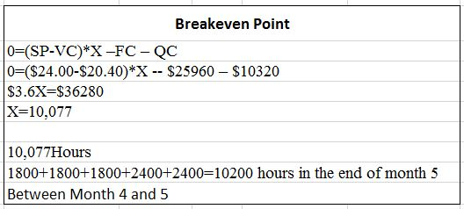
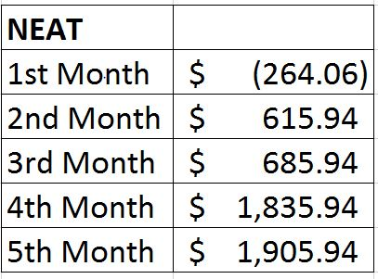
Financials – Breakeven Point
Demand Expected Revenue
1st three month 1800 hours/week………………………..$43,200
Fall/spring semesters 2400 hours/week……………..$57,600
Summer semester 1600 hours/week…………………….$38,400
Reach at end of Month 5

Slide 12
Thank you!

