Slide 1
Corporate Governance
Chapter 2

Slide 2
Learning Objectives
Describe the role and responsibilities of the board of directors in corporate governance
Understand how the composition of a board can affect its operation
Describe the impact of the Sarbanes–Oxley Act on corporate governance in the United States
Discuss trends in corporate governance
Explain how executive leadership is an important part of strategic management
Notes:
After reading this chapter, you should be able to:
Describe the role and responsibilities of the board of directors in corporate governance
Understand how the composition of a board can affect its operation
Describe the impact of the Sarbanes–Oxley Act on corporate governance in the United States
Discuss trends in corporate governance
Explain how executive leadership is an important part of strategic management

Slide 3
Role of the Board of Directors
Corporation
  a mechanism established to allow different parties to contribute capital, expertise and labor for their mutual benefit
The corporation is governed by the board of directors that oversees top management with the concurrence of the shareholders.
Notes:
A corporation is a mechanism established to allow different parties to contribute capital, expertise and labor for their mutual benefit. The board of directors, therefore, has an obligation to approve all decisions that might affect the long-term performance of the corporation. This means that the corporation is fundamentally governed by the board of directors overseeing top management, with the concurrence of the shareholder.

Slide 4
Role of the Board of Directors
Corporate governance
  refers to the relationship among the board of directors, top management and shareholders in determining the direction and performance of the corporation
Notes:
The term corporate governance refers to the relationship among these three groups in determining the direction and performance of the corporation

Slide 5
Responsibilities of the Board
Effective Board Leadership
Strategy of the Organization
Risk vs. Initiative
Succession Planning
Sustainability
Notes:
An article by Spencer Stuart written by an international team of contributors suggested the following five board of director responsibilities:
1. Effective board leadership including the processes, makeup and output of the board
2. Strategy of the organization
3. Risk vs. initiative and the overall risk profile of the organization
4. Succession planning for the board and top management team
5. Sustainability

Slide 6
Responsibilities of the Board
Due care
  the board is required to direct the affairs of the corporation but not to manage them
If a director or the board as a whole fails to act with due care and, as a result, the corporation is in some way harmed, the careless director or directors can be held personally liable for the harm done.
Notes:
In a legal sense, the board is required to direct the affairs of the corporation but not to manage them. It is charged by law to act with due care. If a director or the board as a whole fails to act with due care and, as a result, the corporation is in some way harmed, the careless director or directors can be held personally liable for the harm done.

Slide 7
Role of the Board in
Strategic Management
Monitor developments inside and outside the corporation
Evaluate and Influence management proposals, decisions and actions
Initiate and Determine the corporation’s mission and strategies
Notes:
The role of the board of directors in strategic management is to carry out three basic tasks:
Monitor developments inside and outside the corporation
Evaluate and Influence management proposals, decisions and actions
Initiate and Determine the corporation’s mission and strategies

Slide 8
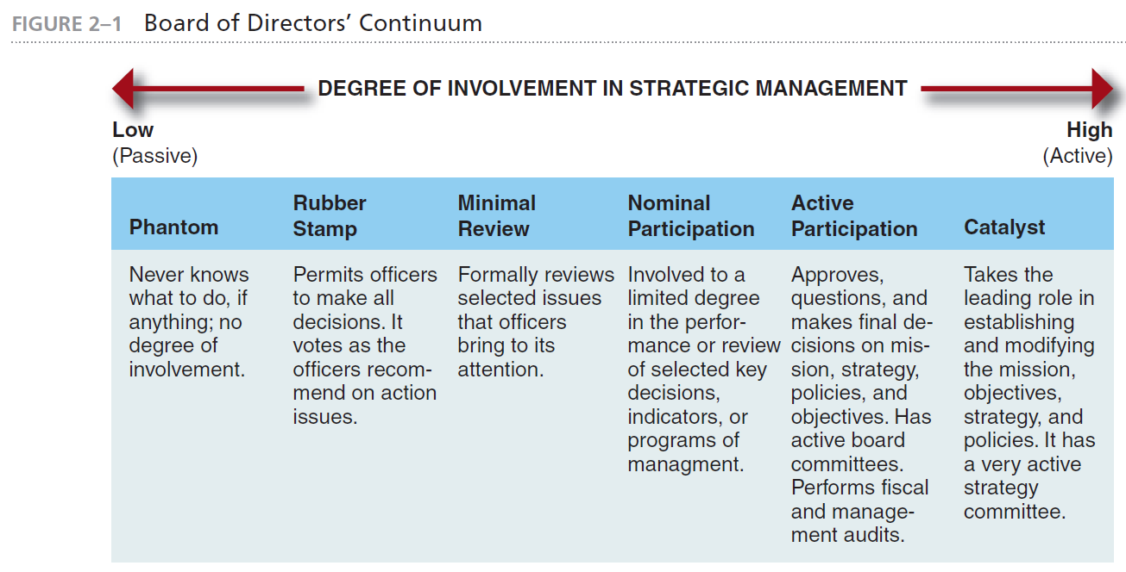
Board of Directors’ Continuum
Notes:
The board of directors’ continuum shown in Figure 2–1 shows the possible degree of involvement (from low to high) in the strategic management process. Boards can range from phantom boards with no real involvement to catalyst boards with a very high degree of involvement.

Slide 9
Members of a Board of Directors
Inside directors
  typically officers or executives employed by the corporation
Outside directors
  may be executives of other firms but are not employees of the board’s corporation
Notes:
Inside directors (sometimes called management directors) are typically officers or executives employed by the corporation. Outside directors (sometimes called
non-management directors) may be executives of other firms but are not employees of the board’s corporation.

Slide 10
Members of a Board of Directors
Agency theory
  states that problems arise in corporations because the agents (top management) are not willing to bear responsibility for their decisions unless they own a substantial amount of stock in the corporation
Notes:
Agency theory states that problems arise in corporations because the agents (top management) are not willing to bear responsibility for their decisions unless they own a substantial amount of stock in the corporation.

Slide 11
Members of a Board of Directors
Stewardship theory
  proposes that, because of their long tenure with the corporation, insiders (senior executives) tend to identify with the corporation and its success
Notes:
Stewardship theory proposes that, because of their long tenure with the corporation, insiders (senior executives) tend to identify with the corporation and its success.

Slide 12
Members of a Board of Directors
Affiliated directors
  not employed by the corporation, handle legal or insurance work
Retired executive directors
  used to work for the corporation, partly responsible for past decisions affecting current strategy
Family directors
  descendants of the founder and own significant blocks of stock
Notes:
Affiliated directors, though not really employed by the corporation, handle the legal or insurance work for the company or are important suppliers (and thus dependent on the current management for a key part of their business). Retired executive directors used to work for the company, such as the past CEO
who is partly responsible for much of the corporation’s current strategy and who probably groomed the current CEO as his or her replacement.
Family directors are descendants of the founder and own significant blocks of stock (with personal agendas based on a family relationship with the current CEO).

Slide 13
Codetermination: Should Employees Serve on Boards?
Codetermination
  the inclusion of a corporation’s workers on its board, began only recently in the United States
Although the movement to place employees on the boards of directors of U.S. companies shows little likelihood of increasing, the European experience reveals an increasing acceptance of worker participation on corporate boards.
Notes:
Codetermination, the inclusion of a corporation’s workers on its board, began only recently in the United States. Although the movement to place employees on the boards of directors of U.S. companies shows little likelihood of increasing (except through employee stock ownership), the European experience reveals an increasing acceptance of worker participation (without ownership) on corporate boards.

Slide 14
Interlocking Directorates
Direct interlocking directorate
  when two firms share a director or when an executive of one firm sits on the board of a second
Indirect interlocking directorate
  when two corporations have directors who serve on the board of a third firm
Notes:
A direct interlocking directorate occurs when two firms share a director or when an executive of one firm sits on the board of a second firm. An indirect interlock occurs when two corporations have directors who also serve on the board of a third firm, such as a bank.

Slide 15
Interlocking Directorates
Interlocking directorates
  useful for gaining both inside information about an uncertain environment and objective expertise about potential strategies and tactics
Notes:
Interlocking directorates are useful for gaining both inside information about an uncertain environment and objective expertise about potential strategies and tactics

Slide 16
Nomination and Election of
Board Members
97% of U.S. boards use nominating committees to identify potential board members
Staggered boards
  only a portion of board members stand for re-election when directors serve more than one year terms
Notes:
Ninety-seven percent of large U.S. corporations now use nominating committees to identify potential directors. This practice is less common in Europe where 60% of boards use nominating committees Many corporations whose directors serve terms of more than one year divide the board into classes and stagger elections so that only a portion of the board stands for election each year. This is called a staggered board.

Slide 17
Nomination and Election of
Board Members
Criteria for a good director include:
  Willingness to challenge management when necessary
  Special expertise that is important to the company
  Available for outside meetings to advise management
  Expertise on global issues
  Understands the firm’s key technologies and processes
Notes:
A survey of directors of U.S. corporations revealed the following criteria in a good director:
■ Willing to challenge management when necessary—95%
■ Special expertise important to the company—67%
■ Available outside meetings to advise management—57%
■ Expertise on global business issues—41%
■ Understands the firm’s key technologies and processes—39%
■ Brings external contacts that are potentially valuable to the firm—33%
■ Has detailed knowledge of the firm’s industry—31%
■ Has high visibility in his or her field—31%
■ Is accomplished at representing the firm to stakeholders—18%

Slide 18
Organization of the Board
The size of a board in the United States is determined by the corporation’s charter and its by- laws, in compliance with state laws.
Although some states require a minimum number of board members, most corporations have quite a bit of discretion in determining board size.
Notes:
The size of a board in the United States is determined by the corporation’s charter and its by-laws, in compliance with state laws.
Although some states require a minimum number of board members, most corporations have quite a bit of discretion in determining board size.

Slide 19
Organization of the Board
The average large, publicly held U.S. firm has 10 directors on its board
The average small, privately-held company has four to five members.
Notes:
The average large, publicly held U.S. firm has 10 directors on its board. The average small, privately-held company has four to five members.

Slide 20
Organization of the Board
Lead director
  consulted by the Chair/CEO regarding board affairs and coordinates the annual evaluation of the CEO
96% of U.S. companies that combine the Chairman and CEO positions had a lead director.
Notes:
Many of those who prefer that the Chairman and CEO positions be combined agree that the outside directors should elect a lead director. This person is consulted by the Chair/CEO regarding board affairs and coordinates the annual evaluation of the CEO. Ninety-six percent of U.S. companies that combine the Chairman and CEO positions had a lead director

Slide 21
Organization of the Board
The most effective boards accomplish much of their work through committees.
Although they do not usually have legal duties, most committees are granted full power to act with the authority of the board between board meetings.
Notes:
The most effective boards accomplish much of their work through committees. Although they do not usually have legal duties, most committees are granted full power to act with the authority of the board between board meetings.

Slide 22
Impact of the Sarbanes–Oxley Act on U.S. Corporate Governance
Sarbanes–Oxley Act
  designed to protect shareholders from excesses and failed oversight of boards of directors
  whistleblower procedures
  improved corporate financial statements
Notes:
In response to the many corporate scandals uncovered since 2000, the U.S. Congress passed the Sarbanes–Oxley Act in June 2002. This act was designed to protect shareholders from the excesses and failed oversight that characterized criminal activities at Enron, Tyco, WorldCom, Adelphia Communications, Qwest, and Global Crossing, among other prominent firms.

Slide 23
Evaluating Governance
S&P Corporate Governance Scoring System
  Ownership Structure and Influence
  Financial Stakeholder Rights and Relations
  Financial Transparency and Information Disclosure
  Board Structure and Processes
Notes:
The S&P Corporate Governance Scoring System researches four major issues:
■ Ownership Structure and Influence
■ Financial Stakeholder Rights and Relations
■ Financial Transparency and Information Disclosure
■ Board Structure and Processes

Slide 24
Avoiding Governance Improvements
Multiple classes of stock
Public to private ownership
Controlled companies
Notes:
A number of corporations are concerned that various requirements to improve corporate governance will constrain top management’s ability to effectively manage the company. Some examples are:
• Multiple classes of stock
• Public to private ownership
• Controlled companies

Slide 25
Trends in Corporate Governance
Boards shaping company strategy
Institutional investors active on boards
Shareholder demands that directors and top management own significant stock
More involvement of non-affiliated outside directors
Increased representation of women and minorities
Notes:
Some trends in corporate governance are:
• Boards shaping company strategy
• Institutional investors active on boards
• Shareholder demands that directors and top management own significant stock
• More involvement of non-affiliated outside directors
• Increased representation of women and minorities

Slide 26
Trends in Corporate Governance
Boards evaluating individual directors
Smaller boards
Splitting the Chairman and CEO positions
Shareholders may begin to nominate board members
Society expects boards to balance profitability with social needs of society
Notes:
Some other trends in corporate governance are:
• Boards evaluating individual directors
• Smaller boards
• Splitting the Chairman and CEO positions
• Shareholders may begin to nominate board members
• Society expects boards to balance profitability with social needs of society

Slide 27
The Role of Top Management
Top management responsibilities
  involve getting things accomplished through and with others in order to meet the corporate objectives.
  are multidimensional and are oriented toward the welfare of the total organization
Notes:
Top management responsibilities, especially those of the CEO, involve getting things accomplished through and with others in order to meet the corporate objectives. Top management’s job is thus multidimensional and is oriented toward the welfare of the total organization.

Slide 28
Executive Leadership and
Strategic Vision
Executive leadership
  the directing of activities toward the accomplishment of corporate objectives, sets the tone for the entire corporation
Strategic vision
  description of what the company is capable of becoming
Notes:
Executive leadership is the directing of activities toward the accomplishment of corporate objectives. Executive leadership is important because it sets the tone for the entire corporation.
A strategic vision is a description of what the company is capable of becoming.

Slide 29
Executive Leadership and
Strategic Vision
Transformational leaders
  provide change and movement in an organization by providing a vision for that change
Notes:
Successful CEOs are noted for having a clear strategic vision, a strong passion for their company, and an ability to communicate with others. They have many of the characteristics of transformational leaders—that is, leaders who provide change and movement in an organization by providing a vision for that change

Slide 30
Executive Leadership and
Strategic Vision
Characteristics of effective CEOs include:
The CEO articulates a strategic vision for the corporation.
The CEO presents a role for others to identify with and to follow.
The CEO communicates high performance standards and also show confidence in the followers’ abilities to meet these standards.
Notes:
Many transformational leaders have been able to command respect and execute effective strategy formulation and implementation because they have exhibited three key characteristics:
The CEO articulates a strategic vision for the corporation.
The CEO presents a role for others to identify with and to follow.
The CEO communicates high performance standards and also show confidence in the followers’ abilities to meet these standards.

Slide 31
Managing the
Strategic Planning Process
Strategic planning staff
  charged with supporting both top management and the business units in the strategic planning process
Notes:
Many large organizations have a strategic planning staff charged with supporting both top management and the business units in the strategic planning process.

Slide 32
Managing the
Strategic Planning Process
Strategic planning staff responsibilities include:
Identify and analyze company-wide strategic issues, and suggest corporate strategic alternatives to top management
Work as facilitators with business units to guide them through the strategic planning process
Notes:
The staff’s major responsibilities are to:
1. Identify and analyze companywide strategic issues, and suggest corporate strategic alternatives to top management
2. Work as facilitators with business units to guide them through the strategic planning process

Slide 33


