Slide 1
Environmental Scanning and Industry Analysis
Chapter 4

Slide 2
Learning Objectives
Recognize aspects of an organization’s environment that can influence its long-term decisions
Identify the aspects of an organization’s environment that are most strategically important
Conduct an industry analysis to understand the competitive forces that influence the intensity of rivalry within an industry
Understand how industry maturity affects industry competitive forces
Categorize international industries based on their pressures for coordination and local responsiveness
Notes:
After reading this chapter, you should be able to:
• Recognize aspects of an organization’s environment that can influence its long-term decisions
• Identify the aspects of an organization’s environment that are most strategically important
• Conduct an industry analysis to understand the competitive forces that influence the intensity of rivalry within an industry
• Understand how industry maturity affects industry competitive forces
• Categorize international industries based on their pressures for coordination and local responsiveness

Slide 3
Learning Objectives
Construct strategic group maps to assess the competitive positions of firms in an industry
Identify key success factors and develop an industry matrix
Use publicly available information to conduct competitive intelligence
Know how to develop an industry scenario
Be able to construct an EFAS Table that summarizes external environmental factors
Notes:
After reading this chapter, you should be able to:
• Construct strategic group maps to assess the competitive positions of firms in an industry
• Identify key success factors and develop an industry matrix
• Use publicly available information to conduct competitive intelligence
• Know how to develop an industry scenario
• Be able to construct an EFAS Table that summarizes external environmental factors

Slide 4
Environmental Scanning
Environmental scanning
the monitoring, evaluation, and dissemination of information relevant to the organizational development of strategy
Notes:
Environmental scanning is the monitoring, evaluation and dissemination of information relevant to the organizational development of strategy

Slide 5
Identifying External Environmental Variables
Natural environment
includes physical resources, wildlife and climate that are an inherent part of existence on Earth
form an ecological system of interrelated life
Notes:
The natural environment includes physical resources, wildlife and climate that are an inherent part of existence on Earth. These factors form an ecological system of interrelated life.

Slide 6
Identifying External Environmental Variables
Societal environment
mankind’s social system that includes general forces that do not directly touch on the short-run activities of the organization, but that can influence its long-term decisions
economic, technological, political-legal and sociocultural
Notes:
The societal environment is mankind’s social system that includes general forces that do not directly touch on the short-run activities of the organization, but that can influence its long-term decisions. These factors affect multiple industries and are as follows: economic, technological, political-legal and sociocultural.

Slide 7
Identifying External Environmental Variables
Task environment
those elements or groups that directly affect a corporation and, in turn, are affected by it
government, local communities, suppliers, competitors, customers, creditors, unions, special interest groups/trade associations
Notes:
The task environment includes those elements or groups that directly affect a corporation and, in turn, are affected by it. These are governments, local communities, suppliers, competitors, customers, creditors, employees/labor unions, special-interest groups and trade associations.

Slide 8
Identifying External Environmental Variables
Industry analysis
an in-depth examination of key factors within a corporation’s task environment
Notes:
Industry analysis is an in-depth examination of key factors within a corporation’s task environment.

Slide 9
Scanning the Societal Environment: STEEP Analysis
STEEP Analysis
monitoring trends in the societal and natural environments
sociocultural, technological, economic, ecological and political-legal forces
Notes:
This scanning can be called STEEP Analysis, the scanning of sociocultural, technological, economic, ecological, and political–legal environmental forces.

Slide 10
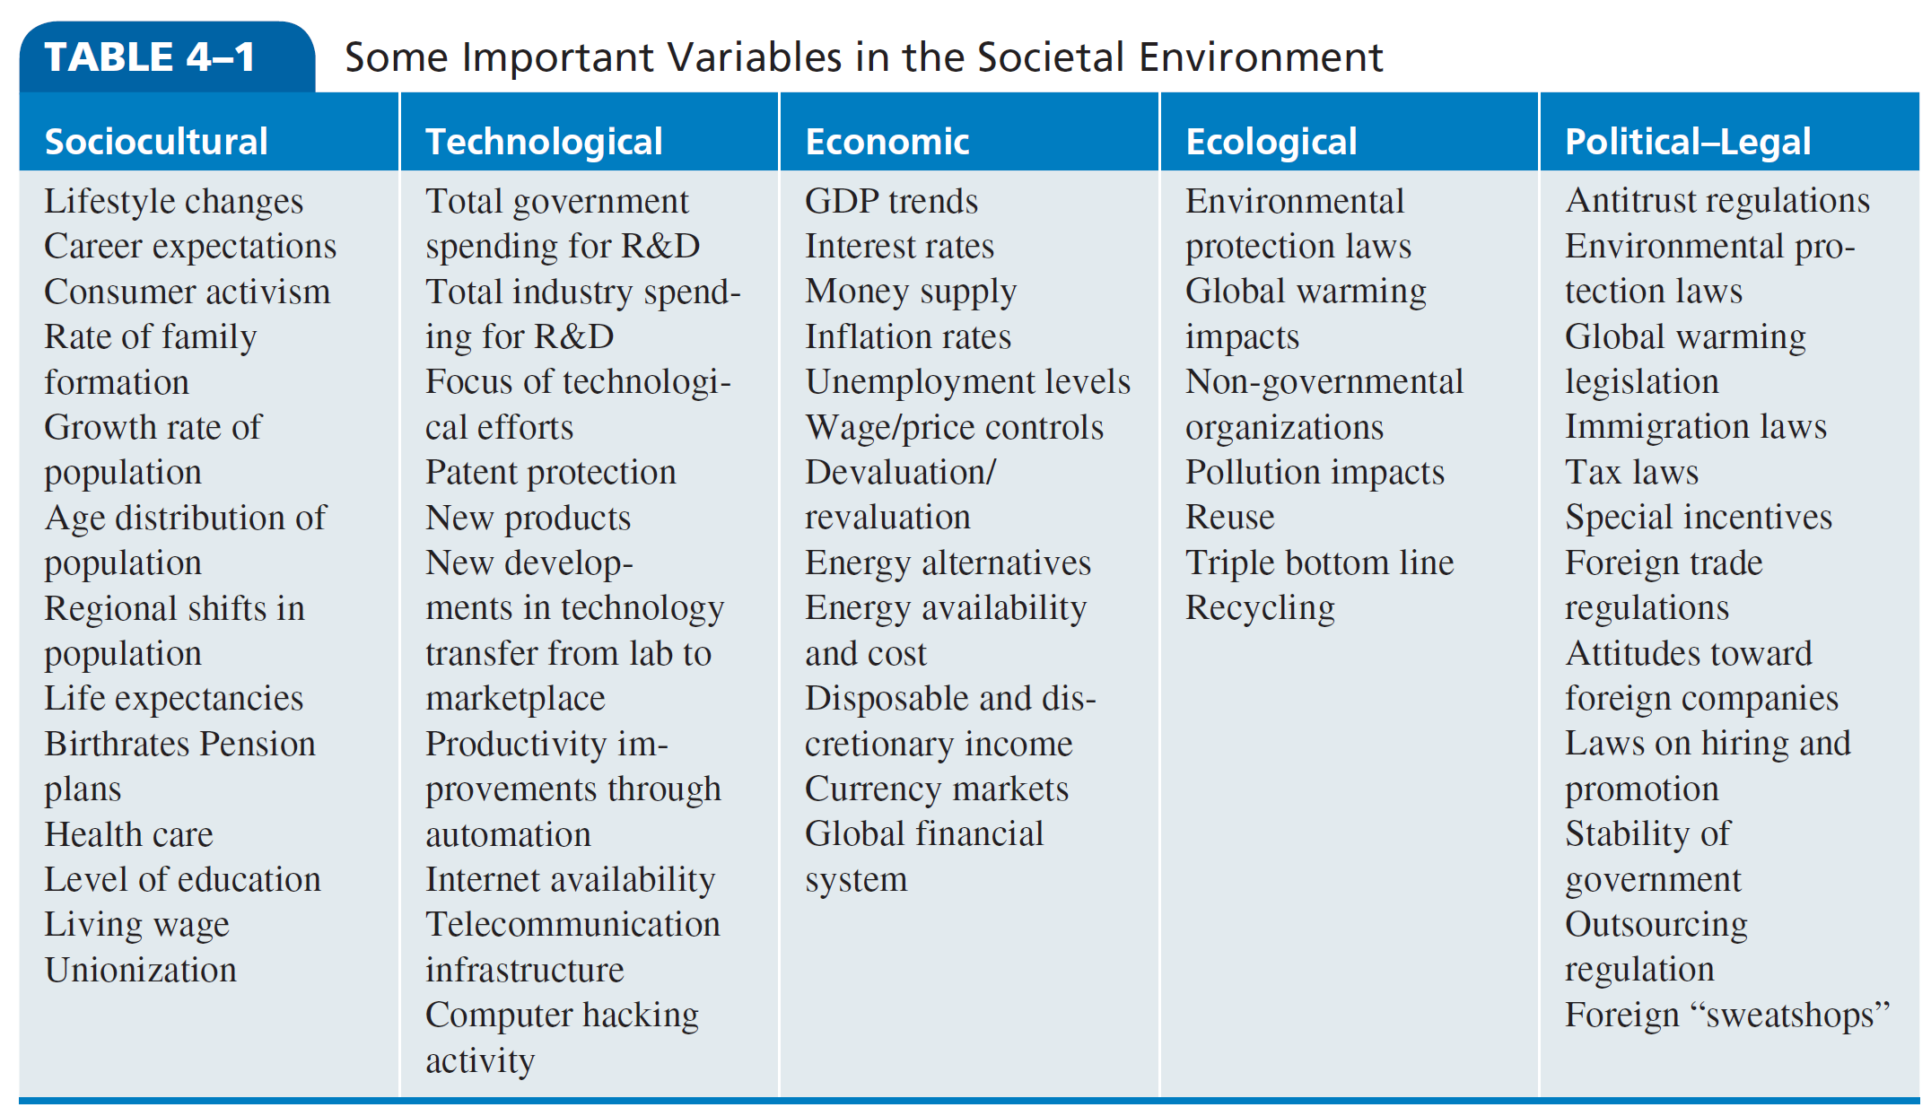
Some Important Variables in the Societal Environment
Notes:
As shown in Table 4–1, large corporations categorize the natural and societal environments in any one geographic region into five areas and focus their scanning in each area on trends that have corporatewide relevance.

Slide 11
Current U.S. Generations
Notes:
For example, the demographic bulge in the U.S. population caused by the baby boom after WWII continues to affect market demand in many industries. This group of 77 million people now in their 50s and 60s is the largest age group in all developed countries, especially in Europe. (See Table 4–2.)

Slide 12
Current Sociocultural Trends
Increasing environmental awareness
Growing health consciousness
Expanding seniors market
Impact of Millennials
Notes:
Eight current sociocultural trends are transforming North America and the rest of the world:
• Increasing environmental awareness
• Growing health consciousness
• Expanding seniors market
• Impact of Millennials

Slide 13
Current Sociocultural Trends
Declining mass market
Changing pace and location of life
Changing household composition
Increasing diversity of workforce and markets
Notes:
The others are:
• Declining mass market
• Changing pace and location of life
• Changing household composition
• Increasing diversity of workforce and markets

Slide 14
Technological Breakthroughs
Portable information devices
Electronic networking
Alternative energy sources
Precision farming
Virtual personal assistants
Genetically altered organisms
Smart, mobile robots
Notes:
Researchers at George Washington University have identified a number of technological breakthroughs that are already having a significant impact on many industries:
• Portable information devices and electronic networking
• Alternative energy sources
• Precision farming
• Virtual personal assistants
• Genetically altered organisms
• Smart, mobile robots

Slide 15
Categories of Risk
Regulatory risk
Supply chain risk
Product and technology risk
Litigation risk
Reputational risk
Physical risk
Notes:
The effects of climate change on companies can be grouped into six categories of risks: regulatory, supply chain, product and technology, litigation, reputational and physical.

Slide 16
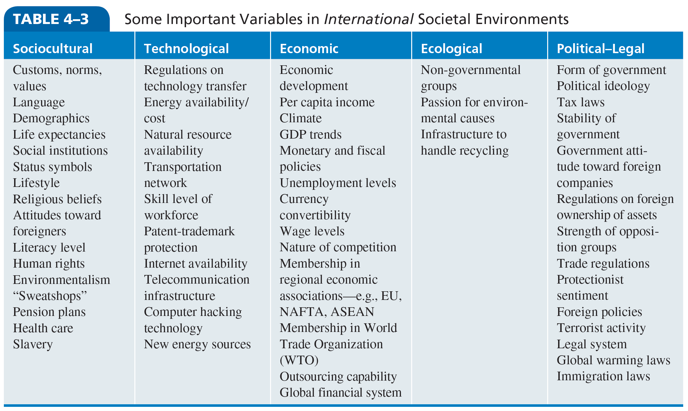
Some Important Variables in International Societal Environments
Notes:
To account for the many differences among societal environments from one country to another, consider Table 4–3. It includes a list of economic, technological, political–legal and sociocultural variables for any particular country or region.

Slide 17
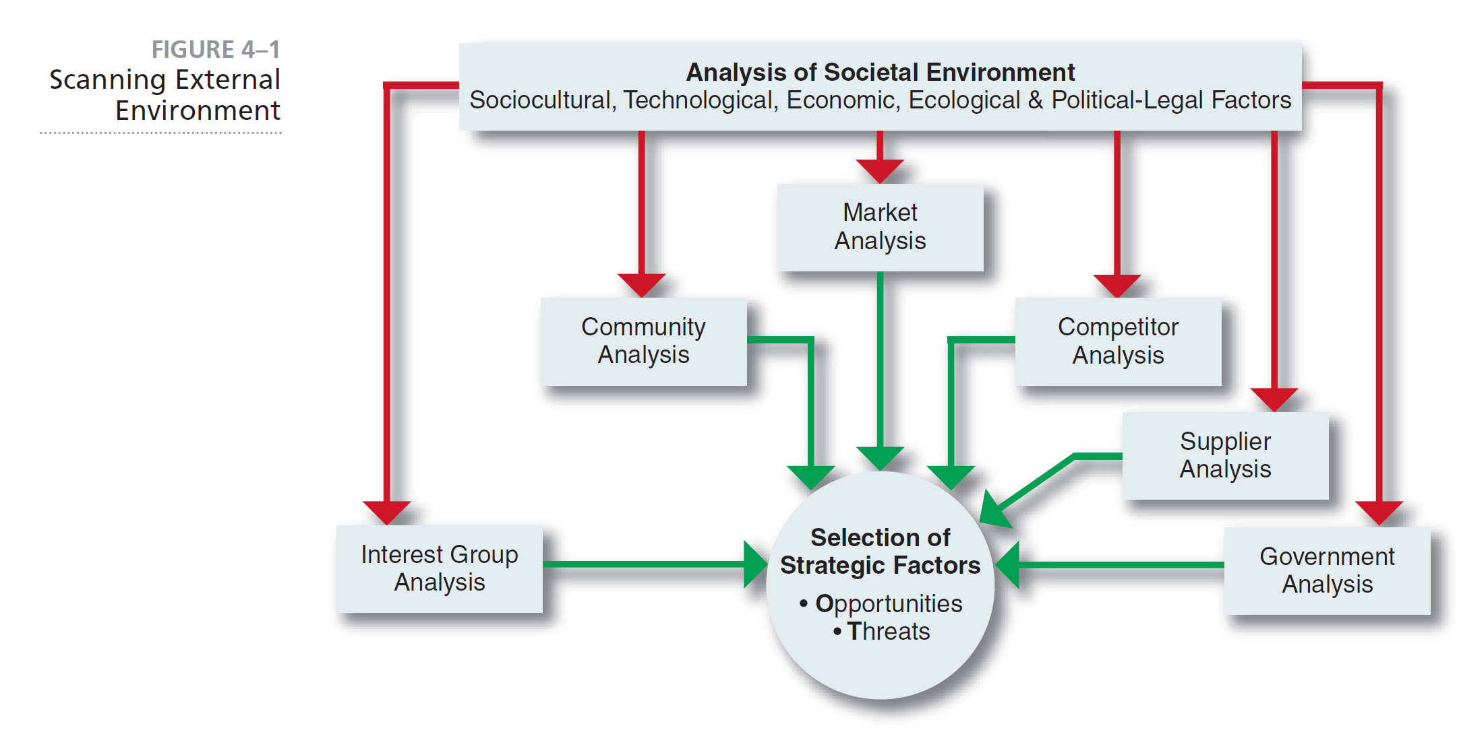
Scanning External Environment
Notes:
As shown in Figure 4–1, a corporation’s scanning of the environment includes analyses of all the relevant elements in the task environment.

Slide 18
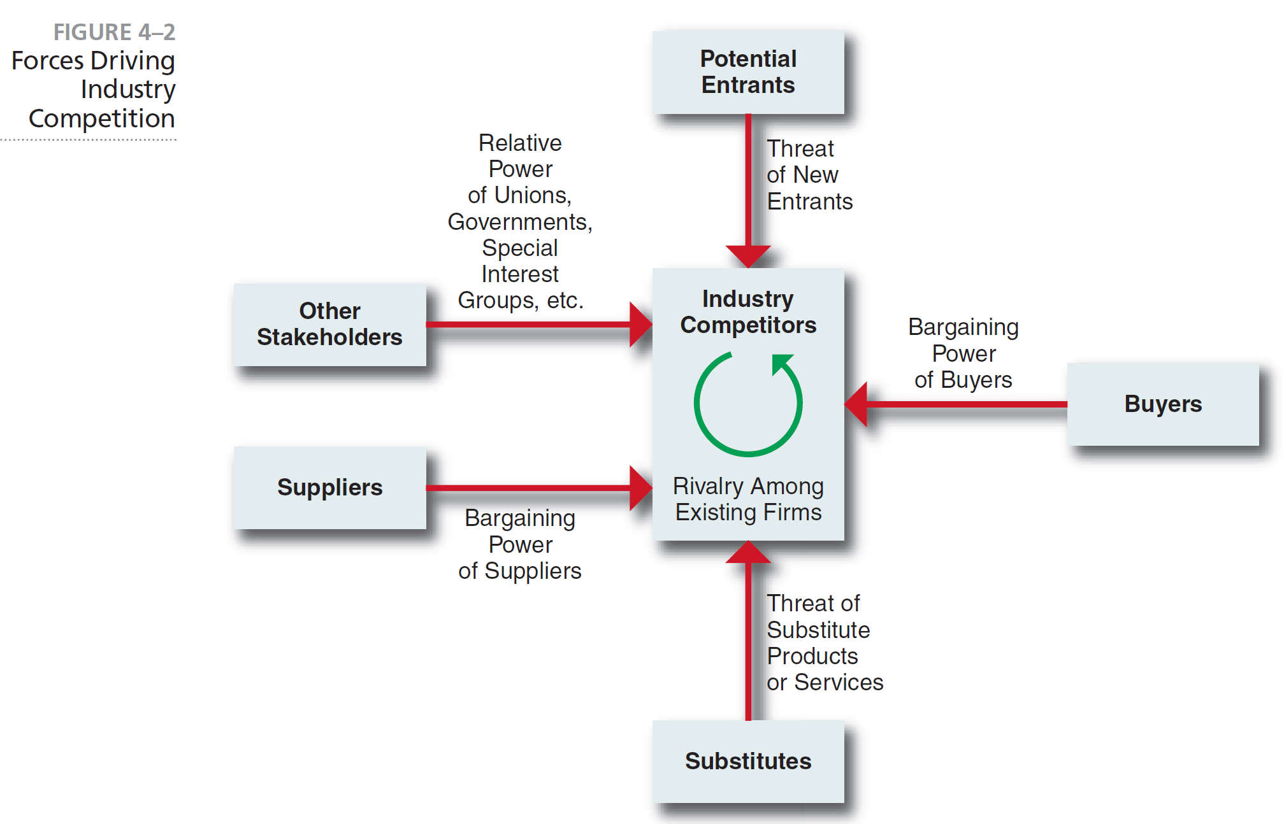
Forces Driving Industry Competition
Notes:
Michael Porter, an authority on competitive strategy, contends that a corporation is most concerned with the intensity of competition within its industry. The level of this intensity is determined by basic competitive forces, as depicted in Figure 4–2.

Slide 19
Threat of New Entrants
Threat of new entrants
new entrants to an industry bring new capacity, a desire to gain market share and substantial resources
Entry barrier
an obstruction that makes it difficult for a company to enter an industry
Notes:
New entrants to an industry typically bring to it new capacity, a desire to gain market share and potentially substantial resources.
An entry barrier is an obstruction that makes it difficult for a company to enter an industry.

Slide 20
Barriers to Entry
Economies of scale
Product differentiation
Capital requirements
Switching costs
Access to distribution channels
Cost disadvantages due to size
Government policies
Notes:
Some of the possible barriers to entry are:
• Economies of scale
• Product differentiation
• Capital requirements
• Switching costs
• Access to distribution channels
• Cost disadvantages due to size
• Government policies

Slide 21
Rivalry among Existing Firms
In most industries, corporations are mutually dependent.
A competitive move by one firm can be expected to have a noticeable effect on its competitors and thus may cause retaliation.
Notes:
In most industries, corporations are mutually dependent. A competitive move by one firm can be expected to have a noticeable effect on its competitors and thus may cause retaliation.

Slide 22
Rivalry among Existing Firms
Number of competitors
Rate of industry growth
Product or service characteristics
Amount of fixed costs
Capacity
Height of exit barriers
Diversity of rivals
Notes:
According to Porter, intense rivalry is related to the presence of several factors, including:
• Number of competitors
• Rate of industry growth
• Product or service characteristics
• Amount of fixed costs
• Capacity
• Height of exit barriers
• Diversity of rivals

Slide 23
Threat of Substitute Products or Services
Substitute product
a product that appears to be different but can satisfy the same need as another product
The identification of possible substitute products means searching for products that can perform the same function, even though they have a different appearance.
Notes:
A substitute product is a product that appears to be different but can satisfy the same need as another product. The identification of possible substitute products or services means searching for products or services that can perform the same function, even though they have a different appearance and may not appear to be easily substitutable.

Slide 24
The Bargaining Power of Buyers
Bargaining power of buyers
ability of buyers to force prices down, bargain for higher quality and play competitors against each other
Large purchases, backward integration, alternative suppliers, low cost to change suppliers, product represents a high percentage of buyer’s cost, buyer earns low profits, product is unimportant to buyer
Notes:
Buyers affect an industry through their ability to force down prices, bargain for higher quality or more services and play competitors against each other. A buyer or a group of buyers is powerful if some of the following factors hold true: large purchases, backward integration, alternative suppliers, low cost to change suppliers, product represents a high percentage of buyer’s cost, buyer earns low profits and product is unimportant to buyer.

Slide 25
The Bargaining Power of Suppliers
Buyers affect an industry through their ability to force down prices, bargain for higher quality or more services and play competitors against each other.
Notes:
Buyers affect an industry through their ability to force down prices, bargain for higher quality or more services and play competitors against each other.

Slide 26
The Bargaining Power of Suppliers
A buyer or a group of buyers is powerful if some of the following factors hold true:
Industry is dominated by a few companies
Unique product or service
Substitutes are not readily available
Ability to forward integrate
Unimportance of product or service to the industry
Notes:
A buyer or a group of buyers is powerful if some of the following factors hold true:
• Industry is dominated by a few companies
• Unique product or service
• Substitutes are not readily available
• Ability to forward integrate
• Unimportance of product or service to the industry

Slide 27
Relative Power of Other Stakeholders
Government
Local communities
Creditors
Trade associations
Special interest groups
Unions
Shareholders
Notes:
A sixth force should be added to Porter’s list to include a variety of stakeholder groups from the task environment.
Some of these groups are:
• Government
• Local communities
• Creditors
• Trade associations
• Special interest groups
• Unions
• Shareholders

Slide 28
Industry Evolution
Fragmented industry
no firm has a large market share and each firm only serves a small piece of the total market in competition with other firms
Consolidated industry
domination by a few large firms, each struggles to differentiate products from its competition
Notes:
A fragmented industry is one where no firm has large market share, and each firm serves only a small piece of the total market in competition with
others (for example, cleaning services).
A consolidated industry is one dominated by a few large firms, each of which struggles
to differentiate its products from those of the competition

Slide 29
Categorizing International Industries
Multi-domestic industries
specific to each country or group of countries
Global industries
operate worldwide with multinational companies making only small adjustments for country-specific circumstances
Regional industries
multinational companies primarily coordinate their activities within regions
Notes:
Multidomestic industries are specific to each country or group of countries. This type of international industry is a collection of essentially domestic industries, such as retailing and insurance. Global industries, in contrast, operate worldwide, with MNCs making only small adjustments for country-specific circumstances. Regional industries are those in which MNCs primarily coordinate their activities within regions, such as the Americas or Asia.

Slide 30
Continuum of International Industries
Notes:
According to Porter, worldwide industries vary on a continuum from multi-domestic to global (see Figure 4–3).

Slide 31
Strategic Groups
Strategic group
a set of business units or firms that pursue similar strategies with similar resources
Notes:
A strategic group is a set of business units or firms that “pursue similar strategies with similar resources.”

Slide 32
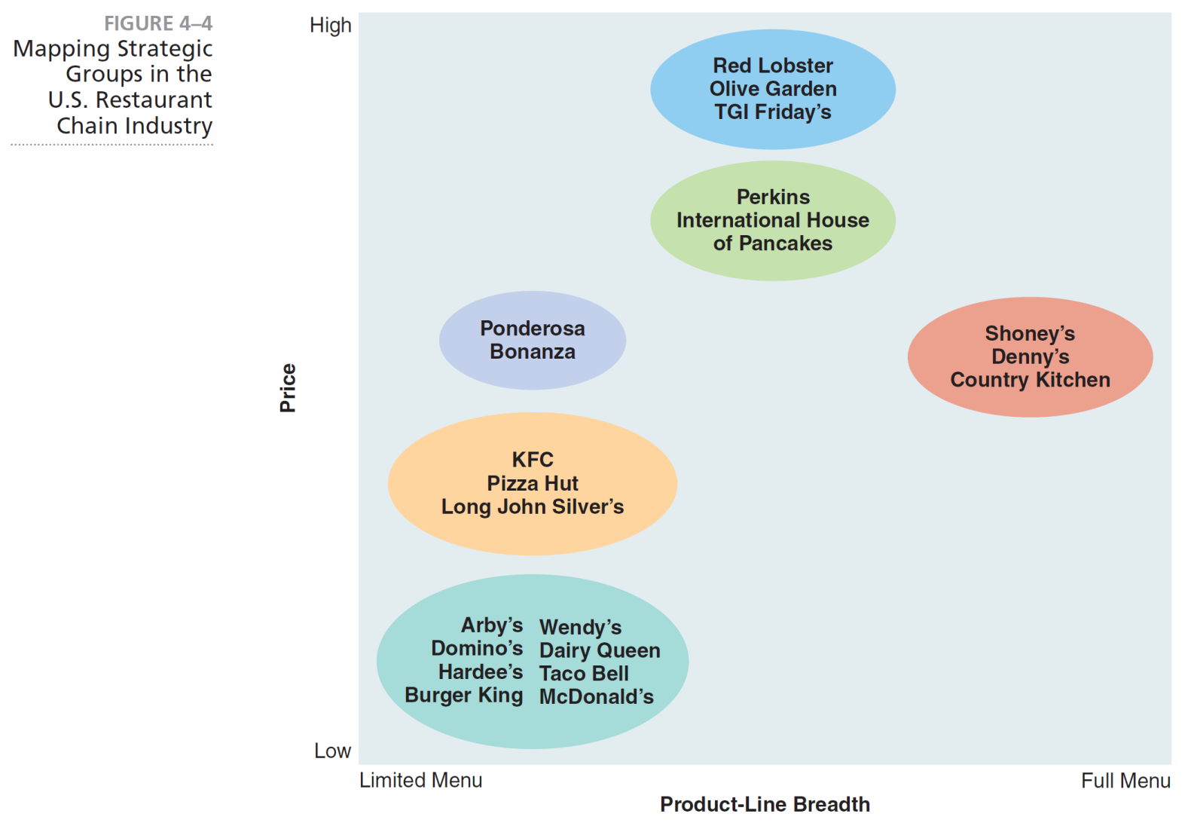
Mapping Strategic Groups in the U.S. Restaurant Chain Industry
Notes:
Strategic groups in a particular industry can be mapped by plotting the market positions of industry competitors on a two-dimensional graph, using two strategic variables as the vertical and horizontal axes (see Figure 4–4).

Slide 33
Strategic Types
Defenders
focus on improving efficiency
Prospectors
focus on product innovation and market opportunities
Analyzers
focus on at least two different product market areas
Reactors
lack a consistent strategy-structure-culture relationship
Notes:
These general types have the following characteristics:
Defenders are companies with a limited product line that focus on improving the efficiency of their existing operations.
Prospectors are companies with fairly broad product lines that focus on product innovation and market opportunities.
Analyzers are corporations that operate in at least two different product-market areas, one stable and one variable.
Reactors are corporations that lack a consistent strategy-structure-culture relationship.

Slide 34
Hypercompetition
Market stability is threatened by short product life cycles, short product design cycles, new technologies, frequent entry by unexpected outsiders, repositioning by incumbents and tactical redefinitions of market boundaries as diverse industries merge.
Notes:
Market stability is threatened by short product life cycles, short product design cycles, new technologies, frequent entry by unexpected outsiders, repositioning by incumbents and tactical redefinitions of market boundaries as diverse industries merge.

Slide 35
Using Key Success Factors to Create an Industry Matrix
Key success factors
variables that can significantly affect the overall competitive positions of companies within any particular industry
Notes:
Key success factors are variables that can significantly affect the overall competitive positions of companies within any particular industry.

Slide 36
Industry Matrix
Industry matrix
summarizes the key success factors within a particular industry
Notes:
As shown in Table 4–4, the matrix gives a weight for each factor based on how important that factor is for success within the industry. The matrix also specifies how well various competitors in the industry are responding to each factor.

Slide 37
Competitive Intelligence
Competitive intelligence
a formal program of gathering information on a company’s competitors
also called business intelligence
Sources of competitive intelligence:
Information brokers
Internet
Industrial espionage
Investigatory services
Notes:
Competitive intelligence is a formal program of gathering information on a company’s competitors. Often called business intelligence, it is one of the fastest growing fields within strategic management. Sources of competitive intelligence are:
• Information brokers
• Internet
• Industrial espionage
• Investigatory services

Slide 38
Useful Forecasting Techniques
Extrapolation
Brainstorming
Expert opinion
Delphi technique
Statistical modeling
Prediction markets
Cross impact analysis
Notes:
Some useful forecasting techniques are:
• Extrapolation
• Brainstorming
• Expert opinion
• Delphi technique
• Statistical modeling
• Prediction markets
• Cross impact analysis

Slide 39
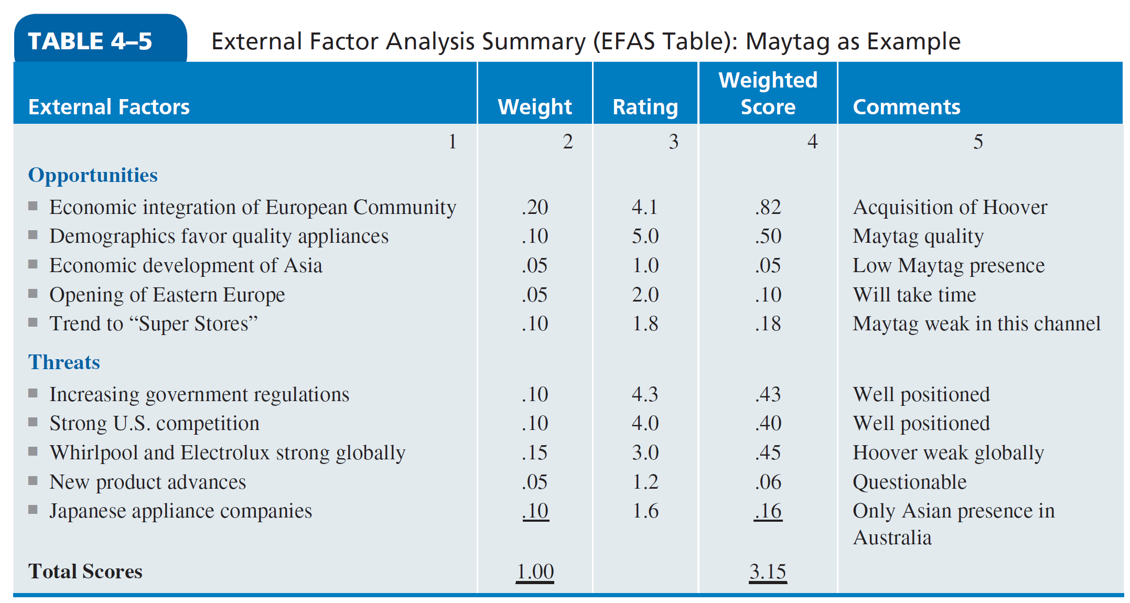
Synthesis of External Factors—EFAS
Notes:
After strategic managers have scanned the natural, societal and task environments and identified a number of likely external factors for their particular corporation, they may want to refine their analysis of these factors by using a form such as that given in Table 4–5.

