Slide 1
Strategy Formulation: Situation Analysis and Business Strategy
Chapter 6

Slide 2
Learning Objectives
Organize environmental and organizational information using a SWOT approach and the SFAS matrix
Understand the competitive and cooperative strategies available to corporations
List the competitive tactics that would accompany competitive strategies
Identify the basic types of strategic alliances
Notes:
After reading this chapter, you should be able to:
• Organize environmental and organizational information using a SWOT approach and the SFAS matrix
• Understand the competitive and cooperative strategies available to corporations
• List the competitive tactics that would accompany competitive strategies
• Identify the basic types of strategic alliances

Slide 3
Situational Analysis: SWOT Approach
Strategy formulation
concerned with developing a corporation’s mission, objectives, strategies and policies
Situation analysis
the process of finding a strategic fit between external opportunities and internal strengths while working around external and internal weaknesses
Notes:
Strategy formulation, often referred to as strategic planning or long-range planning, is concerned with developing a corporation’s mission, objectives, strategies and policies. It begins with situation analysis: the process of finding a strategic fit between external opportunities and internal strengths while working around external threats and internal weaknesses.

Slide 4
Situational Analysis: SWOT Approach
SWOT
acronym used to describe the particular Strengths, Weaknesses, Opportunities and Threats that are potential strategic factors for a specific company
Strategy = opportunity/capacity
Opportunity has no real value unless a company has the capacity to take advantage of that opportunity.
Notes:
SWOT is an acronym used to describe the particular Strengths, Weaknesses, Opportunities and Threats that are potential strategic factors for a specific company. It can be said that the essence of strategy is opportunity divided by capacity. An opportunity by itself has no real value unless a company has the capacity (i.e., resources) to take advantage of that opportunity.

Slide 5
Criticisms of SWOT analysis
It is simply the opinions of those filling out the boxes.
Virtually everything that is a strength is also a weakness.
Virtually everything that is an opportunity is also a threat.
Adding layers of effort does not improve the validity of the list.
Notes:
SWOT, by itself, is just a start to a strategic analysis. Some of the primary criticisms of SWOT are:
■ It is simply the opinions of those filling out the boxes.
■ Virtually everything that is a strength is also a weakness.
■ Virtually everything that is an opportunity is also a threat.
■ Adding layers of effort does not improve the validity of the list.

Slide 6
Criticisms of SWOT analysis
It uses a single point in time approach.
There is no tie to the view from the customer.
There is no validated evaluation approach.
Notes:
■ It uses a single point in time approach.
■ There is no tie to the view from the customer.
■ There is no validated evaluation approach.

Slide 7
Generating a Strategic Factors Analysis Summary (SFAS) Matrix
SFAS (Strategic Factors Analysis Summary) Matrix
summarizes an organization’s strategic factors by combining the external factors from the EFAS Table with the internal factors from the IFAS Table
Notes:
The SFAS (Strategic Factors Analysis Summary) Matrix summarizes an organization’s strategic factors by combining the external factors from the EFAS Table
with the internal factors from the IFAS Table.

Slide 8
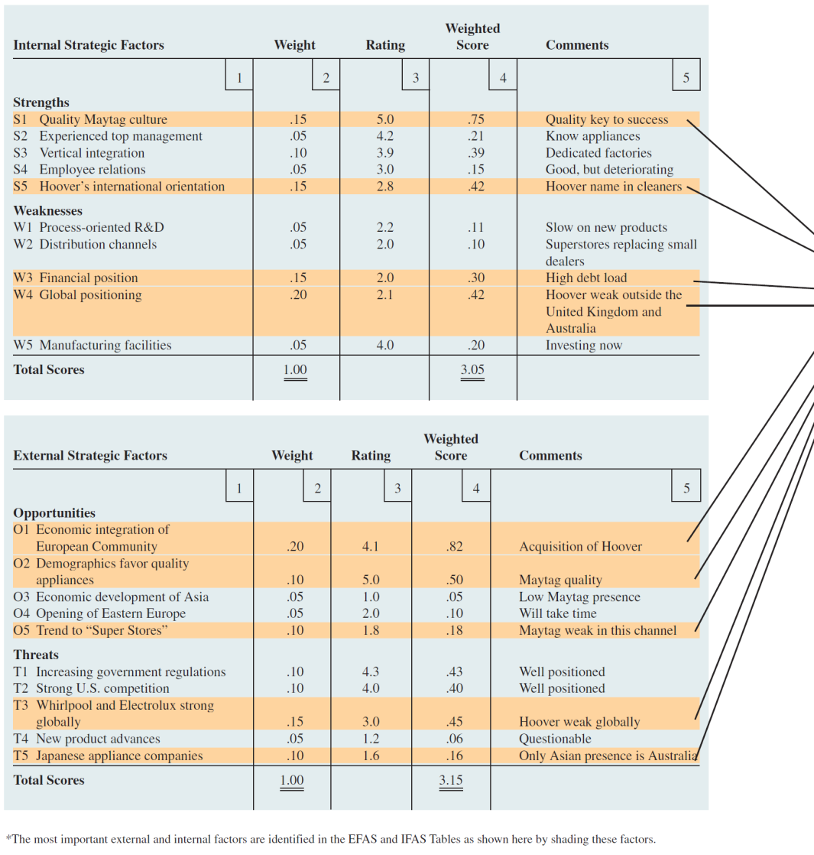
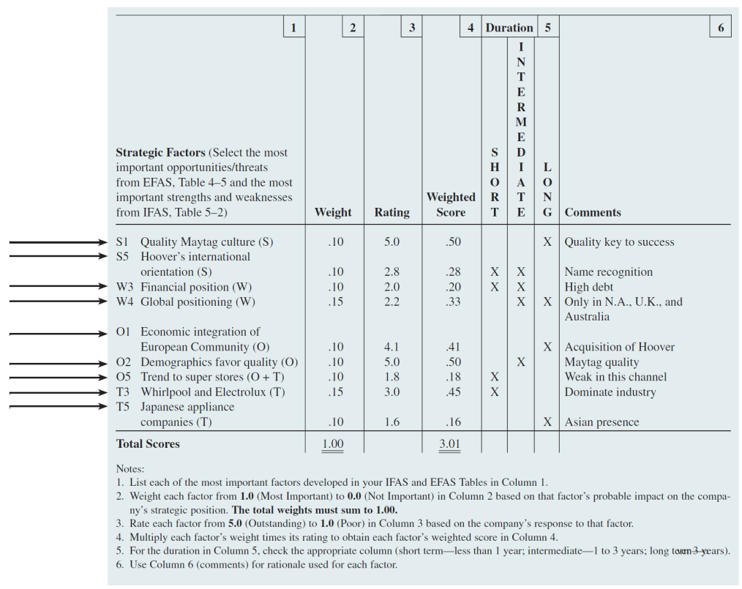
Strategic Factor Analysis Summary (SFAS) Matrix
Notes:
The example given in Figure 6–1 is for Maytag Corporation in 1995, before the firm sold its European and Australian operations and it was acquired by Whirlpool. The SFAS Matrix includes only the most important factors gathered from environmental scanning, and thus provides information that is essential for strategy formulation.

Slide 9
Finding a Propitious Niche
Propitious niche
so well-suited to the firm’s internal and external environment that other corporations are not likely to challenge or dislodge it
Strategic window
a unique market opportunity that is available for a particular time
Notes:
A niche is a need in the marketplace that is currently unsatisfied. The goal is to find a propitious niche—an extremely favorable niche—that is so well-suited to the firm’s internal and external environment that other corporations are not likely to challenge or dislodge it. A firm’s management must continually look for a strategic window—that is, a unique market opportunity that is available only for a particular time.

Slide 10
Review of Mission and Objectives
A re-examination of an organization’s current mission and objectives must be made before alternative strategies can be generated and evaluated.
Performance problems can derive from inappropriate (narrow or too broad) mission statements and objectives.
Notes:
A re-examination of an organization’s current mission and objectives must be made before alternative strategies can be generated and evaluated.
Performance problems can derive from inappropriate (narrow or too broad) mission statements and objectives.

Slide 11
Business Strategies
Business strategy
focuses on improving the competitive position of a company’s or business unit’s products or services within the specific industry or market segment that the company or business unit serves
competitive, cooperative
Notes:
Business strategy focuses on improving the competitive position of a company’s or business unit’s products or services within the specific industry or market segment that the company or business unit serves.

Slide 12
Porter’s Competitive Strategies
Competitive strategy raises the following questions:
Should we compete on the basis of lower cost (and thus price), or should we differentiate our products or services on some basis other than cost, such as quality or service?
Notes:
Competitive strategy raises the following questions:
Should we compete on the basis of lower cost (and thus price), or should we differentiate
our products or services on some basis other than cost, such as quality or service?

Slide 13
Porter’s Competitive Strategies
Should we compete head to head with our major competitors for the biggest but most sought-after share of the market, or should we focus on a niche in which we can satisfy a less sought-after but also profitable segment of the market?
Notes:
Should we compete head to head with our major competitors for the biggest but most sought-after share of the market, or should we focus on a niche in which we can satisfy a less sought-after but also profitable segment of the market?

Slide 14
Porter’s Competitive Strategies
Cost leadership
ability of a company or a business unit to design, produce and market a comparable product more efficiently than its competitors
Differentiation
ability of a company to provide unique and superior value to the buyer in terms of product quality, special features or after-sale service
Notes:
Michael Porter proposed three “generic” competitive strategies for outperforming other corporations in a particular industry: overall cost leadership, differentiation and focus.
Cost leadership is the ability of a company or a business unit to design, produce and market a comparable product more efficiently than its competitors.
Differentiation is the ability of a company to provide unique and superior value to the buyer in terms of product quality, special features or after-sale service.

Slide 15
Porter’s Competitive Strategies
Focus
ability of a company to provide unique and superior value to a particular buyer group, segment of the market line or geographic market
Notes:
Focus is the ability of a company to provide unique and superior value to a particular buyer group, segment of the market line or geographic market.

Slide 16
Porter’s Competitive Strategies
Porter proposed that a firm’s competitive advantage in an industry is determined by its competitive scope—that is, the breadth of the company’s or business unit’s target market.
Notes:
Porter proposed that a firm’s competitive advantage in an industry is determined by its competitive scope—that is, the breadth of the company’s or business unit’s target market.

Slide 17
Porter’s Competitive Strategies
Cost leadership
lower-cost competitive strategy that aims at the broad mass market and requires “aggressive construction of efficient-scale facilities, vigorous pursuit of cost reductions from experience, tight cost and overhead control, avoidance of marginal customer accounts, and cost minimization”
Provides a defense against rivals
Provides a barrier to entry
Generates increased market share
Notes:
Cost leadership is a lower-cost competitive strategy that aims at the broad mass market and requires “aggressive construction of efficient-scale facilities, vigorous pursuit of cost reductions from experience, tight cost and overhead control, avoidance of marginal customer accounts, and cost minimization.”
Because of its lower costs, the cost leader is able to charge a lower price for its products than its competitors and still make a satisfactory profit.
Having a lower-cost position also gives a company or business unit a defense against rivals. Its lower costs allow it to continue to earn profits during times of heavy
competition. Its high market share means that it will have high bargaining power relative to its suppliers (because it buys in large quantities). Its low price will also serve as a barrier to entry because few new entrants will be able to match the leader’s cost advantage. As a result, cost leaders are likely to earn above-average returns on investment.

Slide 18
Porter’s Competitive Strategies
Differentiation
involves the creation of a product or service that is perceived throughout the industry as unique.
can be associated with design, brand image, technology, features, dealer network or customer service
Lowers customers sensitivity to price
Increases buyer loyalty
Can generate higher profits
Notes:
Differentiation is aimed at the broad mass market and involves the creation of a product or service that is perceived throughout its industry as unique.
This specialty can be associated with design or brand image, technology, features, a dealer network or customer service.
Differentiation is a viable strategy for earning above-average returns in a specific business because the resulting brand loyalty lowers customers’ sensitivity to price. Increased costs can usually be passed on to the buyers. Buyer loyalty also serves as an entry barrier; new firms must develop their own distinctive competence to differentiate their products in some way in order to compete successfully.

Slide 19
Porter’s Competitive Strategies
Cost focus
low-cost competitive strategy that focuses on a particular buyer group or geographic market and attempts to serve only this niche to the exclusion of others
Differentiation focus
concentrates on a particular buyer group, product line segment or geographic market to serve the needs of a narrow strategic market more effectively than its competitors
Notes:
Cost focus is a low-cost competitive strategy that focuses on a particular buyer group or geographic market and attempts to serve only this niche, to the exclusion of others.
Differentiation focus, like cost focus, concentrates on a particular buyer group, product line segment or geographic market.

Slide 20
Risks in Competitive Strategies
A company following a differentiation strategy must ensure that the higher price it charges for its higher quality is not too far above the price of the competition, otherwise customers will not see the extra quality as worth the extra cost.
Notes:
Each of the generic strategies has risks. For example, a company following a differentiation strategy must ensure that the higher price it charges for its higher
quality is not too far above the price of the competition, otherwise customers will not see the extra quality as worth the extra cost.

Slide 21
Issues in Competitive Strategies
Stuck in the middle
when a company has no competitive advantage and is doomed to below-average performance
Notes:
Porter argues that to be successful, a company or business unit must achieve one of the previously mentioned generic competitive strategies. Otherwise, the company or business unit is stuck in the middle of the competitive marketplace with no competitive advantage and is doomed to below-average performance.

Slide 22
Issues in Competitive Strategies
Successful entrepreneurial ventures follow focus strategies.
They differentiate their product or service from those of others by focusing on customer wants in a segment of the market, thereby achieving a dominant share of that part of the market.
Notes:
Most entrepreneurial ventures follow focus strategies. The successful ones differentiate their product or service from those of others by focusing on customer wants in a segment of the market, thereby achieving a dominant share of that part of the market.

Slide 23
Industry Structure and Competitive Strategy
Fragmented industry
many small- and medium-size companies compete for relatively small shares of the total market
Products are typically in early stages of product life cycle
Focus strategies are used
Notes:
In a fragmented industry, for example, where many small- and medium-size local companies compete for relatively small shares of the total market, focus strategies will likely predominate. Fragmented industries are typical for products in the early stages of their life cycles.

Slide 24
Industry Structure and Competitive Strategy
Consolidated industry
domination by a few large companies
premium on a firm’s ability to achieve cost leadership
Notes:
As an industry matures, fragmentation is overcome, and the industry tends to become a consolidated industry dominated by a few large companies. Slower growth, overcapacity and knowledgeable buyers combine to put a premium on a firm’s ability to achieve cost leadership or differentiation along the dimensions most desired by the market.

Slide 25
Industry Structure and Competitive Strategy
Strategic rollup
developed in the mid-1990s as an efficient way to quickly consolidate a fragmented industry
They involve large numbers of firms.
The acquired firms are typically owner operated.
The objective is to reinvent an entire industry.
Notes:
The strategic rollup was developed in the mid-1990s as an efficient way to quickly consolidate a fragmented industry. Rollups differ from conventional mergers and acquisitions in three ways: (1) they involve large numbers of firms, (2) the acquired firms are typically owner operated and (3) the objective is not to gain incremental advantage, but to reinvent an entire industry

Slide 26
Hyper-Competition and Competitive Advantage Sustainability
Competitive advantage in a hyper-competitive market is characterized by a continuous series of multiple short-term initiatives that replace current products with new products before competitors can do so.
Notes:
The only way a firm in a hyper-competitive market can sustain any competitive advantage is through a continuous series of multiple short-term initiatives aimed at replacing a firm’s current successful products with the next generation of products before the competitors can do so.

Slide 27
Hyper-Competition and Competitive Advantage Sustainability
Sustained competitive advantage is increasingly a matter not of a single advantage maintained over time, but more a matter of sequencing advantages over time.
Notes:
Sustained competitive advantage is increasingly a matter not of a single advantage maintained over time, but more a matter of sequencing advantages over time

Slide 28
Cooperative Strategies
Cooperative strategies
used to gain a competitive advantage within an industry by working with other firms
collusion, strategic alliances
Notes:
A company can also use cooperative strategies to gain competitive advantage within an industry by working with other firms. The two general types of cooperative strategies are collusion and strategic alliances.

Slide 29
Cooperative Strategies
Collusion
the active cooperation of firms within an industry to reduce output and raise prices to avoid economic law of supply and demand
Notes:
Collusion is the active cooperation of firms within an industry to reduce output and raise prices in order to get around the normal economic law of supply and demand.

Slide 30
Cooperative Strategies
Strategic alliances
a long-term cooperative arrangement between two or more independent firms or business units that engage in business activities for mutual economic gain
Figure 6-2
Notes:
A strategic alliance is a long-term cooperative arrangement between two or more independent firms or business units that engage in business activities for mutual economic gain. Cooperative arrangements between companies and business units fall along a continuum from weak and distant to strong and close. (See Figure 6–2.)

Slide 31
Reasons to Form an Alliance
Obtain or learn new capabilities
Obtain access to specific markets
Reduce financial risk
Reduce political risk
Notes:
Companies or business units may form a strategic alliance for a number of reasons, including:
• Obtain or learn new capabilities
• Obtain access to specific markets
• Reduce financial risk
• Reduce political risk

Slide 32
Types of Alliances
Mutual service consortium
partnership of similar companies in similar industries that pool their resources to gain a benefit that is too expensive to develop alone, such as access to advanced technology
Notes:
A mutual service consortium is a partnership of similar companies in similar industries that pool their resources to gain a benefit that is too expensive to develop
alone, such as access to advanced technology.

Slide 33
Types of Alliances
Joint venture
cooperative business activity, formed by two or more separate organizations for strategic purposes, that creates an independent business entity and allocates ownership, operational responsibilities and financial risks and rewards to each member, while preserving their separate identity/autonomy
Notes:
A joint venture is a cooperative business activity, formed by two or more separate organizations for strategic purposes, that creates an independent business entity and allocates ownership, operational responsibilities and financial risks and rewards to each member, while preserving their separate identity/autonomy.

Slide 34
Types of Alliances
Licensing arrangement
agreement in which the licensing firm grants rights to another firm in another country or market to produce and/or sell a product
Notes:
A licensing arrangement is an agreement in which the licensing firm grants rights to another firm in another country or market to produce and/or sell a product.

Slide 35
Types of Alliances
Value-chain partnership
a strong and close alliance in which one company or unit forms a long-term arrangement with a key supplier or distributor for mutual advantage
Notes:
A value-chain partnership is a strong and close alliance in which one company or unit forms a long-term arrangement with a key supplier or distributor
for mutual advantage.

Slide 36
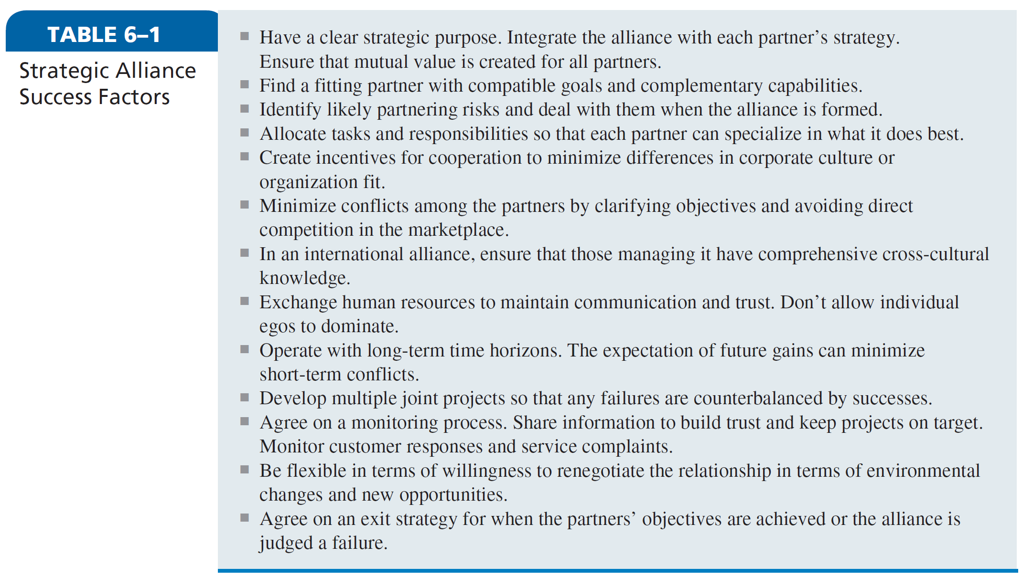
Strategic Alliance Success Factors
Notes:
It is important that a company or business unit that is interested in joining or forming a strategic alliance consider the strategic alliance success factors listed in Table 6–1.

