Slide 1
Strategy Formulation: Functional Strategy and Strategic Choice
Chapter 8

Slide 2
Learning Objectives
Identify a variety of functional strategies that can be used to achieve organizational goals and objectives
Understand what activities and functions are appropriate to outsource in order to gain or strengthen competitive advantage
Recognize strategies to avoid and understand why they are dangerous
Construct corporate scenarios to evaluate strategic options
Develop policies to implement corporate, business and functional strategies
Notes:
After reading this chapter, you should be able to:
Identify a variety of functional strategies that can be used to achieve organizational goals and objectives
Understand what activities and functions are appropriate to outsource in order to gain or strengthen competitive advantage
Recognize strategies to avoid and understand why they are dangerous
Construct corporate scenarios to evaluate strategic options
Develop policies to implement corporate, business and functional strategies

Slide 3
Functional Strategy
Functional strategy
the approach a functional area takes to achieve corporate and business unit objectives and strategies by maximizing resource productivity
Notes:
Functional strategy is the approach a functional area takes to achieve corporate and business unit objectives and strategies by maximizing resource productivity.

Slide 4
Marketing Strategy
Marketing strategy
deals with pricing, selling and distributing a product
Notes:
Marketing strategy deals with pricing, selling and distributing a product

Slide 5
Marketing Strategy
Market development strategy
a company or business unit can (1) capture a larger share of an existing market for current products through market saturation and market penetration or (2) develop new uses and/or markets for current products.
Notes:
Using a market development strategy, a company or business unit can (1) capture a larger share of an existing market for current products through market saturation and market penetration or (2) develop new uses and/or markets for current products.

Slide 6
Marketing Strategy
Product development strategy
a company or unit can (1) develop new products for existing markets or (2) develop new products for new markets.
Notes:
Using the product development strategy, a company or unit can (1) develop new products for existing markets or (2) develop new products for new markets.

Slide 7
Marketing Strategy
Brand extension
using a successful brand name to market other products
Push strategy
trade promotions to gain or hold shelf space in retail outlets
Pull strategy
advertising to “pull” products through the distribution channels
Notes:
Using a successful brand name to market other products is called brand extension, and it is a good way to appeal to a company’s current customers.
Many large food and consumer products companies in the United States and Canada follow a push strategy by spending a large amount of money on trade promotion in order to gain or hold shelf space in retail outlets. The Kellogg Company decided a few years ago to change its emphasis from a push to a pull strategy,
in which advertising “pulls” the products through the distribution channels.

Slide 8
Marketing Strategy
Skim pricing
offers the opportunity to “skim the cream” from the top of the demand curve with a high price while the product is novel and competitors are few
Notes:
When pricing a new product, a company or business unit can follow one of two strategies. For new-product pioneers, skim pricing offers the opportunity to “skim the cream” from the top of the demand curve with a high price while the product is novel and competitors are few.

Slide 9
Marketing Strategy
Penetration pricing
attempts to hasten market development and offers the pioneer the opportunity to use the experience curve to gain market share with low price and then dominate the industry
Notes:
Penetration pricing, in contrast, attempts to hasten market development and offers the pioneer the opportunity to use the experience curve to gain market share with a low price and then dominate the industry.

Slide 10
Financial Strategy
Financial Strategy
examines the financial implications of corporate- and business-level strategic options and identifies the best financial course of action
The management of dividends and stock price is an important part of a corporation’s financial strategy.
Notes:
Financial strategy examines the financial implications of corporate- and business-level strategic options and identifies the best financial course of action.
The management of dividends and stock price is an important part of a corporation’s financial strategy.

Slide 11
Financial Strategy
Leveraged buyout
company is acquired in a transaction financed largely by debt usually obtained from a third party
Reverse stock split
investor’s shares are split in half for the same total amount of money
Notes:
In a leveraged buyout, a company is acquired in a transaction financed largely by debt, usually obtained from a third party, such as an insurance company or an investment banker. A number of firms have been supporting the price of their stock by using reverse stock splits. Contrasted with a typical forward 2-for-1 stock split in which an investor receives an additional share for every share owned (with each share being worth only half as much), in a reverse 1-for-2 stock split, an investor’s shares are split in half for the same total amount of money (with each share now being worth twice as much).

Slide 12
Research and Development Strategy
Research and Development Strategy
deals with product and process innovation and improvement
also deals with the appropriate mix of different types of R&D and question of how new technology should be accessed
Notes:
R&D strategy deals with product and process innovation and improvement. It also deals with the appropriate mix of different types of R&D (basic, product or process) and with the question of how new technology should be accessed—through internal development, external acquisition or strategic alliances.

Slide 13
Research and Development Strategy
Technological leader
pioneering an innovation
Technological follower
imitating the products of competitors
Open innovation
firm uses alliances and connections with corporate, government, academic labs and consumers to develop new products and processes
Notes:
One of the R&D choices is to be either a technological leader, pioneering an innovation, or a technological follower, imitating the products of competitors.
A newer approach to R&D is open innovation, in which a firm uses alliances and connections with corporate, government, academic labs and consumers to develop new products and processes.

Slide 14
Operations Strategy
Operations Strategy
determines how and where a product or service is to be manufactured, the level of vertical integration in the production process, the deployment of physical resources and relationships with suppliers
Notes:
Operations strategy determines how and where a product or service is to be manufactured, the level of vertical integration in the production process, the deployment of physical resources and relationships with suppliers.

Slide 15
Purchasing Strategy
Purchasing Strategy
deals with obtaining raw materials, parts and supplies needed to perform the operations function
multiple, sole and parallel sourcing
Notes:
Purchasing strategy deals with obtaining the raw materials, parts and supplies needed to perform the operations function. The basic purchasing choices are multiple, sole and parallel sourcing.

Slide 16
Purchasing Strategy
Multiple sourcing
the purchasing company orders a particular part from several vendors
Sole sourcing
relies on only one supplier for a particular part
Parallel sourcing
two suppliers are the sole suppliers of two different parts, but they are also backup suppliers for each other’s parts
Notes:
Under multiple sourcing, the purchasing company orders a particular part from several vendors. Sole sourcing relies on only one supplier for a particular part
In parallel sourcing, two suppliers are the sole suppliers of two different parts, but they are also backup suppliers for each other’s parts.

Slide 17
Logistics Strategy
Logistics Strategy
deals with the flow of products into and out of the manufacturing process
Trends include:
Centralization
Outsourcing
Internet
Notes:
Logistics strategy deals with the flow of products into and out of the manufacturing process. Three trends related to this strategy are evident: centralization, outsourcing, and the use of the Internet.

Slide 18
HRM Strategy
HRM strategy
addresses the issue of whether a company or business unit should hire a large number of low-skilled employees who receive low pay, perform repetitive jobs and will most likely quit after a short time (the fast-food restaurant strategy) or hire skilled employees who receive relatively high pay and are cross-trained to participate in self-managing work teams
Notes:
HRM strategy, among other things, addresses the issue of whether a company or business unit should hire a large number of low-skilled employees who receive low pay, perform repetitive jobs and will most likely quit after a short time (the fast-food restaurant strategy) or hire skilled employees who receive relatively high pay and are cross-trained to participate in self-managing work teams.

Slide 19
Information Technology
Follow-the-sun management
project team members living in one country can pass their work to team members in another country in which the work day is just beginning.
Notes:
Multinational corporations are finding that having a sophisticated intranet allows employees to practice follow-the-sun management, in which project team members living in one country can pass their work to team members in another country in which the work day is just beginning.

Slide 20
The Sourcing Decision: Location of Functions
Outsourcing
purchasing from someone else a product or service that had been previously provided internally
the reverse of vertical integration
Offshoring
the outsourcing of an activity or a function to a wholly owned company or an independent provider in another country.
Notes:
Outsourcing is purchasing from someone else a product or service that had been previously provided internally. Thus, it is the reverse of vertical integration.
Offshoring is the outsourcing of an activity or a function to a wholly owned company or an independent provider in another country.

Slide 21
Disadvantages of Outsourcing
Customer complaints
Locked in to long-term contracts
Lack of ability to learn new skills and develop new core competencies
Lack of cost savings
Poor product quality
Notes:
Some disadvantages of outsourcing are:
Customer complaints
Locked in to long-term contracts
Lack of ability to learn new skills and develop new core competencies
Lack of cost savings
Poor product quality

Slide 22
Errors in Outsourcing to Avoid
Outsourcing the wrong activities
Selecting the wrong vendor
Writing a poor contracts
Overlooking personnel issues
Lack of control
Overlooking hidden costs
Lack of an exit strategy
Notes:
A study of 91 outsourcing efforts conducted by European and North American firms found seven major errors that should be avoided:
Outsourcing the wrong activities
Selecting the wrong vendor
Writing a poor contracts
Overlooking personnel issues
Lack of control
Overlooking hidden costs
Lack of an exit strategy

Slide 23
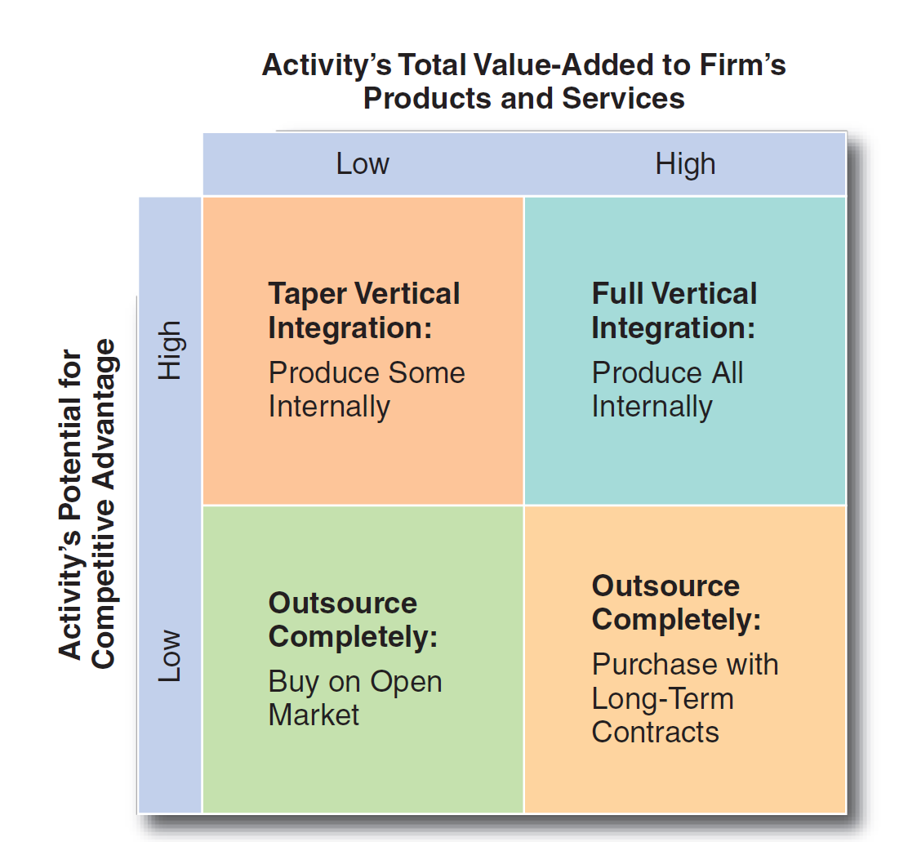
Proposed Outsourcing Matrix
Figure 8-1
Notes:
An outsourcing decision depends on the fraction of total value added that the activity under consideration represents and on the amount of potential competitive advantage in that activity for the company or business unit. See the outsourcing matrix in Figure 8–1.

Slide 24
Strategies to Avoid
Follow the leader
Hit another home run
Arms race
Do everything
Losing hand
Notes:
Several strategies that could be considered corporate, business or functional are very dangerous. Managers who have made poor analyses or lack creativity may be trapped into considering some of the following strategies to avoid:
Follow the leader
Hit another home run
Arms race
Do everything
Losing hand

Slide 25
Strategic Choice: Selecting the Best Strategy
Corporate scenarios
pro forma (estimated future) balance sheets and income statements that forecast the effect each alternative strategy and its various programs will likely have on division and corporate return on investment
Notes:
Corporate scenarios are pro forma (estimated future) balance sheets and income statements that forecast the effect each alternative strategy and its various programs will likely have on division and corporate return on investment.

Slide 26
Corporate Scenario Steps
Use industry scenarios to develop assumptions about the task environment
Develop common-size financial statements for prior years
Construct detailed pro forma financial statements for each strategic alternative
Notes:
To construct a corporate scenario, follow these steps:
Use industry scenarios to develop assumptions about the task environment
Develop common-size financial statements for prior years
Construct detailed pro forma financial statements for each strategic alternative

Slide 27
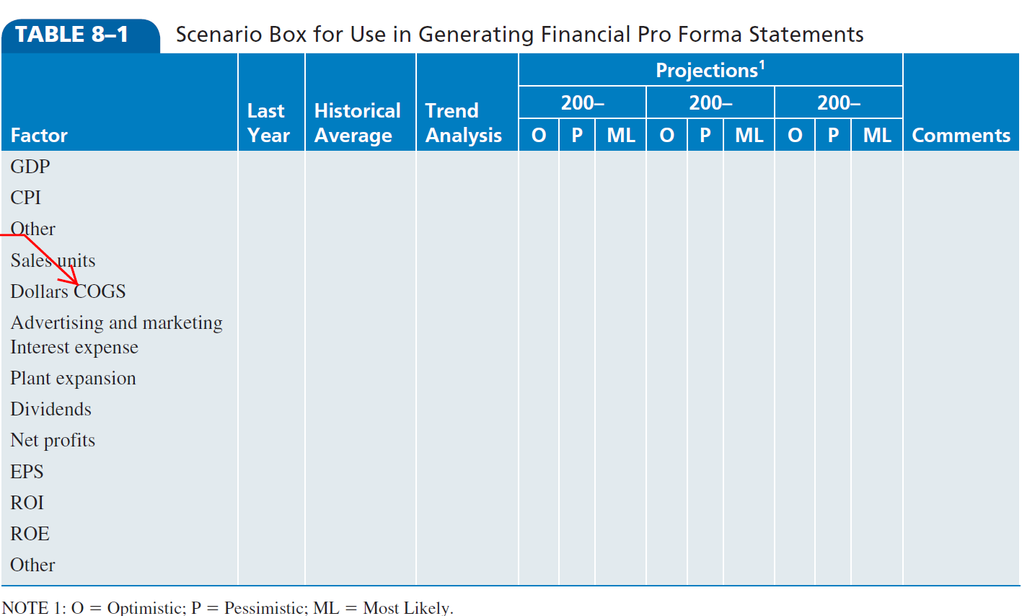
Scenario Box for Use in Generating Financial Pro Forma Statements
Notes:
Develop common-size financial statements (as discussed in Chapter 12) for the company’s or business unit’s previous years to serve as the basis for the trend analysis projections of pro forma financial statements. Use the Scenario Box form shown in Table 8–1.

Slide 28
Management’s Attitude Toward Risk
Risk
composed not only of the probability that the strategy will be effective but also of the amount of assets the corporation must allocate to that strategy and the length of time the assets will be unavailable for other uses
Notes:
Risk is composed not only of the probability that the strategy will be effective but also of the amount of assets the corporation must allocate to that strategy and the length of time the assets will be unavailable for other uses.

Slide 29
Management’s Attitude Toward Risk
Real-options approach
when the future is highly uncertain, it pays to have a broad range of options open
Net present value
calculates the value of a project by predicting its payouts, adjusting them for risk and subtracting the amount invested
Notes:
A new approach to evaluating alternatives under conditions of high environmental uncertainty is to use the real-options theory. According to the real-options approach, when the future is highly uncertain, it pays to have a broad range of options open. This is in contrast to using net present value (NPV) to calculate the value of a project by predicting its payouts, adjusting them for risk and subtracting the amount invested.

Slide 30
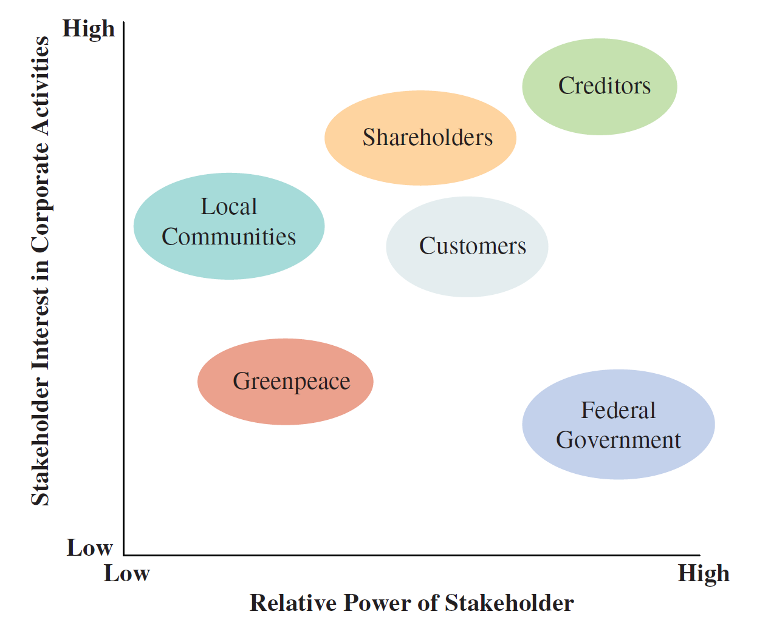
Stakeholder Priority Matrix
Figure 8-2
Notes:
Stakeholders can be categorized in terms of their (1) interest in the corporation’s activities and (2) relative power to influence the corporation’s activities. As shown in Figure 8–2, each stakeholder group can be shown graphically based on its level of interest (from low to high) in a corporation’s activities and on its relative power (from low to high) to influence a corporation’s activities.

Slide 31
Questions to Assess Stakeholder Concerns
How will this decision affect each stakeholder?
How much of what stakeholders want are they likely to get under the alternative?
What are the stakeholders likely to do if they don’t get what they want?
What is the probability that they will do it?
Notes:
Strategic managers should ask four questions to assess the importance of stakeholder concerns in a particular decision:
How will this decision affect each stakeholder?
How much of what stakeholders want are they likely to get under the alternative?
What are the stakeholders likely to do if they don’t get what they want?
What is the probability that they will do it?

Slide 32
Pressures from Stakeholders
Political strategy
plan to bring stakeholders into agreement with a corporation’s actions
constituency building, political action committee contributions, advocacy advertising, lobbying and coalition building
Notes:
A political strategy is a plan to bring stakeholders into agreement with a corporation’s actions. Some of the most commonly used political strategies are constituency building, political action committee contributions, advocacy advertising, lobbying and coalition building.

Slide 33
Pressures from the Corporate Culture
If there is little fit, management must decide if it should:
Take a chance on ignoring the culture.
Manage around the culture and change the implementation plan.
Try to change the culture to fit the strategy.
Change the strategy to fit the culture.
Notes:
In evaluating a strategic alternative, strategy makers must consider pressures from the corporate culture and assess a strategy’s compatibility with that culture. If there is little fit, management must decide if it should:
■ Take a chance on ignoring the culture.
■ Manage around the culture and change the implementation plan.
■ Try to change the culture to fit the strategy.
■ Change the strategy to fit the culture.

Slide 34
Process of Strategic Choice
Strategic choice
the evaluation of alternative strategies and selection of the best alternative
Failure almost always stems from the actions of the decision maker, not from bad luck or situational limitations.
Notes:
Strategic choice is the evaluation of alternative strategies and selection of the best alternative. Failure almost always stems from the actions of the decision maker, not from bad luck or situational limitations.

Slide 35
Avoiding the Consensus Trap
Devil’s advocate
assigned to identify potential pitfalls and problems with a proposed alternative strategy in a formal presentation
may be an individual or a group
Dialectical inquiry
requires that two proposals using different assumptions be generated for each alternative strategy under consideration
Notes:
A devil’s advocate (who may be an individual or a group) is one who is assigned to identify potential pitfalls and problems with a proposed alternative strategy in a formal presentation. When applied to strategic decision making, dialectical inquiry requires that two proposals using different assumptions be generated for each alternative strategy under consideration.

Slide 36
Process of Strategic Choice
Criteria for evaluating alternatives includes:
Mutual exclusivity
Success
Completeness
Internal Consistency
Notes:
Regardless of the process used to generate strategic alternatives, each resulting alternative must be rigorously evaluated in terms of its ability to meet four criteria:
1. Mutual exclusivity: Doing any one alternative would preclude doing any other.
2. Success: It must be feasible and have a good probability of success.
3. Completeness: It must take into account all the key strategic issues.
4. Internal consistency: It must make sense on its own as a strategic decision for the entire
firm and not contradict key goals, policies and strategies currently being pursued by the
firm or its units.

Slide 37
Developing Policies
When crafted correctly, an effective policy accomplishes three things:
It forces trade-offs between competing resource demands.
It tests the strategic soundness of a particular action.
It sets clear boundaries within which employees must operate, while granting them the freedom to experiment within those constraints.
Notes:
When crafted correctly, an effective policy accomplishes three things:
■ It forces trade-offs between competing resource demands.
■ It tests the strategic soundness of a particular action.
■ It sets clear boundaries within which employees must operate, while granting them the freedom to experiment within those constraints.

