Slide 1
Strategy Implementation: Organizing for Action
Chapter 9

Slide 2
Learning Objectives
Develop programs, budgets and procedures to implement strategic change
Understand the importance of achieving synergy during strategy implementation
List the stages of corporate development and the structure that characterizes each stage
Identify the blocks to changing from one stage to another
Notes:
After reading this chapter, you should be able to:
Develop programs, budgets and procedures to implement strategic change
Understand the importance of achieving synergy during strategy implementation
List the stages of corporate development and the structure that characterizes each stage
Identify the blocks to changing from one stage to another

Slide 3
Learning Objectives
Construct matrix and network structures to support flexible and nimble organizational strategies
Decide when and if programs such as reengineering, Six Sigma and job redesign are appropriate methods of strategy implementation
Understand the centralization versus decentralization issue in multinational corporations
Notes:
After reading this chapter, you should be able to:
Construct matrix and network structures to support flexible and nimble organizational strategies
Decide when and if programs such as reengineering, Six Sigma and job redesign are appropriate methods of strategy implementation
Understand the centralization versus decentralization issue in multinational corporations

Slide 4
Strategy Implementation
Strategy implementation
the sum total of all activities and choices required for the execution of a strategic plan
Who are the people to carry out the strategic plan?
What must be done to align company operations in the intended direction?
How is everyone going to work together to do what is needed?
Notes:
Strategy implementation is the sum total of the activities and choices required for the execution of a strategic plan.
To begin the implementation process, strategy makers must consider these questions:
■ Who are the people who will carry out the strategic plan?
■ What must be done to align the company’s operations in the new intended direction?
■ How is everyone going to work together to do what is needed?

Slide 5
Common Strategy Implementation Problems
Took more time than planned
Unanticipated major problems
Ineffective coordination
Competing activities and crises created distractions
Employees with insufficient capabilities
Lower-level employees were inadequately trained
Uncontrollable external environmental factors
Poor departmental leadership and direction
Inadequately defined implementation tasks and activities
Inefficient information system to monitor activities
Notes:
A survey of 93 Fortune 500 firms revealed that more than half of the corporations experienced the following 10 problems when they attempted to implement a strategic change. These problems are listed in order of frequency:
1. Implementation took more time than originally planned.
2. Unanticipated major problems arose.
3. Activities were ineffectively coordinated.
4. Competing activities and crises took attention away from implementation.
5. The involved employees had insufficient capabilities to perform their jobs.
6. Lower-level employees were inadequately trained.
7. Uncontrollable external environmental factors created problems.
8. Departmental managers provided inadequate leadership and direction.
9. Key implementation tasks and activities were poorly defined.
10. The information system inadequately monitored activities.

Slide 6
Developing Programs, Budgets and Procedures
Program
a collection of tactics where a tactic is the individual action taken by the organization as an element of the effort to accomplish a plan
The purpose of a program or a tactic is to make a strategy action-oriented.
Notes:
In practice, a program is a collection of tactics where a tactic is the individual action taken by the organization as an element of the effort to accomplish a plan.
The purpose of a program or a tactic is to make a strategy action-oriented.

Slide 7
Timing Tactics: When to Compete
Timing tactic
deals with when a company implements a strategy
First mover
first company to manufacture and sell a new product or service
Late movers
may be able to imitate the technological advances of others, keep risks down by waiting until a new technological standard or market is established and take advantage of the first mover’s natural inclination to ignore market segments
Notes:
A timing tactic deals with when a company implements a strategy. The first company to manufacture and sell a new product or service is called the first mover (or pioneer).
Late movers may be able to imitate the technological advances of others (and thus keep R&D costs low), keep risks down by waiting until a new technological standard or market is established and take advantage of the first mover’s natural inclination to ignore market segments

Slide 8
Market Location Tactics: Where to Compete
Market location tactic
deals with where a company implements a strategy.
Offensive tactic
usually takes place in an established competitor’s market location
Defensive tactic
usually takes place in the firm’s own current market position as a defense against possible attack by a rival
Notes:
A market location tactic deals with where a company implements a strategy. A company or business unit can implement a competitive strategy either offensively or defensively. An offensive tactic usually takes place in an established competitor’s market location. A defensive tactic usually takes place in the firm’s own current market position as a defense against possible attack by a rival.

Slide 9
Offensive Tactics
Frontal assault
Flanking maneuver
Bypass attack
Encirclement
Guerilla warfare
Notes:
Some of the methods used to attack a competitor’s position are:
Frontal assault
Flanking maneuver
Bypass attack
Encirclement
Guerilla warfare

Slide 10
Defensive Tactics
Raise structural barriers
Increase expected retaliation
Lower the inducement for attack
Notes:
These tactics deliberately reduce short-term profitability to ensure long-term profitability: raise structural barriers, increase expected retaliation and lower the inducement for attack.

Slide 11
Developing Programs, Budgets and Procedures
Planning a budget is the last real check a corporation has on the feasibility of its selected strategy.
Procedures
detail the various activities that must be carried out to complete a corporation’s programs
Standard operating procedures
Notes:
Planning a budget is the last real check a corporation has on the feasibility of its selected strategy. After the divisional and corporate budgets are approved, procedures must be developed. Often called Standard Operating Procedures (SOPs), they typically detail the various activities that must be carried out to complete a corporation’s programs and tactical plans.

Slide 12
Achieving Synergy
Synergy
exists for a divisional corporation if the return on investment is greater than what the return would be if each division were an independent business
Notes:
Synergy is said to exist for a divisional corporation if the return on investment (ROI) of each division is greater than what the return would be if each division were an independent business.

Slide 13
Forms of Synergy
Shared know-how
Coordinated strategies
Shared tangible resources
Economies of scale or scope
Pooled negotiating power
New business creation
Notes:
According to Goold and Campbell, synergy can take place in one of six forms:
Shared know-how
Coordinated strategies
Shared tangible resources
Economies of scale or scope
Pooled negotiating power
New business creation

Slide 14
Structure Follows Strategy
Structure Follows Strategy
changes in corporate strategy lead to changes in organizational structure
New strategy is created
New administrative problems emerge
Economic performance declines
New appropriate structure is invented
Profit returns to its previous level
Notes:
In a classic study of large U.S. corporations such as DuPont, General Motors, Sears and Standard Oil, Alfred Chandler concluded that structure follows strategy—that is, changes in corporate strategy lead to changes in organizational structure
Chandler, therefore, proposed the following as the sequence of what occurs:
1. New strategy is created.
2. New administrative problems emerge.
3. Economic performance declines.
4. New appropriate structure is created.
5. Economic performance rises.

Slide 15
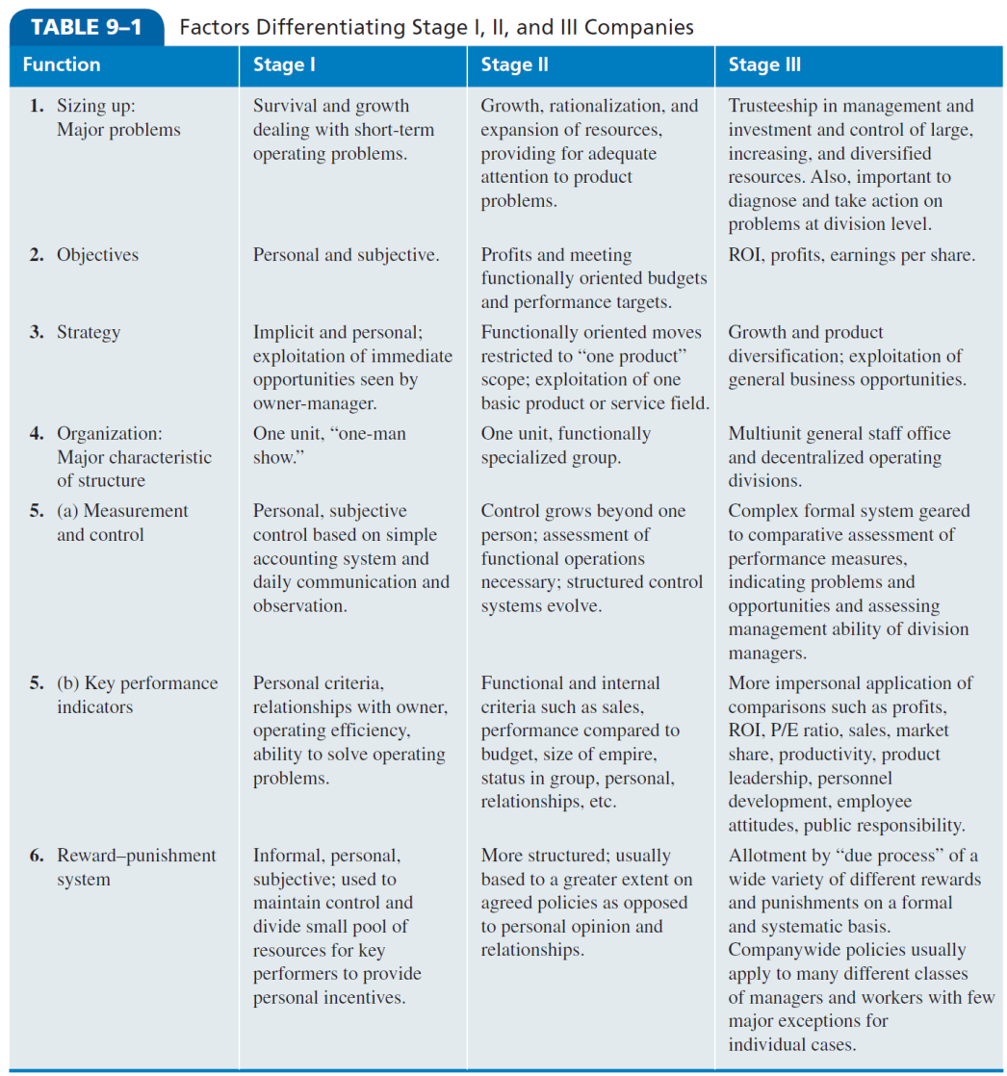
Factors Differentiating Stage I, II and III Companies
Notes:
The differences among these three structural stages of corporate development in terms of typical problems, objectives, strategies, reward systems and other characteristics are specified in detail in Table 9–1.

Slide 16
Stages of Corporate Development
Simple Structure
Flexible and dynamic
Functional Structure
Entrepreneur is replaced by a team of managers
Divisional Structure
Management of diverse product lines in numerous industries
Decentralized decision making
Beyond SBU’s
Matrix
Network
Notes:
Successful, large conglomerate organizations have tended to follow a pattern of structural development as they grow and expand. Beginning with the simple structure of the entrepreneurial firm (in which everybody does everything), these organizations tend to get larger and organize along functional lines, with marketing, production and finance departments.

Slide 17
Blocks to Changing Stages
Internal
Lack of resources
Lack of ability
Refusal of top management to delegate
External
Economic conditions
Labor shortages
Lack of market growth
Notes:
Blocks to development may be internal (such as lack of resources, lack of ability or refusal of top management to delegate decision making to others) or external (such as economic conditions, labor shortages and lack of market growth).

Slide 18
Blocks to Changing Stages (Entrepreneurs)
Loyalty to comrades
Task oriented
Single-mindedness
Working in isolation
Notes:
Entrepreneurs who start businesses generally have four tendencies that work very well for small new ventures but become Achilles’ heels for these same individuals when they try to manage a larger firm with diverse needs, departments, priorities and constituencies:
Loyalty to comrades
Task oriented
Single-mindedness
Working in isolation

Slide 19
Organizational Life Cycle
Organizational life cycle
describes how organizations grow, develop and decline
Notes:
The organizational life cycle describes how organizations grow, develop and eventually decline. It is the organizational equivalent of the product life cycle in marketing. These stages are Birth (Stage I), Growth (Stage II), Maturity (Stage III), Decline (Stage IV) and Death (Stage V). The impact of these stages on corporate strategy and structure is summarized in Table 9–2.

Slide 20
Advanced Types of Organizational Structures
Matrix structures
functional and product forms are combined simultaneously at the same level of the organization
Notes:
In matrix structures, functional and product forms are combined simultaneously at the same level of the organization.

Slide 21
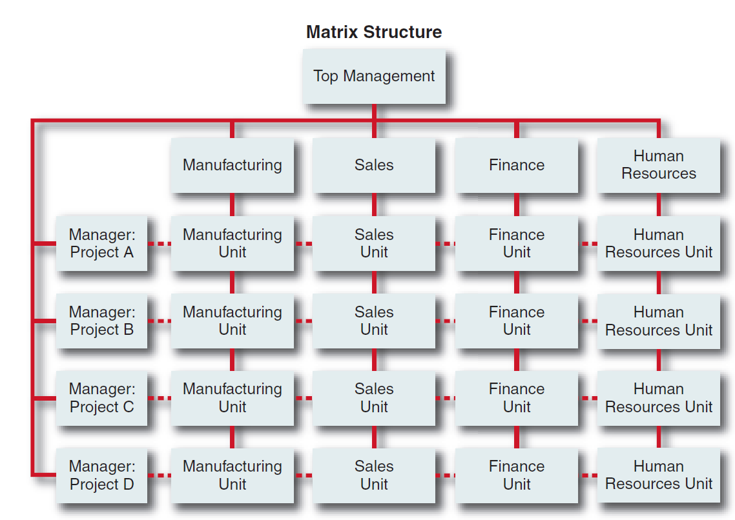
Matrix Structure
Figure 9-1
Notes:
(See Figure 9–1.) Employees have two superiors, a product or project manager, and a functional manager.

Slide 22
Advanced Types of Organizational Structures
Conditions for matrix structures include:
Ideas need to be cross-fertilized across projects or products
Scarcity of resources
Abilities to process information and to make decisions needs to be improved
Notes:
The matrix structure is often found in an organization or SBU when the following three conditions exist:
■ Ideas need to be cross-fertilized across projects or products.
■ Resources are scarce.
■ Abilities to process information and to make decisions need to be improved.

Slide 23
Advanced Types of Organizational Structures
Phases of matrix structure development
Temporary cross-functional task forces
Product/brand management
Mature matrix
Notes:
Davis and Lawrence, authorities on the matrix form of organization, propose that three distinct phases exist in the development of the matrix structure:
Temporary cross-functional task forces
Product/brand management
Mature matrix

Slide 24
Advanced Types of Organizational Structures
Network structure
virtual elimination of in-house business functions
Virtual organization
composed of a series of project groups or collaborations linked by constantly changing nonhierarchical, cobweb-like electronic networks
Notes:
A network structure could be termed a “nonstructure” because of its virtual elimination of in-house business functions. A corporation organized in this manner is often called a virtual organization because it is composed of a series of project groups or collaborations linked by constantly changing nonhierarchical, cobweb-like electronic networks

Slide 25
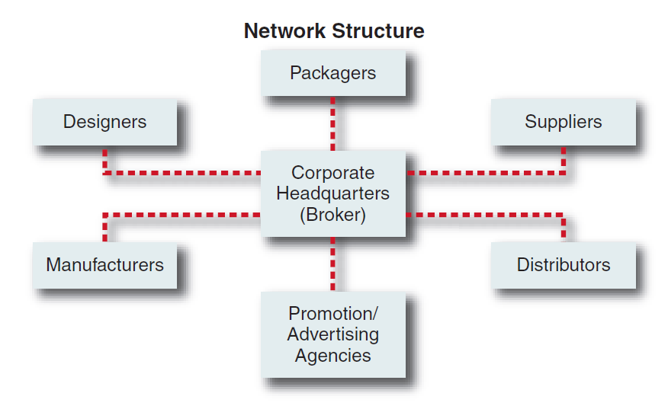
Network Structure
Figure 9-1
Notes:
A newer and somewhat more radical organizational design is the network structure (see Figure 9–1).

Slide 26
Cellular/Modular Organization: A New Type of Structure?
Cellular/Modular structure
composed of cells (self-managing teams, autonomous business units, etc.) which can operate alone but which can interact with other cells to produce a more potent and competent business mechanism
Beginning to appear in firms that are focused on rapid product and service innovation
Notes:
According to Miles and Snow et al., “a cellular organization is composed of cells (self-managing teams, autonomous business units, etc.) which can operate alone but which can interact with other cells to produce a more potent and competent business mechanism.”

Slide 27
Reengineering and Strategy Implementation
Reengineering
the radical redesign of business processes to achieve major gains in cost, service or time
effective program to implement a turnaround strategy
Notes:
Reengineering is the radical redesign of business processes to achieve major gains in cost, service or time. It is not in itself a type of structure, but it is an effective program to implement a turnaround strategy.

Slide 28
Principles for Reengineering
Organize around outcomes, not tasks
Have those who use the output of the process perform the process
Subsume information-processing work into real work that produces information
Treat geographically-dispersed resources as though they were centralized
Notes:
Michael Hammer, who popularized the concept of reengineering, suggests the following principles for reengineering:
Organize around outcomes, not tasks
Have those who use the output of the process perform the process
Subsume information-processing work into real work that produces information
Treat geographically-dispersed resources as though they were centralized

Slide 29
Principles for Reengineering
Link parallel activities instead of integrating their results
Put the decision point where the work is performed and build control into the process
Capture information once and at the source
Notes:
Some other principles are:
Link parallel activities instead of integrating their results
Put the decision point where the work is performed and build control into the process
Capture information once and at the source

Slide 30
Six Sigma
Six Sigma
analytical method for achieving near perfect results on a production line
emphasis is on reducing product variance in order to boost quality and efficiency
Lean Six Sigma
includes the removal of unnecessary steps in any process and fixing those that remain
Notes:
Six Sigma is an analytical method for achieving near-perfect results on a production line. A new program called Lean Six Sigma is becoming increasingly popular in companies.

Slide 31
Process of Six Sigma
Define a process where results are poorer than average
Measure the process to determine current performance
Analyze the information to pinpoint where things are going wrong
Improve the process and eliminate the error
Establish controls to prevent future defects from occurring
Notes:
The process of Six Sigma encompasses five steps.
1. Define a process where results are poorer than average.
2. Measure the process to determine exact current performance.
3. Analyze the information to pinpoint where things are going wrong.
4. Improve the process and eliminate the error.
5. Establish controls to prevent future defects from occurring.

Slide 32
Designing Jobs to Implement Strategy
Job design
the study of individual tasks in an attempt to make them more relevant to the company and to the employees
Job enlargement
combining tasks to give a worker more of the same type of duties to perform
Job rotation
moving workers through several jobs to increase variety
Notes:
Job design refers to the study of individual tasks in an attempt to make them more relevant to the company and to the employee(s).
To minimize some of the adverse consequences of task specialization, corporations have turned to new job design techniques: job enlargement (combining tasks to give a worker more of the same type of duties to perform) and job rotation (moving workers through several jobs to increase variety).

Slide 33
Designing Jobs to Implement Strategy
Job characteristics
using task characteristics to improve employee motivation
Job enrichment
altering the jobs by giving the worker more autonomy and control over activities
Notes:
To minimize some of the adverse consequences of task specialization, corporations have turned to new job design techniques: job characteristics (using task characteristics to improve employee motivation) and job enrichment (altering the jobs by giving the worker more autonomy and control over activities).

Slide 34
International Issues in Strategy Implementation
Multinational corporation (MNC)
a highly developed international company with a deep involvement throughout the world, plus a worldwide perspective in its management and decision making
Notes:
A multinational corporation (MNC), in contrast, is a highly developed international company with a deep involvement throughout the world, plus a worldwide perspective in its management and decision making.

Slide 35
Drivers for Strategic Fit among Alliance Partners
Partners must agree on values and vision
Alliance must be derived from business, corporate and functional strategy
Alliance must be important to partners, especially top management
Partners must be mutually dependent for achieving objectives
Notes:
Key drivers for strategic fit between alliance partners are the following:
■ Partners must agree on fundamental values and have a shared vision about the potential for joint value creation.
■ Alliance strategy must be derived from business, corporate and functional strategy.
■ The alliance must be important to both partners, especially to top management.
■ Partners must be mutually dependent for achieving clear and realistic objectives.
■ Joint activities must have added value for customers and the partners.
■ The alliance must be accepted by key stakeholders.
■ Partners contribute key strengths but protect core competencies.

Slide 36
Stages of International Development
Stage 1: Domestic company
Stage 2: Domestic company with export division
Stage 3: Primarily domestic company with international division
Stage 4: Multinational corporation with multidomestic emphasis
Stage 5: Multinational corporation with global emphasis
Notes:
Corporations operating internationally tend to evolve through five common stages, both in their relationships with widely dispersed geographic markets and in the manner in which they structure their operations and programs. These stages of international development are:
Stage 1: Domestic company
Stage 2: Domestic company with export division
Stage 3: Primarily domestic company with international division
Stage 4: Multinational corporation with multidomestic emphasis
Stage 5: Multinational corporation with global emphasis

Slide 37
Centralization versus Decentralization
Product group structure
enables the company to introduce and manage a similar line of products around the world
enables the corporation to centralize decision making along product lines and to reduce costs
Geographic area structure
allows the company to tailor products to regional differences and to achieve regional coordination
Notes:
The product-group structure of American Cyanamid enables the company to introduce and manage a similar line of products around the world. This enables the corporation to centralize decision making along product lines and to reduce costs.
The geographic-area structure allows a company to tailor products to regional differences and to achieve regional coordination.

Slide 38
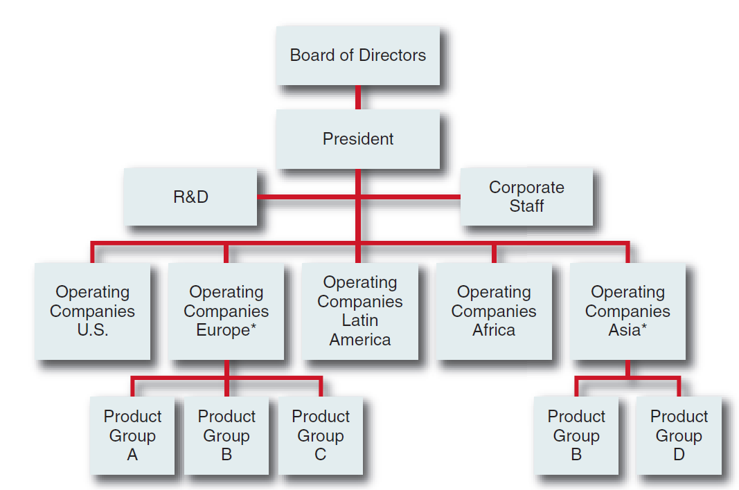
Geographic Area Structure for an MNC
Figure 9-2
Notes:
Two examples of the usual international structure are Nestlé and American Cyanamid. Nestlé’s structure is one in which significant power and authority have been decentralized to geographic entities. This structure is similar to that depicted in Figure 9–2, in which each geographic set of operating companies has a different group of products.

