Slide 1
Strategy Implementation: Staffing and Directing
Chapter 10

Slide 2
Learning Objectives
Understand the link between strategy and staffing decisions
Match the appropriate manager to the strategy
Understand how to implement an effective downsizing program
Discuss important issues in effectively staffing and directing international expansion
Assess and manage the corporate culture’s fit with a new strategy
Formulate effective action plans when MBO and TQM are determined to be appropriate methods of strategy implementation
Notes:
After reading this chapter, you should be able to:
Understand the link between strategy and staffing decisions
Match the appropriate manager to the strategy
Understand how to implement an effective downsizing program
Discuss important issues in effectively staffing and directing international expansion
Assess and manage the corporate culture’s fit with a new strategy
Formulate effective action plans when MBO and TQM are determined to be appropriate methods of strategy implementation

Slide 3
Integration Managers
Prepare a competitive profile of the company in terms of its strengths and weaknesses
Draft a profile of what the ideal combined company should look like
Develop action plans to close the gap between actual and ideal
Establish training programs to unite the combined company and make it more competitive
Notes:
To deal with integration issues such as these, some companies are appointing special integration managers to shepherd companies through the implementation process. The job of the integrator is to prepare a competitive profile of the combined company in terms of its strengths and weaknesses, draft an ideal profile of what the combined company should look like, develop action plans to close the gap between the actuality and the ideal and establish training programs to unite the combined company and make it more competitive.

Slide 4
Staffing
To be a successful integration manager, a person should have:
Deep knowledge of the acquiring company
Flexible management style
Ability to work in cross-functional teams
Willingness to work independently
Sufficient emotional and cultural intelligence to work in a diverse environment
Notes:
To be a successful integration manager, a person should have (1) a deep knowledge of the acquiring company, (2) a flexible management style, (3) an ability to work
in cross-functional project teams, (4) a willingness to work independently and (5) sufficient emotional and cultural intelligence to work well with people from all backgrounds.

Slide 5
Staffing Follows Strategy
One way to implement a company’s business strategy, such as overall low cost, is through training and development.
Executive characteristics influence strategic outcomes for a corporation.
Notes:
One way to implement a company’s business strategy, such as overall low cost, is through training and development.
Executive characteristics influence strategic outcomes for a corporation.

Slide 6
Matching the Manager to the Strategy
Executive type
executives with a particular mix of skills and experiences
paired with a specific corporate strategy
Notes:
Executives with a particular mix of skills and experiences may be classified as an executive type and paired with a specific corporate strategy.

Slide 7
Executive Types
Dynamic industry expert
Analytical portfolio manager
Cautious profit planner
Turnaround specialist
Professional liquidator
Notes:
A corporation following a concentration strategy emphasizing vertical or horizontal growth would probably want an aggressive new chief executive with a great deal of experience in that particular industry—a dynamic industry expert. A diversification strategy, in contrast, might call for someone with an analytical mind who is highly knowledgeable in other industries and can manage diverse product lines—an analytical portfolio manager. A corporation choosing to follow a stability strategy would probably want as its CEO a cautious profit planner, a person with a conservative style, a production or engineering background and experience with controlling budgets, capital expenditures, inventories and standardization procedures. Weak companies in a relatively attractive industry tend to turn to a type of challenge-oriented executive known as a turnaround specialist to save the company. If a company cannot be saved, a professional liquidator might be called on by a bankruptcy court to close the firm and liquidate its assets.

Slide 8
Selection and Management Development
Executive succession
process of replacing a key top manager
Succession planning
identifying candidates below the top layer of management
measuring internal candidates against external candidates
providing financial incentives
Notes:
Executive succession is the process of replacing a key top manager. Some of the best practices for top management succession are encouraging boards to
help the CEO create a succession plan, identifying succession candidates below the top layer, measuring internal candidates against outside candidates to ensure the development of a comprehensive set of skills and providing appropriate financial incentives.

Slide 9
Identifying Abilities and Potential
Performance appraisal systems identify good performers with promotion potential.
Assessment centers evaluate a person’s suitability for an advanced position.
Job rotation ensures employees are gaining a mix of experience to prepare them for future responsibilities.
Notes:
A company can identify and prepare its people for important positions in several ways. One approach is to establish a sound performance appraisal system to identify good performers with promotion potential. Many large organizations are using assessment centers to evaluate a person’s suitability for an advanced position. Job rotation—moving people from one job to another—is also used in many large corporations to ensure that employees are gaining the appropriate mix of experiences to prepare them for future responsibilities.

Slide 10
Problems in Retrenchment
Downsizing
the planned elimination of positions or jobs
also called “rightsizing” or “resizing”
Can damage the learning capacity of an organization
Creativity drops significantly and it becomes very difficult to keep high performers from leaving the company
Notes:
Downsizing (sometimes called “rightsizing” or “resizing”) refers to the planned elimination of positions or jobs. Because the survivors often didn’t know how to do the work of those who had left the company, morale and productivity plummeted. Downsizing can seriously damage the learning capacity of organizations. Creativity drops significantly (affecting new product development), and it becomes very difficult to keep high performers from leaving the company

Slide 11
Guidelines for Successful Downsizing
Eliminate unnecessary work instead of making across the board cuts
Contract out work that others can do cheaper
Plan for long-run efficiencies
Communicate the reasons for actions
Invest in the remaining employees
Develop value added jobs to balance out job elimination
Notes:
Consider the following guidelines that have been proposed for successful downsizing:
Eliminate unnecessary work instead of making across the board cuts
Contract out work that others can do cheaper
Plan for long-run efficiencies
Communicate the reasons for actions
Invest in the remaining employees
Develop value added jobs to balance out job elimination

Slide 12
International Issues in Staffing
Companies that do a good job of managing foreign assignments follow three general practices:
When making international assignments, they focus on transferring knowledge and developing global leadership.
They make foreign assignments to people whose technical skills are matched or exceeded by their cross-cultural abilities.
Notes:
One study of 750 U.S., Japanese, and European companies, found that the companies that do a good job of managing foreign assignments follow three general practices:
■ When making international assignments, they focus on transferring knowledge and developing global leadership.
■ They make foreign assignments to people whose technical skills are matched or exceeded by their cross-cultural abilities.

Slide 13
International Issues in Staffing
They end foreign assignments with a deliberate repatriation process, with career guidance and jobs where the employees can apply what they learned in their assignments.
Notes:
They end foreign assignments with a deliberate repatriation process, with career guidance and jobs where the employees can apply what they learned in their assignments.

Slide 14
International Issues in Staffing
Stealth expatriates
managers that are either cross-border commuters (especially in the EU) or the accidental expatriate who goes on many business trips or temporary assignments due to offshoring and/or international joint ventures
Notes:
Because an increasing number of multinational corporations are primarily organized around business units and product lines instead of geographic areas, product and SBU managers who are based at corporate headquarters are often traveling around the world to work personally with country managers. These managers and other mobile workers are being called stealth expatriates because they are either cross-border commuters (especially in the EU) or the accidental expatriate who goes on many business trips or temporary assignments due to offshoring and/or international joint ventures.

Slide 15
Leading
Implementation
involves leading and coaching people to use their abilities and skills most effectively and efficiently to achieve organizational objectives
Without direction, people tend to do their work according to their personal view of what tasks should be done, how and in what order.
Notes:
Implementation also involves leading through coaching people to use their abilities and skills most effectively and efficiently to achieve organizational objectives.
Without direction, people tend to do their work according to their personal view of what tasks should be done, how and in what order.

Slide 16
Managing Corporate Culture
Strong cultures are resistant to change.
Optimal culture supports mission and strategies.
Management must evaluate what a particular change in strategy means to the corporate culture, assess whether a change in culture is needed and decide whether an attempt to change the culture is worth the likely costs.
Notes:
Corporate culture has a strong tendency to resist change because its very reason for existence often rests on preserving stable relationships and patterns of behavior.
An optimal culture is one that best supports the mission and strategy of the company of which it is a part. This means that corporate culture should support the strategy. Management must evaluate what a particular change in strategy means to the corporate culture, assess whether a change in culture is needed and decide whether an attempt to change the culture is worth the likely costs.

Slide 17
Assessing Strategy—Culture Compatibility
Is the proposed strategy compatible with the company’s current culture?
Can the culture be easily modified to make it more compatible with the new strategy?
Is management willing and able to make major organizational changes and accept probable delays and a likely increase in costs?
Is management still committed to implementing the strategy?
Notes:
Consider the following questions regarding a corporation’s culture:
Is the proposed strategy compatible with the company’s current culture?
Can the culture be easily modified to make it more compatible with the new strategy?
Is management willing and able to make major organizational changes and accept probable delays and a likely increase in costs?
Is management still committed to implementing the strategy?

Slide 18
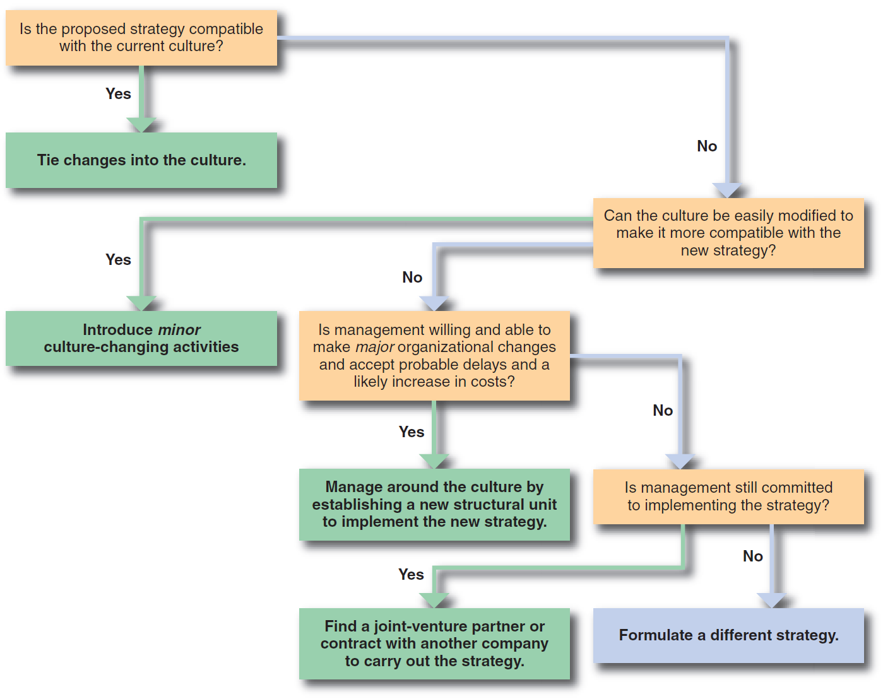
Assessing Strategy—Culture Compatibility
Figure 10-1
Notes:
When implementing a new strategy, a company should take the time to assess strategy-culture compatibility. (See Figure 10–1.)

Slide 19
Managing Cultural Change Through Communication
Companies in which major cultural changes have successfully taken place had the following characteristics in common:
The CEO and other top managers had a strategic vision of what the company could become and communicated that vision to employees at all levels.
The vision was translated into the key elements necessary to accomplish that vision.
Notes:
Companies in which major cultural changes have successfully taken place had the following characteristics in common:
The CEO and other top managers had a strategic vision of what the company could become and communicated that vision to employees at all levels.
The vision was translated into the key elements necessary to accomplish that vision.

Slide 20
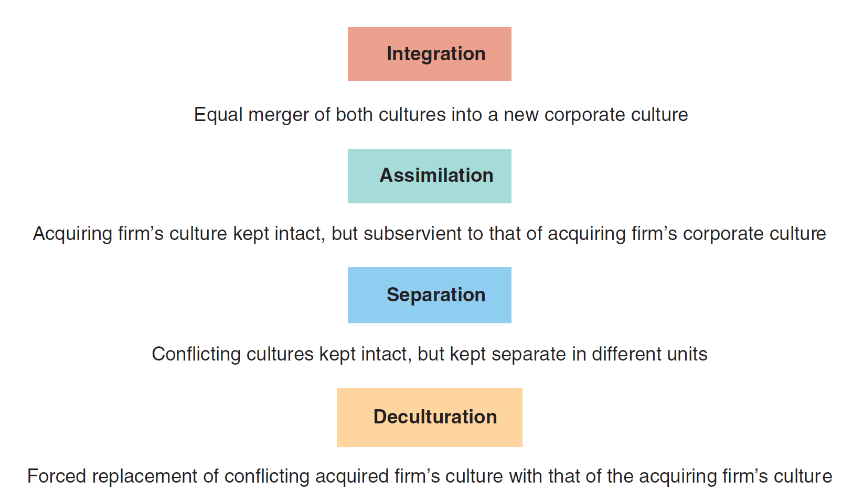
Methods of Managing the Culture of an Acquired Firm
Figure 10-2
Notes:
There are four general methods of managing two different cultures. (See Figure 10–2.)

Slide 21
Methods of Managing the Culture of an Acquired Firm
The choice of which method to use should be based on:
How much members of the acquired firm value preserving their own culture
How attractive they perceive the culture of the acquirer to be
Notes:
The choice of which method to use should be based on (1) how much members of the acquired firm value preserving their own culture and (2) how attractive they perceive the culture of the acquirer to be.

Slide 22
Methods of Managing the Culture of an Acquired Firm
Integration
involves a relatively balanced give-and-take of cultural and managerial practices between the merger partners, and no strong imposition of cultural change on either company
Assimilation
involves the domination of one organization over the other
Notes:
Integration involves a relatively balanced give-and-take of cultural and managerial practices between the merger partners, and no strong imposition of cultural change on either company.
Assimilation involves the domination of one organization over the other.

Slide 23
Methods of Managing the Culture of an Acquired Firm
Separation
characterized by a separation of the two companies’ cultures
Deculturation
involves the disintegration of one company’s culture resulting from unwanted and extreme pressure from the other to impose its culture and practices
Notes:
Separation is characterized by a separation of the two companies’ cultures.
Deculturation involves the disintegration of one company’s culture resulting from unwanted and extreme pressure from the other to impose its culture and practices.

Slide 24
Action Planning
Action plan
states what actions are going to be taken, by whom, during what time frame and with what expected results
Notes:
Activities can be directed toward accomplishing strategic goals through action planning. At a minimum, an action plan states what actions are going to be taken, by whom, during what time frame and with what expected results.

Slide 25
Action Planning
Specific actions to be taken to make the program operational
Dates to begin and end each action
Person responsible for carrying out each action
Person responsible for monitoring the timeliness and effectiveness of each action
Expected financial and physical consequences of each action
Contingency plans
Notes:
Take the example of a company choosing forward vertical integration through the acquisition of a retailing chain as its growth strategy.
The resulting action plan to develop a new advertising program should include much of the following information:
Specific actions to be taken to make the program operational
Dates to begin and end each action
Person responsible for carrying out each action
Person responsible for monitoring the timeliness and effectiveness of each action
Expected financial and physical consequences of each action
Contingency

Slide 26
Importance of an Action Plan
Serves as a link between strategy formulation and evaluation and control
Specifies what needs to be done differently from current operations
Helps in both the appraisal of performance and in the identification of any remedial actions
Explicit assignment of responsibilities for implementing and monitoring the programs may contribute to better motivation
Notes:
Action plans are important for several reasons. First, action plans serve as a link between strategy formulation and evaluation and control. Second, the action plan specifies what needs to be done differently from the way operations are currently carried out. Third, during the evaluation and control process that comes later, an action plan helps in both the appraisal of performance and in the identification of any remedial actions, as needed. In addition, the explicit assignment of responsibilities for implementing and monitoring the programs may contribute to better motivation.

Slide 27
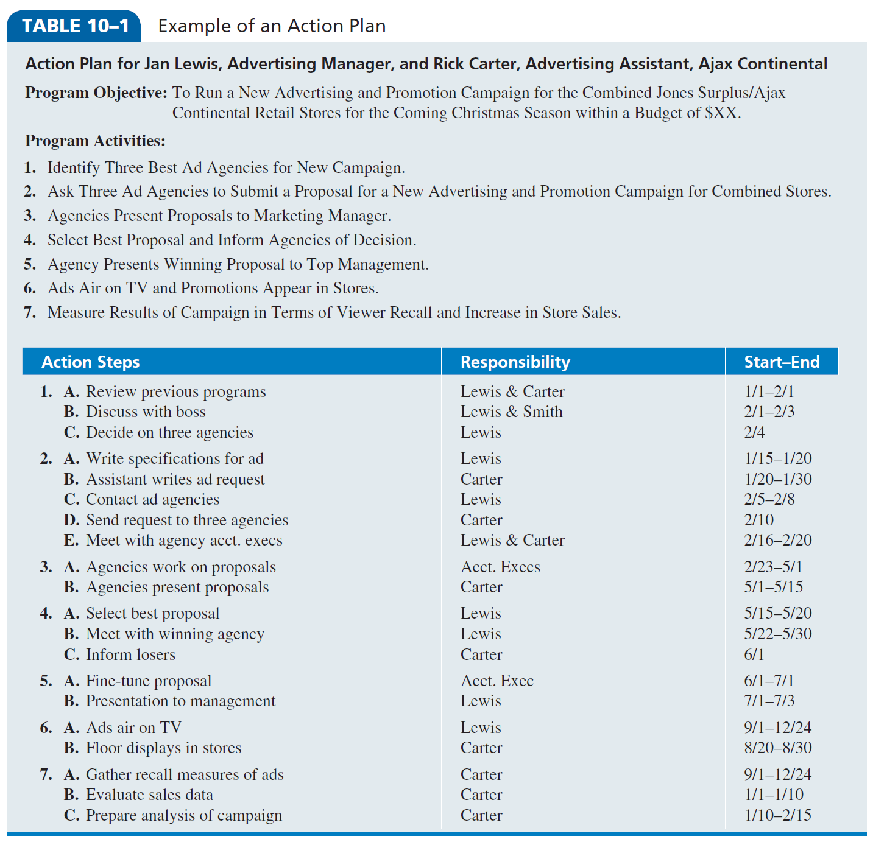
Example of an Action Plan
Notes:
Table 10–1 shows an example of an action plan for a new advertising and promotion program.

Slide 28
Management by Objectives
Management by Objectives (MBO)
encourages participative decision making through shared goal setting and performance assessment based on achieving stated objectives
Notes:
Management By Objectives (MBO) is a technique that encourages participative decision making through shared goal setting at all organizational levels and performance assessment based on the achievement of stated objectives.

Slide 29
Management by Objectives
The MBO process involves:
Establishing and communicating organizational objectives
Setting individual objectives
Developing an action plan to achieve objectives
Periodically (at least quarterly) reviewing performance
Notes:
The MBO process involves:
1. Establishing and communicating organizational objectives
2. Setting individual objectives (through superior–subordinate interaction) that help implement organizational ones
3. Developing an action plan of activities needed to achieve the objectives
4. Periodically (at least quarterly) reviewing performance as it relates to the objectives and including the results in the annual performance appraisal

Slide 30
Total Quality Management
Total Quality Management (TQM)
an operational philosophy committed to customer satisfaction and continuous improvement
committed to quality/excellence and to being the best in all functions
Notes:
Total Quality Management (TQM) is an operational philosophy committed to customer satisfaction and continuous improvement. TQM is committed to quality/excellence and to being the best in all functions.

Slide 31
Total Quality Management
TQM’s essential ingredients are:
Intense focus on customer satisfaction
Internal as well as external customers
Accurate measurement of every critical variable in a company’s operations
Continuous improvement of products and services
New work relationships based on trust and teamwork
Notes:
TQM’s essential ingredients are:
Intense focus on customer satisfaction
Internal as well as external customers
Accurate measurement of every critical variable in a company’s operations
Continuous improvement of products and services
New work relationships based on trust and teamwork

Slide 32
Dimensions of National Culture
Power distance (PD)
extent to which a society accepts an unequal distribution of power in organizations
Uncertainty avoidance (UA)
extent to which a society feels threatened by uncertain and ambiguous situations
Notes:
In measuring the differences among dimensions of national culture from country to country, Hofstede was able to explain why a certain management practice might be successful in one nation but fail in another. Power distance (PD) is the extent to which a society accepts an unequal distribution of power in organizations. Uncertainty avoidance (UA) is the extent to which a society feels threatened by uncertain and ambiguous situations.

Slide 33
Dimensions of National Culture
Individualism–collectivism (I–C)
extent to which a society values individual freedom and independence of action compared with a tight social framework and loyalty to the group
Masculinity–femininity (M–F)
extent to which society is oriented toward money and things (masculine) or toward people (feminine)
Notes:
Individualism–collectivism (I–C) is the extent to which a society values individual freedom and independence of action compared with a tight social framework and loyalty to the group.
Masculinity–femininity (M–F) is the extent to which society is oriented toward money and things (which Hofstede labels masculine) or toward people (which Hofstede labels feminine).

Slide 34
Dimensions of National Culture
Long-term orientation (LT)
extent to which society is oriented toward the long versus the short term
Notes:
Long-term orientation (LT) is the extent to which society is oriented toward the long versus the short term.

