Slide 1
Evaluation and Control
Chapter 11

Slide 2
Learning Objectives
Understand the basic control process
Choose among traditional measures, such as ROI, and shareholder value measures, such as economic value added, to properly assess performance
Use the balanced scorecard approach to develop key performance measures
Apply the benchmarking process to a function or an activity
Develop appropriate control systems to support specific strategies including performance measurement
Notes:
After reading this chapter, you should be able to:
Understand the basic control process
Choose among traditional measures, such as ROI, and shareholder value measures, such as economic value added, to properly assess performance
Use the balanced scorecard approach to develop key performance measures
Apply the benchmarking process to a function or an activity
Develop appropriate control systems to support specific strategies including performance measurement

Slide 3
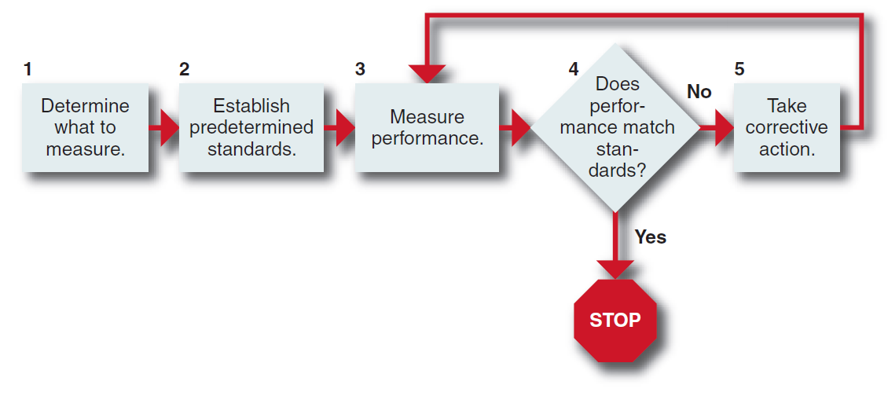
Evaluation and Control Process
Figure 11-1
Notes:
Evaluation and control information consists of performance data and activity reports (gathered in Step 3 in Figure 11–1).

Slide 4
Measuring Performance
Performance
end result of activity
Steering controls
measure variables that influence future profitability
Cost per available seat mile (airlines)
Inventory turnover ratio (retail)
Customer satisfaction
Notes:
Performance is the end result of activity. A firm, therefore, needs to develop measures that predict likely profitability. These are referred to as steering controls because they measure variables that influence future profitability. Every industry has its own set of key metrics that tend to predict profits. Airlines, for example, closely monitor cost per available seat mile (ASM). An example of a steering control used by retail stores is the inventory turnover ratio, in which a retailer’s cost of goods sold is divided by the average value of its inventories. Another steering control is customer satisfaction.

Slide 5
Types of Controls
Output controls
specify what is to be accomplished by focusing on the end result through the use of objectives
Behavior controls
specify how something is done through policies, rules, standard operating procedures and orders from supervisors
Input controls
emphasize resources
Notes:
Output controls specify what is to be accomplished by focusing on the end result. Behavior controls specify how something is done through policies, rules, standard operating procedures and orders from supervisors. Input controls emphasize resources.

Slide 6
Activity-Based Costing
Activity-based costing
allocates indirect and direct costs to individual product lines based on value-added activities going into that product
Allows accountants to charge costs more accurately because it allocates overhead more precisely
Notes:
Activity-based costing (ABC) is a recently developed accounting method for allocating indirect and fixed costs to individual products or product lines based on the value-added activities going into that product. ABC accounting allows accountants to charge costs more accurately than the traditional method because it allocates overhead far more precisely

Slide 7
Enterprise Risk Management
Enterprise Risk Management
corporate-wide, integrated process for managing uncertainties that could negatively or positively influence the achievement of objectives
Notes:
Enterprise Risk Management is the corporate-wide, integrated process for managing uncertainties that could negatively or positively influence the achievement of objectives.

Slide 8
Enterprise Risk Management
The process of rating risks involves three steps:
Identify the risks using scenario analysis, brainstorming or performing risk assessments
Rank the risks, using some scale of impact and likelihood
Measure the risks using some agreed-upon standard
Notes:
The process of rating risks involves three steps:
1. Identify the risks using scenario analysis or brainstorming or by performing risk self-assessments
2. Rank the risks, using some scale of impact and likelihood
3. Measure the risks, using some agreed-upon standard

Slide 9
Traditional Financial Measures
Return on investment (ROI)
result of dividing net income before taxes by the total amount invested in the company (typically measured by total assets)
Earnings per share (EPS)
dividing net earnings by the amount of common stock
Notes:
The most commonly used measure of corporate performance (in terms of profits) is return on investment (ROI). It is simply the result of dividing net income before taxes by the total amount invested in the company (typically measured by total assets).
Earnings per share (EPS), which involves dividing net earnings by the amount of common stock.

Slide 10
Traditional Financial Measures
Return on equity (ROE)
involves dividing net income by total equity
Operating cash flow
the amount of money generated by a company before the cost of financing and taxes, is a broad measure of a company’s funds
Free cash flow
the amount of money a new owner can take out of the firm without harming the business.
Notes:
Return on equity (ROE) involves dividing net income by total equity. Operating cash flow, the amount of money generated by a company before the cost
of financing and taxes, is a broad measure of a company’s funds. Some takeover specialists look at a much narrower free cash flow: the amount of money a new owner can take out of the firm without harming the business.

Slide 11
Nonfinancial Performance Measures Used by Internet Business Ventures
Stickiness
length of Web site visit
Eyeballs
number of people who visit a Web site
Mindshare
brand awareness
Notes:
For example, some nonfinancial performance measures used by Internet business ventures are stickiness (length of Web site visit), eyeballs (number of people
who visit a Web site), and mindshare (brand awareness).

Slide 12
Shareholder Value
Shareholder value
the present value of the anticipated future streams of cash flows from the business plus the value of the company if liquidated
Economic value added (EVA)
measures the difference between the pre- strategy and post-strategy values for the business
after-tax operating income minus the total annual cost of capital
Notes:
Shareholder value can be defined as the present value of the anticipated future stream of cash flows from the business plus the value of the company if liquidated.
EVA measures the difference between the pre-strategy and post-strategy values for the business. Simply put, EVA is after-tax operating income minus the total annual cost of capital.

Slide 13
Shareholder Value
Market value added (MVA)
measures the difference between the market value of a corporation and the capital contributed by shareholders and lenders
Measures the stock market’s estimate of the net present value of a firm’s past and expected capital investment projects
Notes:
Market value added (MVA) is the difference between the market value of a corporation and the capital contributed by shareholders and lenders. Like net present value, it measures the stock market’s estimate of the net present value of a firm’s past and expected capital investment projects.

Slide 14
Balanced Score Card
Balanced scorecard
combines financial measures that tell the results of actions already taken with operational measures on customer satisfaction, internal processes and the corporation’s innovation and improvement activities—the drivers of future financial performance
Notes:
The balanced scorecard combines financial measures that tell the results of actions already taken with operational measures on customer satisfaction,
internal processes and the corporation’s innovation and improvement activities—the drivers of future financial performance.

Slide 15
Balanced Score Card
In the balanced scorecard, management develops goals or objectives in each of four areas:
Financial: How do we appear to shareholders?
Customer: How do customers view us?
Internal business perspective: What must we excel at?
Innovation and learning: Can we continue to improve and create value?
Notes:
In the balanced scorecard, management develops goals or objectives in each of four areas:
Financial: How do we appear to shareholders?
Customer: How do customers view us?
Internal business perspective: What must we excel at?
Innovation and learning: Can we continue to improve and create value?

Slide 16
Balanced Score Card
Key performance measures
measures that are essential for achieving a desired strategic option
Notes:
Each goal in each area (for example, avoiding bankruptcy in the financial area) is then assigned one or more measures, as well as a target and an initiative. These measures can be thought of as key performance measures—measures that are essential for achieving a desired strategic option.

Slide 17
Chairman-CEO Feedback Instrument
Questionnaire focuses on four key areas:
Company performance,
Leadership of the organization
Team-building and management succession
Leadership of external constituencies
Notes:
The questionnaire focuses on four key areas: (1) company performance, (2) leadership of the organization, (3) team-building and management succession and
(4) leadership of external constituencies.

Slide 18
Management Audit
Management audits
developed to evaluate activities such as corporate social responsibility, functional areas such as the marketing department, and divisions such as the international division
useful to boards of directors in evaluating management’s handling of various corporate activities
Notes:
Management audits are very useful to boards of directors in evaluating management’s handling of various corporate activities. Management audits have
been developed to evaluate activities such as corporate social responsibility, functional areas such as the marketing department, and divisions such as the international division.

Slide 19
Strategic Audit
Strategic audit
provides a checklist of questions, by area or issue, that enables a systematic analysis of various corporate functions and activities to be made
useful as a diagnostic tool to pinpoint corporate-wide problem areas and to highlight organizational strengths and weaknesses
Notes:
The strategic audit provides a checklist of questions, by area or issue, that enables a systematic analysis of various corporate functions and activities to be made. It is a type of management audit and is extremely useful as a diagnostic tool to pinpoint corporate-wide problem areas and to highlight organizational strengths and weaknesses.

Slide 20
Responsibility Centers
Responsibility centers
used to isolate a unit so it can be evaluated separately from the rest of the corporation
has its own budget and is evaluated on its use of budgeted resources
headed by the manager responsible for the center’s performance
Notes:
Responsibility centers are used to isolate a unit so it can be evaluated separately from the rest of the corporation. Each responsibility center, therefore, has its own budget and is evaluated on its use of budgeted resources. It is headed by the manager responsible for the center’s performance.

Slide 21
Responsibility Centers
Standard cost centers
Revenue centers
Expense centers
Profit centers
Investment centers
Notes:
Standard cost centers are primarily used in manufacturing facilities. With revenue centers, production, usually in terms of unit or dollar sales, is measured without consideration of resource costs (for example, salaries). Typical expense centers are administrative, service and research departments. A profit center is
typically established whenever an organizational unit has control over both its resources and its products or services. An investment center’s performance is measured in terms of the difference between its resources and its services or products.

Slide 22
Benchmarking
Benchmarking
the continual process of measuring products, services and practices against the toughest competitors or those companies recognized as industry leaders
Notes:
Benchmarking is “the continual process of measuring products, services, and practices against the toughest competitors or those companies recognized as industry leaders.”

Slide 23
Benchmarking
Identify the area or process to be examined
Find behavioral and output measures
Select an accessible set of competitors of best practices
Calculate the differences among the company’s performance measurements and those of the competitors and determine why the differences exist
Develop tactical programs for closing performance gaps
Implement the programs and compare the results
Notes:
The benchmarking process usually involves the following steps:
Identify the area or process to be examined
Find behavioral and output measures
Select an accessible set of competitors of best practices
Calculate the differences among the company’s performance measurements and those of the competitors and determine why the differences exist
Develop tactical programs for closing performance gaps
Implement the programs and compare the results

Slide 24
Strategic Information Systems
Enterprise Resource Planning (ERP)
unites all of a company’s major business activities within a single family of software modules providing instant access throughout the organization
Notes:
Many corporations around the world have adopted enterprise resource planning (ERP) software. ERP unites all of a company’s major business activities, from order processing to production, within a single family of software modules. The system provides instant access to critical information to everyone in the organization, from the CEO to the factory floor worker.

Slide 25
Strategic Information Systems
Radio frequency identification (RFID)
an electronic tagging technology used to improve supply-chain efficiency
Divisional and functional IS support
used to support, reinforce or enlarge business-level strategy throughout the decision support system
Notes:
Radio frequency identification (RFID) is an electronic tagging technology used in a number of companies to improve supply-chain efficiency. By tagging containers and items with tiny chips, companies use the tags as wireless barcodes to track inventory more efficiently. At the divisional or SBU level of a corporation, the information system should be used to support, reinforce or enlarge its business-level strategy through its decision support system.

Slide 26
Problems in Measuring Performance
Lack of quantifiable objectives or performance standards
Inability to use information systems to provide timely and valid information
Notes:
The lack of quantifiable objectives or performance standards and the inability of the information system to provide timely and valid information are two obvious control problems.

Slide 27
Short-Term Orientation
Long-term evaluations may not be conducted because executives:
Don’t realize their importance
Believe that short-term considerations are more important than long-term considerations
Aren’t personally evaluated on a long-term basis
Don’t have the time to make a long-term analysis
Notes:
Long-term evaluations may not be conducted because executives (1) don’t realize their importance, (2) believe that short-term considerations are more important
than long-term considerations, (3) aren’t personally evaluated on a long-term basis or (4) don’t have the time to make a long-term analysis.

Slide 28
Goal Displacement
Goal displacement
confusion of means with ends and occurs when activities originally intended to help managers attain corporate objectives become ends in themselves—or are adapted to meet ends other than those for which they were intended
behavior substitution and suboptimization
Notes:
Goal displacement is the confusion of means with ends and occurs when activities originally intended to help managers attain corporate objectives become ends in themselves—or are adapted to meet ends other than those for which they were intended. Types of goal displacement are behavior substitution and suboptimization.

Slide 29
Goal Displacement
Behavior substitution
refers to the phenomenon of when people substitute activities that do not lead to goal accomplishment for activities that do lead to goal accomplishment because the wrong activities are being rewarded
Notes:
Behavior substitution refers to the phenomenon of when people substitute activities that do not lead to goal accomplishment for activities that do lead to goal accomplishment because the wrong activities are being rewarded.

Slide 30
Goal Displacement
Suboptimization
refers to the phenomenon of a unit optimizing its goal accomplishment to the detriment of the organization as a whole
Notes:
Suboptimization refers to the phenomenon of a unit optimizing its goal accomplishment to the detriment of the organization as a whole.

Slide 31
Guidelines for Proper Control
Controls should involve only the minimum amount of information needed to give a reliable picture of events.
Controls should monitor only meaningful activities and results, regardless of measurement difficulty.
Controls should be timely so that corrective action can be taken before it is too late.
Long-term and short-term goals should be used.
Controls should aim at pinpointing exceptions.
Emphasize the reward of meeting or exceeding standards rather than punishment for failing to meet standards.
Notes:
The following guidelines are recommended:
Controls should involve only the minimum amount of information needed to give a reliable picture of events.
Controls should monitor only meaningful activities and results, regardless of measurement difficulty.
Controls should be timely so that corrective action can be taken before it is too late.
Long-term and short-term goals should be used.
Controls should aim at pinpointing exceptions.
Emphasize the reward of meeting or exceeding standards rather than punishment for failing to meet standards.

Slide 32
Approaches to Strategic Incentive Management
Weighted-factor method
Long-term evaluation method
Strategic funds method
Notes:
The following three approaches are tailored to help match measurements and rewards with explicit strategic objectives and time frames:
Weighted-factor method
Long-term evaluation method
Strategic funds method

Slide 33
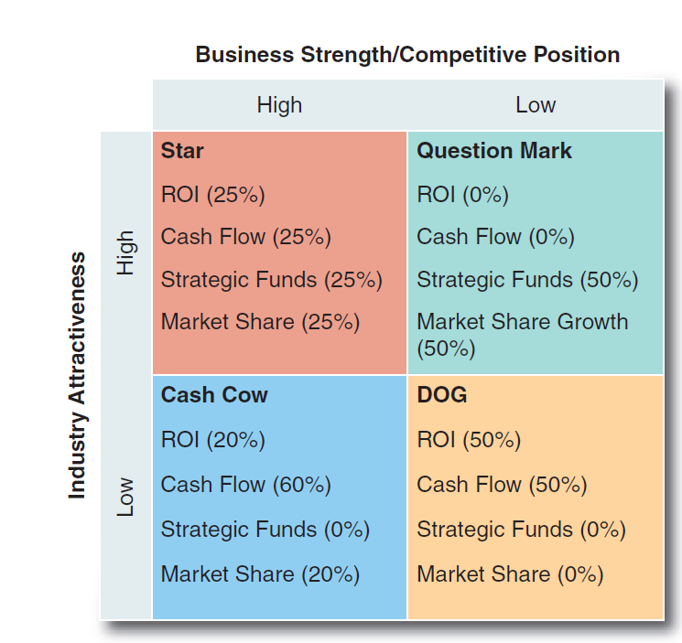
Business Strength/ Competitive Position
Figure 11-2
Notes:
Using portfolio analysis, one corporation’s measurements might contain the following variations: the performance of high-performing (star) SBUs is measured equally in terms of ROI, cash flow, market share and progress on several future-oriented strategic projects; the performance of low-growth, but strong (cash cow) SBUs, in contrast, is measured in terms of ROI, market share and cash generation; and the performance of developing question mark SBUs is measured in terms of development and market share growth with no weight on ROI or cash flow. (Refer to Figure 11–2.)

Slide 34
Approaches to Strategic Incentive Management
An effective way to achieve the desired strategic results through a reward system is to combine the three approaches:
Segregate strategic funds from short-term funds
Develop a weighted-factor chart for each SBU
Measure performance based on pre-tax profit, weighted factors and long-term evaluation of the SBU’s performance
Notes:
An effective way to achieve the desired strategic results through a reward system is to combine the three approaches:
Segregate strategic funds from short-term funds
Develop a weighted-factor chart for each SBU
Measure performance based on pre-tax profit, weighted factors and long-term evaluation of the SBU’s performance

